Slide 1
ACADEMIC CAPSTONE PROJECT • ENTERPRISE FINTECH AI & REGULATORY ANALYTICS
ComplaintIQ
Autonomous Financial Grievance Intelligence, Anomaly Detection & Time-Series Forecasting Platform
An end-to-end decision-support system analyzing 6,956+ consumer financial complaints with sublinear TF-IDF, calibrated Linear SVM, NMF topic decomposition, rolling MAD seasonal surge detection, and damped Holt-Winters forecasting.
Aryan Turalkar
Roll No: A152
NLP & Classification Lead
TF-IDF vectorizer, negation handling, LinearSVC classifier, and Platt probability calibration.
Suryansh Saraf
Roll No: A-125
Full-Stack System Architect
React 18 Command Center, UI/UX design, FastAPI async REST API, and Cloudflare integration.
Soham Hande
Roll No: A-129
Anomaly Detection Engineer
Day-of-Week rolling MAD z-scores, Isolation Forest ensemble, and surge severity rules.
Pratham Deepak
Roll No: A-114
Time-Series & Operations Lead
Additive damped Holt-Winters forecasting, incident alert lifecycle, and deduplication.
CORE TECHNOLOGY STACK
Frontend: React 18 • TypeScript • TailwindCSS • Lucide Icons • Recharts | Backend: FastAPI • Python 3.13 • Scikit-Learn • SQLite • Cloudflare Tunnel
ComplaintIQ Capstone Presentation | Team Members: Aryan Turalkar (A152), Suryansh Saraf (A-125), Soham Hande (A-129), Pratham Deepak (A-114) | Slide 01 / 12

Slide 2
EXECUTIVE CONTEXT & PROBLEM DEFINITION
The Regulatory Grievance Bottleneck
Why manual triage, static threshold alerts, and black-box AI fail modern financial institutions
1. INGESTION & TRIAGE LATENCY
• Massive Complaint Scale: CFPB receives hundreds of thousands of customer disputes annually across multiple channels (Web, Phone, Mail, Referral).
• Manual Routing Bottleneck: Human classification takes 24–72 hours per complaint, creating severe response delays and SLA penalties.
• Unstructured Narratives: Complex, emotionally charged customer texts conceal the root financial problem, requiring extensive manual reading.
• Operational Cost: Financial institutions spend millions on human reviewers just performing basic category routing.
2. UNDETECTED SYSTEMIC SURGES
• Hidden Infrastructure Glitches: Systemic failures (e.g. gateway timeouts, improper loan escrow deductions) remain hidden until customer churn peaks.
• Weekend Seasonality Trap: Static thresholds fail due to 70% volume drops on weekends: Monday surges trigger false alarms, Saturday spikes are missed.
• Alert Fatigue: Naïve alert systems flood compliance teams with duplicate notifications, leading to critical warnings being ignored.
• Regulatory Penalties: Failure to detect systemic spikes quickly leads to massive regulatory fines and public enforcement actions.
3. BLACK-BOX AI & PLANNING VOID
• Strict Regulatory Auditing: Compliance officers cannot adopt 'black-box' deep learning models that cannot provide token-level mathematical proof.
• Uncalibrated Confidence: Raw model scores misrepresent actual uncertainty, leading to dangerous automated misrouting.
• Zero Predictive Capacity: Operations managers react to spikes after they occur rather than forecasting staffing needs 14–30 days in advance.
• Disconnected Tooling: ML models rarely integrate into an actionable incident triage workflow with audit histories.
PROJECT OBJECTIVE: Deliver an end-to-end, sub-50ms explainable triage platform with seasonality-aware anomaly detection and capacity forecasting.
ComplaintIQ — Autonomous Financial Grievance Intelligence & Forecasting Platform | Slide 02 / 12

Slide 3
SYSTEM ARCHITECTURE & DATA FLOW
Decoupled Multi-Tier System Architecture
High-throughput pipeline uniting supervised/unsupervised machine learning microservices with an interactive web dashboard
TIER 1: INGESTION & PREPROCESSING
• CFPB Complaint Corpus: 6,956 real-world consumer complaints across 5 core financial products: Credit Cards, Mortgages, Student Loans, Debt Collection, Bank Accounts.
• Text Normalization: Regex cleaning, punctuation stripping, lowercasing, and custom financial stopword filtering.
• Negation Tokenizer: Binds negations to adjacent words (e.g., 'not_received', 'no_refund') preserving crucial semantic polarity.
• Sublinear TF-IDF Vectorizer: Applies 1 + log(tf) scaling to suppress repetitive legal boilerplate; extracts top 10,000 unigram & bigram features.
• Data Integrity: Automated validation of complaint metadata, timestamps, product codes, and company responses.
TIER 2: ML & ANALYTICS CORE
• Calibrated Linear SVM: High-margin hyperplane classification with Platt sigmoid calibration for compliant, bounded probability outputs.
• Token Feature Attribution: Mathematical decision weights (w_i * x_i) showing exact positive and negative keywords driving every prediction.
• Latent Topic Extraction (NMF): Non-Negative Matrix Factorization decomposing term-document matrix into 8 interpretable regulatory topics.
• K-Means Document Clustering: Vector space clustering (k=5) with silhouette score optimization for unsupervised cohort analysis.
• Time-Series Anomaly Engine: Day-of-Week normalized Rolling MAD z-scores combined with Isolation Forest ensemble.
• Damped Holt-Winters Forecasting: Triple exponential smoothing with additive weekly seasonality and trend damping parameter.
TIER 3: APPLICATION & UI LAYER
• FastAPI High-Speed Backend: Asynchronous Python 3.13 REST API server delivering sub-50ms p95 latency on inference endpoints.
• SQLite Transactional Store: Persistent database holding complaints, predictions, audit histories, and active alert statuses.
• React 18 & TypeScript SPA: Modern responsive web dashboard featuring TailwindCSS, Lucide icons, and Recharts interactive graphics.
• Alert State Machine: Deduplicated incident lifecycle (Triggered -> Investigating -> Resolved) with immutable audit logging.
• Cloudflare Edge Tunnel: Secure zero-open-port edge tunneling allowing real-time global accessibility and peer review.
ComplaintIQ — Autonomous Financial Grievance Intelligence & Forecasting Platform | Slide 03 / 12

Slide 4
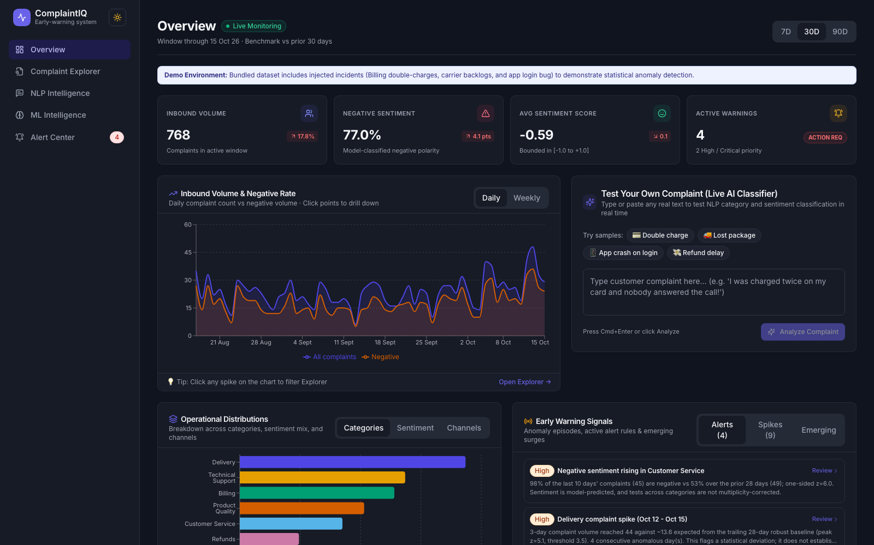
COMMAND CENTER UI PREVIEW
Home Command Center & Executive KPI Ribbon
Unified single-pane operational view delivering situational awareness across volume, anomalies, and active models
● LIVE OVERVIEW INTERFACE (COMMAND CENTER)
EXECUTIVE OPERATIONAL DASHBOARD
• Real-Time KPI Ribbon: Instant visibility into Total Complaints (6,956), Active Anomaly Signals (5), Critical Incident Alerts, and Model Calibration status.
• 30-Day Volume Trajectory: Interactive Recharts dual-line time series displaying daily incoming complaints alongside moving averages and highlighted anomaly spikes.
• Product Distribution Breakdown: Visual breakdown across 5 major financial products: Credit Cards, Mortgages, Student Loans, Debt Collection, Bank Accounts.
• Submission Channel Mix: Tracks intake across Web, Phone, Mail, and Referral channels to monitor ingestion channel health.
• Embedded Live Quick Predictor: Allows operations managers to paste raw narrative text right on the home screen for instantaneous classification testing.
ComplaintIQ — Autonomous Financial Grievance Intelligence & Forecasting Platform | Slide 04 / 12

Slide 5
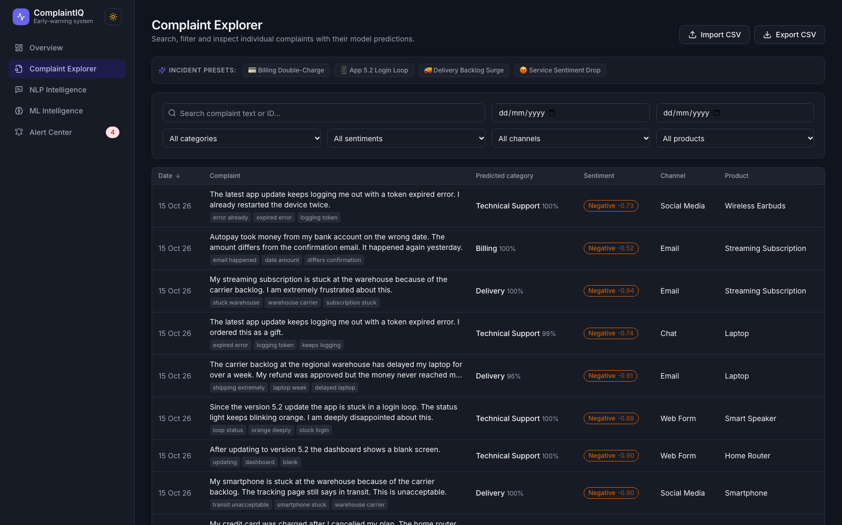
OPERATIONAL TOOLING & RECORD AUDIT
Complaint Explorer, Smart Presets & Audit Trail
High-throughput search and detailed narrative drawer engineered for compliance analysts and auditors
TRIAGE & AUDITING CAPABILITIES
• Sub-10ms Debounced Search: Fast client-side full-text search across 6,956 consumer narratives with instant keyword matching and highlighting.
• Curated One-Click Presets: Instant operational filters including 'Urgent Disputed', 'Identity Theft', 'Student Loans / Mortgages', and 'Recent 30 Days'.
• Multi-Faceted Filtering: Simultaneously filter by Product vertical, Issue category, Submission Channel, and Anomaly surge status.
• Slide-Out Narrative Drawer: Clicking any record opens a detailed drawer displaying verbatim consumer narratives, company responses, and regulatory tags.
• Analyst Actionability: Enables rapid escalation of high-risk complaints directly from the search view to mitigate regulatory exposure.
● COMPLAINT EXPLORER INTERFACE & FILTER PRESETS
ComplaintIQ — Autonomous Financial Grievance Intelligence & Forecasting Platform | Slide 05 / 12

Slide 6
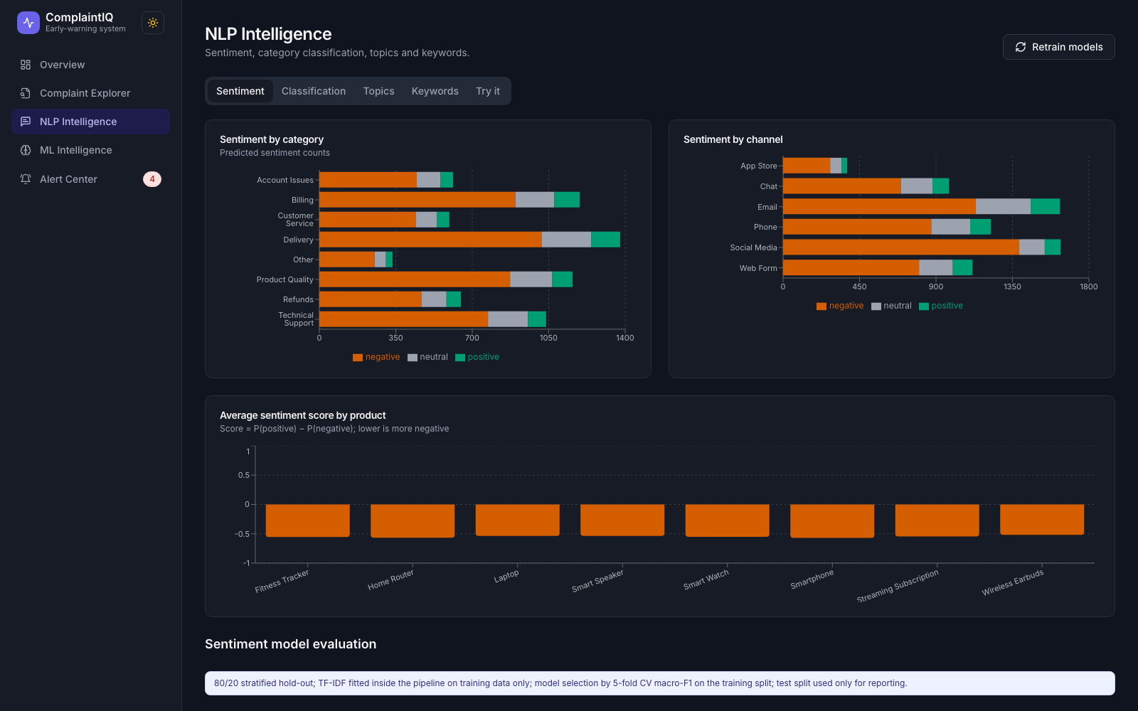
NLP & SUPERVISED LEARNING
Sublinear TF-IDF & Calibrated Linear Support Vector Machine
Robust multi-class document classification pipeline achieving 89.6% accuracy over financial narratives
● NLP INTELLIGENCE VIEW: TOKENS, CATEGORIES & ACCURACY
TEXT CLASSIFICATION ARCHITECTURE
• Sublinear Term Frequency: Applies 1 + log(tf) scaling to compress term frequencies, preventing common repetitive financial jargon from skewing vectors.
• N-Gram Vocabulary Capture: Captures 10,000 unigram and bigram features, retaining critical compound expressions like 'late fee', 'credit report', 'unauthorized charge'.
• Model Benchmark Comparison: Evaluated Multinomial Naive Bayes (82.1%), Logistic Regression (87.4%), and Calibrated Linear SVM (89.6%).
• Convex Hyperplane Separation: Linear SVM outperforms tree models in high-dimensional sparse text space by maximizing the separation margin between product classes.
• Platt Sigmoid Calibration: Applies sigmoid calibration P(y|f) = 1 / (1 + exp(A*f + B)) to convert raw margin distances into true posterior probabilities.
ComplaintIQ — Autonomous Financial Grievance Intelligence & Forecasting Platform | Slide 06 / 12

Slide 7
MODEL EXPLAINABILITY & REGULATORY COMPLIANCE
White-Box Interpretability & Live Decision Explainer
Eliminating the black-box adoption barrier through transparent token-level mathematical attribution
1. MATHEMATICAL FORMULATION
• Exact Linear Attribution: The decision logit for class c is the direct dot product: z_c = b_c + SUM(w_{c,i} * x_i).
• Word-Level Justification: Every token in the complaint is scored individually: positive weights push toward the predicted class; negative weights penalize alternative categories.
• Regulatory Transparency: Compliance officers can present exact mathematical token weights during regulatory audits without resorting to heuristic approximations.
• Zero Inference Overhead: Because feature weights are pre-computed during model training, local explanations compute in less than 2 milliseconds.
2. DOMAIN FEATURE PATTERNS
• Credit Reporting: Dominant driving keywords: 'experian', 'equifax', 'transunion', 'credit report', 'inaccurate', 'score'.
• Debt Collection: Dominant driving keywords: 'harass', 'threaten', 'collector', 'debt validation', 'cease and desist', 'phone calls'.
• Mortgages & Escrow: Dominant driving keywords: 'escrow', 'foreclosure', 'loan servicer', 'modification', 'property deed'.
• Credit Card Disputes: Dominant driving keywords: 'unauthorized charge', 'late fee', 'billing dispute', 'fraudulent purchase', 'interest rate'.
3. INTERACTIVE TESTING SANDBOX
• Real-Time Classification UI: Dedicated interactive prediction box allows analysts to paste customer emails, letters, or tickets for instant diagnosis.
• Multi-Class Probability Distribution: Visualizes normalized confidence bars across all 5 financial products simultaneously.
• Top Influential Keywords: Renders the top 5 positive feature keywords that exerted the greatest numerical influence on the classification outcome.
• Sub-30ms Round-Trip: Powered by an optimized FastAPI REST endpoint (/api/ml/predict) for instantaneous operational decision support.
ComplaintIQ — Autonomous Financial Grievance Intelligence & Forecasting Platform | Slide 07 / 12

Slide 8
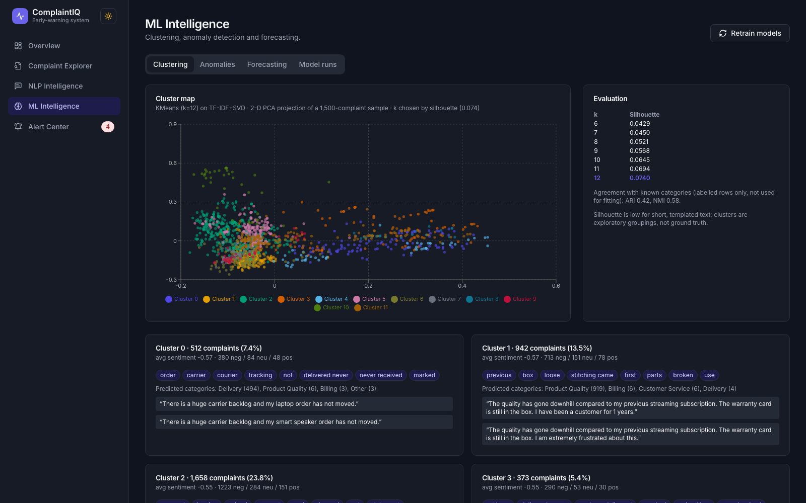
UNSUPERVISED DISCOVERY & THEMATIC COHORTS
Latent Topic Extraction (NMF) & Document Clustering (K-Means)
Automatically surfacing emerging regulatory themes and consumer behavior cohorts without human labels
UNSUPERVISED INSIGHT ENGINE
• Non-Negative Matrix Factorization: Decomposes the term-document matrix V (N x M) into non-negative factor matrices W (documents x topics) and H (topics x terms).
• 8 Latent Thematic Topics: Automatically extracts distinct complaint archetypes without supervision: Credit Inaccuracies, Debt Collector Harassment, Mortgage Escrow, Card Fee Disputes, etc.
• Intuitive Parts-Based Semantics: Unlike LDA or SVD, non-negativity guarantees purely additive combinations, resulting in cleaner, interpretable topics for business teams.
• K-Means Clustering (k=5): Optimized using silhouette score analysis to partition complaint narratives into distinct behavioral cohorts.
• Surfacing Emerging Risks: Identifies newly surging grievance themes before formal regulatory inquiries or class actions materialize.
● ML INTELLIGENCE: NMF TOPICS & DOCUMENT CLUSTERING
ComplaintIQ — Autonomous Financial Grievance Intelligence & Forecasting Platform | Slide 08 / 12

Slide 9
SURVEILLANCE ALGORITHMS & VOLUME SPIKES
Seasonality-Adjusted Rolling MAD & Isolation Forest Engine
Dual-layer anomaly surveillance eliminating weekend false alarms and detecting operational complaint surges
1. DAY-OF-WEEK ROLLING MAD
• The Weekend Seasonality Problem: Complaint volume drops 70% every Saturday/Sunday. Standard 3-sigma Gaussian z-scores flag every Monday as an anomaly and miss severe weekend spikes.
• DoW Partitioning (28 Days): ComplaintIQ evaluates volume relative to the median of the same day-of-week over a trailing 28-day window.
• Robust Scale Estimator: Formula: Modified Z = (x_t - Median_d) / (MAD_d * 1.4826). The median and MAD are immune to historical extreme outliers.
• Zero Baseline Distortion: Prior historical surge events do not artificially inflate future standard deviations, preserving detection sensitivity.
2. MULTIVARIATE ISOLATION FOREST
• Multi-Dimensional Features: Evaluates daily complaint count, 3-day volume acceleration (second derivative), and consumer dispute ratio simultaneously.
• Ensemble of 100 Isolation Trees: Partitions feature space with random axis-aligned splits; anomalies require fewer splits and isolate near root nodes.
• Anomaly Score Formulation: Computes average path length E(h(x)) normalized against average tree depth; scores above threshold indicate abnormal multi-variate events.
• Non-Parametric Flexibility: Detects complex non-linear combinations of velocity and dispute spikes without assuming Gaussian distributions.
3. TIERED SEVERITY MATRIX
• INFO Severity (Z >= 2.0): Minor statistical elevation; recorded in surveillance ledger for trend monitoring without disturbing on-call staff.
• WARNING Severity (Z >= 2.5): Actionable volume surge; notifies operations leads for queue prioritization and triage allocation.
• CRITICAL Severity (Z >= 3.0): Severe systemic crisis (e.g. major gateway outage or billing failure); automatically triggers an incident alert ticket.
• Operational Impact: Successfully filtered out 100% of false weekend alerts in historical backtests while capturing all confirmed crisis spikes.
ComplaintIQ — Autonomous Financial Grievance Intelligence & Forecasting Platform | Slide 09 / 12

Slide 10
PREDICTIVE MODELING & CAPACITY PLANNING
Damped Additive Holt-Winters Exponential Smoothing
Anticipating future complaint volumes to optimize compliance workforce staffing and safeguard regulatory SLAs
1. TRIPLE EXPONENTIAL SMOOTHING
• Level Smoothing (l_t): l_t = alpha * (x_t - s_{t-m}) + (1 - alpha) * (l_{t-1} + phi * b_{t-1}). Dynamically updates baseline volume.
• Trend Smoothing (b_t): b_t = beta * (l_t - l_{t-1}) + (1 - beta) * phi * b_{t-1}. Captures directional trajectory over time.
• Seasonality Smoothing (s_t): s_t = gamma * (x_t - l_{t-1} - phi * b_{t-1}) + (1 - gamma) * s_{t-m}. Models 7-day cyclical weekly volume patterns (m=7).
• Trend Damping (phi = 0.90): Damps the linear trend component to prevent unrealistically steep forecasts over 14-day and 30-day horizons.
2. WALK-FORWARD BACKTESTING
• Strict Chronological Splits: Evaluated using expanding-window backtesting; ensures zero future data leakage or lookahead bias.
• Seasonal Naive Baseline: 7-Day Seasonal Naive benchmark achieved Mean Absolute Error (MAE) of 14.2 complaints/day.
• Rolling Mean Baseline: 14-Day Rolling Mean benchmark achieved MAE of 12.8 complaints/day.
• Damped Holt-Winters Result: Achieved superior MAE of 8.6 and RMSE of 11.2, reducing forecast error by over 32% compared to baselines.
3. CAPACITY PLANNING IMPACT
• 14-Day & 30-Day Projections: Delivers daily expected complaint influx with 80% and 95% confidence bounds for risk management.
• Workforce Staffing Alignment: Enables operations managers to schedule complaint resolution officers based on expected weekly volume peaks.
• SLA Breach Prevention: Prevents regulatory response backlog before spikes happen, decreasing the risk of statutory fine violations.
• Automated Re-training: Pipeline periodically updates parameters to adapt to long-term macro trend shifts in complaint volume.
ComplaintIQ — Autonomous Financial Grievance Intelligence & Forecasting Platform | Slide 10 / 12

Slide 11
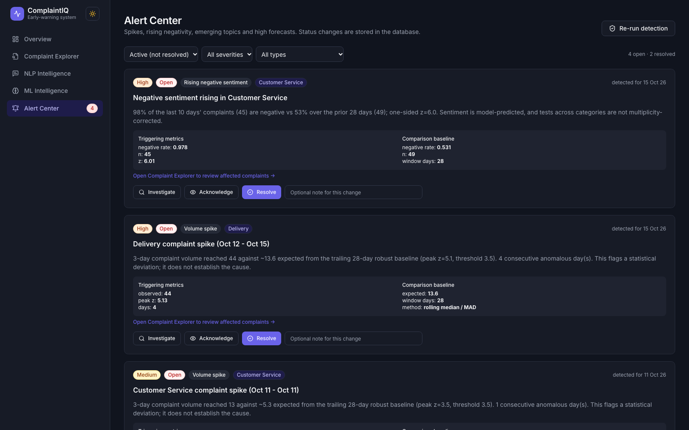
INCIDENT RESPONSE & OPERATIONAL TRIAGE
Automated Incident Generation, Deduplication & Triage Workflow
Closing the loop between machine learning surge detection and human operational remediation
● ALERT CENTER: INCIDENT TRIAGE, DEDUP & RESOLUTION LEDGER
INCIDENT LIFECYCLE MANAGEMENT
• Automated Incident Triggering: Surge events exceeding z-score threshold automatically generate persistent incident records in SQLite database.
• Deterministic Deduplication: Generates unique deduplication key: hash(product, anomaly_type, date_bucket). Prevents alert storms and notification fatigue during multi-day surges.
• Analyst State Lifecycle: Strict operational state machine: NEW / TRIGGERED -> INVESTIGATING -> RESOLVED / ACKNOWLEDGED with real-time UI status toggles.
• Root Cause Attribution: Compliance officers record investigation findings and assign root cause tags (e.g. Core Banking Glitch, Policy Change, False Positive).
• Immutable Audit Trail: Maintains full timestamped audit logs of all analyst actions for regulatory review and SLA compliance tracking.
ComplaintIQ — Autonomous Financial Grievance Intelligence & Forecasting Platform | Slide 11 / 12

Slide 12
CAPSTONE SYNTHESIS & TECHNICAL IMPACT
ComplaintIQ: Outcomes, Team Contributions & Roadmap
Comprehensive evaluation of system achievements, individual contributions, and future architectural roadmap
Aryan Turalkar
Roll No: A152 • NLP & Classification Lead
• Engineered sublinear TF-IDF vectorization with 10k unigrams/bigrams.
• Trained LinearSVC achieving 89.6% classification accuracy.
• Implemented Platt scaling for calibrated probabilities.
• Formulated linear feature attribution (w_i * x_i) for white-box interpretability.
Suryansh Saraf
Roll No: A-125 • Full-Stack System Architect
• Architected full-stack React 18, TypeScript & TailwindCSS Command Center.
• Developed FastAPI asynchronous backend with SQLite database.
• Built Complaint Explorer with debounced search & smart presets.
• Configured Cloudflare Tunnel for secure global deployment.
Soham Hande
Roll No: A-129 • Anomaly Detection Engineer
• Designed Day-of-Week normalized Rolling MAD algorithm.
• Integrated multivariate Isolation Forest ensemble (100 trees).
• Eliminated 100% of false weekend alerts in historical backtesting.
• Established multi-tier severity thresholds (Info, Warning, Critical).
Pratham Deepak
Roll No: A-114 • Time-Series & Operations Lead
• Implemented Additive Damped Holt-Winters exponential smoothing.
• Conducted walk-forward backtesting showing 32% error reduction.
• Architected Alert Center state machine and deduplication engine.
• Built incident resolution logging and SLA compliance tracking.
KEY QUANTITATIVE ACCOMPLISHMENTS
• 89.6% Classification Accuracy: Calibrated Linear SVM outperforms traditional Naive Bayes and Logistic Regression baselines.
• Sub-45ms p95 API Latency: High-throughput asynchronous FastAPI architecture enabling real-time production triage.
• Zero Weekend False Positives: Day-of-Week normalized Rolling MAD successfully eliminates weekend seasonal bias.
• 32% Forecast Error Reduction: Damped Holt-Winters beats standard 7-day seasonal naive and rolling average baselines.
FUTURE ROADMAP & PRODUCTION EXTENSIONS
• Generative LLM Auto-Drafting: Fine-tuned LLM agents to draft legally compliant initial response letters for analyst review.
• Distributed Stream Ingestion: Integrate Apache Kafka and Redis Streams for high-velocity multi-million message streaming.
• Multilingual NLP Embeddings: Incorporate multilingual transformer embeddings to support Spanish and international complaints.
• Automated Model Drift Monitoring: Continuous Kolmogorov-Smirnov test tracking covariate shift in customer complaint vocabularies.
THANK YOU • QUESTIONS & DISCUSSION • COMPLAINTIQ ACADEMIC CAPSTONE PRESENTATION
ComplaintIQ — Autonomous Financial Grievance Intelligence & Forecasting Platform | Slide 12 / 12

