Slide 1

FRIENDSHUB
MINI PROJECT-1
Submitted By: Submitted To:
Suryansh Verma (201500726) Dr. Manoj Varshney
Ripunjay Yadav (201500562)
Umang Gupta (201500752)
Ravi Kumar (201500561)
Aryan Choudhary (201500147)

Slide 2
CONTENTS
- INTRODUCTION : What is Friendshub ?
- PROBLEM STATEMENT : Why This Application ?
- All about Friendshub
- Tool used
- Outputs images
- References
Conclusion
Future work
- Thank you -
Notes:
FRIENDSHUB

Slide 3
What is Friendshub ?
Websites and applications that enable users to create and share content or to participate in social networking.
Benefits of Friendshub
Social networking services can provide an accessible and powerful toolkit for highlighting and acting on issues and causes that affect and interest young people. Social networking services can be used for organising activities, events, or groups to showcase issues and opinions and make a wider audience aware of them.

Slide 4
Why is this application ?
Billions of people around the world use social media to share information and make connections. On a personal level, social media allows you to communicate with friends and family, learn new things, develop your interests, and be entertained. On a professional level, you can use social media to broaden your knowledge in a particular field and build your professional network by connecting with other professionals in your industry. At the company level, social media allows you to have a conversation with your audience, gain customer feedback, and elevate your brand.

Slide 5
Introduction to Friendshub
When used properly, social media can be a valuable addition to a department's communications strategy. Because many employees have expressed an interest in developing and maintaining a social media presence in personal and professional capacities, the Office of University Communications and Marketing has crafted the following introduction to social media.

Slide 6
TOOLS USED
HTML : HTML stands for Hyper Text Markup Language. HTML is the standard markup language for creating Web pages. HTML describes the structure of a Web page. HTML consists of a series of elements. HTML elements tell the browser how to display the content.
CSS : Cascading Style Sheets (CSS) is a stylesheet language used to describe the presentation of a document written in HTML or XML (including XML dialects such as SVG, MathML or XHTML). CSS describes how elements should be rendered on screen, on paper, in speech, or on other media.
JS : JavaScript, often abbreviated as JS, is a programming language that is one of the core technologies of the World Wide Web, alongside HTML and CSS.
BOOTSTRAP : Bootstrap is a free, open source front-end development framework for the creation of websites and web apps.
PHP : PHP is a script language and interpreter that is freely available and used primarily on Linux Web servers. PHP, originally derived from Personal Home Page Tools, now stands for PHP: Hypertext Preprocessor, which the PHP FAQ describes as a "recursive acronym."

Slide 7
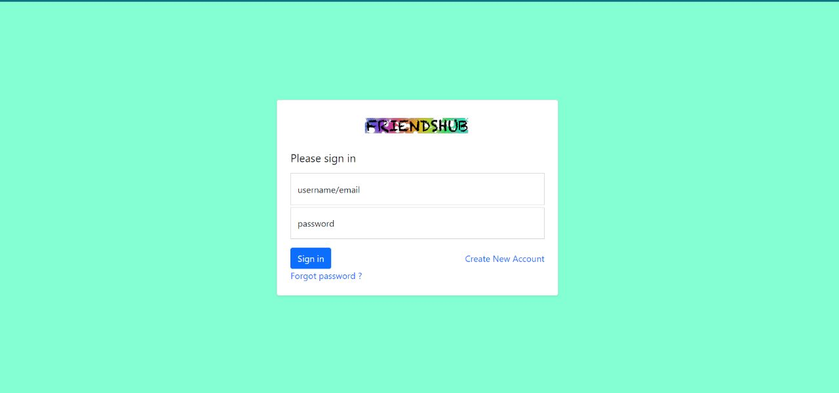
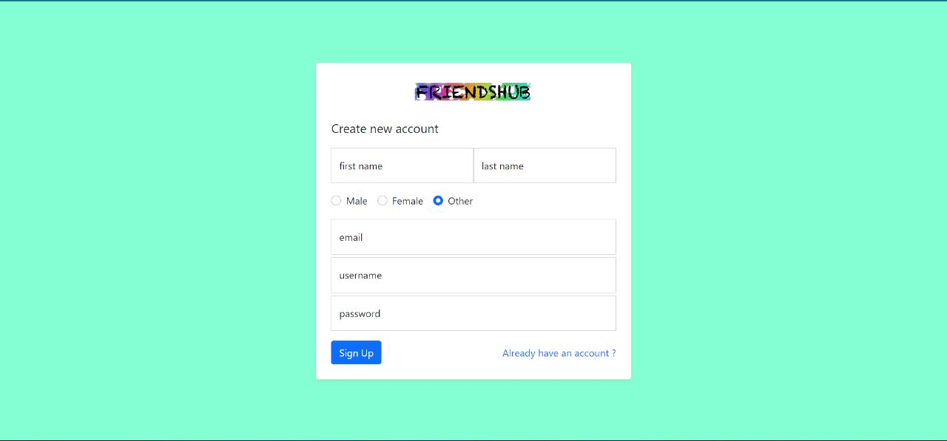
OUTPUT IMAGES

Slide 8
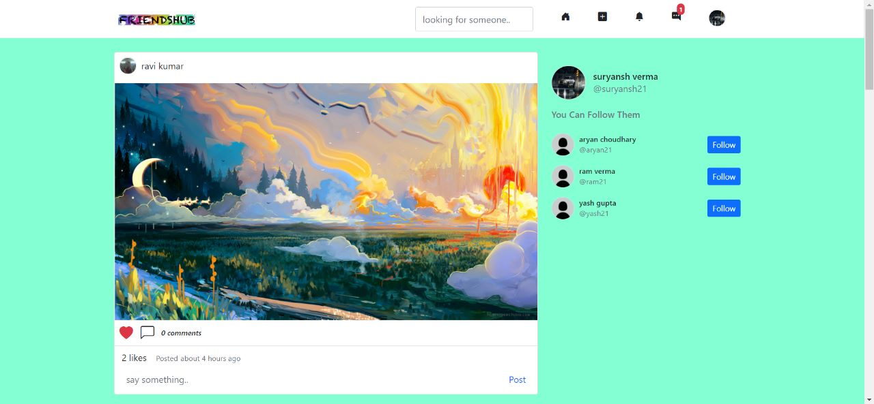
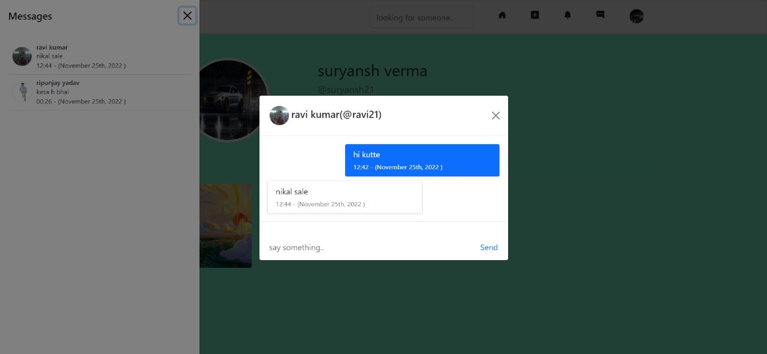

Slide 9
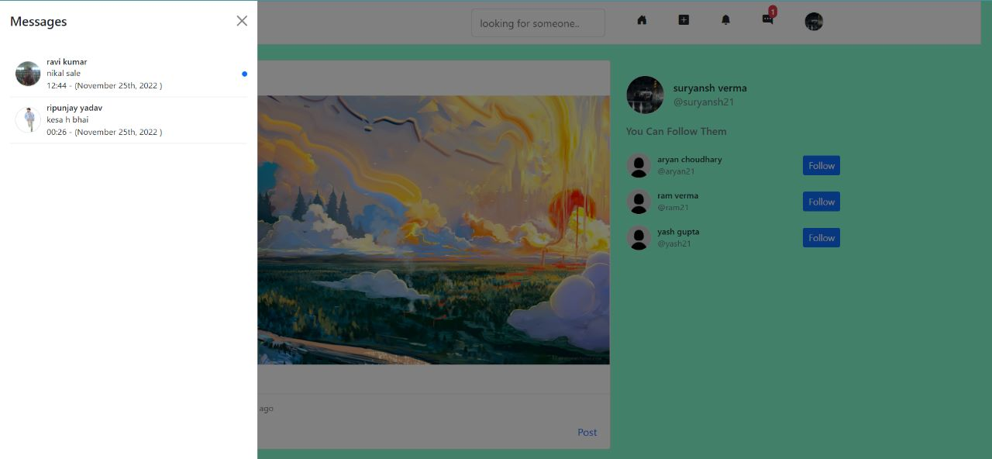
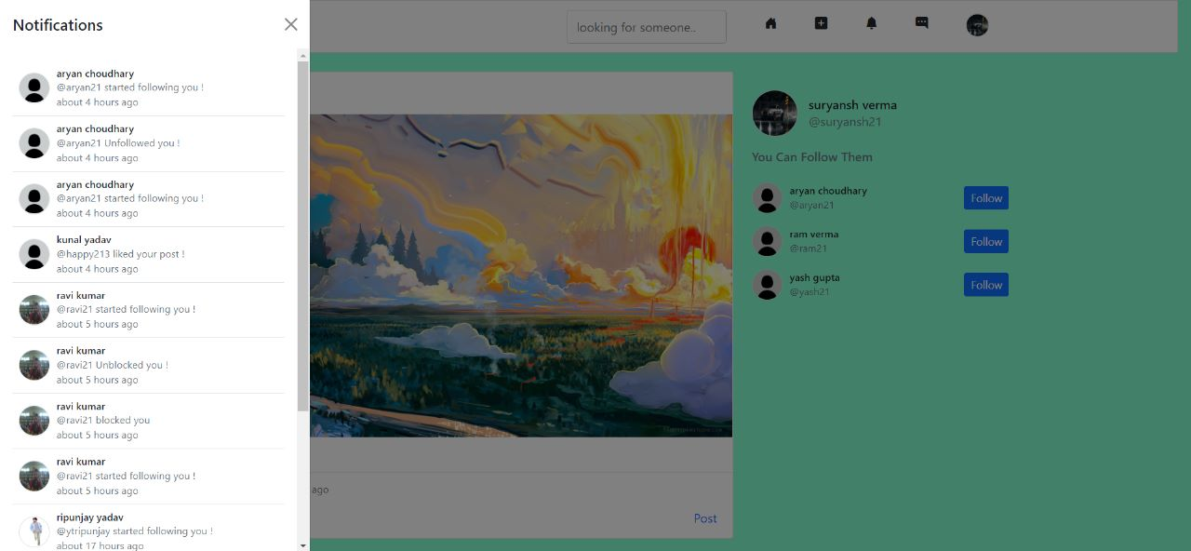

Slide 10
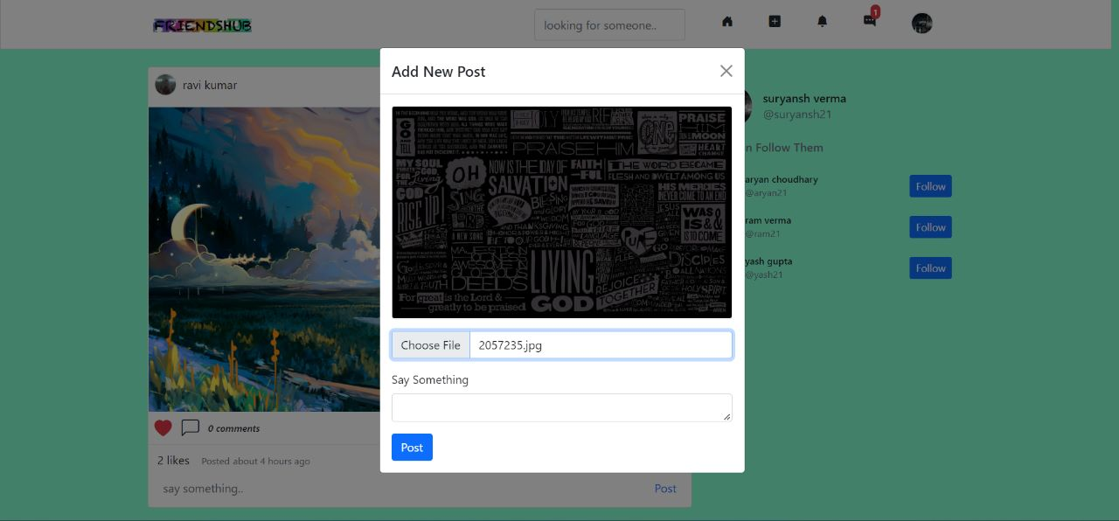
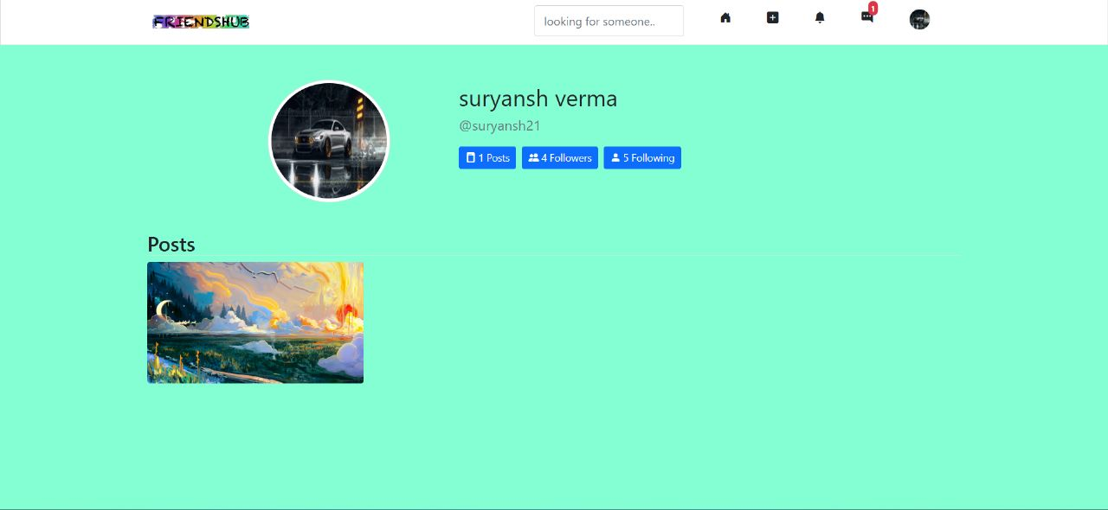

Slide 11
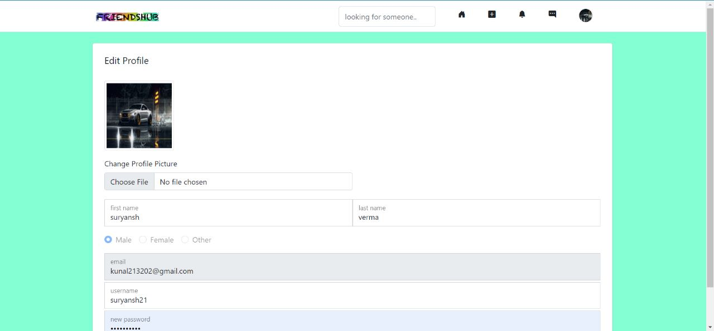
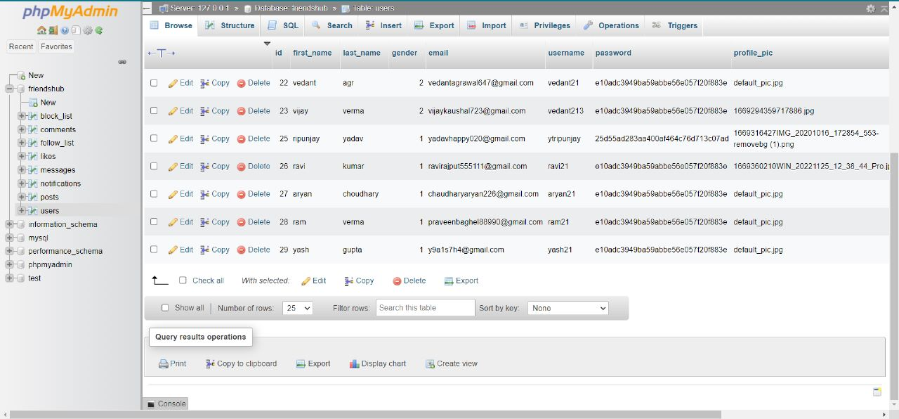

Slide 12
REFERENCES
Books:
- Head First HTML and CSS
A Learner's Guide to Creating Standards- Based Web Pages
Elisabeth Robin
Eric Freeman
﻿﻿- HTML & CSS : design and Build websites
﻿﻿- Learning Web design
- JAVAScript

Slide 13
CONCLUSION
As per the goal of this project an attempt is made to show how we can communicate on online platform and also enable users to communicate globally.
By looking into the benefits and harms, we know that while social media is convenient to us in daily life, it is also dangerous to make online friends. The survey shows that even though users knew that they shouldn't provide personal information to internet friends, there are still a small group of people who leaked their personal information to strangers.
In conclusion, there are benefits of making friends on the Internet while harms. also exist. Therefore, we should take precaution and always be careful and cautious, so that we can use social networking sites safely.

Slide 14
FUTURE WORK
The scope of social media in India bloomed during the pandemic. This success can also be the result of increased internet use among our generation.
Many different adaptations, tests, and experiments have been left for the future due to lack of time. The present system is just an interactive UI with user database but Future work concerns with developing a Admin panel and a data base to store users detail with user information & data.

Slide 15
- THANK YOU ! -

