Slide 1

Laptop Market Insights

Slide 2
About us
NAME : SREE HARI
QUALIFICATION : BCA
NAME : ABINASH
QUALIFICATION : MCA

Slide 3
Contents :
Introduction
Tools (Libraries) used
Website URL’s for Web-Scrapping
Raw Data
Data Cleaning and Data Manipulation
Cleaned Data
EDA (Uni, Bi and Multi - variate Data analysis using graphs)
Observations
Challenges
Conclusion

Slide 4
Problem Statement :
To gain insights into the laptop market and aid in informed decision-making, we have conducted a comprehensive analysis of data scraped from Flipkart, one of the leading online retailers.

Slide 5
Introduction :
In today's highly competitive market, the laptop industry continues to witness rapid advancements and innovations. As consumers, we are constantly seeking the best value for our money when it comes to purchasing a laptop that meets our specific needs and preferences. To gain insights into the laptop market and aid in informed decision-making, we have conducted a comprehensive analysis of data scraped from Flipkart, one of the leading online retailers.
Our study focuses on key aspects such as ratings, processors, RAM, operating systems (OS), storage, prices, original prices, brands, and customer reviews. By examining these factors, we aim to provide a deeper understanding of the laptop market landscape, uncover trends, and identify patterns that can help consumers make more informed choices.

Slide 6







Tools (Libraries) Used:
Requests
Beautiful Soup
Pandas
Numpy
Matplotlib
Seaborn

Slide 7
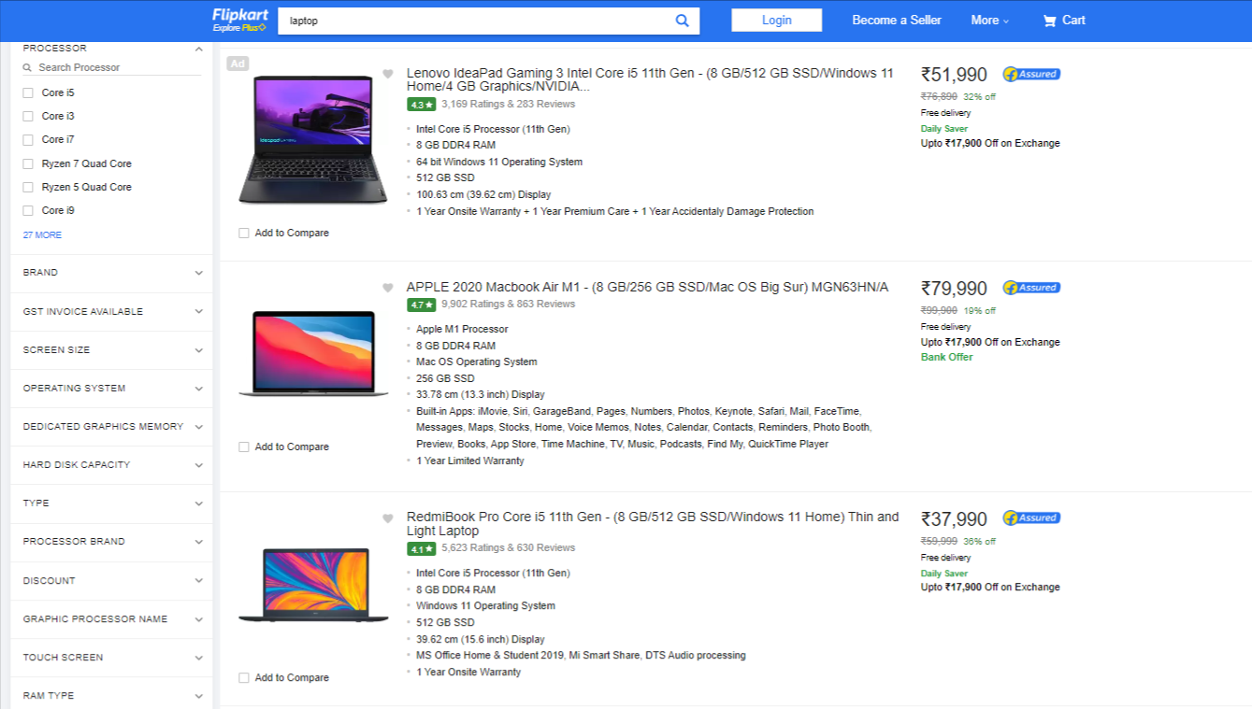
Website URL’s for Web-Scrapping
https://www.flipkart.com/search?q=laptop&otracker=search&otracker1=search&marketplace=FLIPKART&as-show=off&as=off

Slide 8
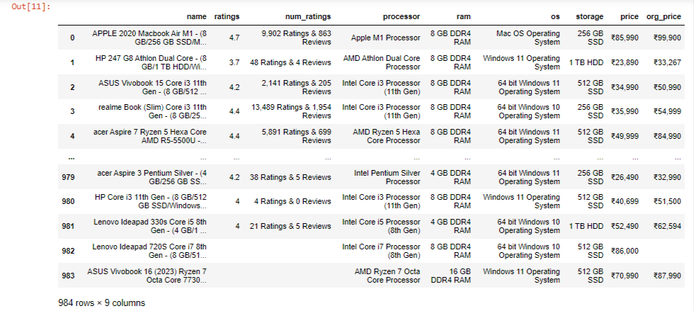
Raw data from website :
Insights : We got 984 rows and 9 columns in the Raw data.

Slide 9
Data Cleaning Steps
We have separated the brand names.
Separating the ratings and number of reviews.
Splitting the RAM and ROM.
Dropped duplicate values.
Replaced the null values.

Slide 10
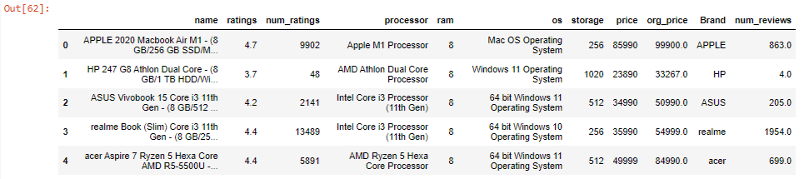
Cleaned Dataframe :

Slide 11

Data Visualization
Representing data into pictorial format.
We have come across Uni-variate,Bi-variate and Multi Variate while analysing and Visualizating the data.

Slide 12
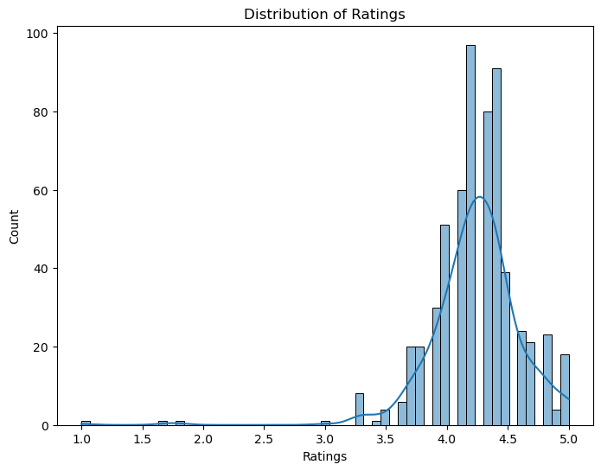
What is the distribution of ratings?
Most of peoples rated the laptops in flipkart between the ratings of 3.5 to 5.0
Customers highly rated the laptops with a 4.2 rating.

Slide 13
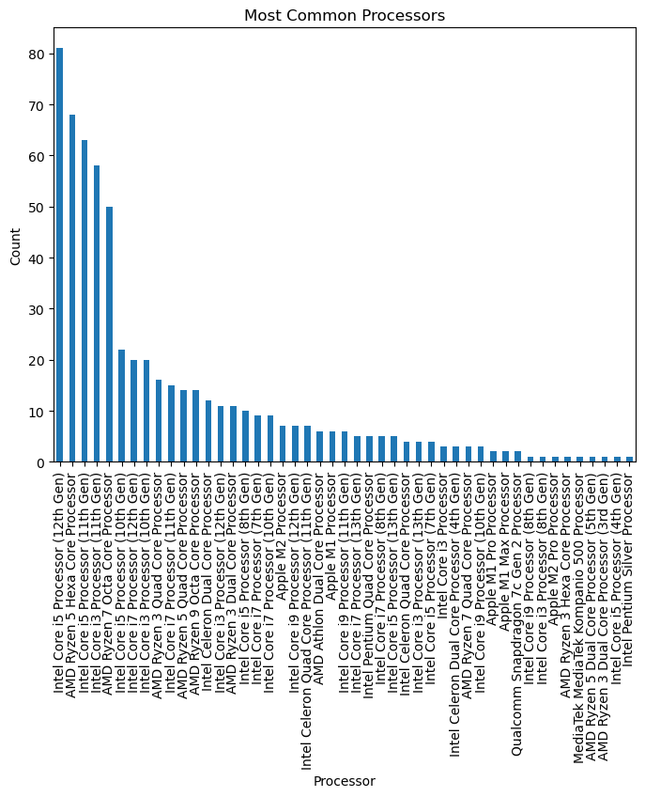
What are the most common processors in the dataset?
The most common processor in the dataset is the Intel Core i5 Processor (12th Gen)

Slide 14
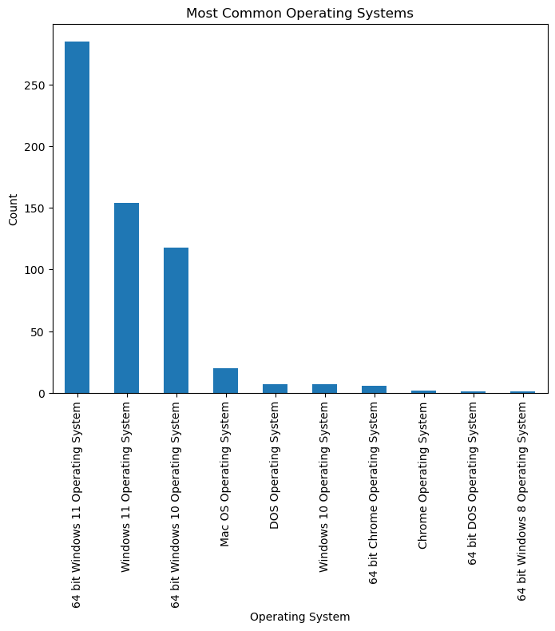
What are the most common operating systems (OS) in the dataset?
The most common operating system (OS) in the dataset is the 64-bit Windows 11 Operating System
64-bit version of Windows 11 is the most prevalent or frequently used

Slide 15
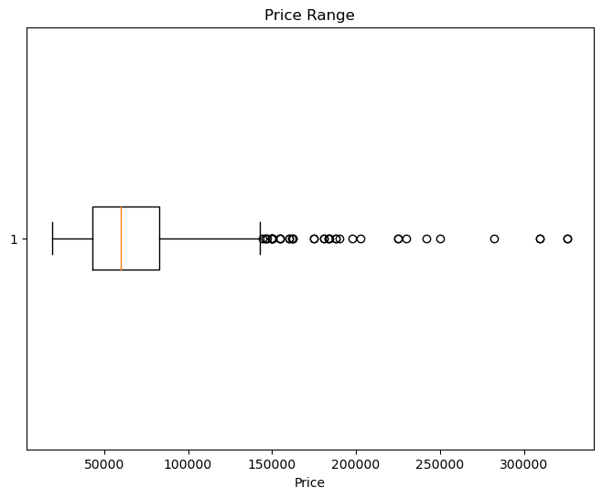
What is the price range of the products?
The price range of the products in the dataset is from 18,990 to 325,990. This indicates that the dataset includes products with prices ranging from 18,990 at the lower end to 325,990 at the higher end

Slide 16
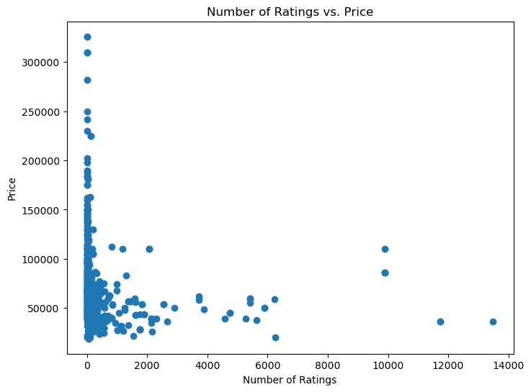
How does the number of ratings vary with the price?
Based on the available data, it appears that most people have provided ratings for laptops within the price range of 18,000 to 100,000

Slide 17
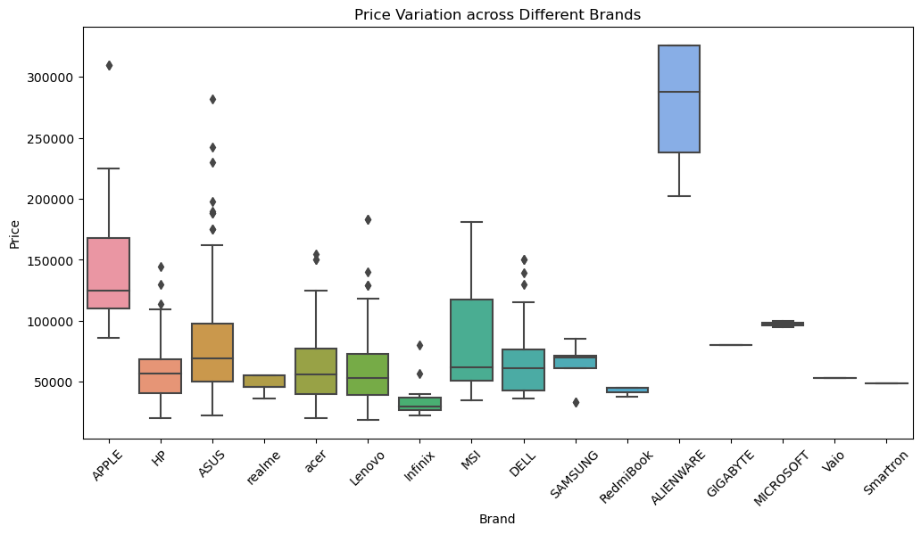
How does the rating distribution vary for different processors?
ALIENWARE Laptops priced between the range of 1,09,000 to 3,05,000
APPLE Laptops priced between the range of 80,000 to 2,40,000

Slide 18
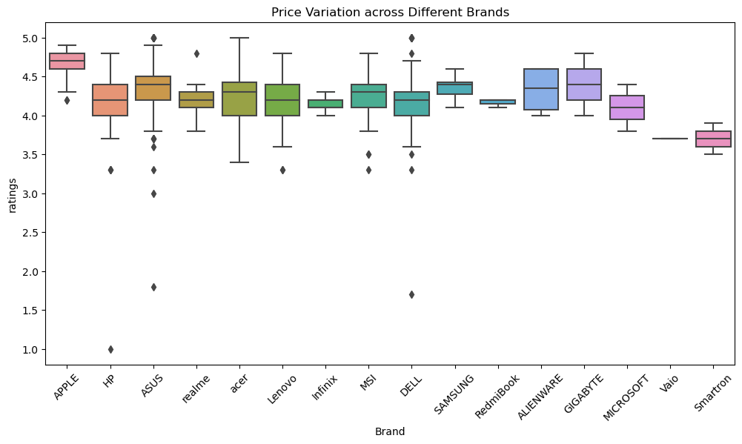
OS Price range
Mac Os are priced between the range of 1,02,000 to 1,70,000
Windows 10 OS priced between the range of 18,000 to 3,05,000

Slide 19
Challenges faced :
Data extracting from container
Changing the data types per required
Choosing the correct plot

Slide 20
Conclusion :
The average rating of the product is 4.2
The highest number of ratings a product has received 13,489
The most common Processor is Intel Core i5 Processor (12th Gen)
The Most common RAM: 8
Most common OS: 64 bit Windows 11 Operating System
Average storage capacity: 556
The price range of the products is between 18,990 – 3,25,990
16 brands are there in the Flipkart

Slide 21


Slide 22

THANK YOU

