Slide 1
AfterBuy.
Everything after the purchase.
An invoice, product and warranty organiser
PROJECT OVERVIEW
AfterBuy.
01
Notes:
Source: local AfterBuy project README.md and frontend/src/glass.css. Project overview based on implemented features. Screenshots, where present, use test data.

Slide 2
A home for what you own
Purchase details stay connected to the documents and coverage behind them.
The everyday problem
The AfterBuy approach
Receipts get scattered.
Warranty dates become hard to find.
Repair history lives in separate places.
Keep each purchase in one workspace, with its invoice, product details, confirmed coverage and service history.
AfterBuy.
02
Notes:
Source: local AfterBuy project README.md and frontend/src/glass.css. Project overview based on implemented features. Screenshots, where present, use test data.

Slide 3
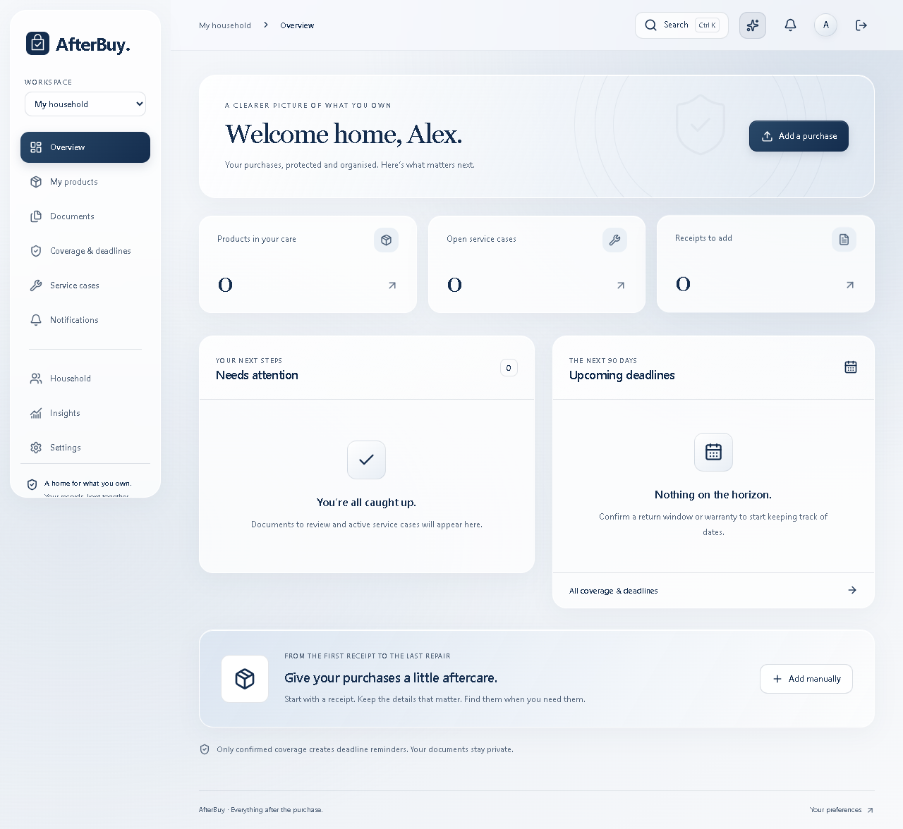
Your purchase overview
The dashboard brings products, open cases and upcoming deadlines together.
One workspace
Switch between personal and household records.
Clear next steps
See documents to review and coverage dates that need attention.
AfterBuy.
03
Notes:
Source: local AfterBuy project README.md and frontend/src/glass.css. Project overview based on implemented features. Screenshots, where present, use test data.

Slide 4
Invoice to saved products
AI prepares the details. The user reviews them before saving.
01
02
03
04
Upload
Extract
Review
Confirm
Add a PDF, JPEG or PNG invoice.
Groq reads purchase and product details.
Check prices, specifications and warranty information.
Create product records and confirmed coverage.
AfterBuy.
04
Notes:
Source: local AfterBuy project README.md and frontend/src/glass.css. Project overview based on implemented features. Screenshots, where present, use test data.

Slide 5
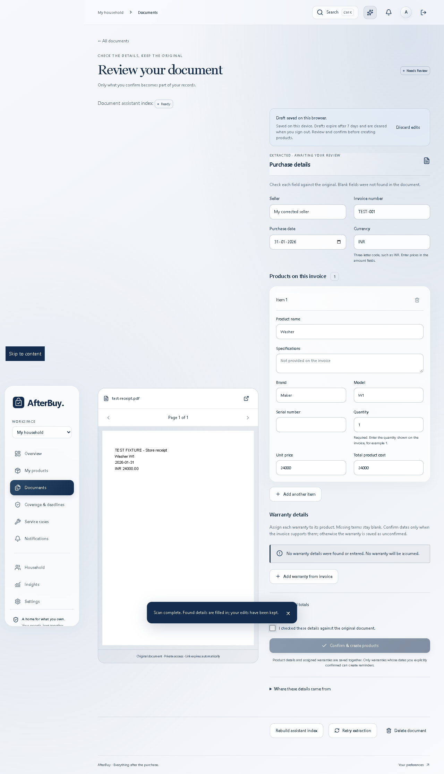
Review before you save
Only details supported by the invoice should become part of the saved purchase.
Product details
Name, quantity, price and specifications extracted from the invoice.
Warranty details
Review available terms and confirm coverage. Missing information needs user input.
AfterBuy.
05
Notes:
Source: local AfterBuy project README.md and frontend/src/glass.css. Project overview based on implemented features. Screenshots, where present, use test data.

Slide 6
Care beyond the receipt
The product record supports the rest of the ownership journey.
Coverage & deadlines
Service cases
Track return windows and confirmed warranty periods.
Keep repair notes, support history and outcomes together.
Search & saved drafts
Deletion choices
Find products quickly and return to unfinished invoice reviews.
Keep saved products, or explicitly remove the products created by an invoice.
AfterBuy.
06
Notes:
Source: local AfterBuy project README.md and frontend/src/glass.css. Project overview based on implemented features. Screenshots, where present, use test data.

Slide 7
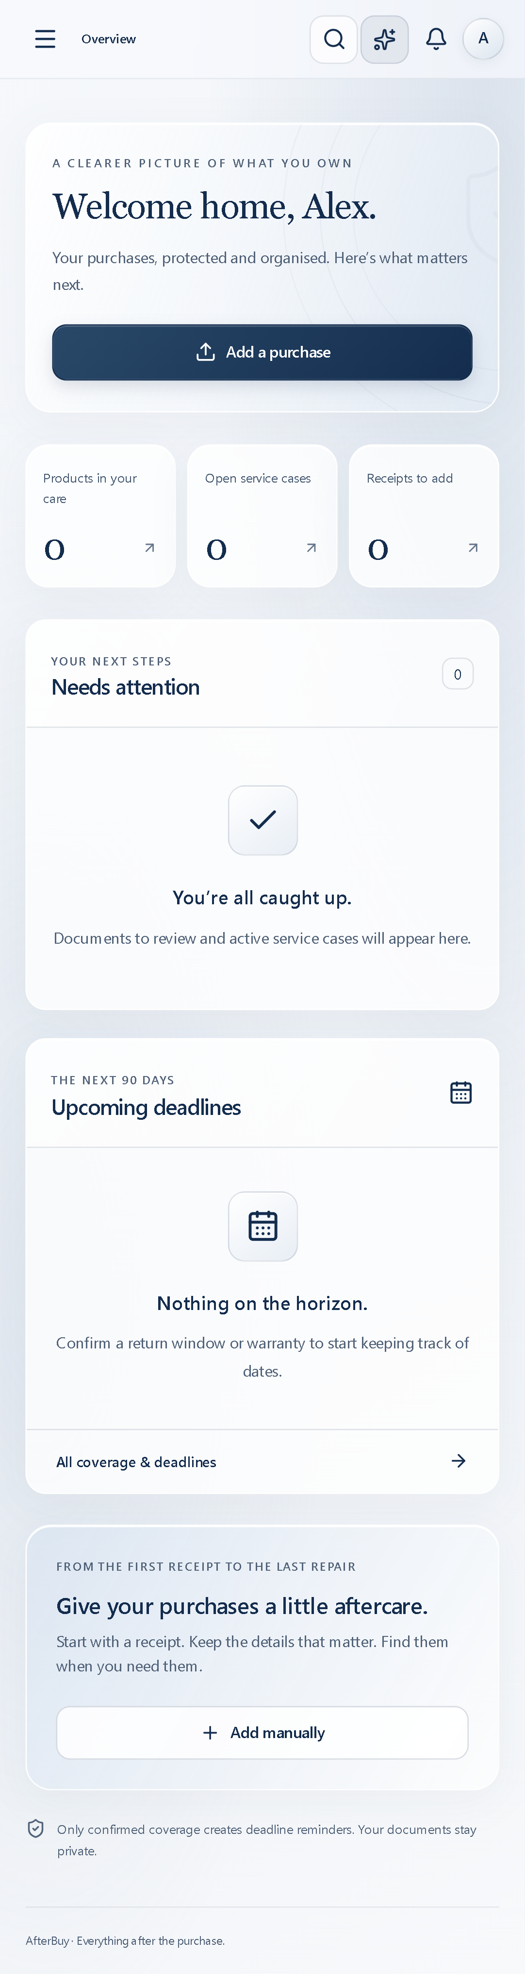
A calm, classic interface
The visual language stays consistent across desktop and mobile.
Navy and frosted white
Soft glass surfaces, rounded cards and generous spacing keep the interface readable.
Motion with control
Subtle transitions and optional pointer effects respect reduced-motion preferences.
AfterBuy.
07
Notes:
Source: local AfterBuy project README.md and frontend/src/glass.css. Project overview based on implemented features. Screenshots, where present, use test data.

Slide 8
How the project fits together
React handles the interface. Express connects the app to storage and extraction.
React + Vite
Pages, forms, search and review controls
Express + TypeScript
Validation, document processing and product creation
Supabase
Authentication, PostgreSQL records and private files
Groq
Invoice extraction for the review workflow
AfterBuy.
08
Notes:
Source: local AfterBuy project README.md and frontend/src/glass.css. Project overview based on implemented features. Screenshots, where present, use test data.

Slide 9
Current scope and next steps
A working purchase organiser with human review at the centre.
Available in the project
Before wider release
Invoice extraction and review
Product and coverage records
Service history and notifications
Household workspace permissions
Test varied real invoice layouts.
Verify production setup and recovery.
Configure optional chat and email services before using them.
AfterBuy.
09
Notes:
Source: local AfterBuy project README.md and frontend/src/glass.css. Project overview based on implemented features. Screenshots, where present, use test data.

