Slide 1
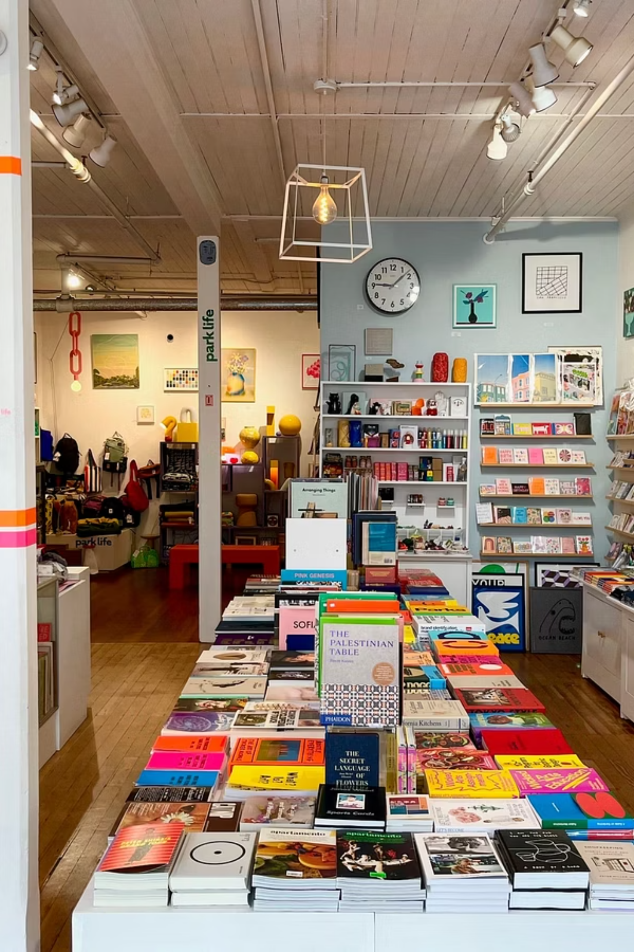
Customer Shopping Behavior Analysis
Uncovering spending patterns, customer segments, and product preferences from 3,900 transactions to guide strategic business decisions.

Slide 2
Dataset at a Glance
3,900
18
Transactions
Features
Rows in dataset
Columns per record
$59.76
37
Avg. Purchase
Missing Values
Mean spend per order
In Review Rating only
Key features span customer demographics (Age, Gender, Location, Subscription Status), purchase details (Item, Category, Amount, Season), and shopping behavior (Discount, Promo Code, Frequency, Review Rating, Shipping Type).

Slide 3

Data Preparation in Python
Load & Explore
Imported via pandas; used df.info() and .describe() for structure and statistics.
Clean Missing Data
Imputed 37 missing Review Ratings using the median rating per product category.
Feature Engineering
Created age_group bins and purchase_frequency_days; dropped redundant promo_code_used column.
Database Integration
Loaded cleaned DataFrame into PostgreSQL for SQL analysis.

Slide 4
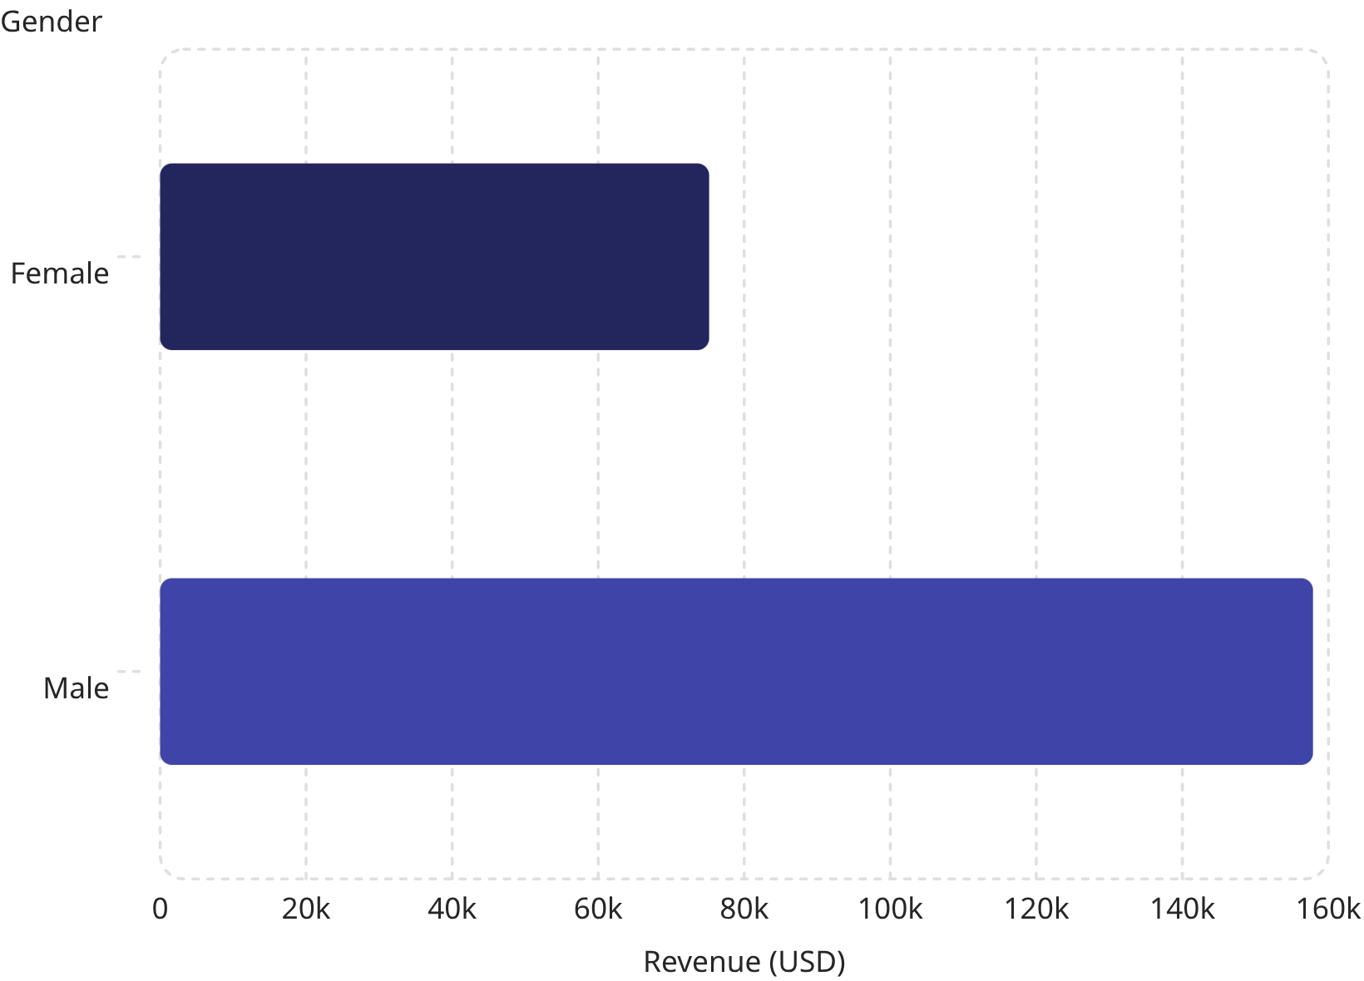
Revenue & High-Spending Customers
Revenue by Gender
Male customers generated $157,890 — more than double female revenue at $75,191.
High-Spending Discount Users
839 customers used discounts yet spent above the average purchase amount — indicating strong deal-seeking but high-value buyers worth targeting with premium offers.

Slide 5
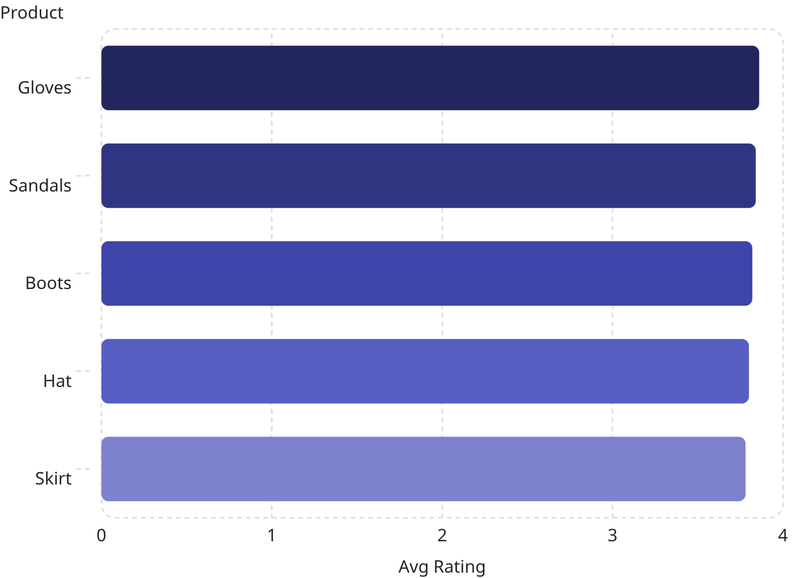
Product Ratings & Shipping Behavior
Top 5 Products by Rating
Gloves lead with a 3.86 average review rating. All top-rated products cluster tightly between 3.78–3.86.
Shipping Type Comparison
Express shipping averages $60.48 vs. Standard at $58.46 — a modest $2 premium. Overall average purchase amount across all shipping types is $59.76.

Slide 6
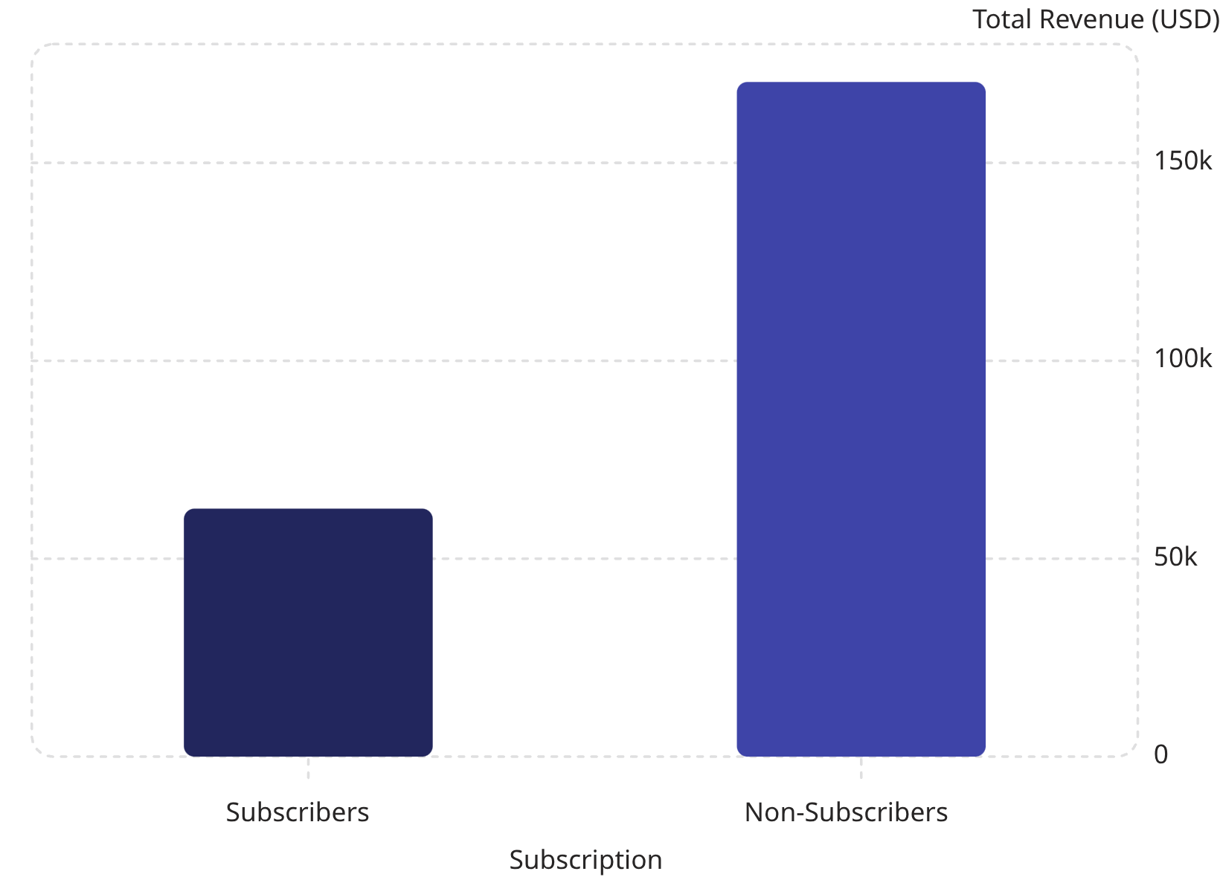

Subscribers vs. Non-Subscribers
Subscription Gap
Non-subscribers (73% of customers) generate $170,436 in revenue vs. $62,645 from subscribers (27%).
Average spend is nearly identical: $59.49 (subscribers) vs. $59.87 (non-subscribers) — suggesting subscription status doesn't affect per-order value.
Among repeat buyers (>5 purchases), 958 subscribe while 2,518 do not — a major untapped conversion opportunity.

Slide 7
Discount-Dependent Products
These five products have the highest percentage of purchases made with a discount applied:
Hat
Sneakers
Coat
50.00% discounted
49.66% discounted
49.07% discounted
Sweater
Pants
48.17% discounted
47.37% discounted
Nearly half of all purchases for these items rely on discounts — a key signal for margin and pricing strategy.

Slide 8
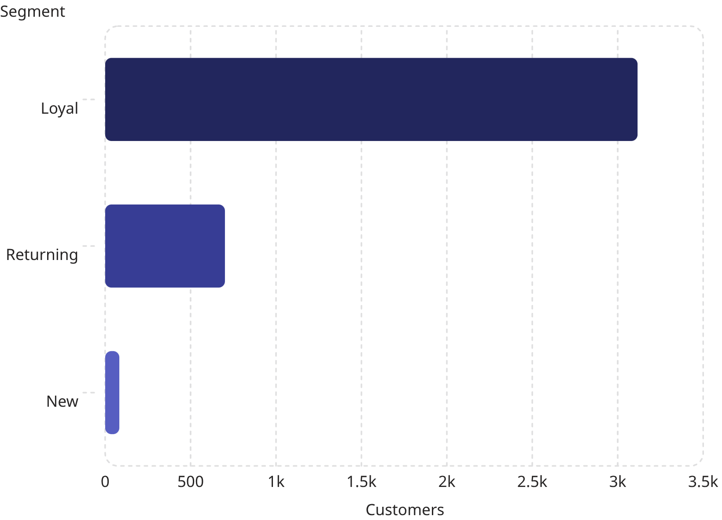
Customer Segmentation
Segment Breakdown
Loyal customers dominate at 3,116 (80% of base), followed by 701 Returning and only 83 New customers.
Top Products by Category
Accessories: Jewelry, Sunglasses, Belt
Clothing: Blouse, Pants, Shirt
Footwear: Sandals, Shoes, Sneakers
Outerwear: Jacket, Coat

Slide 9
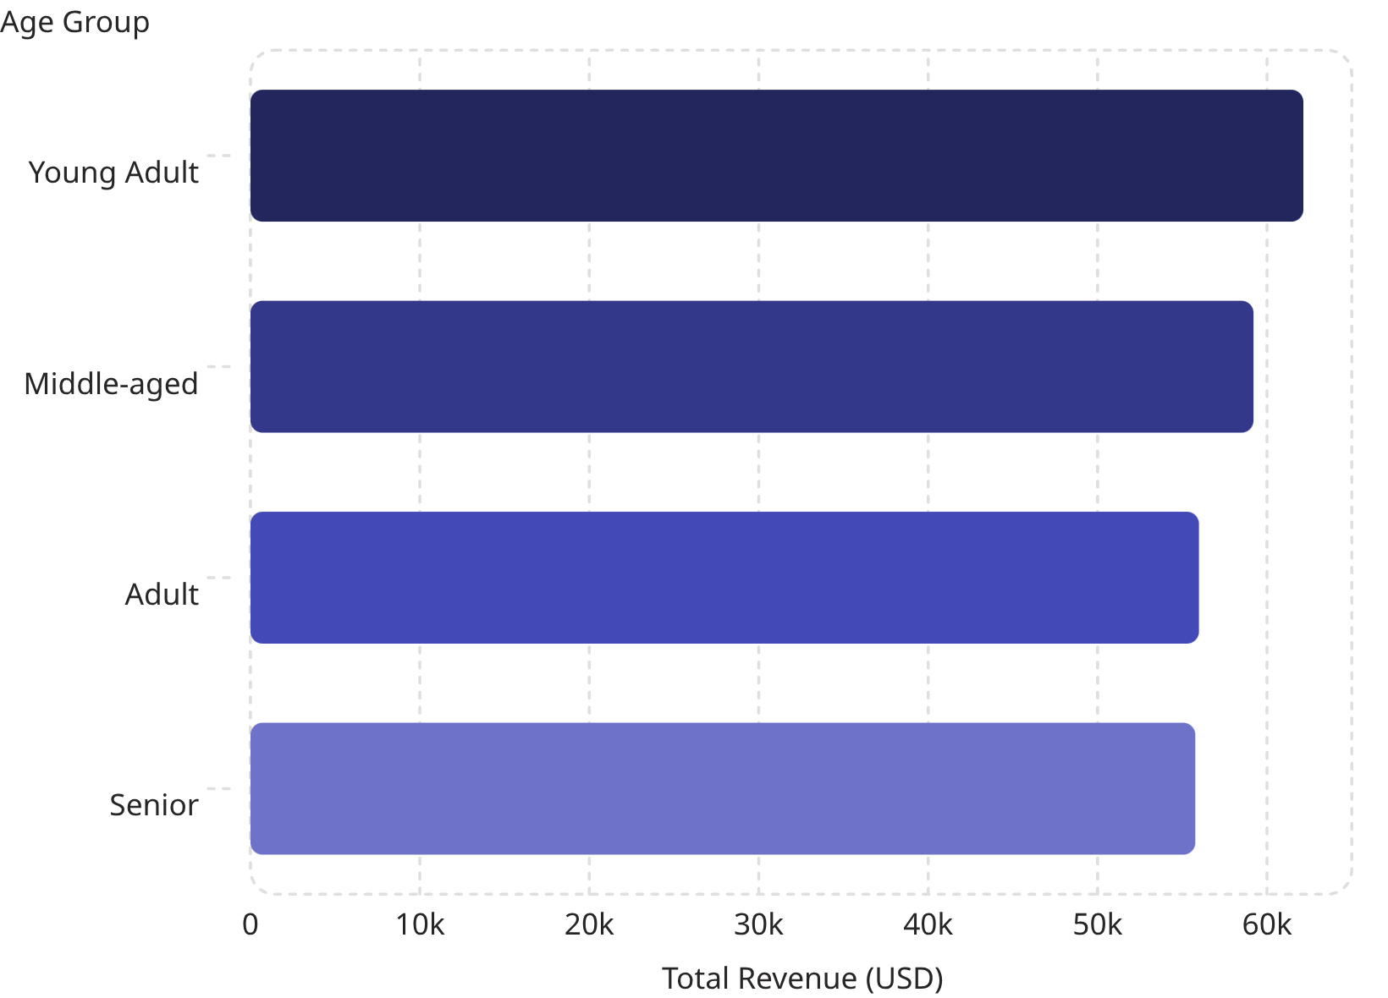
Revenue by Age Group & Power BI Dashboard
Age Group Insights
Young Adults lead revenue at $62,143, with other groups closely clustered — no single age group dominates.
Power BI Dashboard
Interactive dashboard features filters for Subscription, Gender, Category, and Shipping Type. Key visuals include revenue by category, sales by age group, and a donut chart showing 27% subscribers vs. 73% non-subscribers.

Slide 10
Business Recommendations
Boost Subscriptions
Loyalty Programs
Review Discount Policy
Promote exclusive subscriber benefits to convert the 73% non-subscriber base.
Reward repeat buyers to advance them into the "Loyal" segment (currently 80% of customers).
~50% of top product sales rely on discounts — balance sales lift with margin control.
Product Positioning
Targeted Marketing
Highlight top-rated products (Gloves, Sandals, Boots) and best-sellers in campaigns.
Focus on high-revenue age groups (Young Adults) and express-shipping users.

