Slide 1





EMPLOYEE CHURN PREDICTION
Team : SURYAPRAKASH K Guide: P.RAJA
prakashsurya3003@gmail.com (Master trainer edunet foundation)
912421114306
1A0E77C91FE6AEDB0914C7FF8E0899F5 (aut2291240012)
Disclaimer: The content is curated for educational purposes only.
Notes:
Slides: Prepare a short slide deck (10-12 slides) summarizing the project objectives, methodology, and key results.

Slide 2
OUTLINE
Abstract of the Project
Problem Statement
Proposed Solution
System Architecture
Live Demo of the Project
Embedded Video of Project
Conclusion
Future Scope

Slide 3
Abstract
Employee churn, which involves both voluntary and involuntary departures, presents significant challenges for businesses, impacting workforce stability, productivity, and recruitment costs. Unlike customer churn, where businesses cannot choose their clients, organizations can actively pursue strategies to retain employees. This project aims to analyze employee churn through a structured approach, including “exploratory analysis, data visualization, cluster analysis, model building, and performance evaluation.” The process begins with an in-depth examination of the dataset to uncover patterns and trends related to turnover, followed by visualization techniques to highlight key churn-influencing factors and effectively present insights. Cluster analysis will then group employees with similar characteristics, offering a clearer understanding of segments more likely to leave. A predictive model will be developed using machine learning algorithms to forecast churn based on the identified features, and the model’s performance will be evaluated with metrics like “accuracy, precision, recall, and F1-score to ensure its practical reliability”. By leveraging these data-driven insights, organizations can adopt targeted retention strategies, fostering a more engaged workforce and minimizing operational disruptions.

Slide 4
Problem Statement
You are tasked to perform Employee Churn prediction in Python. Employee churn can be defined as a leak or departure of an intellectual asset from a company or organization. or in simple words, you can say, when employees leave the organization is known as churn. The following points help you to understand, employee and customer churn in a better way:
• The business chooses the employee to hire someone while in marketing you don’t get to choose your customers.
• Employees will be the face of your company, and collectively, the employees produce everything your company does.
• Losing a customer affects revenues and brand image. acquiring new customers is difficult and costly compared to retaining existing customers. Employee churn is also painful for companies in organizations. It requires time and effort to find and train a replacement.

Slide 5
You are going to cover the following steps – 1. Exploratory Analysis 2. Data Visualization 3. Cluster Analysis 4. Building Prediction Model 5. Evaluating Model Performance this statement

Slide 6
Proposed Solution
Employee churn, the departure of intellectual assets from an organization, poses challenges similar to customer churn, albeit with distinct differences. While businesses choose employees through hiring processes, they do not have control over who becomes a customer. Employees are the face of the company, collectively responsible for producing everything the organization offers. Just as losing customers impacts revenue and brand image-making customer retention essential due to the high costs of acquisition-employee churn disrupts the organization, requiring time and resources to recruit, train, and integrate replacements. This project seeks to address employee churn through a structured approach, encompassing exploratory analysis, data visualization, cluster analysis, model building, and performance evaluation. We will begin with a detailed exploratory analysis of the dataset to uncover key patterns and trends related to turnover. Data visualization techniques will help highlight factors influencing churn, providing insights into areas for intervention. Cluster analysis will then group employees by similar characteristics, shedding light on high-risk segments. A predictive model will be developed using machine learning algorithms, which will then be evaluated for accuracy, precision, recall, and F1-score to ensure practical utility. Through these data-driven insights, organizations can deploy targeted retention strategies, promoting workforce stability and minimizing operational disruptions.

Slide 7
Employee churn prediction plays a pivotal role in talent management, providing organizations with the insights needed to maintain a stable workforce and reduce turnover costs. By accurately predicting which employees are most at risk of leaving, organizations can proactively implement retention strategies, thereby reducing the need for costly recruitment and training processes. With skilled employees often representing a critical competitive advantage, managing employee retention becomes essential for long-term success. The process of employee churn prediction typically involves several key steps. First, a comprehensive exploratory analysis is conducted on the dataset, identifying potential factors such as job satisfaction, compensation, work-life balance, and career progression opportunities that may influence turnover. Visualization techniques can then be applied to reveal patterns and correlations, offering a clear picture of the factors with the highest impact. Following this, cluster analysis is used to segment employees into groups with similar characteristics, such as department, years of service, and performance scores. This clustering provides a nuanced view of employee profiles, helping HR teams better understand the diverse reasons behind potential turnover. Once these patterns and clusters are established, machine learning models such as logistic regression, decision trees, or random forests can be trained to predict churn likelihood. Evaluating the model's effectiveness with metrics like precision, recall, and F1-score ensures the model’s insights are actionable and reliable.

Slide 8
System Architecture
Hardware Requirements:
1. Processor (CPU):(Minimum: Dual-core processor, Recommended: Quad-core or higher for faster data processing and model training.)
2. Memory (RAM):(Minimum: 8 GB, Recommended: 16 GB or more for handling larger datasets and running complex models)
3. Storage:(Minimum: 10 GB of available disk space, Recommended: 50 GB or more for storing datasets, models, and outputs)
4. Graphics Processing Unit (GPU):(Recommended: NVIDIA GPU with CUDA support for accelerated model training, especially for deep learning tasks. Google Colab provides access to GPUs and TPUs)
5. Network:(Reliable internet connection to access Google Colab and datasets stored online (e.g., Google Drive, Kaggle))

Slide 9
System requirement
1. Operating System:(Google Colab runs in a cloud-based environment, so no specific operating system is required on the user's local machine. However, a web browser (Chrome, Firefox, etc.) is needed) 2. Programming Language:(Python 3.x: Ensure the project is compatible with Python 3, which is the default in Google Colab) 3. Libraries and Frameworks: Data Manipulation:( Pandas, NumPy) Data Visualization:(Matplotlib,Seaborn) Machine Learning:(Scikit-learn,TensorFlow or PyTorch) 4. Development Environment:(Google Colab, which provides an interactive Jupyter notebook environment with built-in support for many libraries.) 5. Version Control (Optional):(Git for tracking changes and collaborating on code (can be integrated with GitHub)) 6. Data Storage Solutions:(Google Drive for storing and accessing datasets easily within Google Colab)

Slide 10

Live Demo of Project

Slide 11
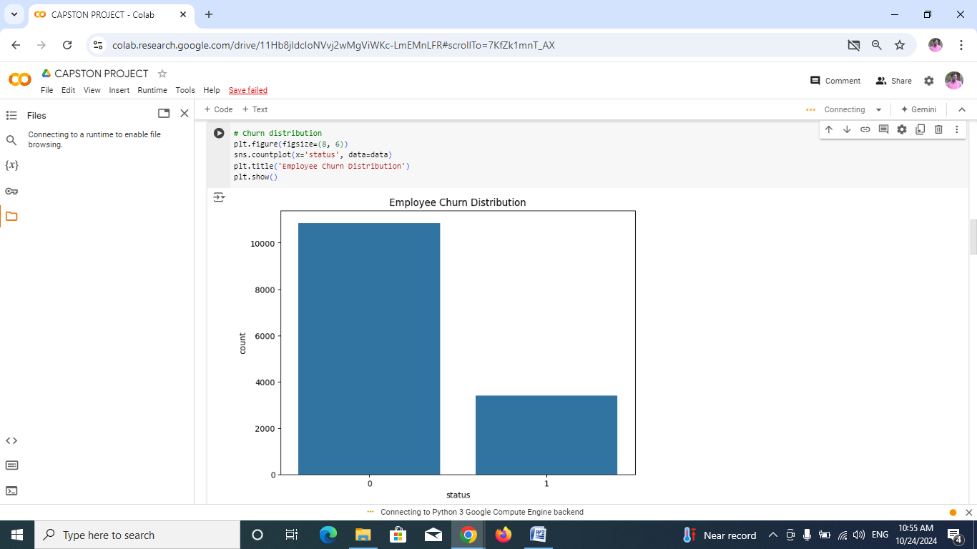
Video of Project Demo
EMPLOYEE CHURN DISTRIBUTION

Slide 12
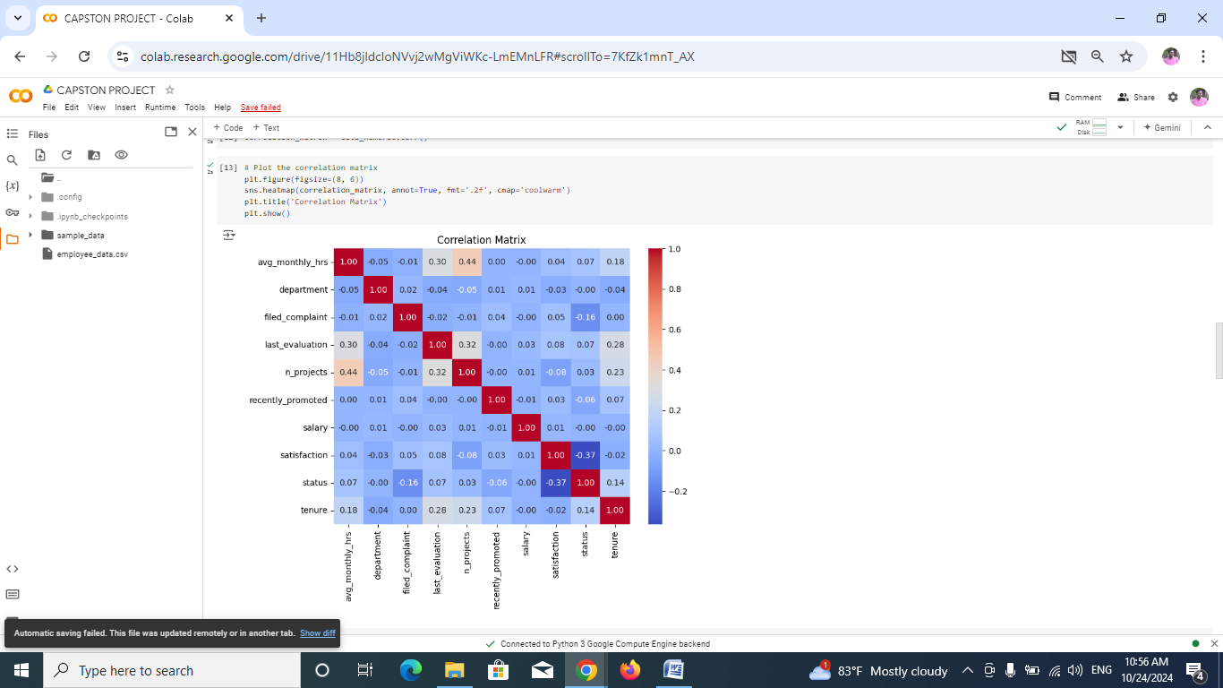
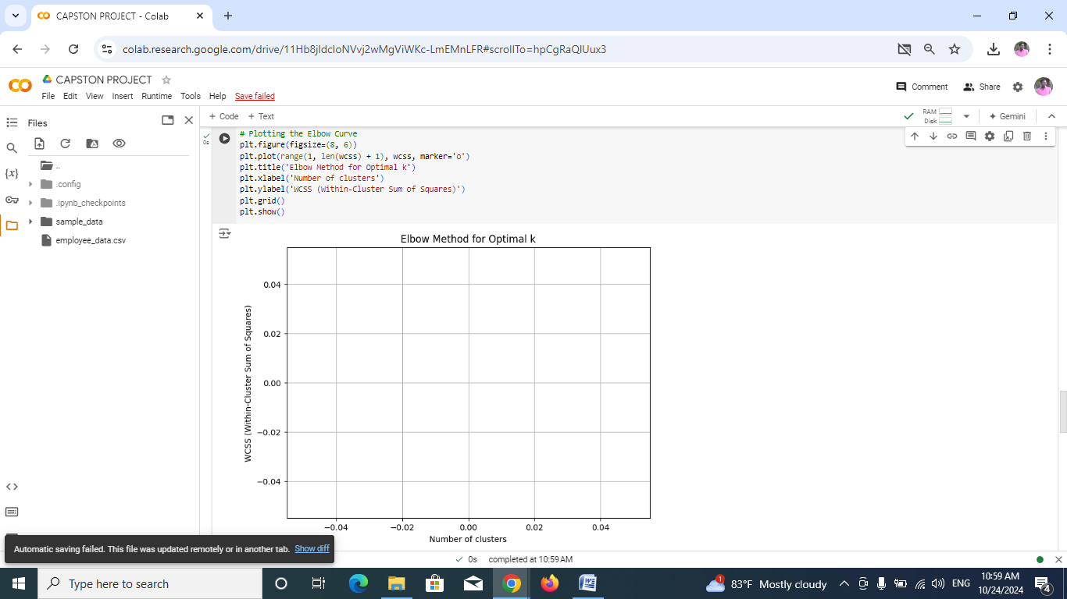
CORRECTION MATRIX ELBOW METHOD OPTIONAL K

Slide 13
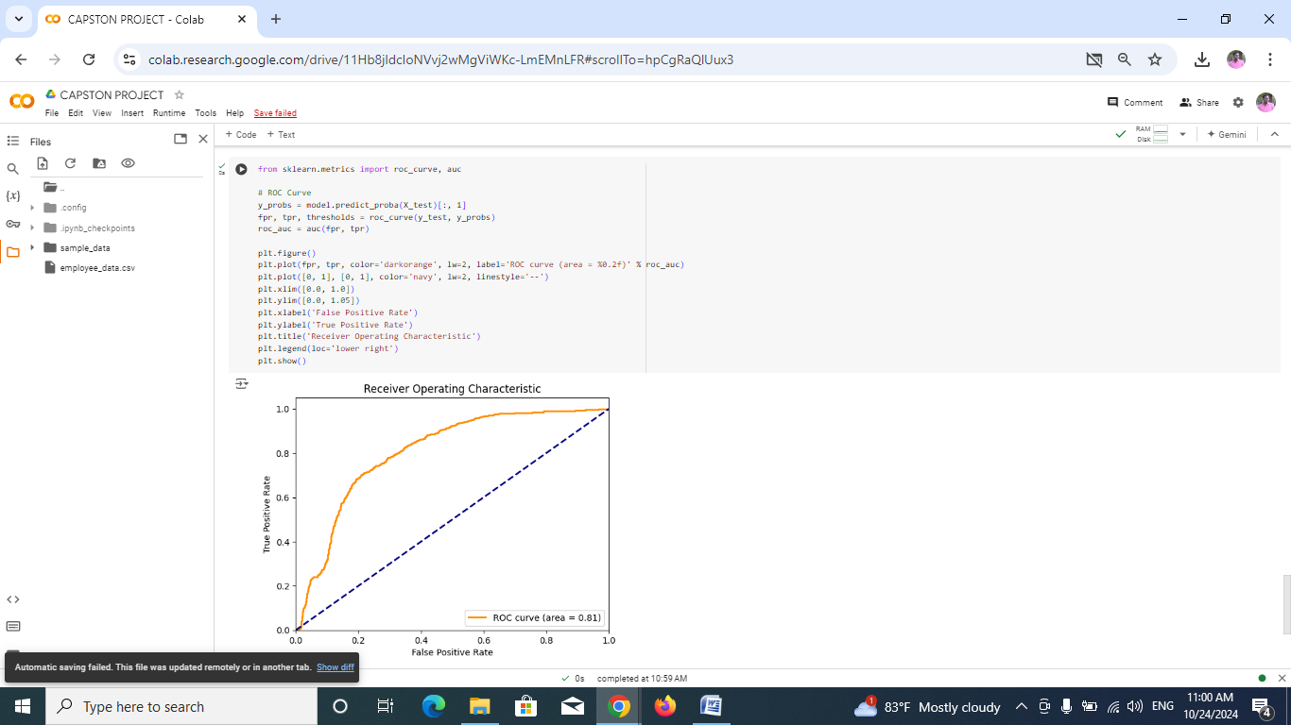
ROC CURVE

Slide 14
Conclusion
Employee churn prediction is crucial for organizations as it directly influences operational efficiency, costs, and employee morale. High turnover rates can lead to significant expenses associated with recruiting and training new staff, alongside the loss of valuable institutional knowledge that departing employees take with them. Furthermore, frequent turnover can create a destabilized work environment, impacting the morale of remaining employees and potentially exacerbating the churn problem. Additionally, a company known for high employee turnover may struggle with its brand image, making it less appealing to potential hires and customers alike.
To effectively address employee churn, organizations can utilize various data analysis techniques. Exploratory analysis helps identify patterns and trends in employee behavior, while data visualization tools like Matplotlib and Seaborn provide intuitive insights into these findings. Implementing cluster analysis can reveal at-risk employee groups, allowing for targeted retention strategies. Predictive modeling using algorithms such as logistic regression or decision trees helps forecast churn based on numerous factors, including demographics and job satisfaction. Continuous evaluation of model performance ensures reliability, and future directions, such as integrating real-time data and personalizing retention initiatives, can further enhance these efforts, leading to a more engaged and stable workforce.

Slide 15
Future Scope
The future scope of this Employee Churn Prediction project lies in refining prediction accuracy, expanding data integration, and enhancing interpretability to provide even more actionable insights. As the project evolves, leveraging additional data sources such as employee engagement surveys, performance reviews, exit interviews, and external market conditions could improve predictive accuracy. By incorporating more sophisticated techniques like sentiment analysis on feedback data or text data from employee surveys, the model could better capture subtle signals of dissatisfaction that may lead to turnover.
. Advanced machine learning and deep learning techniques, such as recurrent neural networks (RNNs) or ensemble methods, could also be explored to capture complex patterns and improve performance. Furthermore, explainable AI (XAI) approaches could be applied to provide HR teams with transparent and understandable insights into which factors most influence churn, helping them make more informed decisions

Slide 16
Another promising area is the development of real-time monitoring tools. These could continuously evaluate employee churn risk using updated data, allowing HR departments to act swiftly to prevent potential turnover. The project’s insights could also be extended to strategic workforce planning, identifying long-term trends in employee needs, preferences, and retention drivers across different employee segments, leading to more personalized and effective retention strategies.

Slide 17
Thank you!
Notes:
thank you very much for joining this PPT, keep learning.
17

