Slide 1

Stack Overflow survey
Part 1
B.Surya Prakash
13-December-2025

Slide 2
Outline
Executive Summary
Introduction
Methodology
Programming Language Trends
Database Trends
Dashboards
Findings & Implications
Conclusion
Appendix

Slide 3
Executive Summary
The most-used programming language is **JavaScript** among respondents.
Developers most admire **JavaScript**, indicating strong interest or growing adoption.
The most-used database is **PostgreSQL** among respondents.
Databases that respondents want to work with include **PostgreSQL**, suggesting future demand.

Slide 4
Introduction
Dataset: Stack Overflow Developer Survey (provided)
Objective: Analyze tech usage, trends, and implications
Audience: Recruiters, Hiring Managers, Tech Leads

Slide 5
Methodology
Data cleaning: parsed multi-select columns, trimmed extreme salary outliers (if any)
Aggregations: counted occurrences for top-10 lists
Dashboards: generated summary charts for current and future trends

Slide 6
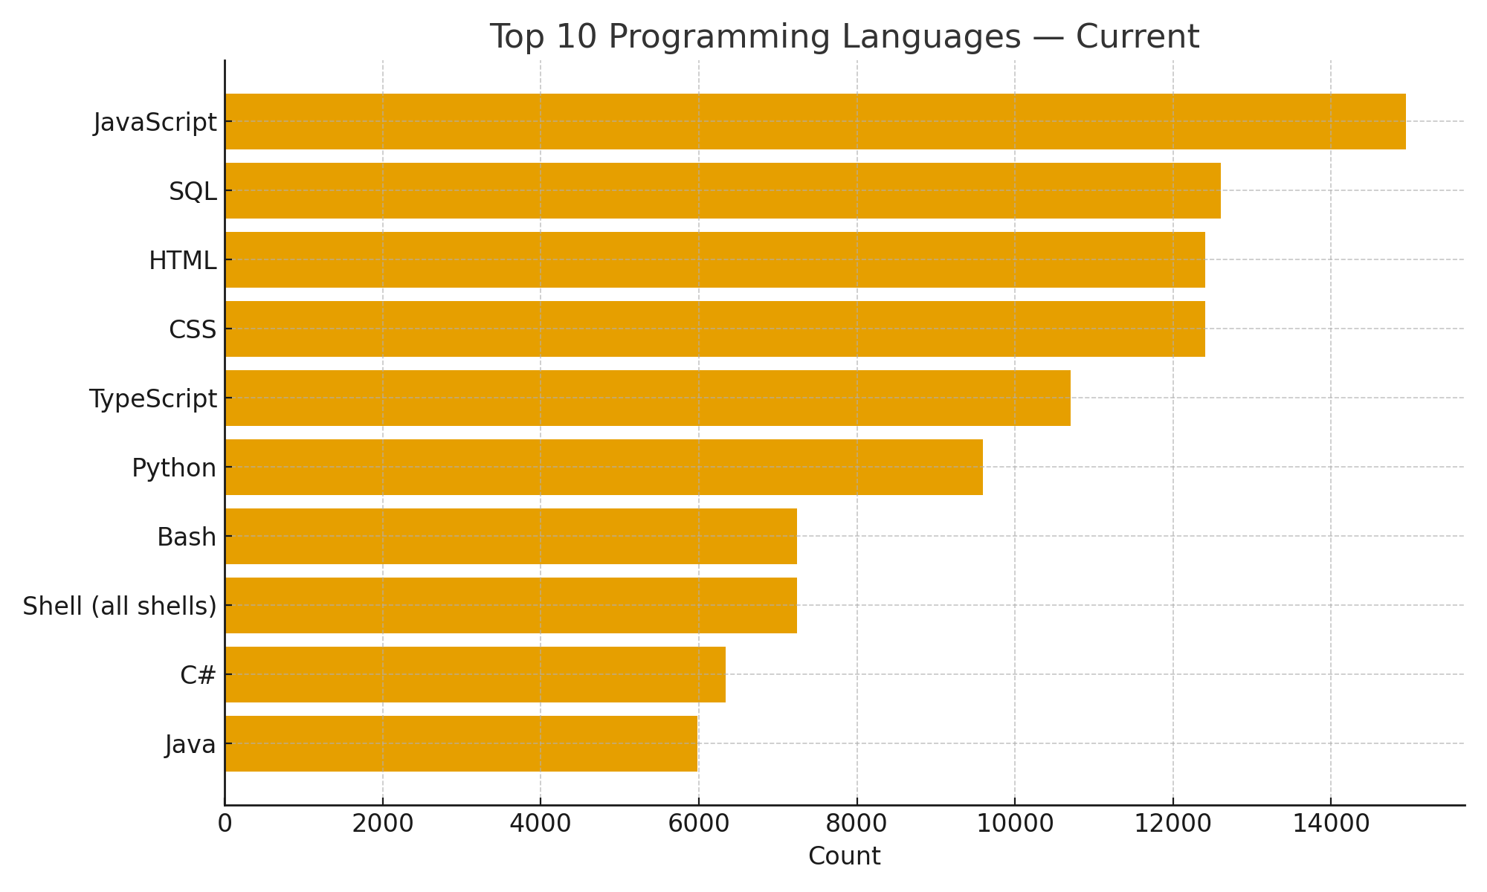
Programming Languages — Current Year (Top 10)

Slide 7
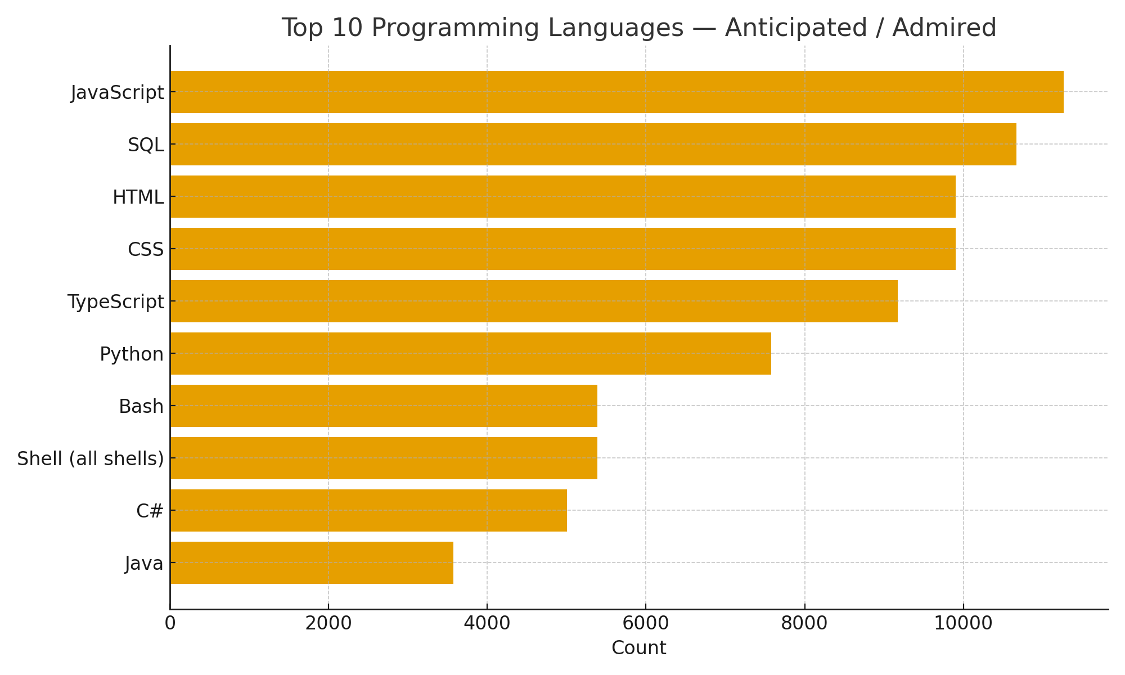
Programming Languages — Anticipated Trends (Top 10)

Slide 8
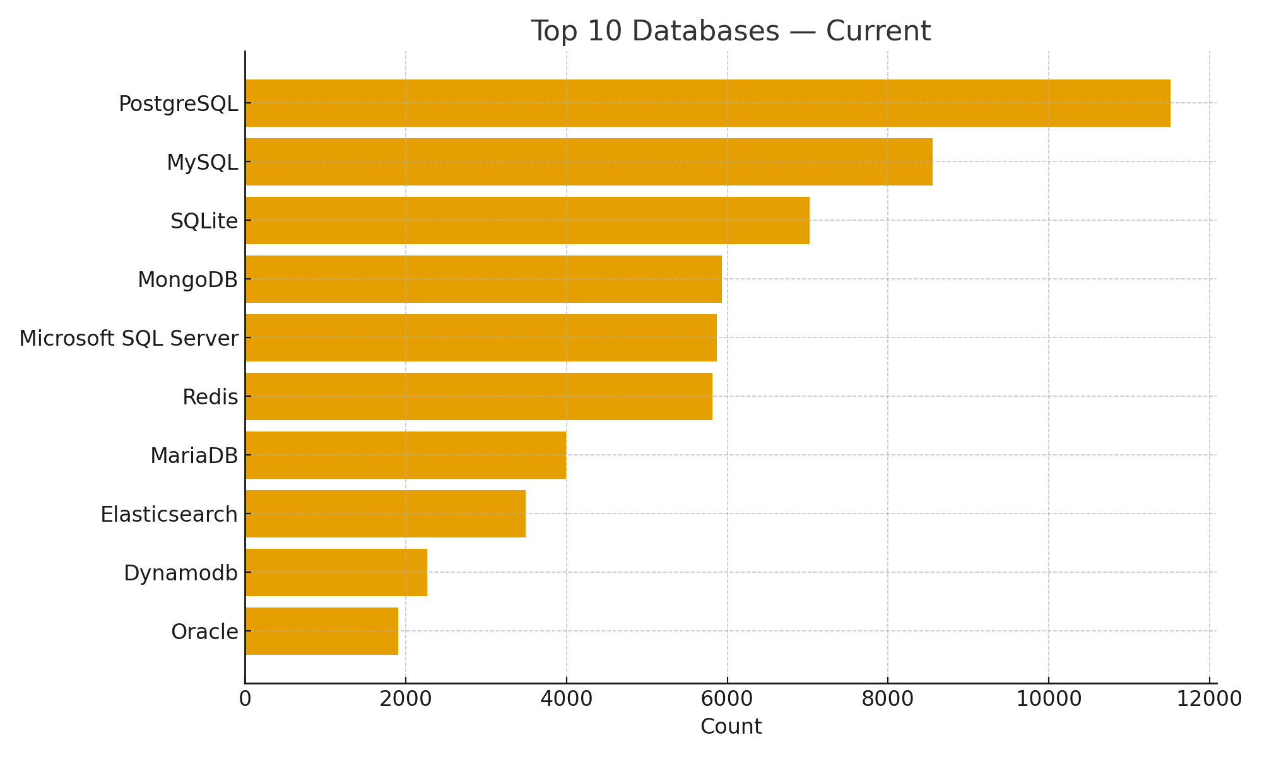
Databases — Current Year (Top 10)

Slide 9
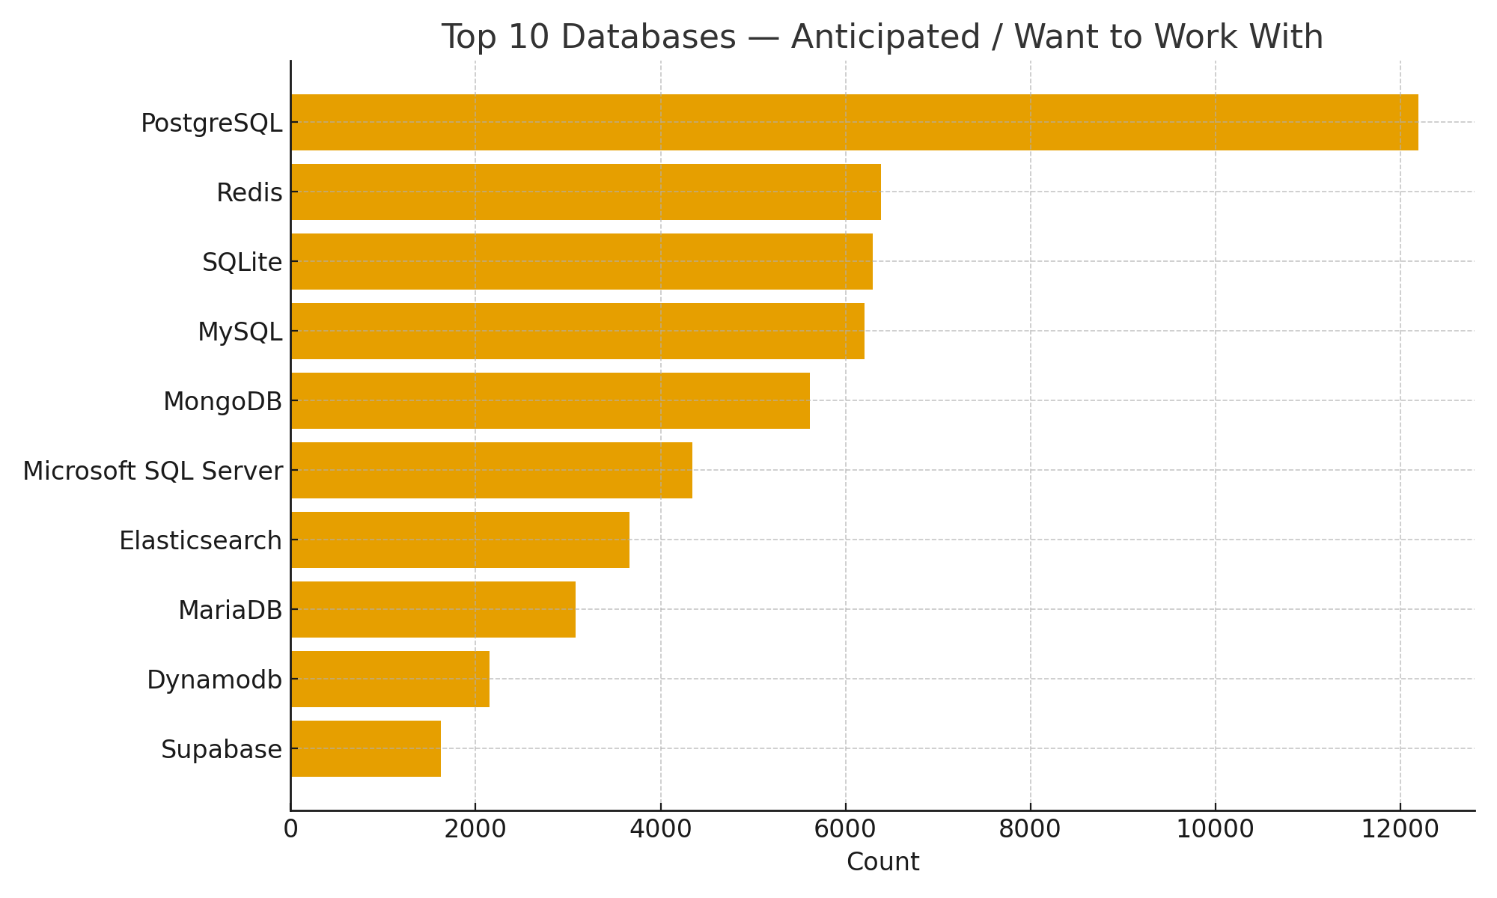
Databases — Anticipated Trends (Top 10)

Slide 10
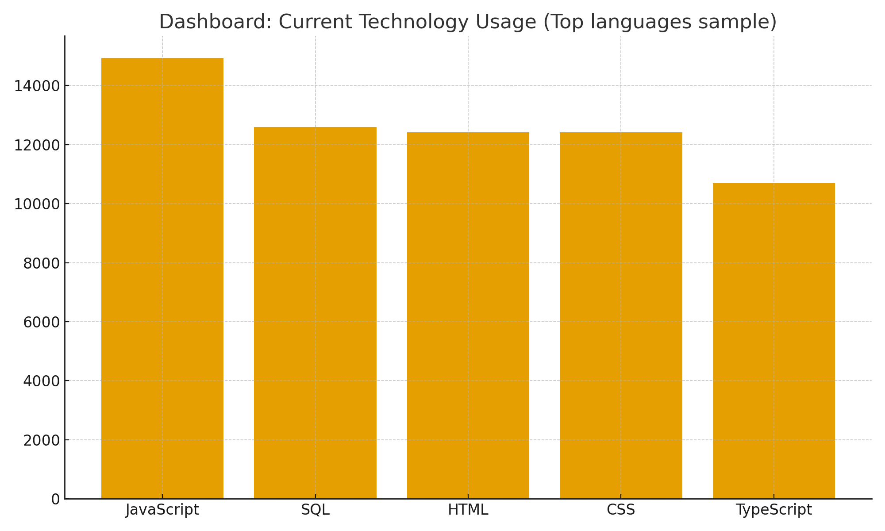
Dashboard: Current Technology Usage

Slide 11
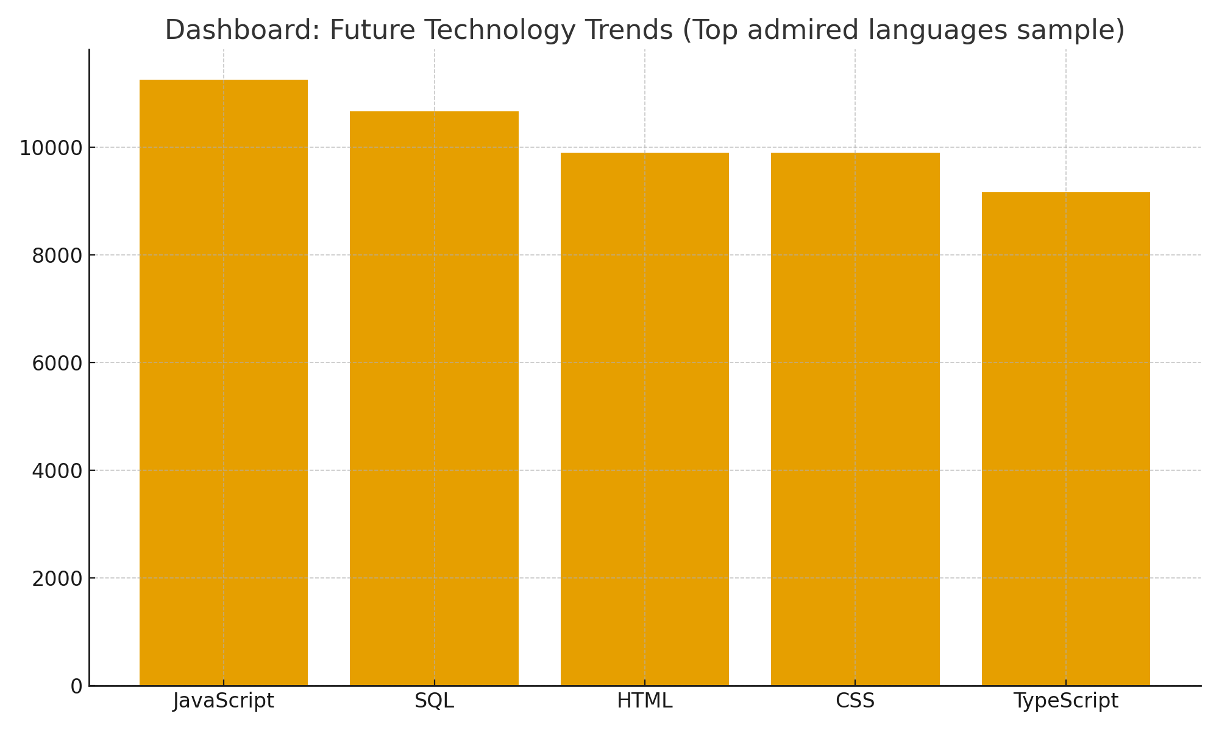
Dashboard: Future Technology Trends

Slide 12
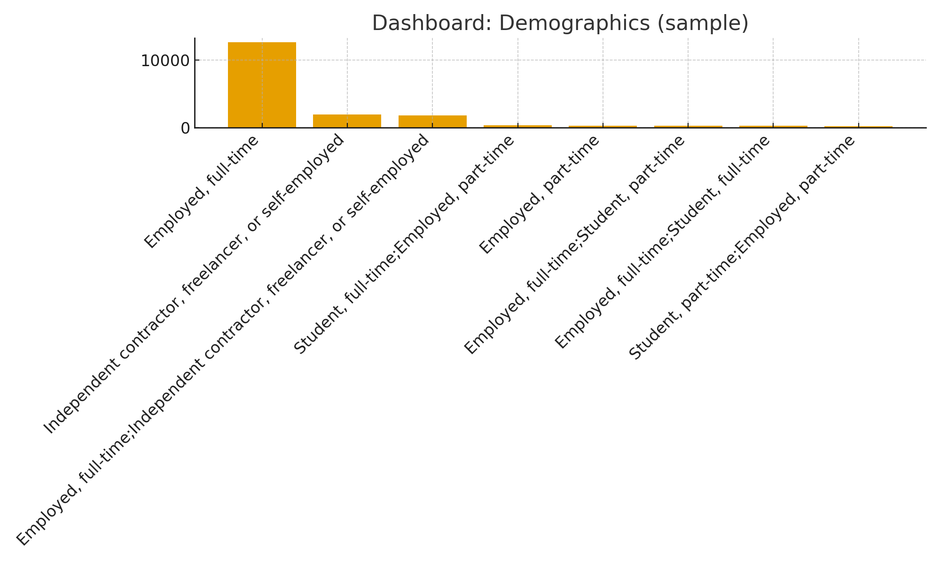
Dashboard: Demographics

Slide 13
Insights from Dashboards
The most-used programming language is **JavaScript** among respondents.
Developers most admire **JavaScript**, indicating strong interest or growing adoption.
The most-used database is **PostgreSQL** among respondents.
Databases that respondents want to work with include **PostgreSQL**, suggesting future demand.

Slide 14
Overall Findings & Implications
The most-used programming language is **JavaScript** among respondents.
Developers most admire **JavaScript**, indicating strong interest or growing adoption.
The most-used database is **PostgreSQL** among respondents.
Databases that respondents want to work with include **PostgreSQL**, suggesting future demand.
  Implication: Companies hiring for roles in the top languages should expect a larger talent pool but potentially higher salary competition for specialists.
  Implication: Organizations should consider training or migration strategies towards admired languages and databases to stay competitive.
  Implication: Remote-friendly hiring can expand access to candidates with top skills (recommend checking RemoteWork distributions).

Slide 15
Conclusion
The analysis highlights top languages and databases in current use and those admired for future work.
Organizations should align hiring/training with observed trends to remain competitive.
Further work: explore salary relationships and regional breakdowns, build interactive dashboards.

Slide 16
Appendix
Additional charts and tables available in the notebook.
Job postings & popular languages charts to be added from Module 1 files (job-postings.xlsx, popular-languages.csv).

