Slide 1
Project Presentation
Walmart sales forecasting

Slide 2
Team Members
Sree Surya Sreemanth Yedidhi (Data collection and Preprocessing)
Vivek Chandra (Model selection and Training)
Yagna praseeda Atmuri (Model Evaluation and Optimization)
Parimala Anjanappa (Deploying the model and Documentation)

Slide 3

Introduction of the problem
Sales Forecasting: The primary objective is to develop models that can predict weekly sales for each store. Additionally, we can determine the impact of external factors like temperature, fuel prices, holidays, markdowns, and economic indicators on sales.
Notes:
Data is indeed a valuable asset for organizations, and Walmart, being a major player in the retail industry, recognizes the importance of harnessing data for decision-making and strategy formulation.
This project aims to leverage data analysis techniques to understand the factors influencing sales at Walmart stores and to develop models for predicting future sales.
The analysis involves exploring a subset of Walmart stores' performance and using various regression and machine learning models, including linear regression, random forest, and gradient boosting, to forecast weekly sales.
Through exploratory data analysis, insights into the impact of factors such as holidays, fuel price, and temperature on weekly sales are uncovered.

Slide 4
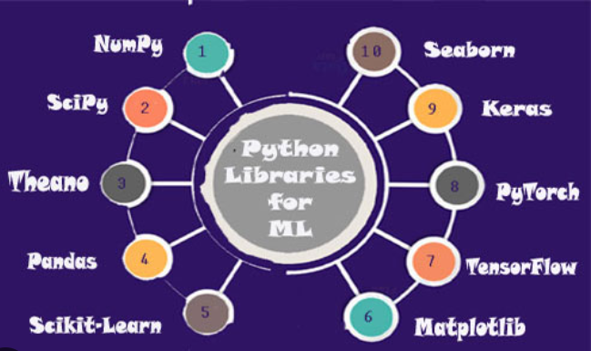
Tools used
Data Manipulation and Analysis:
Pandas
NumPy
Scipy
Matplotlib
Seaborn
PySpark
Machine Learning:
Scikit-learn
Spark MLlib

Slide 5
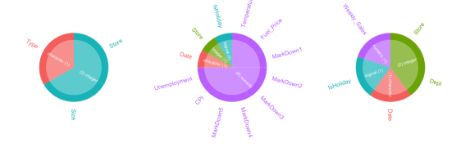
Dataset Overview
Dataset for this study has been acquired from a past Kaggle competition hosted by Walmart
train.csv: This dataset contains historical sales data, including the weekly sales figures for each department within each store, along with the corresponding dates and holiday indicators.
stores.csv: It provides additional information about each Walmart store, such as its type (categorized as A, B, or C) and its size in square feet.
features.csv: This dataset includes various features potentially influencing sales, such as temperature, fuel prices, promotional markdowns, CPI, and unemployment rates, along with holiday indicators.
Notes:
It contains historic weekly sales information about 45 Walmart stores across different regions in the country along with department-wide information for these stores.

Slide 6
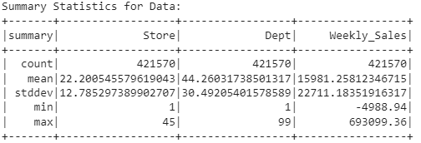
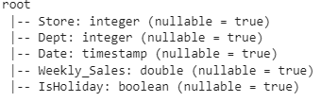

train
Shape of the DataFrame: (421570, 5)
Missing values:

Slide 7
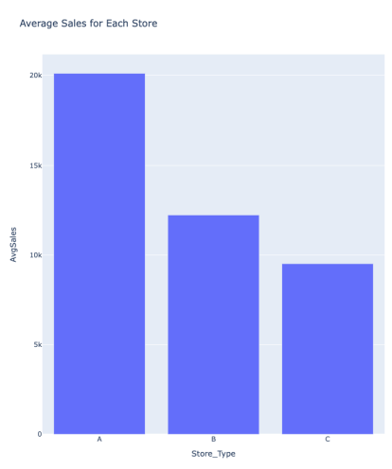
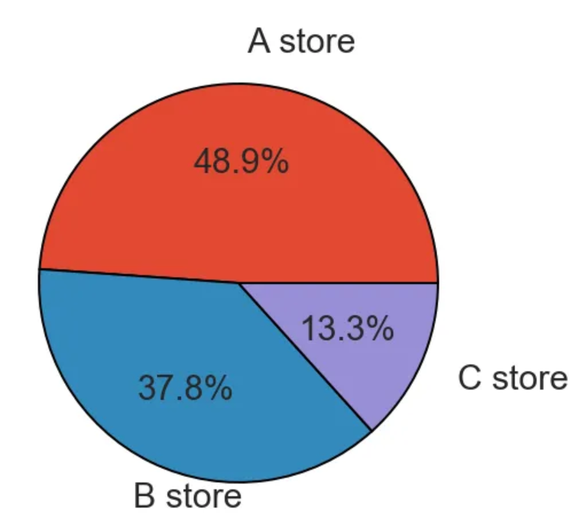
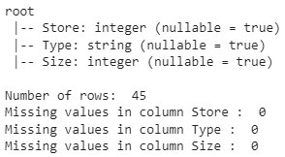
stores
Number of rows: 45
Number of columns: 3
contains some more detailed information about the type and size of these 45 stores used in this study.

Slide 8
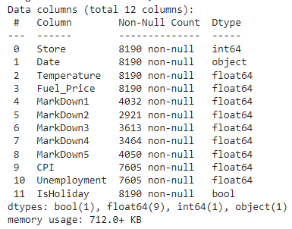
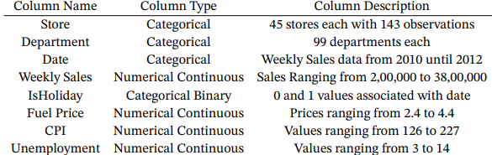
features
Number of rows: 8190
Number of columns: 12
Converting them to float64

Slide 9
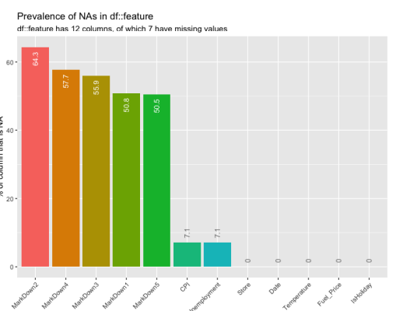
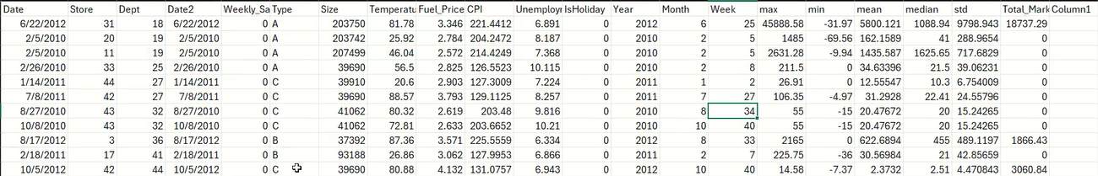
Data preprocessing
Data Cleaning:
Handling missing values
Handling outliers
Negative weekly Sales
Correcting data formats

Slide 10
Feature Engineering
One-hot-encoding:
One-hot-encoding is a technique used to represent categorical variables as binary vectors, suitable for machine learning models to process.
Data Normalization:
Normalization is applied to numerical columns to scale their values within a specific range, often between 0 and 1. This ensures that features with larger magnitudes do not overshadow others,
Notes:
From the Date column, I have extracted DayOfMonth, Month, Year, DayOfWeek, WeekOfYear, and Quarter and dropped the Date column
Created a new column called MarkDown which is the sum of all MarkDown(1–5) columns after which those 5 columns were dropped
In the IsHoliday column, I have changed the value to 1 for national and federal holidays as weeks with holidays might have higher sales than the weeks without holidays. Walmart could have even offered promotions during holidays.

Slide 11
Preparing the Dataset
Feature selection using a RandomForestRegressor:
Trained a RandomForestRegressor (radm_clf) on the features (data[feature_col]) and the target variable (data['Weekly_Sales']).
Saved the trained model to disk using pickle.
Extracted the top 23 important features from the model.
Selected these top features from the original dataset.
train_test_split
Assigned the target variable 'Weekly_Sales' to Y.
Used the train_test_split function to split the data into training and testing sets. You allocated 80% of the data for training (X_train, y_train) and 20% for testing (X_test, y_test), with a specified random state for reproducibility.

Slide 12
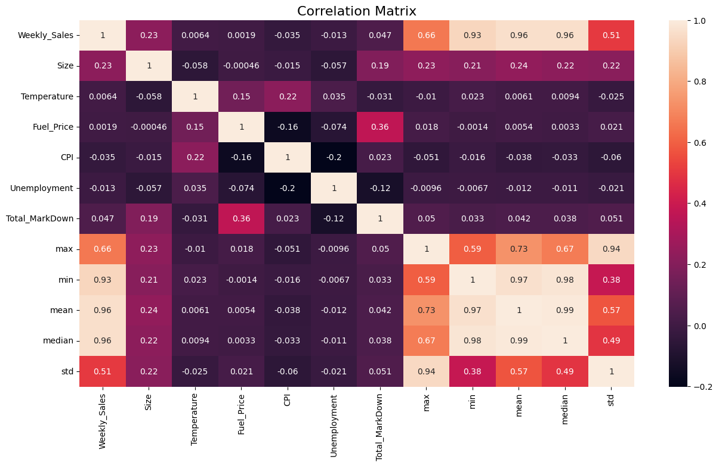
EDA
Identifying store as well as department-wide sales in Walmart - the average sales for the stores and departments,
Correlation between the different factors that affect sales. There are five primary components from our dataset
Temperature,
Unemployment,
CPI (Consumer Price Index),
Fuel Price,
IsHoliday.
We are exploring their relationship to sales
Notes:
I’ll go through some EDA we did -here we look at visualizations that can answer some crucial questions about the Walmart dataset- like how sales varies across different stores, and how they are affected by different factors.
With the numerous variables available through this dataset, its imp to study correlations between some of them. The correlation matrix is a popular method which scores the linear relationship between two variables. From analyzing the matrix we can see that
There is a slight correlation between weekly sales and store, type, and department
There seems to be a negative correlation between weekly sales and temperature, unemployment, CPI, and fuel price. This could suggest that sales are not impacted by changes in these factors
Markdowns 1-5 show no distinct correlation with weekly sales

Slide 13
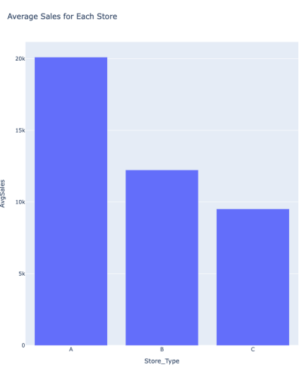
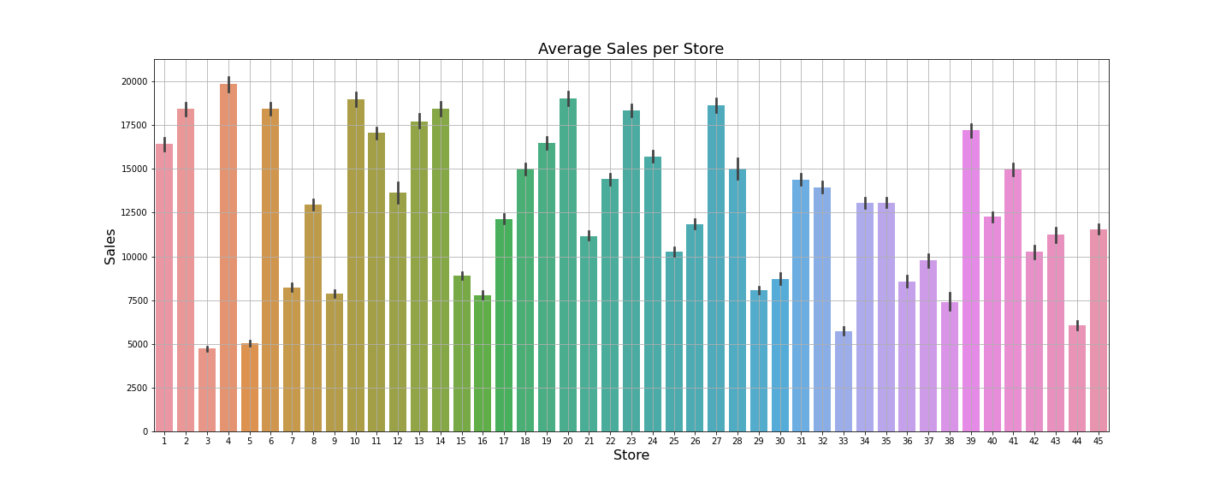
Average sales per Store
Notes:
There are 3 store types A, B, C - Clearly, type A has highest avg sales and type C the lowest but this can also be associated to the fact that store A count is more, so the weekly sales/avg sales for A is more than other stores.
There are 45 stores associated with the three store types and looking at average sales for each of these stores we can conclud that store numbers 4, 10, 14, 20 have the highest average sales. We see that there is a very high difference between the average sales for each of the stores; some stores record huge sales while others don't.

Slide 14
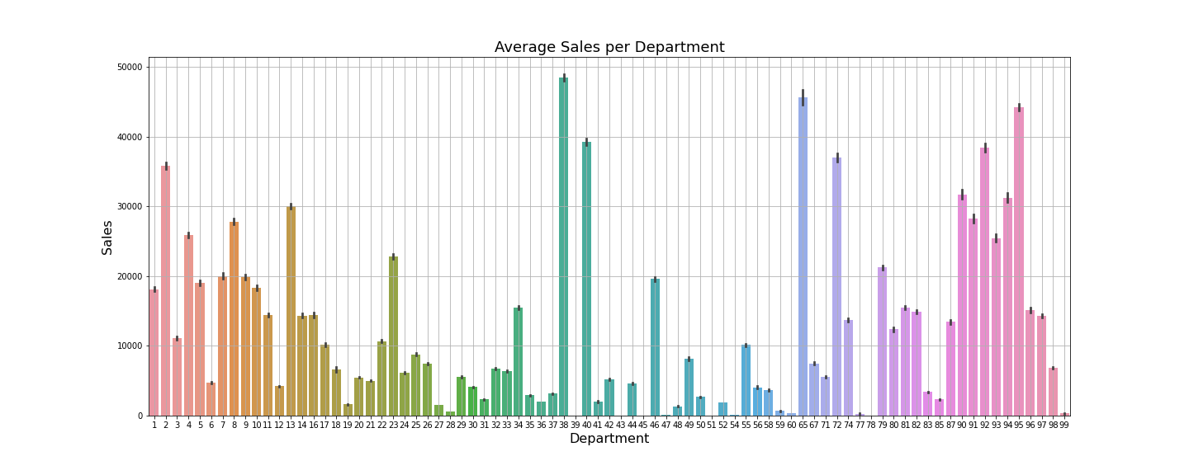
Average sales per Department
Notes:
Now, looking at what departments for each of these stores have the highest average sales.
Most of the departments are below the 20000 sales
38, 65 and 95 have highest avg sales

Slide 15
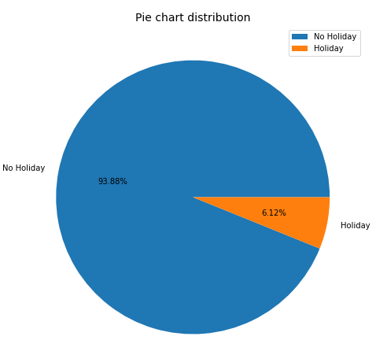
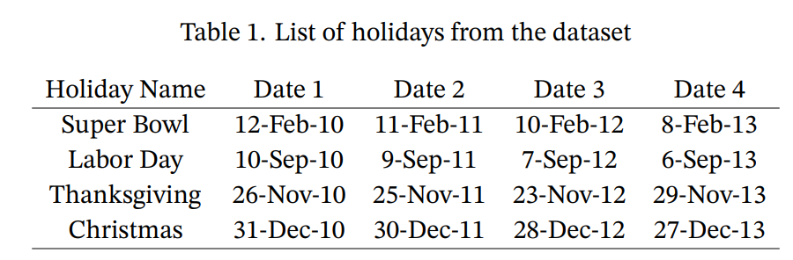
Holiday Distribution
Notes:
These are the holidays available in the dataset
Close to 6% of the data is holiday data we can see how sales are affected on these holiday weeks in the next visualization.

Slide 16
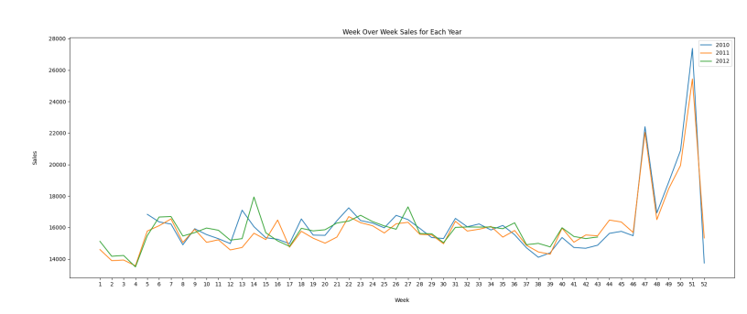
Week over week sales.
The week over week overview helps us in understanding if there is an increase in sales during holiday weeks each year, i.e. the weeks of Thanksgiving, Christmas, Labor day, etc.
Notes:
week over week sales helps us understand if there is an increase in sales during holiday weeks each year,
We can clearly see a hike in sales in weeks 47 and 51 which corresponds to Thanksgiving and Christmas time.
There is dip in sales in january which picks up during february, which is again superbowl week/month.
insufficiency of data for the year 2012, these conclusions have only been made based on the data available from 2010 and 2011

Slide 17
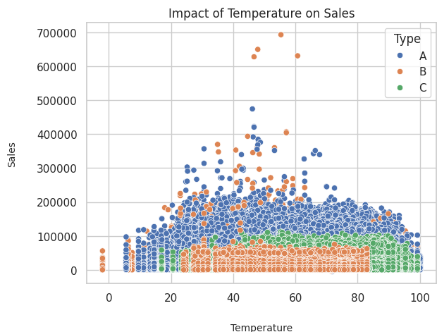
Impact of Temperature on Sales
Highest sales occurs for most store types at temp range of 40 to 80 degrees Fahrenheit
Notes:
pleasant weather encourages higher sales- temperatures between 40 to 70 degrees Fahrenheit are considered as favorable for humans when its not as hot or cold, we can see the same is reflected in the graph. Sales are relatively lower for very low and very high temperatures

Slide 18
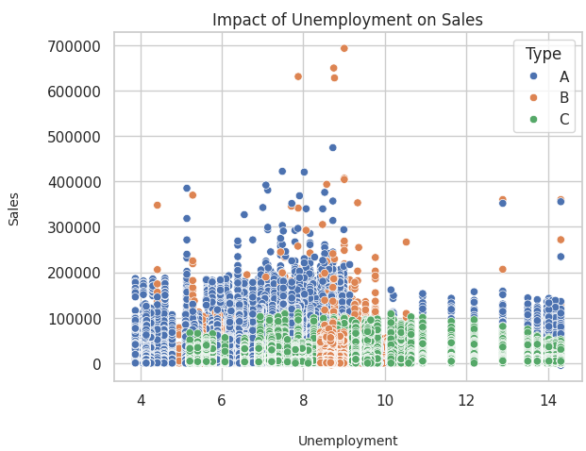
Impact of Unemployment on Sales
When the unemployment index is higher than 11, there is no significant change in the average sales for Type C stores when compared to the overall sales
There is significant drop in sales for store types A and B when the unemployment index increases
Notes:
Spending sharply drops with increase in unemployment; a higher unemployment index would generally result in a dip in sales as individuals tend to decrease overall spending.
-For the given store types, there seems to be a visible decrease in sales when the unemployment index is higher than 11
-Highest recorded sales for store types A and B occur around the unemployment index of 6 to 10;

Slide 19
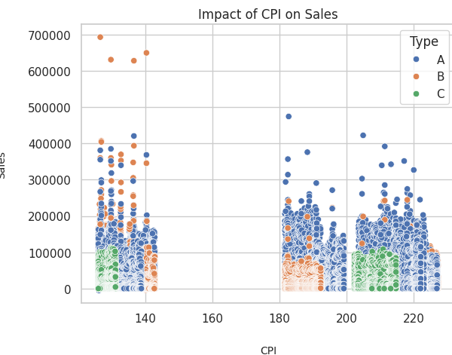
Impact of CPI on Sales
CPI (Consumer Price Index) is defined as the measure of the average change over time in the prices paid by urban consumers for a market basket of consumer goods and services
Notes:
-CPI is a measure that assesses the price changes that are associated with the cost of living for each individual.
- A higher CPI generally means that the price of goods has increased and that an individual needs to spend more money to maintain the same standard of living.
-In our scatter plot above, we can see three clusters around different ranges of CPI; there's no visible relationship between the change in CPI and weekly sales for Walmart stores (sales still occur at high CPI rates), the only negligible observation that can be made is the high amount of sales for store Type B when CPI is at a low rate of 140.

Slide 20
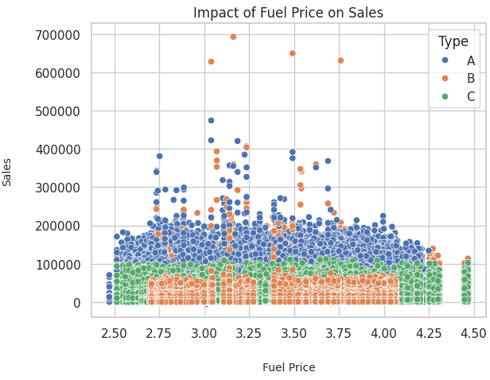
Impact of Fuel price on Sales
Study conducted by an economist from Brown University: investigates the relationship between gasoline prices and consumer buying behavior.
The economist assumes that even a slight increase in fuel prices significantly adds up to the annual expenditure and thus discourages consumers from actively buying their required goods and services.
This can be observed in the adjacent visualization.
Notes:
When fuel prices rise, consumers may face higher transportation costs, leading them to reduce non-essential expenditures to compensate for the increased fuel expenses.
->there seems to be a decrease in sales when fuel price is higher than 4.25 dollars, sales are higher when fuel price ranges between 2.75 to 3.75 dollars
->Some of the highest occurring sales for store types A and B happen during this period. While there is no definite pattern that proves this, some observations do support the theory that lower fuel prices encourage higher sales

Slide 21
ML models and Evaluation metrics:
ML model:
Linear Regression
Random Forest Regressor
K-Nearest Neighbors Regressor
XGBoost Regressor
Deep Neural Network (DNN)
Evaluation Metrics:
MAE
MSE
RMSE
R2 Score
Notes:
The Dataset given is not large dataset so the impact of outlier points will impact more than usual. So, RMSE can increase the impact of outliers double almost. So, MAE would be a better performance metric to compare.

Slide 22
Linear Regression model
Performance: Linear Regression Model - 90.86%
Mean Absolute Error (MAE): 0.04066
Root Mean Squared Error (RMSE): 0.073
R-squared (R2): 0.9068
Notes:
Linear regression is a simple yet powerful model used for predicting continuous outcomes.
It assumes a linear relationship between the independent variables and the target variable.
In our project, we used linear regression to establish a baseline performance for predicting weekly sales based on various features.
The model achieved an accuracy of 92% , MAE suggests $0.0301 deviation from the actual sales values
high R2 score of 0.923 indicates that the model explains approximately 92.3% of the variance in the weekly sales data, signifying a good fit to the observed data.

Slide 23
Random Forest Regression Model
Performance of Random Forest Regression Model- 91.23%
Mean Absolute Error (MAE): 0.039
Root Mean Squared Error (RMSE): 0.0716
R-squared (R2): 0.9123
Notes:
Random Forest is an ensemble learning technique that combines multiple decision trees to improve prediction accuracy and reduce overfitting.
It works by training multiple decision trees on random subsets of the data and averaging their predictions.
Random Forest is well-suited for handling non-linear relationships and interactions between features.
In our project, the Random Forest model achieved an accuracy of [insert accuracy score], outperforming the linear regression model.
Feature importance analysis revealed that [mention important features] were the most influential in predicting sales.

Slide 24
Decision Tree Regression Model
Decision Tree Regression Model Perfomance - 91.008%
Mean Absolute Error (MAE): 0.04004
Root Mean Squared Error (RMSE): 0.0725
R-squared (R2): 0.91008
Performance of Decision Tree Regression Model is slightly lower than the performance of the Random Forest Regressor model, it still performs reasonably well in predicting weekly sales.
Notes:
K-Nearest Neighbors is a simple yet effective algorithm used for both classification and regression tasks.
It works by finding the K nearest data points in the training set to a given test data point and averaging their target values (for regression).
In our project, we used KNN as a regression model to predict weekly sales based on similar instances in the training data.
The model's accuracy, measured by [insert accuracy metric], was [insert accuracy score], indicating its effectiveness in predicting sales.
KNN is a non-parametric algorithm, meaning it does not make any assumptions about the underlying data distribution.
One limitation of KNN is its computational complexity during prediction, as it requires storing and searching through the entire training dataset.
Despite this limitation, KNN can be a suitable choice for regression tasks, especially when the data is not too large and the feature space is not high-dimensional.
Feature scaling and careful selection of the number of neighbors (K) are important considerations when using KNN, as they can significantly impact its performance.

Slide 25
Gradient Boost model
Accuracy: XGBoost Regressor Accuracy - 93.52%
Mean Absolute Error (MAE): 0.035
Root Mean Squared Error (RMSE): 0.0615
R-squared (R2): 0.9352
The XGBoost Regressor model demonstrates excellent accuracy and performance in predicting weekly sales, with a high R-squared value and low errors.
Notes:
XGBoost (Extreme Gradient Boosting) is a gradient boosting algorithm known for its efficiency and performance in structured/tabular data.
It builds a series of decision trees sequentially, with each tree correcting the errors of the previous one.
XGBoost incorporates regularization techniques to prevent overfitting and improve generalization.
In our project, the XGBoost model achieved an accuracy of [insert accuracy score], demonstrating its effectiveness in predicting weekly sales.
The model's feature importance analysis highlighted [mention important features] as key predictors of sales.

Slide 26
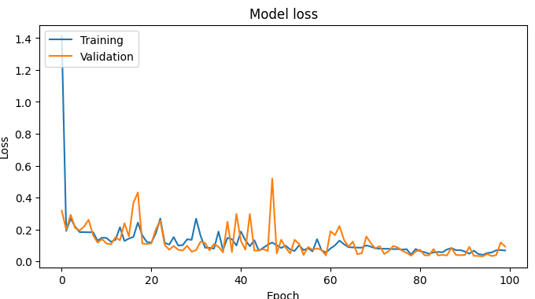
Custom deep learning neural network
Accuracy : 84.51%
Mean Absolute Error (MAE): 0.05009
Mean Squared Error (MSE): 0.0069
Root Mean Squared Error (RMSE): 0.0832
R-squared (R2): 0.8829
Notes:
We set up a simple neural network with one input layer, one hidden layer with 64 neurons, another hidden layer with 32 neurons, and an output layer.
Using the mean absolute error as the loss function and the Adam optimizer for optimization.
Neural networks, particularly deep learning models, are powerful tools for capturing complex patterns and relationships in data.
Our deep neural network consists of multiple layers of interconnected nodes (neurons), allowing it to learn intricate patterns in the data.
We used a dense neural network architecture with [insert number of layers and neurons] to predict weekly sales.
Despite its complexity, the neural network achieved an accuracy of [insert accuracy score], comparable to or better than other models.
While neural networks require more computational resources and tuning, they offer great flexibility and performance for predictive modeling tasks.

Slide 27
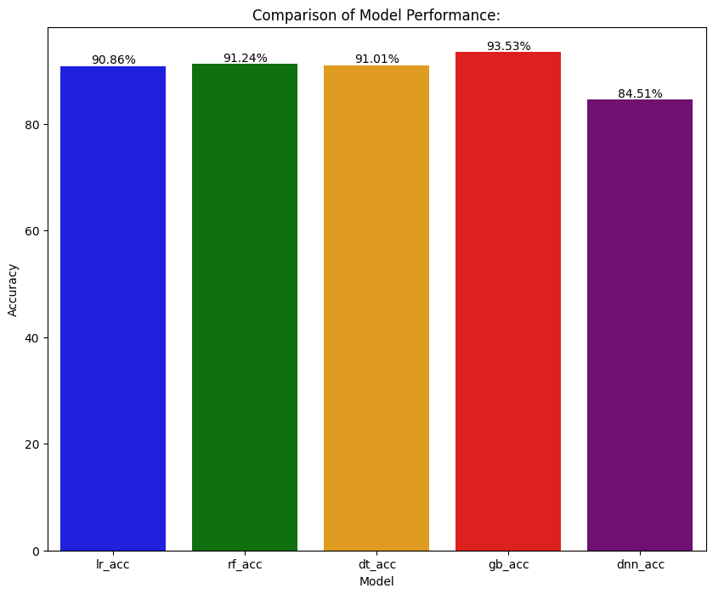
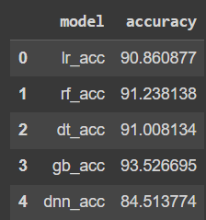
Comparing models

Slide 28
Future work
Customer Segmentation and Targeted Marketing:
By analyzing regional and departmental sales data, Walmart can implement customer segmentation strategies to target specific demographics with personalized marketing messages.
Cloud-based analytics tools provide insights into consumer preferences and behavior, enabling Walmart to focus on profitable regions and enhance product offerings to meet local demand.
Predictive Analytics and Forecasting:
Utilizing cloud-based predictive analytics models, such as ARIMA or machine learning algorithms, Walmart can forecast future sales trends for individual stores and departments.
These forecasting techniques enable Walmart to optimize inventory management, reduce stockouts, and improve overall sales performance.

Slide 29
Questions?

Slide 30
Thank You

