Slide 1
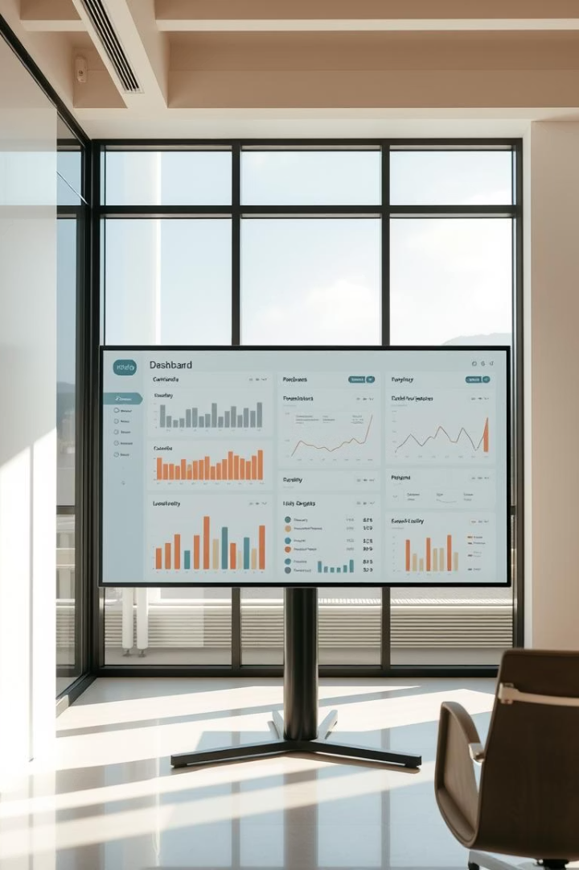

Interactive Dashboard Design for Business Stakeholders
Leveraging Power BI and Tableau to transform sales and financial data. This dashboard empowers informed decision-making with actionable insights.
Designed for [Company Name], Date: [Date]
by Santhosh

Slide 2
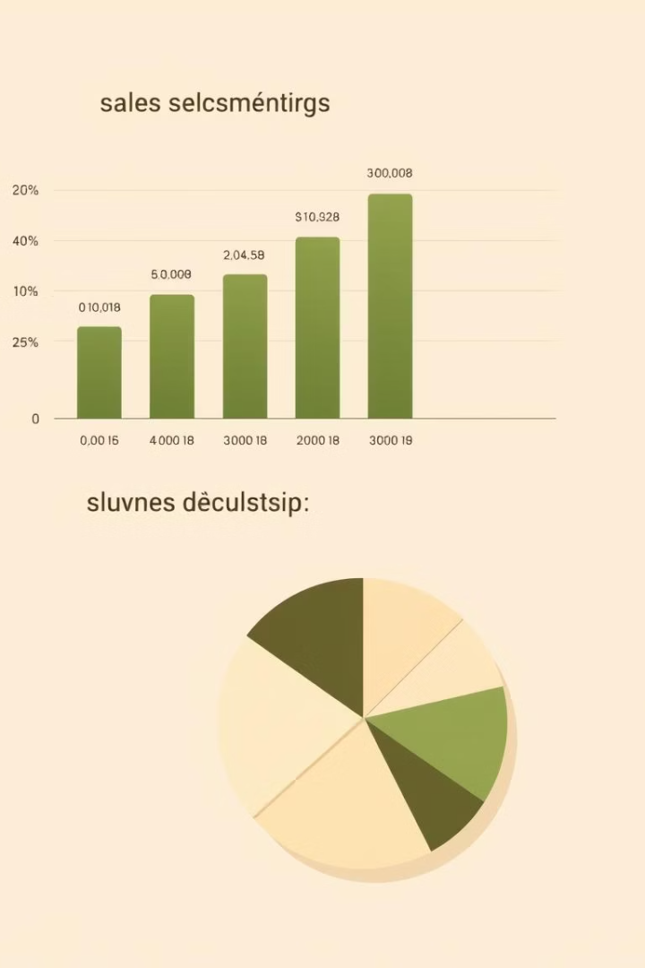
Defining Key Performance Indicators (KPIs)
Sales Performance
Total Sales Revenue
Sales Growth Rate (MoM, YoY)
Profitability
Gross Profit Margin
Net Profit Margin
Operating Profit
Customer Analytics
Customer Acquisition Cost (CAC)
Customer Lifetime Value (CLTV)
Operational Efficiency
Inventory Turnover Ratio
Order Fulfillment Time
Example data from Kaggle's "Sales Financial" dataset.

Slide 3
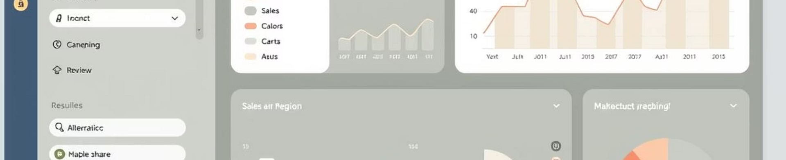
Dashboard Interactivity: Slicers and Filters
Slicers
Date Filters
Interactive Drill-Down
Filter by Region, Product Category, Customer Segment dynamically.
Analyze data by Year, Quarter, Month, or Week for trend insights.
Click charts to explore detailed data views with multi-select support.

Slide 4
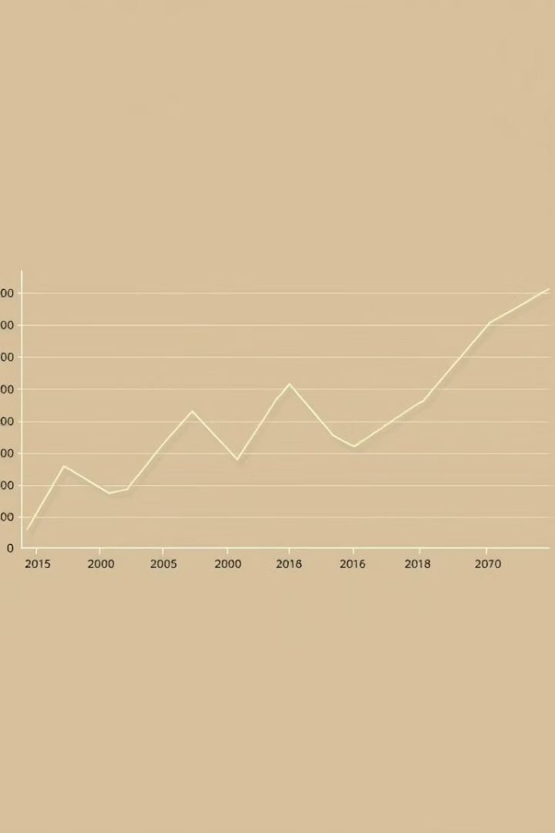



Time-Series Analysis: Uncovering Trends
Sales Trend
Monthly sales performance tracked over the last 3 years.
Seasonality
Identify peak and low seasons using moving averages.
Forecasting
Predict future sales with models like exponential smoothing and ARIMA.

Slide 5
Cards for Totals and Summary Metrics
Total Revenue
Gross Profit
Customer Count
Visual Alerts
$XX.XX Million (YoY Growth: XX%)
$YY.YY Million (Margin: XX%)
XX,XXX (CLTV: $ZZZ)
Color-coded metrics highlight performance and risks.

Slide 6
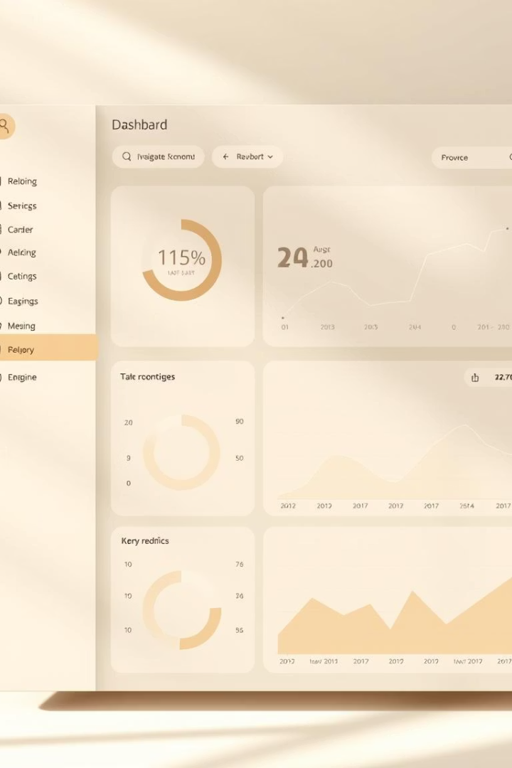
Navigation and User Experience
Intuitive Layout
Top-down flow from summary metrics to detailed visuals.
Clear Navigation Menu
Tabs or buttons enable easy switching between dashboard views.
Tooltips and Labels
Additional context explains metrics for better user understanding.
Accessibility
Design adheres to WCAG for inclusive usability.

Slide 7
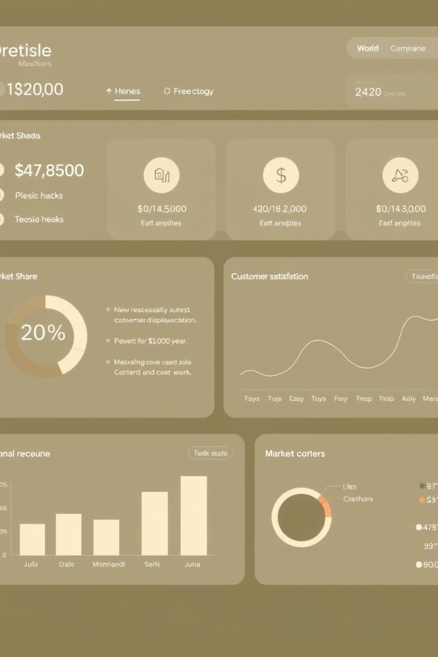
Consistent Color Theme and Design
Branding
Align colors, fonts, and logos with corporate identity.
Visual Hierarchy
Use size, color, and spacing to emphasize key data.
Minimalist Approach
Focus on essentials to avoid clutter and distractions.
Theme Options
Allow users to select preferred color schemes.

Slide 8

Conclusion: Empowering Data-Driven Decisions
Engage Stakeholders
Interactive dashboard users gain real-time insights.
Visualize KPIs
Monitor performance with clear, actionable metrics.
Identify Opportunities
Analyze trends and forecast for strategic growth.
Drive Strategies
Data fuels informed business decisions and action.
Deliverables include the interactive dashboard and a summarized PPT after review.

