Slide 1
HabotConnect Hiring Project
Secure Cloud Infrastructure Provisioning using Terraform, Google Cloud Platform, GitHub Actions & Django REST Framework Amruta Suryavanshi

Slide 2
Project Overview
• Provision secure GCP staging infrastructure • Automate deployment using Terraform • Protect student data • Implement Fail-Closed CI/CD
Project Objectives
• Infrastructure as Code • Secure IAM & Least Privilege • Row-Level Security • Automated validation

Slide 3
Technology Stack
Terraform Google Cloud Platform GitHub Actions Django REST Framework BigQuery Cloud Storage

Slide 4
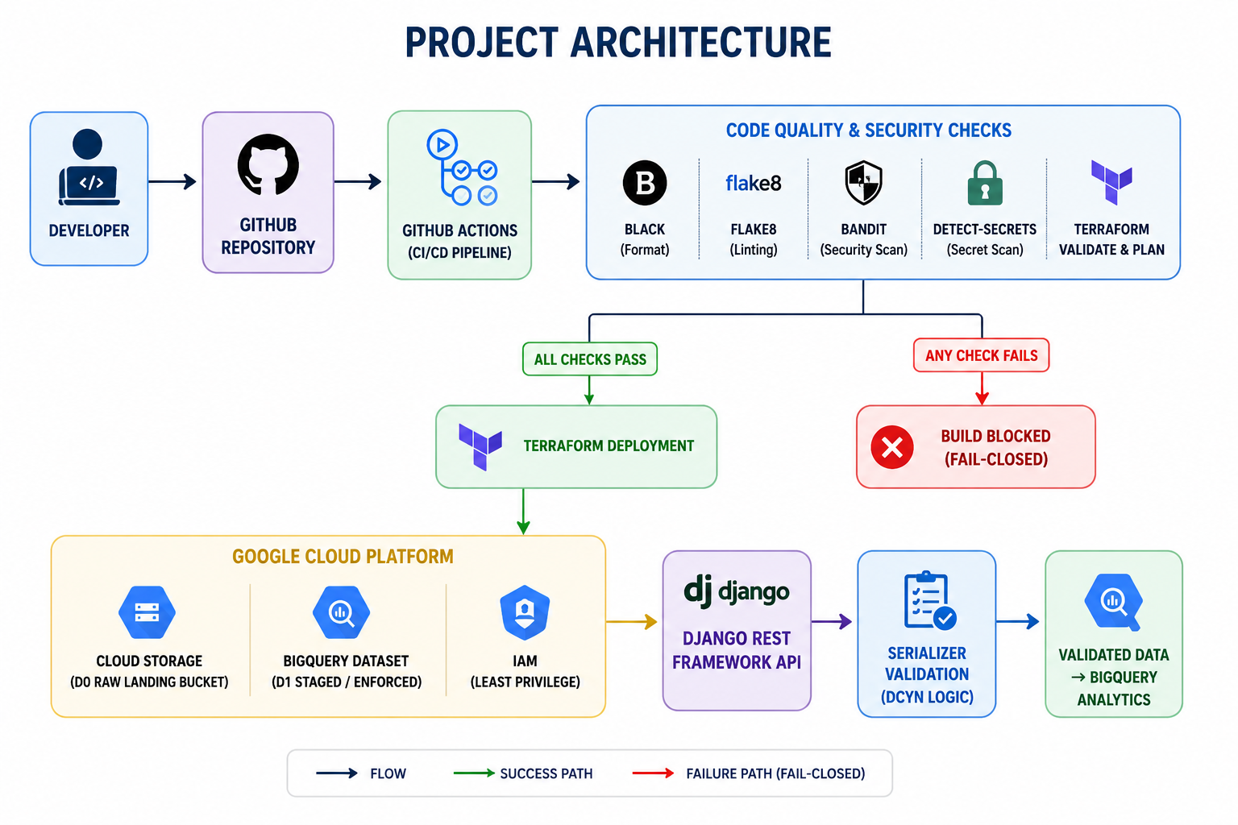
Project Architecture

Slide 5
Task 1: Terraform
• Provider & Variables • GCS Raw Landing Bucket • BigQuery Dataset • IAM • Public Access Prevention • Versioning

Slide 6
Security Implementation
• IAM (RBAC) • Principle of Least Privilege • Row-Level Security (RLS) • Secret Protection

Slide 7
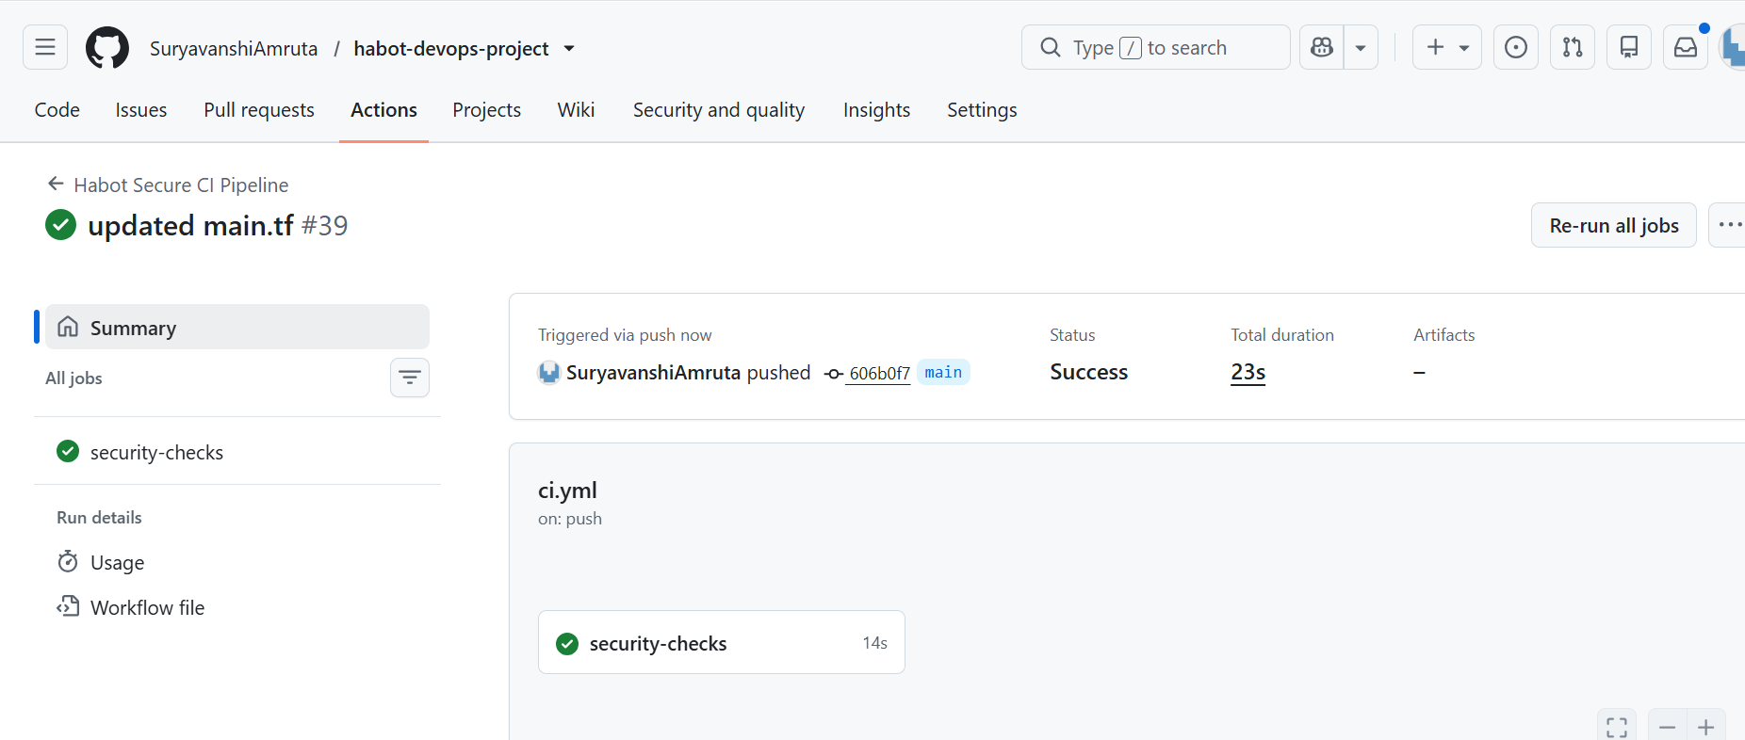
Task 2: CI/CD
Pipeline: Checkout → terraform fmt → validate → flake8 → Secret Scan → Deploy
Successful pipeline

Slide 8
Fail-Closed Build Gate
Pipeline immediately stops if: • Formatting fails • Linting fails • Hardcoded API key detected • Terraform validation fails

Slide 9
Task 3: DRF Validation
• Student onboarding JSON • Serializer validation • DCYN Yes/No logic • Strict field validation

Slide 10
Testing & Results
• Terraform Apply Successful • Bucket & Dataset Created • IAM Verified • Pipeline Tested • API Validation Successful

Slide 11
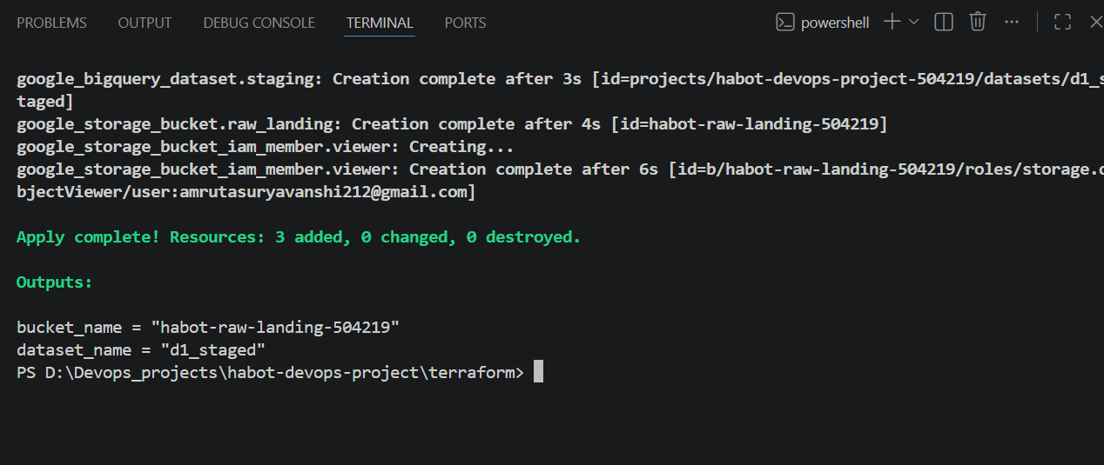
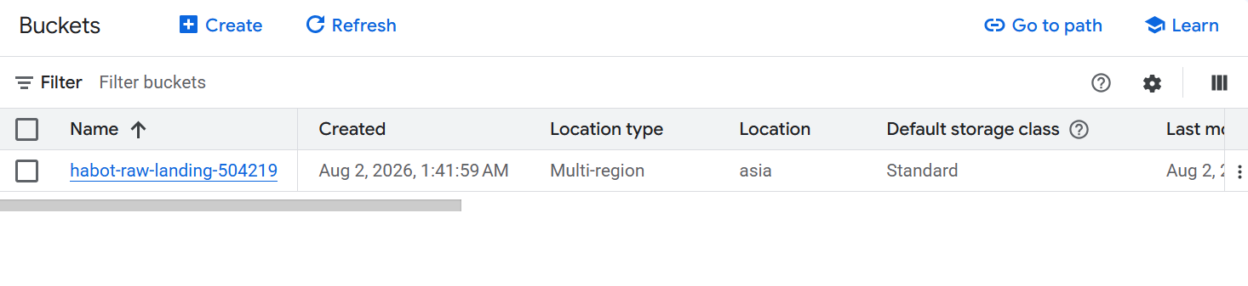
Terraform Apply
Storage bucket

Slide 12
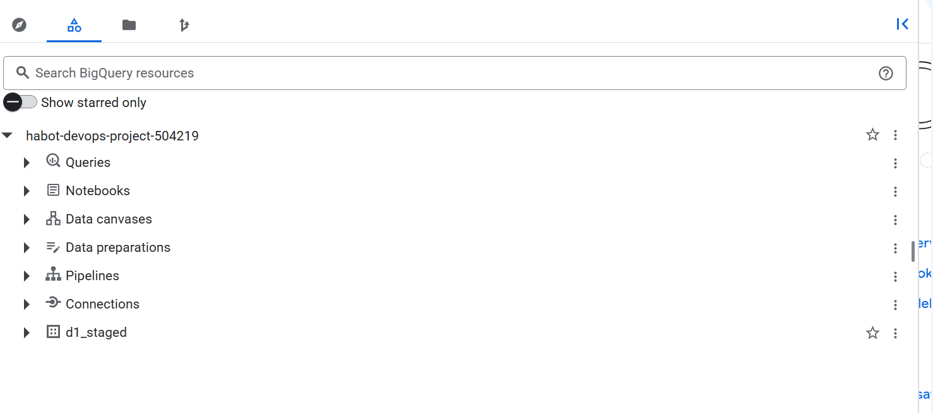
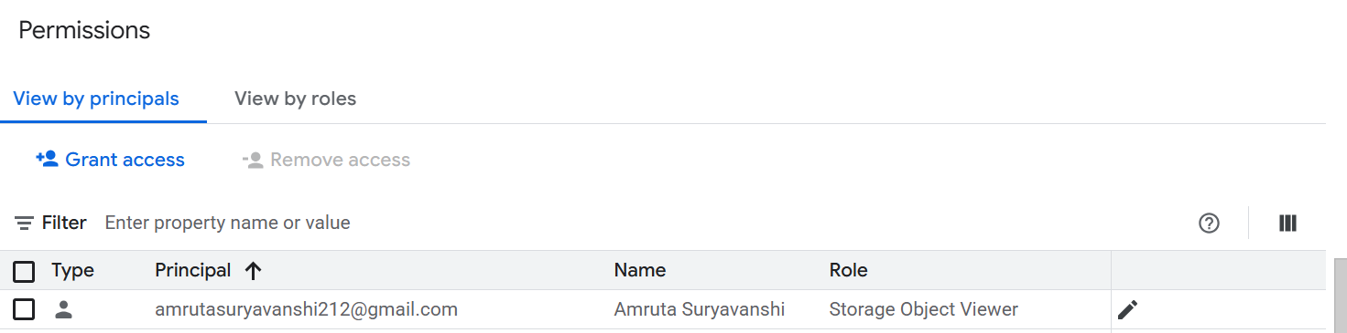
BigQuery dataset
IAM Verified

Slide 13
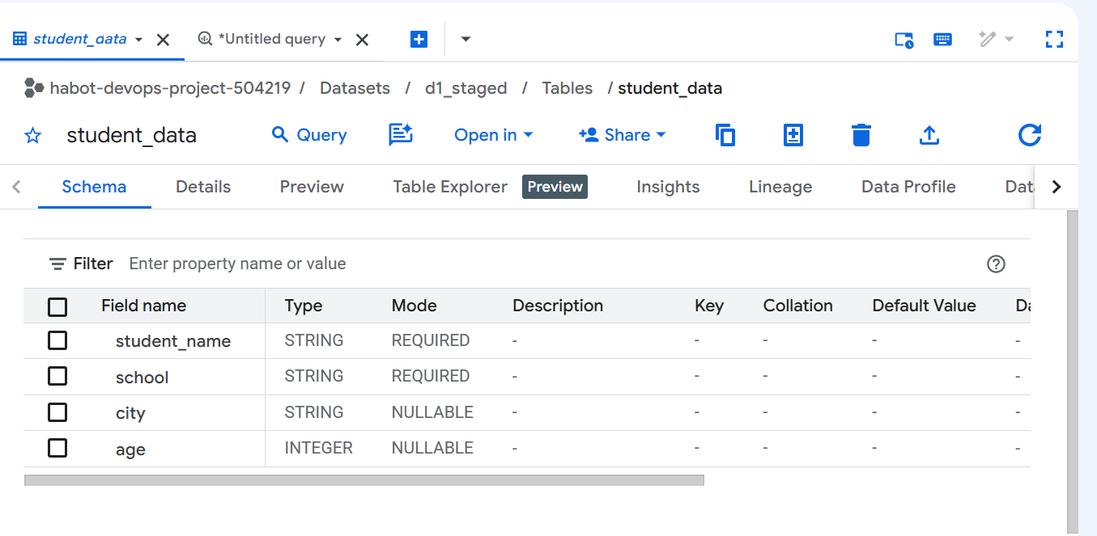
Pipeline Tested
API Validation Successful

Slide 14
Future Improvements
Challenges
• Learning IAM & RLS • CI/CD integration • Cloud security
• Remote Terraform state • Secret Manager • Cloud Monitoring • Multi-environment deployment

Slide 15
Conclusion
Project meets HabotConnect requirements using secure IaC, automated CI/CD, robust validation, and cloud security best practices.

Slide 16
Thank You

