Slide 1


Foundations of Matrix theory, SVD, PCA with Applications
Nithin Nagaraj
Consciousness Studies Programme
National Institute of Advanced Studies (NIAS) Bengaluru
Foundations of Data Science: Theory and Applications
PES University, South Campus, 17th May 2018

Slide 2
Plan of lecture
Matrices
Singular Value Decomposition (SVD)
Applications of SVD
Principal Component Analysis (PCA)
Relationship between SVD & PCA
Applications of PCA

Slide 3

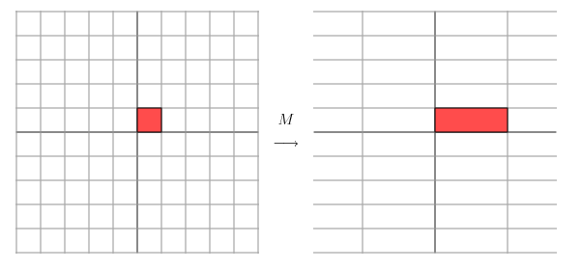

Example 1:
‘Stretch’

Slide 4

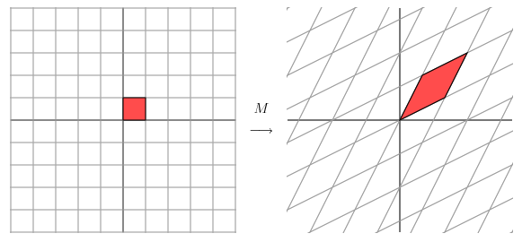
Example 2: ‘Shear’

Slide 5

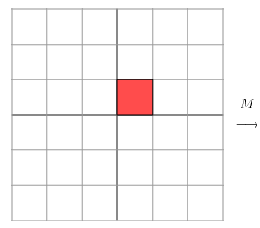
Example 3: ‘Projection’

Slide 6
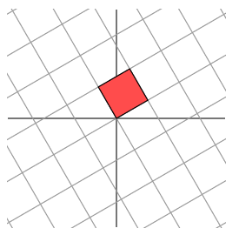
Example 4: ‘Rotation’
θ

Slide 7
Example 4: ‘Rotation’
θ
Cos(θ) -Sin(θ)
Sin(θ) Cos(θ)
M =

Slide 8
Important concepts
Vector spaces
Determinants
Eigenvalues, Eigenvectors
Diagonalizing a matrix
Symmetric matrices
Orthogonal matrices
Co-variance matrix

Slide 9
Singular Value Decomposition
(SVD)
References:
http://www.ams.org/featurecolumn/archive/svd.html
http://www.uwlax.edu/faculty/will/svd/subspaces/index.html
Notes:
1) http://www.ams.org/featurecolumn/archive/svd.html
2) http://www.uwlax.edu/faculty/will/svd/subspaces/index.html
Nithin Nagaraj, “Image Compression Using SVD”, NIAS report, Oct 2005
3) Nithin Nagaraj, “Image Compression Using SVD”, NIAS report, Oct 2005

Slide 10
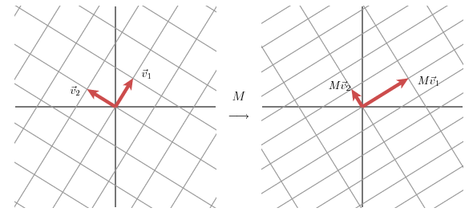
Singular Value Decomposition
(SVD)
M
U (Rot.)
Σ (Stretch)
V^{T} (Rot.)

Slide 11
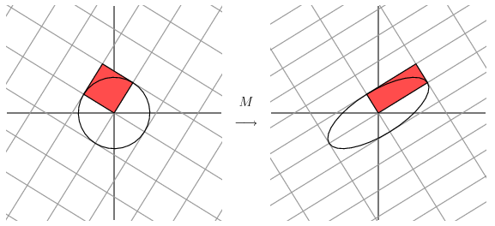

Slide 12
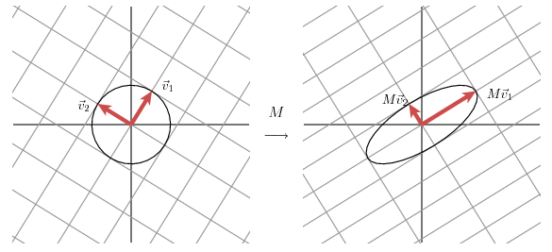

Slide 13
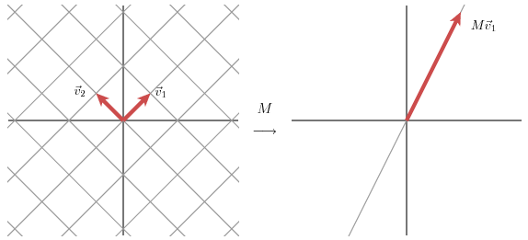
v₂

Slide 14
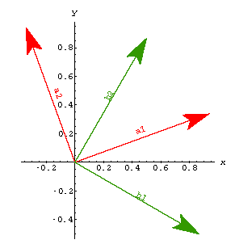
SVD in action…

Slide 15

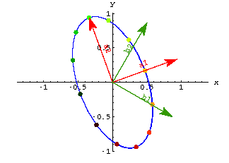
Before the action by matrix ‘A’

Slide 16
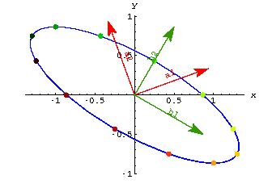
After the action by matrix ‘A’

Slide 17
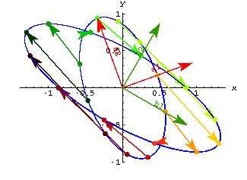
During the action by matrix ‘A’

Slide 18
List of applications of SVD
To find rank of a matrix
Pseudo-inverse – solution of over-determined linear equations
Image Compression
Medical image registration using SVD
De-noising applications
Separating Fetal ECG from Mother ECG
Neuroscience – spike detection and sorting
Many many more…

Slide 19
Example 1:
Dominant Singular Values: 3654.05, 3573.07 (rest are all zeros)

Slide 20
Left: Reconstruction with first singular value (all others are set to zero)
Right: Reconstruction with second singular value (all others set to zero)

Slide 21
Example 2
Size of image is 256x256 pixels

Slide 22
12 reconstructions
# of Singular values used – 0,2,3,4,5,6,7,9,14,19,169,128

Slide 23
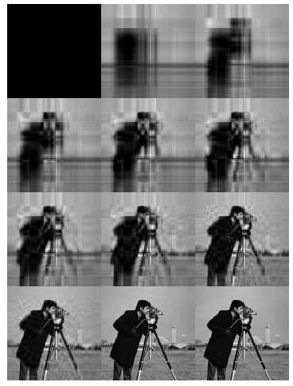
# of Singular values used – 0,2,3,4,5,6,7,9,14,19,69,99

Slide 24
CR = 113:1
# of Singular values used – 0,2,3,4,5,6,7,9,14,19,69,99

Slide 25
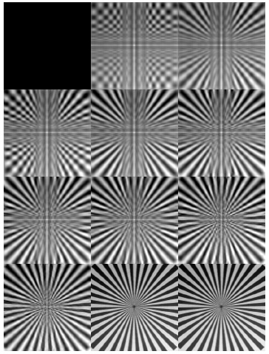
CR = 116:1
# of Singular values used – 0,2,3,4,5,6,7,9,14,19,69,99

Slide 26
CR = 249:1
# of Singular values used – 0,2,3,4,5,6,7,9,14,19,69,99

Slide 27
MSE, PSNR and CR

Slide 28
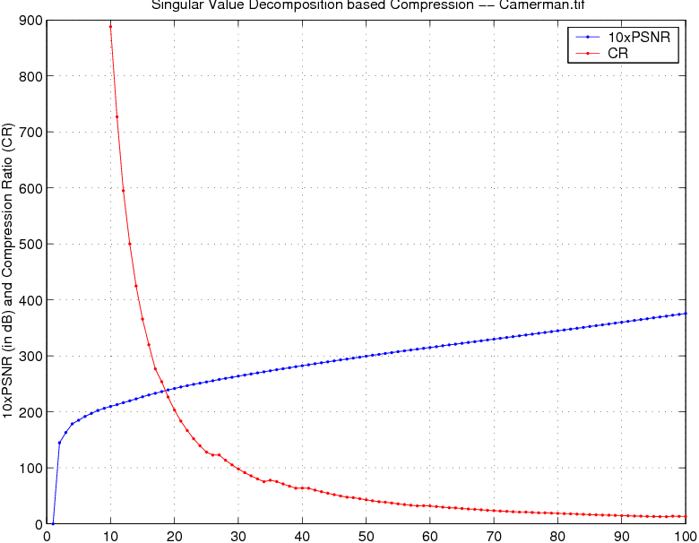
Number of Singular Values used (rest set to zero)

Slide 29
Principal Component Analysis
(PCA)
References
L. I. Smith, A tutorial on principal components analysis
Jonathon Shlens, "A tutorial on principal component analysis." arXiv preprint arXiv:1404.1100 (2014).

Slide 30
Why and Where is PCA used?
Dimensionality reduction
Feature reconstruction
Image compression
Signal processing
EEG analysis

Slide 31
PCA is “an orthogonal linear transformation that transfers the data to a new coordinate system such that the greatest variance by any projection of the data comes to lie on the first coordinate (first principal component), the second greatest variance lies on the second coordinate (second principal component), and so on.”

Slide 32
Background for PCA
Suppose attributes are A₁ and A₂, and we have n training examples. x’s denote values of A₁ and y’s denote values of A₂ over the training examples.
Variance of an attribute:

Slide 33
Covariance of two attributes:
If covariance is positive, both dimensions increase together. If negative, as one increases, the other decreases.
Zero: uncorrelated.

Slide 34

Covariance matrix
  Suppose we have m attributes, A₁, ..., A_{m}.
  Each have n samples
  Covariance matrix:

Slide 35
Covariance matrix

Slide 36
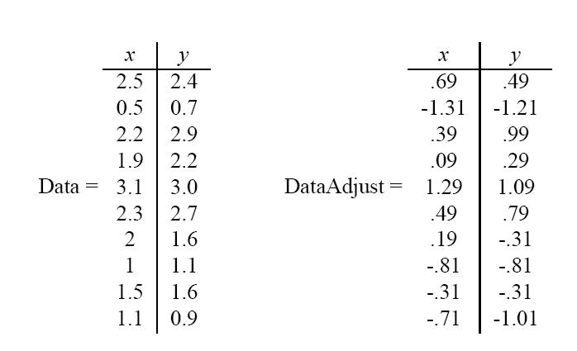
PCA
Given original data set S = {x¹, ..., x^{m}}, produce new set by subtracting the mean of attribute A_{i} from each x_{i}.
Mean: 1.81 1.91
Mean: 0 0

Slide 37
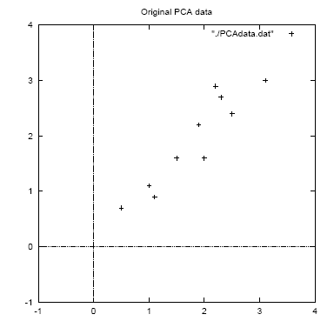

Slide 38
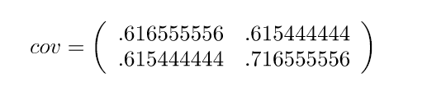
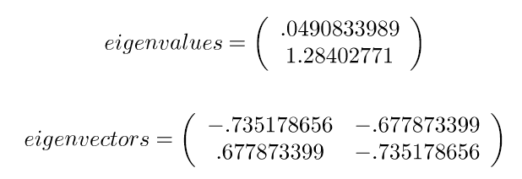
Calculate the covariance matrix:
Calculate the (unit) eigenvectors and eigenvalues of the covariance matrix:
x y
x
y

Slide 39
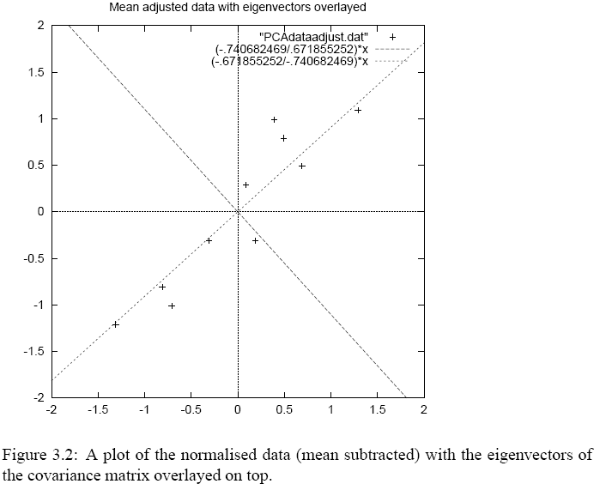
Eigenvector with largest
eigenvalue traces
linear pattern in data

Slide 40
Order eigenvectors by eigenvalue, highest to lowest.
In general, you get m components. To reduce dimensionality to p, ignore m−p components at the bottom of the list.

Slide 41
Construct new feature vector.
  Feature vector = (v₁, v₂, ...v_{p})

Slide 42
Derive the new data set.
  TransformedData = RowFeatureVector × RowDataAdjust
  This gives original data in terms of chosen components (eigenvectors)—that is, along these axes.

Slide 43
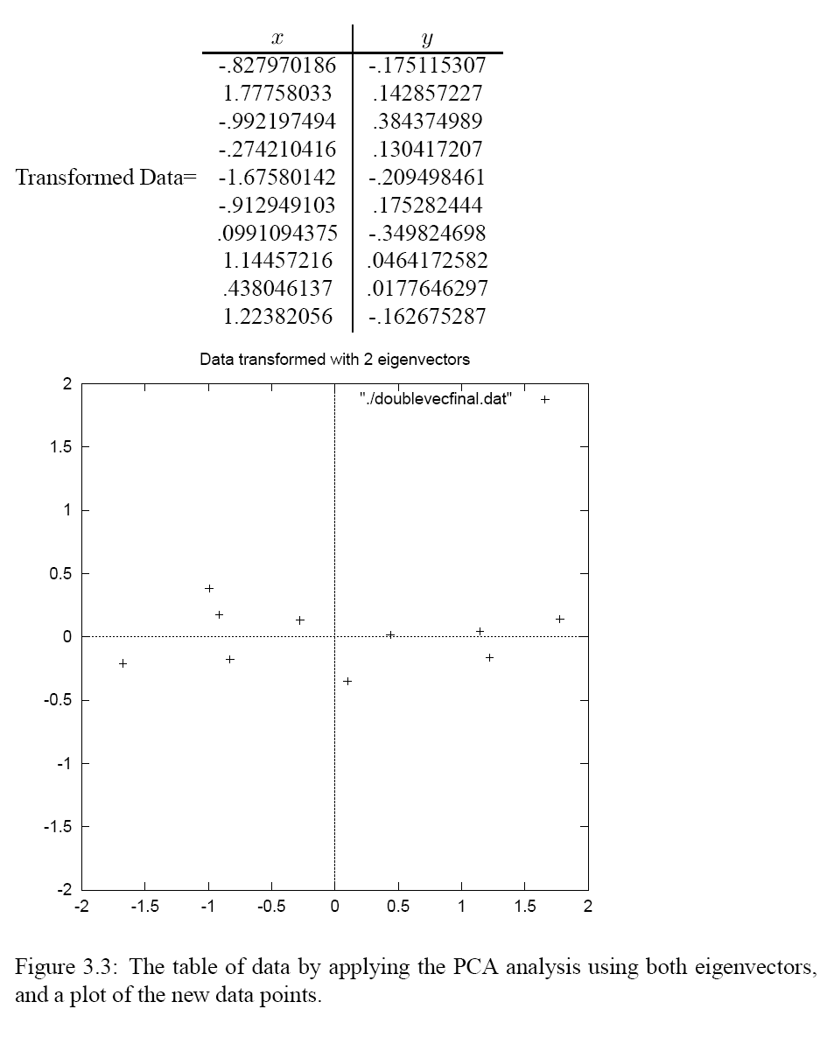

Slide 44
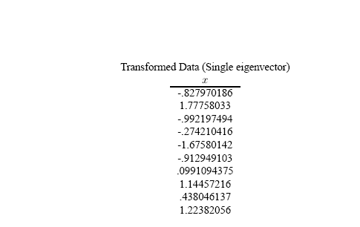
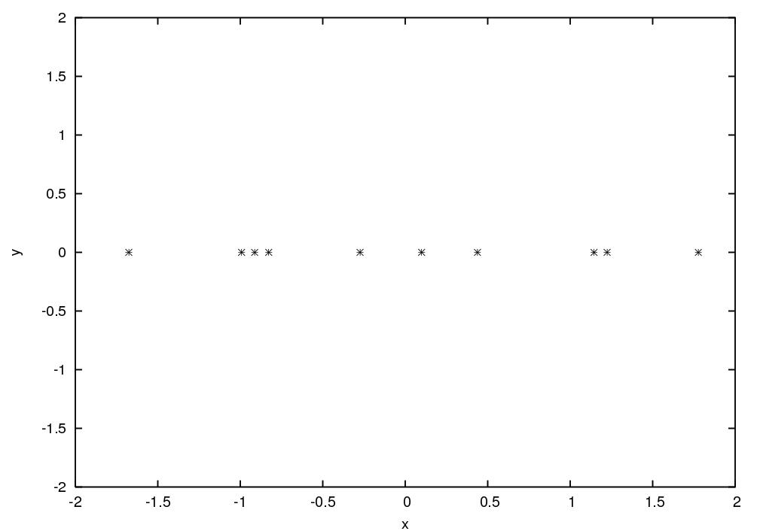

Slide 45
Reconstructing the original data
  We did:
  TransformedData = RowFeatureVector × RowDataAdjust
  so we can do
  RowDataAdjust = RowFeatureVector ⁻¹ × TransformedData
  = RowFeatureVector ^{T} × TransformedData
  and
  RowDataOriginal = RowDataAdjust + OriginalMean

Slide 46
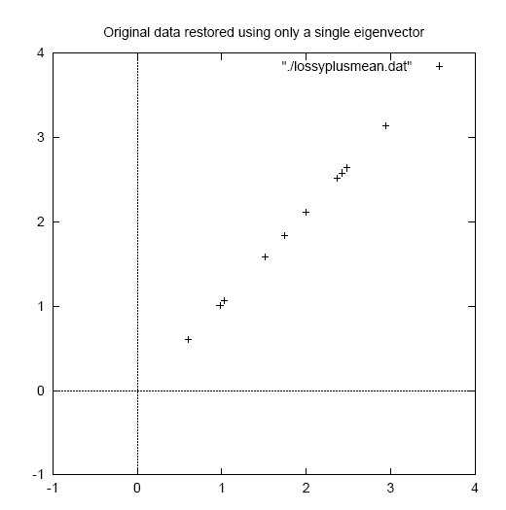

Slide 47
Summary of PCA
Remove means from data (each dimension)
Find Covariance of X
Find eigenvectors of Covariance of X
Construct matrix P with rows as eigenvectors of Covariance of X
Y = PX
The eigenvectors are the principal components of X

Slide 48
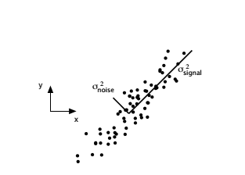
Assumptions of PCA
Linearity
Large variance have important structure
Principal components are orthogonal

Slide 49
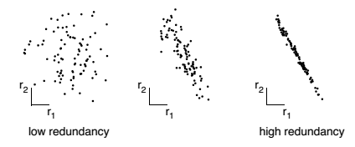
2D data with varying redundancies

Slide 50
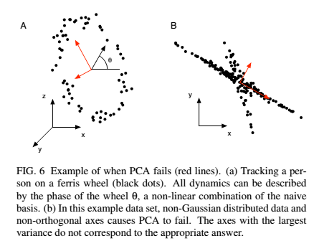
When does PCA Fail?
Non-linearity, non-Gaussian, non-orthogonality

Slide 51
SVD & PCA
How are the two related?

Slide 52

Thank You

Slide 53
Extras

Slide 54
Independent Component Analysis
(ICA)
Reference:
J Shlens, “A tutorial on independent component analysis”. arXiv preprint arXiv:1404.2986, 2014.

Slide 55
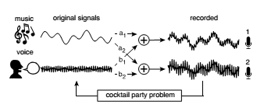
Cocktail Party Problem

Slide 56
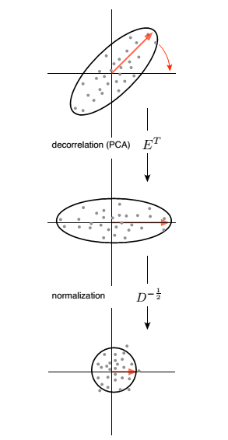
First two steps of ICA

Slide 57
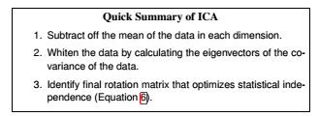

Third step of ICA: Find V

Slide 58
ICA on EEG data
Several papers, see:
J Onton , & S Makeig, Information-based modeling of event-related brain dynamics. Progress in brain research, 159, 99-120, 2006.
See also:
http://cnl.salk.edu/~jung/artifact.html

Slide 59
ICA on EEG: Benefits
For removing stereotyped data artifacts including eye blinks and lateral eye movements, muscle activities, electrode or line noise, and pulse artifacts.
Independent components accounting for and isolating these artifacts can be recognized easily.

Slide 60
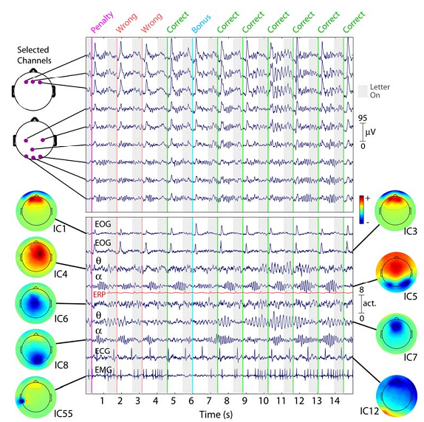
Ref: J Onton , & S Makeig, Information-based modeling of event-related brain dynamics. Progress in brain research, 159, 99-120, 2006.
Notes:
In our experience, applying ICA decomposition to 31-channel data typically yields five to fifteen physiologically plausible components comparable to those obtained from high-density recordings.

Slide 61
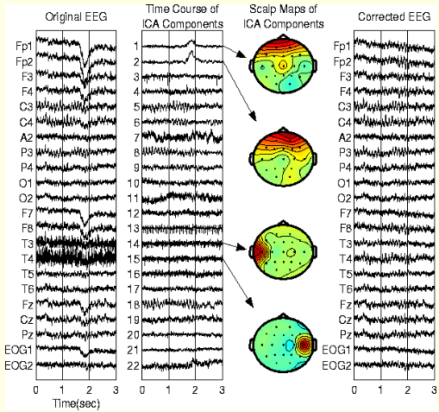
Ref: http://cnl.salk.edu/~jung/artifact.html

Slide 62
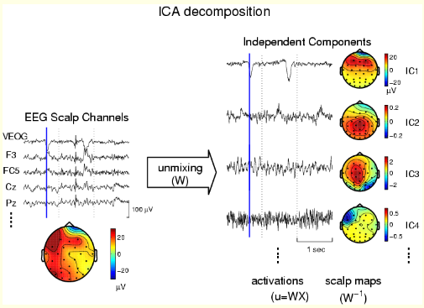
Ref: http://cnl.salk.edu/~jung/artifact.html

Slide 63
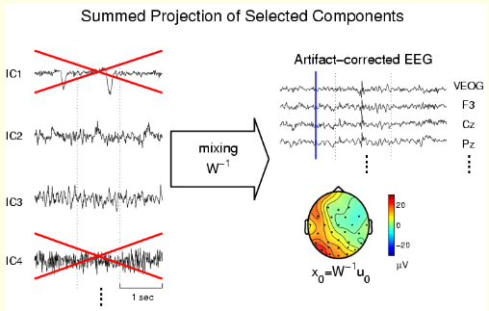
Ref: http://cnl.salk.edu/~jung/artifact.html

Slide 64
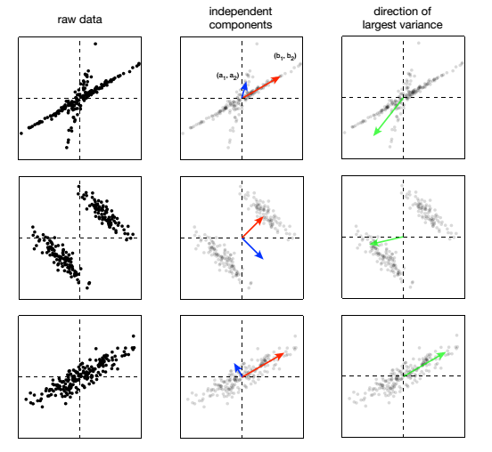
ICA vs. PCA

Slide 65
Assumptions of ICA
Linear superposition of independent sources
Statistically independent sources (but not required to be orthogonal like PCA)
Spatially static ICA model: spatially fixed and temporally stable sources (cortical activation sources as well as artifact sources) with fixed scalp maps that can be used to estimate the spatial locations of the underlying source areas.
Non-Gaussian (for Gaussian, ICA=PCA)
Channel location information is not used in ICA
Notes:
Finally, the spatially static ICA model assumes that the cortical domains or patches, as well as the artifact sources that together constitute EEG ‘sources,’ remain spatially fixed over time and therefore project to the scalp channels with fixed weights or proportions.
Many major sources of EEG activity are sufficiently spatially stable to be reproducibly resolved into temporally near-independent sources with fixed scalp maps that can be used to estimate the spatial locations of the underlying source areas.

Slide 66
How much EEG data?
For ICA:
Data needed = 25 x (# of channels)²
For 256-channel, we need 1,638,400 samples which translates to 2 hrs (@ 256-Hz sampling rate)
For 64-channel, it is ~7 minutes of EEG data
Ref: J Onton , & S Makeig, Information-based modeling of event-related brain dynamics. Progress in brain research, 159, 99-120, 2006.

Slide 67
Issues with ICA for EEG
We assume that scalp maps are stationary
No time delays
What if number of sources > number of electrodes?
Interpretations of ICs and Scalp Maps is non-trivial (ICs need not pertain to maximal variance)
Problem of units, only projection maps have units, not individual sources or scalp maps!
Large muscle movements will take up multiple ICs, not many ICs left for independent cortical activations of interest
Can we compare ICs across subjects?

Slide 68
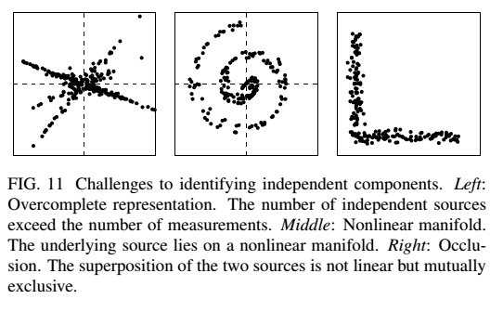
When does ICA fail?

Slide 69
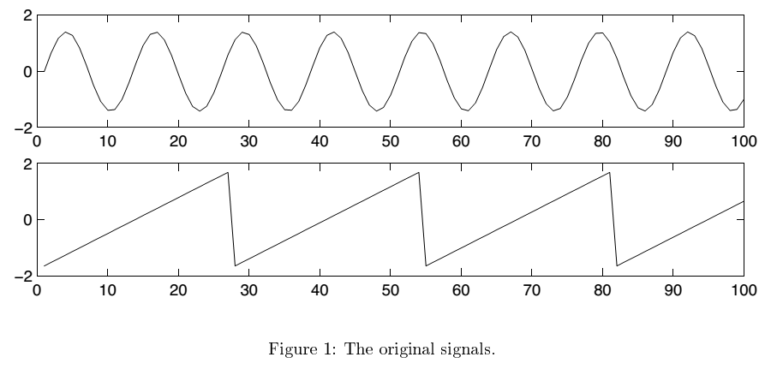
Ref: A HyvWrinen, & E Oja, Independent Component Analysis: A Tutorial, 1999.

Slide 70
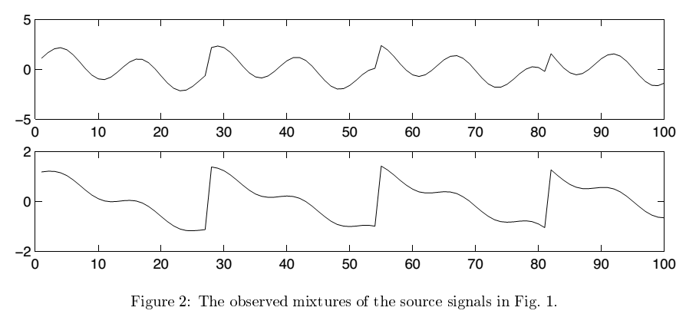

Slide 71
