Slide 1
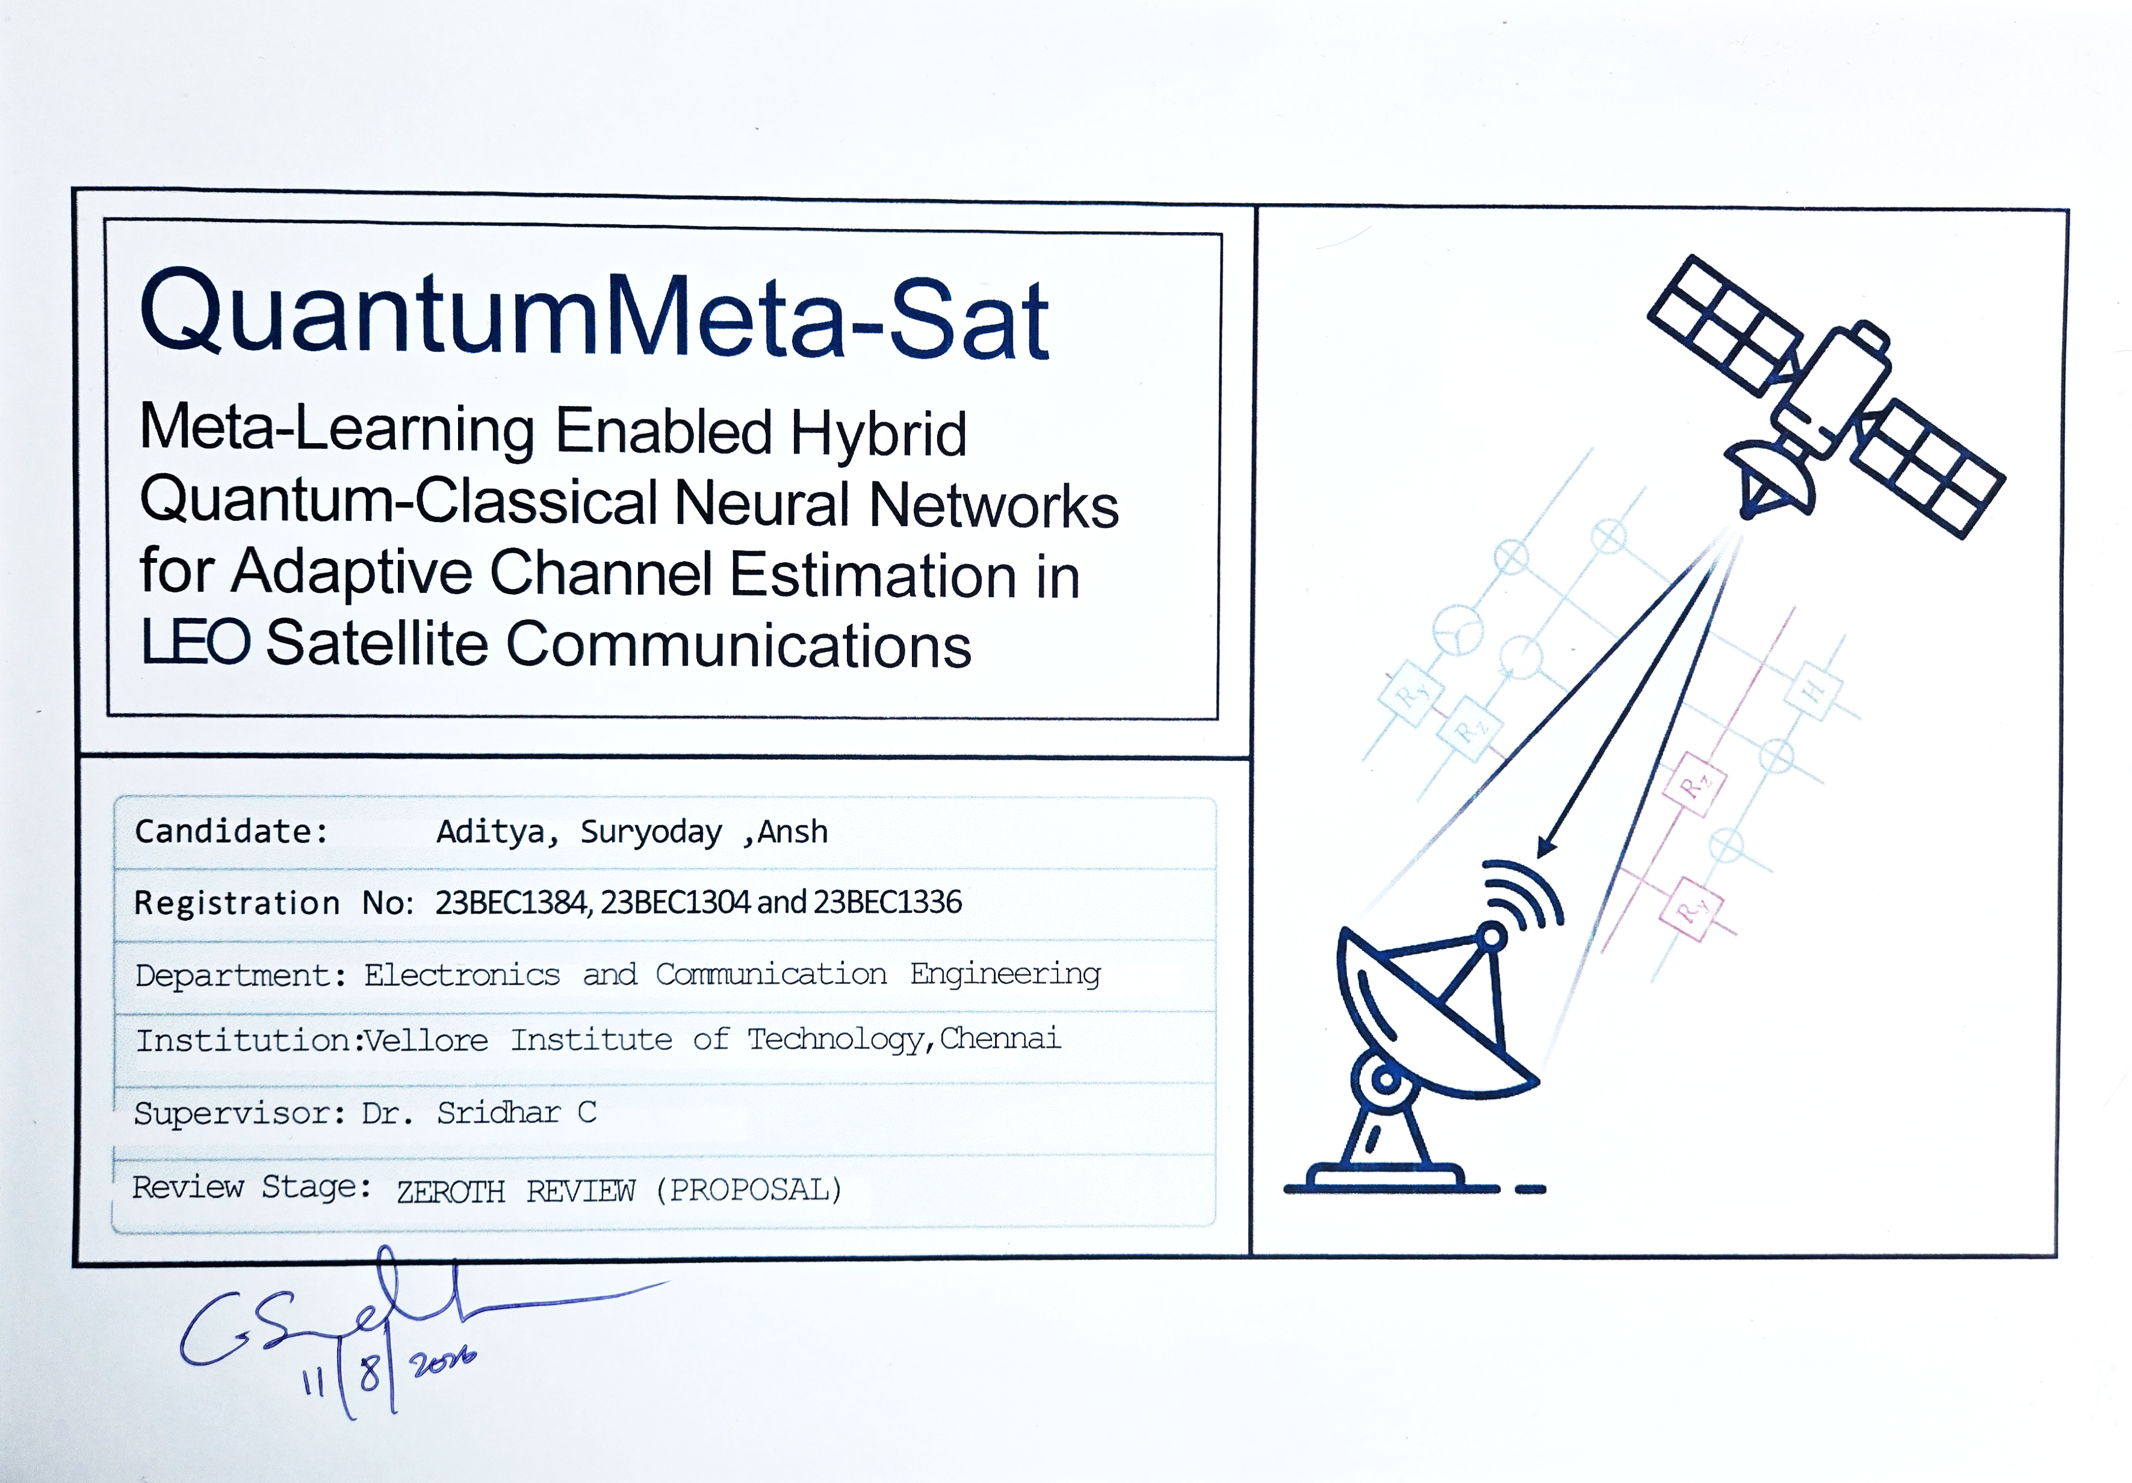

Slide 2
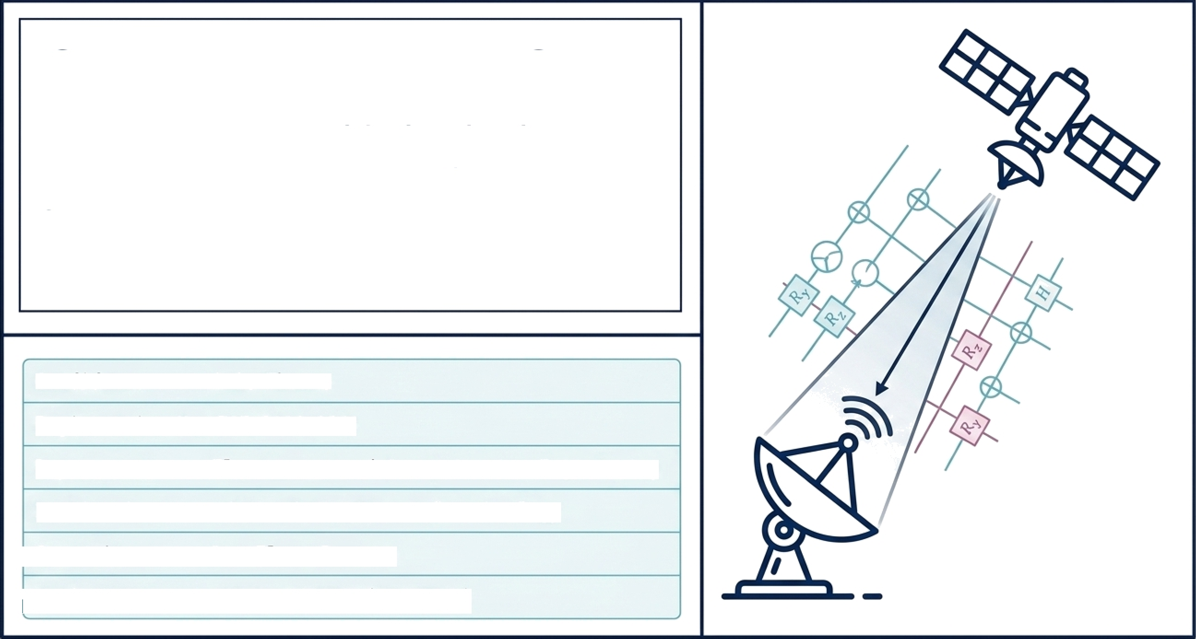
Quantum-Meta-Sat
Meta-Learning Enabled Hybrid Quantum-Classical Neural Networks for Adaptive Channel Estimation in L E O Satellite Communications
Candidates- Aditya, Suryoday & Ansh
Registration no.- 23BEC1384, 23BEC1304 and 23BEC1336
Department- Electronics and Communication
College- Vellore Institute of Technology, Chennai
Guide- Dr. Sridhar C
Review Stage- Zeroth Review

Slide 3
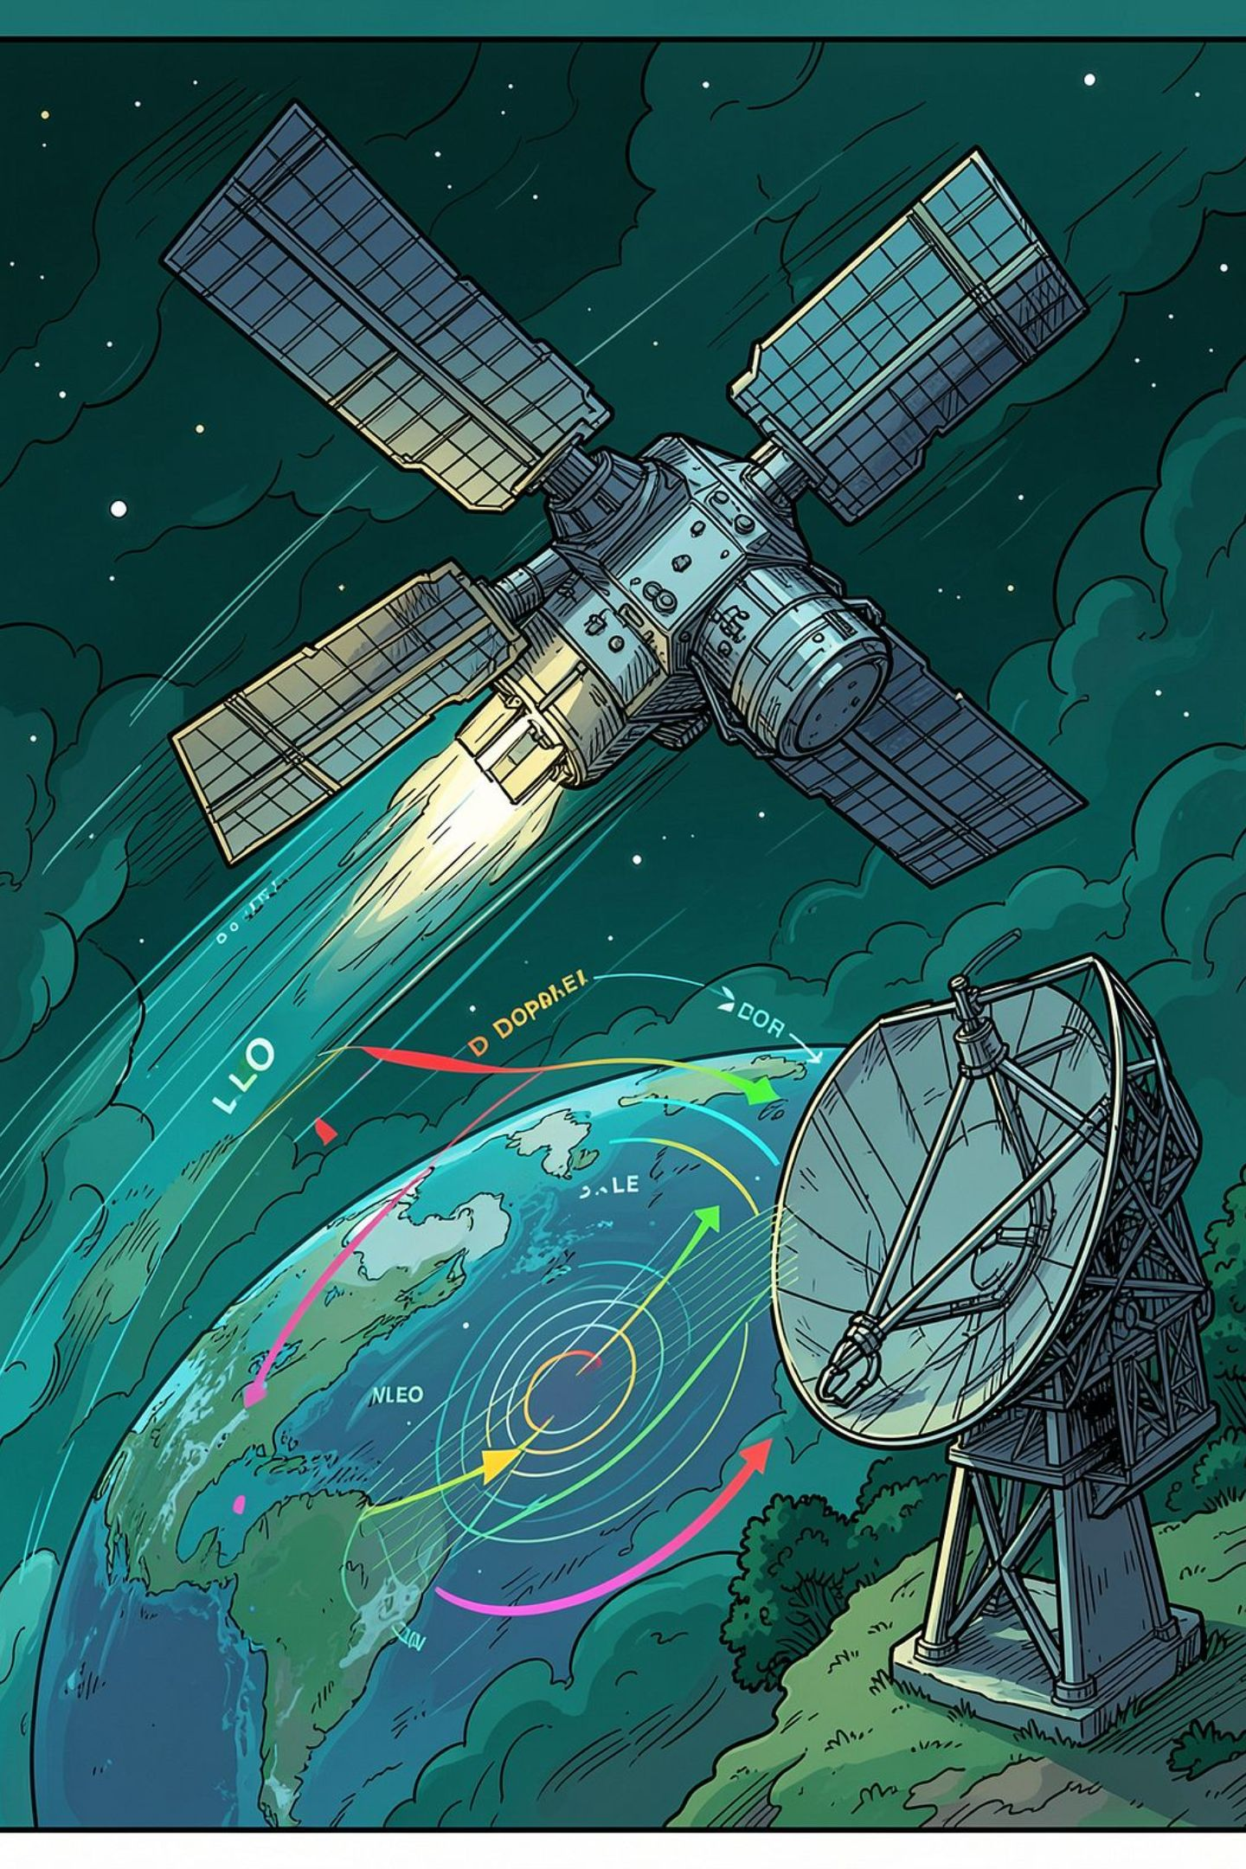
PROBLEM STATEMENT
LEO Channels Are Highly Dynamic
The received signal follows y = hx + n. The receiver must estimate \hat{h} from a channel where h(t_1) \neq h(t_2) — with rapid geometry changes, high Doppler, and variable fading.
Rapid Elevation Changes
20°–90° satellite-ground geometry shifts rapidly
High Doppler
Up to ~100 kHz from high relative velocity
Variable Fading
Shadowed-Rician fading with changing propagation conditions
Unpredictable Channel State
Time-varying: h(t_1) \neq h(t_2)

Slide 4
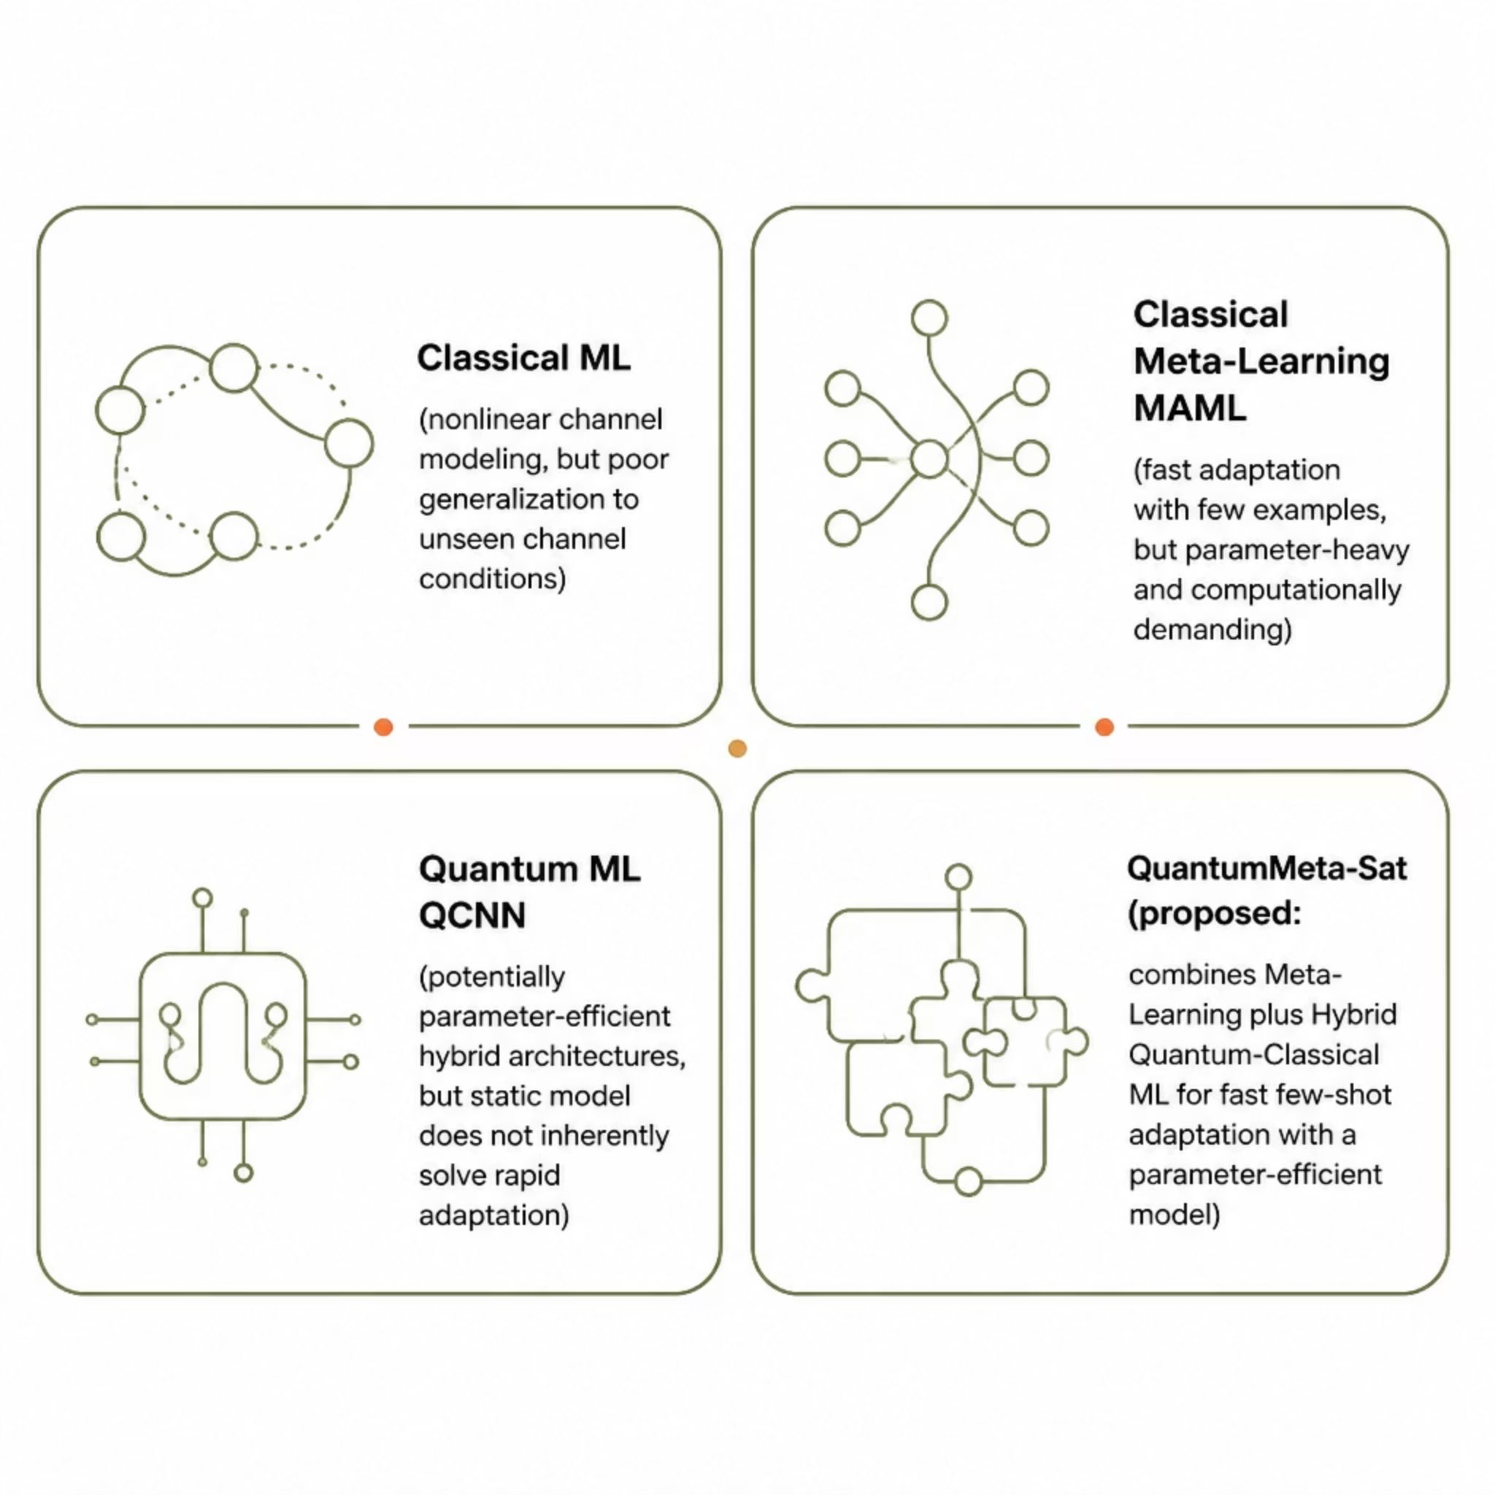
MOTIVATION
From Conventional ML to Adaptive Quantum Learning
Existing approaches each address part of the challenge — but none combine fast few-shot adaptation with parameter-efficient quantum architectures for dynamic LEO channels. QuantumMeta-Sat proposes to bridge this gap.

Slide 5
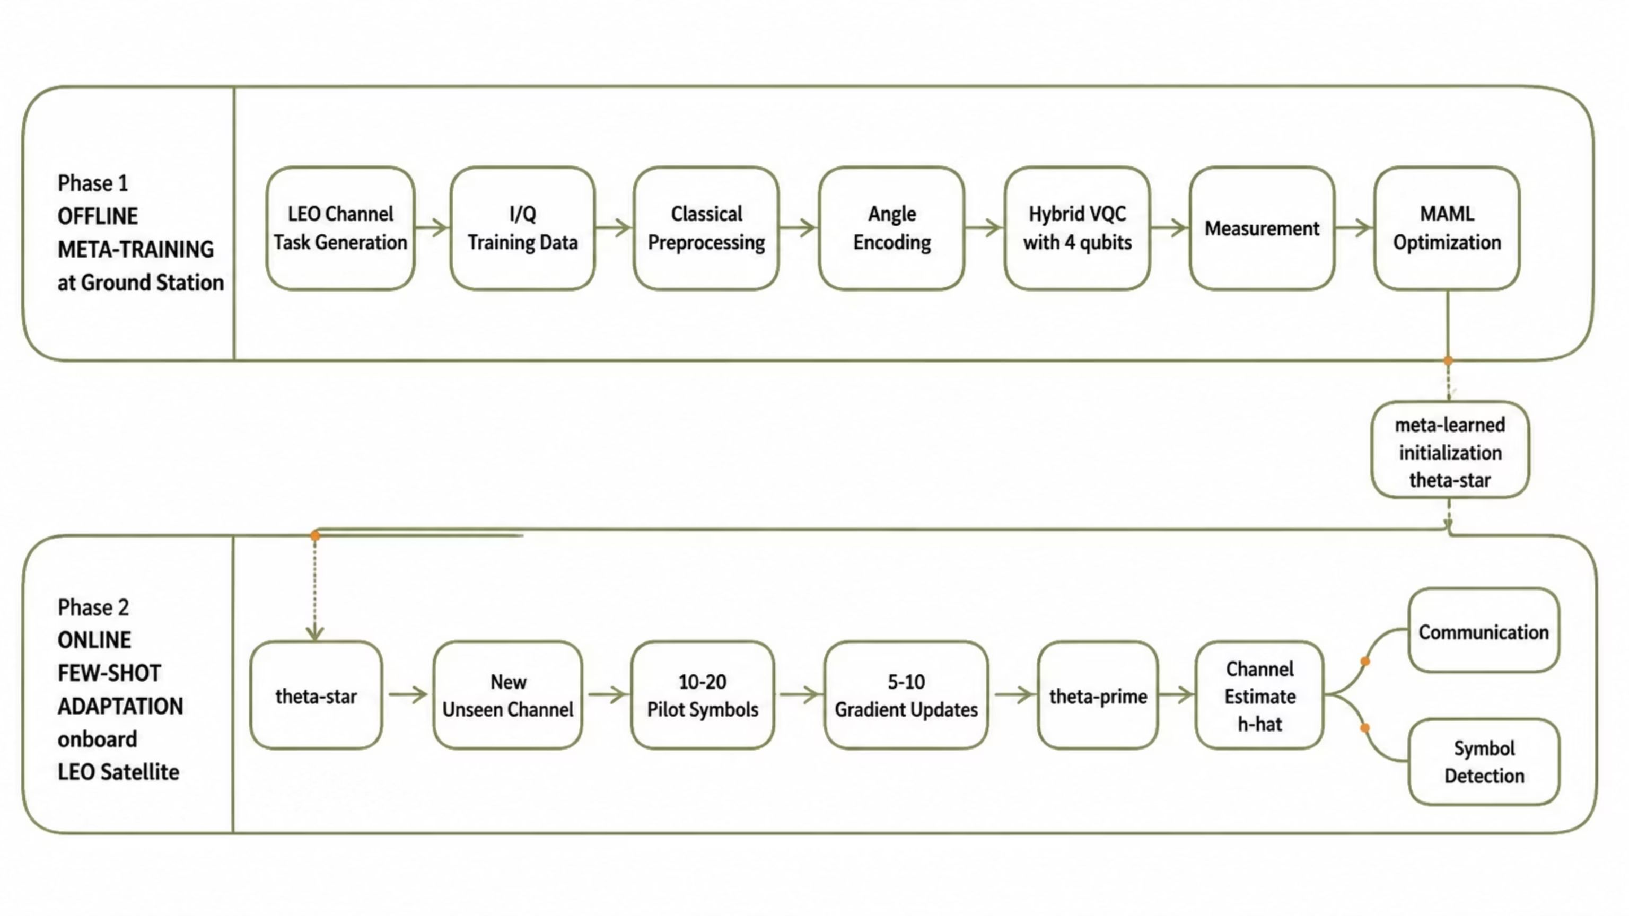
ARCHITECTURE
QuantumMeta-Sat: End-to-End Architecture
Meta-training occurs offline at the ground station. Onboard adaptation requires only 10–20 pilot symbols and 5–10 gradient updates to produce \hat{h}.

Slide 6
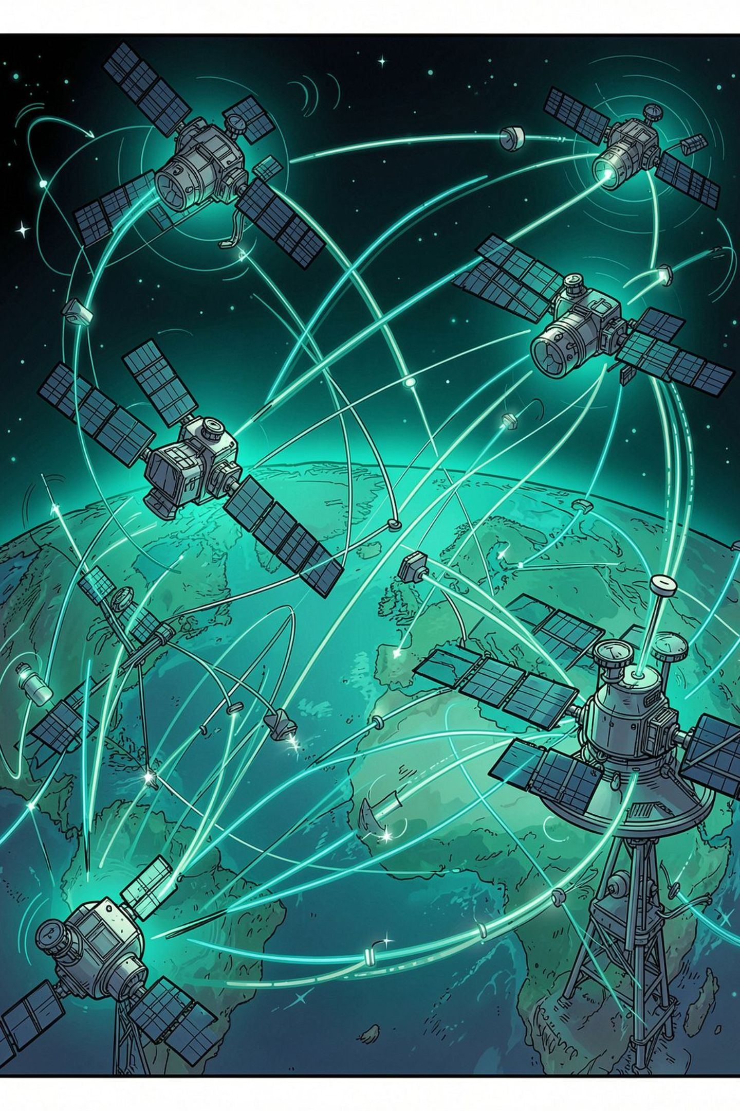
META-LEARNING FRAMEWORK
Learning Across Diverse LEO Channel Conditions
Each task T_i represents a distinct LEO channel. MAML learns \theta^* across the task distribution T_1, T_2, \ldots, T_N for rapid adaptation to unseen channels.
1
Task T₁
Elevation 20° · Doppler ~100 kHz · Shadowed-Rician · Low SNR
2
Task T₂
Elevation 45° · Moderate Doppler · Variable fading · Medium SNR
3
Task T₃
Elevation 70° · Low Doppler · Different propagation · High SNR
4
Task T_N
Unseen environment — target for few-shot adaptation

Slide 7
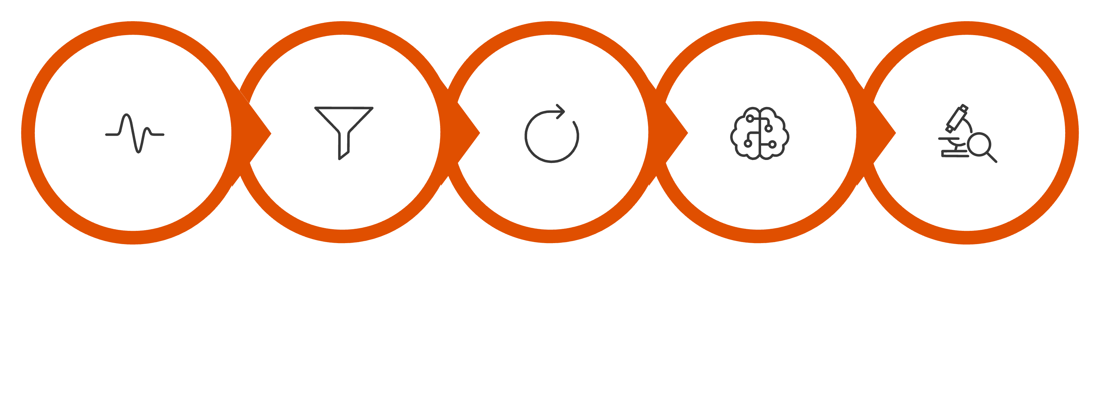

QUANTUM ENGINE
Inside the Hybrid VQC Engine
Preprocessing
Angle Encoding
VQC 4→8 qubits
I/Q Samples
Measurement
Angle Encoding
VQC Architecture
Classical features are encoded via R_y and R_z rotations. Data re-uploading injects input repeatedly across layers to enhance representational capacity.
Initial design uses 4 qubits, with a planned scale-up to 8 qubits. Measurement expectation values \langle Z \rangle produce classical outputs.
Research focus: Parameter efficiency — not quantum supremacy.

Slide 8
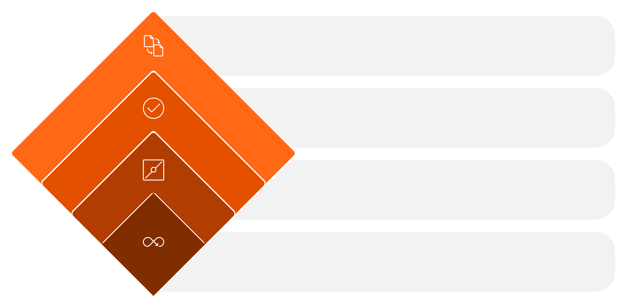
META-LEARNING ALGORITHM
MAML: Learning How to Adapt
Outer Loop
Aggregate losses, update θ
Evaluate
Test θ'_i on query data
Gradient Update
θ'_i = θ - α ∇_θ L_{T_i}(θ)
Inner Loop
Adapt θ to task T_i
Inner Loop — Adapt to Task
Outer Loop — Improve Initialization
For each channel task T_i, compute \theta_i' = \theta - \alpha \nabla_\theta L_{T_i}(\theta) using support data.
Aggregate query losses across tasks to update \theta \to \theta^*, enabling rapid adaptation to new channels.

Slide 9
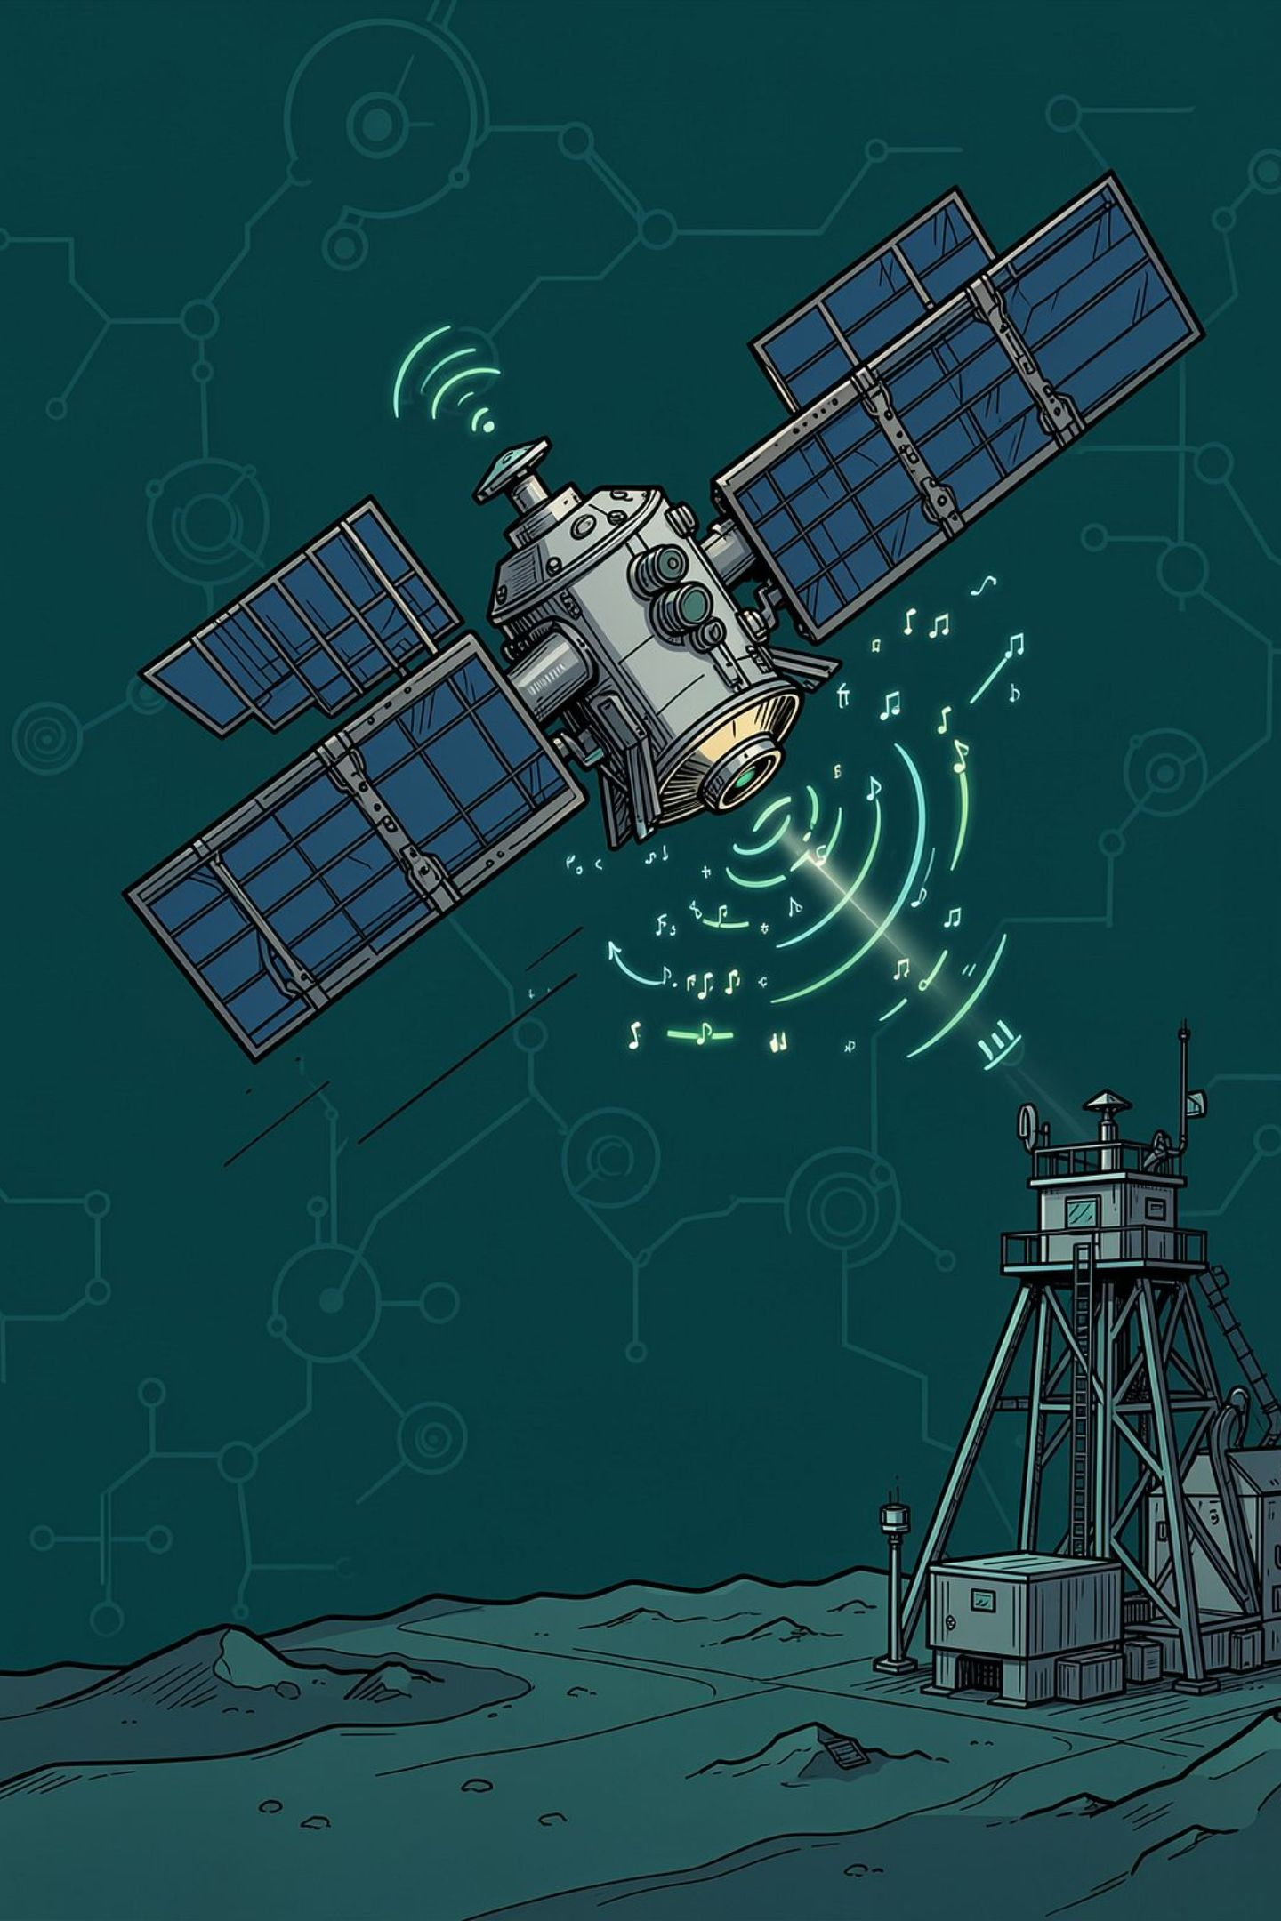


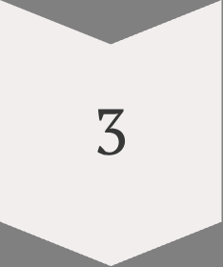


ONLINE ADAPTATION
From Unseen Channel to Adapted Estimator
Detect Unseen Channel
New environment encountered; begin with \theta^*
Micro-Sampling
Collect only 10–20 pilot symbols
Rapid Adaptation
Perform 5–10 gradient updates: \theta^* \to \theta^{(1)} \to \cdots \to \theta'
Channel Estimation
Generate \hat{h} for equalization, symbol detection, and communication processing
Few samples + few updates → rapid channel adaptation. Experimental validation pending.

Slide 10
EVALUATION
How Will QuantumMeta-Sat Be Evaluated?
Model
Quantum
Meta-Learning
Purpose
Ablation Studies
Isolate each component's contribution:
Classical CNN
No
No
Classical ML baseline
Remove quantum layer → classical MAML
Remove MAML → fixed QCNN
Both included → full QuantumMeta-Sat
Classical MAML
No
Yes
Measure meta-learning benefit
Performance to be evaluated — no results claimed at this stage.
Fixed QCNN
Yes
No
Measure quantum architecture benefit
QuantumMeta-Sat
Yes
Yes
Proposed architecture

Slide 11

SUCCESS CRITERIA
What Does Success Look Like?
NMSE
BER
Channel Estimation Accuracy
Communication Impact
Bit and symbol error rates — lower is better
<10
20
Convergence Velocity
Sample Efficiency
Target: fewer than 10 adaptation steps
Evaluate with 1, 5, 10, and 20 pilot samples
Additional metric: Computational Footprint — trainable parameter count and real-time adaptation latency to be measured.

