Slide 1

Trading Strategy Planner

Slide 2
Team Members
AKASH THAKKAR SHRADDHA SHRESTHA SMIT PATEL SUTHARSANAN SAMPATH
Data Scientist
(Team Leader)
Data Engineer
Python Developer
Data Analyst

Slide 3

Project Introduction
The proposed project aims to develop and end-to-end data processing pipeline to predict behaviour(+ve/-ve) of a particular stock based on past trained model.
With rise in data size and market sentiment based on other factor’s apart from just investment and performance the company is panning to explore possible investment platform driven my data and AI.
The final deliverable in this project should help the company to make a better investment decisions.

Slide 4

Business Question
How can implementing an automated data processing pipeline enhance ABC Hedge fund's trading strategy process, leading to more informed investment decisions and improved profitability?

Slide 5
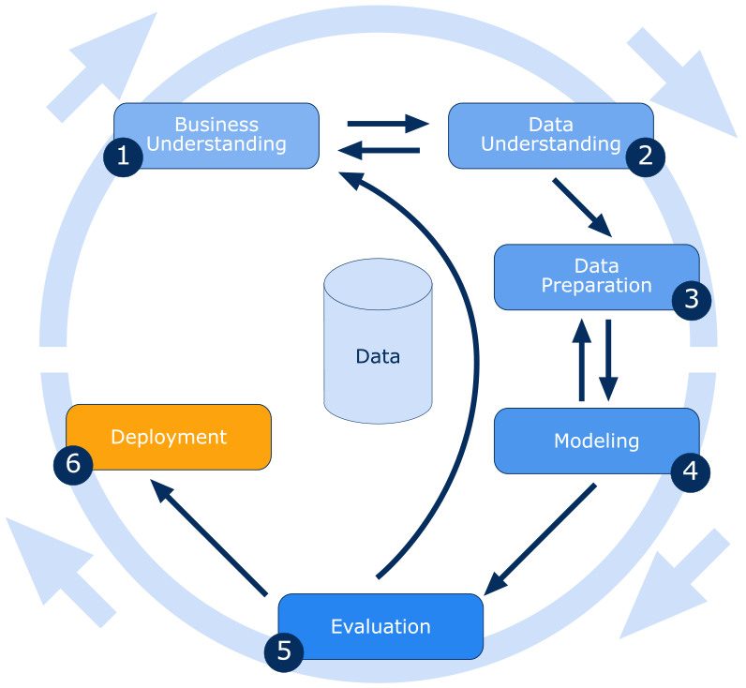
Methodology (CRISP-DM MODEL)

Slide 6

Challenges
Data Ingestion : Retrieve historical data from multiple sources.
Data Storage : Historical data retrieved from single or multiple source will be of various type and large size.
Data Processing : Effective process of transforming raw data to process format for further use.
Data Analytics : Using processed data to generate insights.
Data Utilization : Successfully utilizing insights generated from data.

Slide 7

Data Understanding
The historical data has is daily data of target stock in 1 minute interval consisting of seven core columns from which other market indicators are derived:
Open
High
Low
PriceChange
Volume
Close
Adj Close

Slide 8

Data Processing
AWS Ec2 Instances/ AWS Lambda
AWS S3 Bucket
AWS CodeCommit
Establish an automated parallel processing workflow utilizing AWS Lambda, Glue, and Kinesis for data processing and storage in AWS S3. Additionally, leveraging AWS Code Commit for robust versioning and progress tracking.

Slide 9

Modelling
Select modelling techniques: Utilize AWS EC2 Instances or Lambda for parallel processing to derive market indicators.
Build predictive models: Train machine learning models using processed data to predict stock behaviours.
Evaluate model performance: Assess model accuracy, precision, and recall using appropriate evaluation metrics.

Slide 10

Evaluation
Validate model effectiveness: Measure the performance of predictive models against predefined criteria.
Gather feedback: Obtain feedback from stakeholders to refine models and improve prediction accuracy.
Adjust models: Fine-tune models based on feedback and evaluation results.

Slide 11

Deployment
Deploy
Deploy models: Implement automated parallel processing workflow using AWS.
Monitor
Monitor performance: Monitor data processing pipeline for scalability, efficiency, and accuracy.
Document
Document deployment: Document deployment process and share with stakeholders for transparency.
Design
Platform : Design interface platform for model access and tasking.

Slide 12

Model Maintenance
Monitor
Monitor model performance: Continuously monitor model performance and update as needed.
Retrain
Retrain models: Periodically retrain models with new data to ensure relevance and accuracy.
Address
Address drift: Address concept drift and data distribution changes to maintain model effectiveness over time.

Slide 13


