Slide 1

DATA ANALYTICS & BI | PORTFOLIO PROJECT
Adult Social Care Performance in Lincolnshire:
Demand, Outcomes, and Provider Quality
An interactive Power BI dashboard using national data to support Adult Social Care planning and decision-making
Susairaj Anthony
Data Analyst

Slide 2





01 CONTEXT
The problem, in plain terms
One Dashboard, Three Key Questions.
Imagine a scenario
As a manager in Lincolnshire's Adult Care team, you need reliable answers to questions such as:
Are we helping people recover well after a hospital stay?
Will we have enough care home capacity in five years?
Which care homes in the county need closer attention on quality?
At present, answering these questions means consulting three separate government sources, downloading spreadsheets, and working through the figures manually. That takes time, and it limits who can produce an answer to someone with analytical training.
Page 1 — “Is demand for care going up?”
Lincolnshire's population, and how much older it's getting.
Page 2 — “How well is the council actually doing?”
Real outcomes, compared honestly against England.
Page 3 — “Is the local care market healthy?”
Every care home in the county, mapped by quality.
Susairaj Anthony | Adult Social Care Performance
02

Slide 3





02 HOW IT WORKS
From Raw Data to Useful Information
Think of it like a factory line. Raw data comes in one end; a finished dashboard comes out the other.
ASCOF
ONS
CQC
DHSC / NHS England
Population & projections
Care directory & ratings
Outcomes at council, region and England level
Demand: the ageing population by area & year
Provider quality across the county
Three stages, three tools
1. Clean — Python
2. Combine — SQL
3. Display — Power BI
Python cleaned the data and made sure all files used the same format.
SQL combined all three datasets into one reliable dataset.
Power BI turned the combined, clean data into the interactive charts, maps and filters.
Nothing personal in this data: Every source here is public and already totalled up, so no individual is identifiable anywhere in this build. I apply that same care around GDPR and Freedom of Information principles whenever I work with real, person-level data.
Susairaj Anthony | Adult Social Care Performance
03

Slide 4
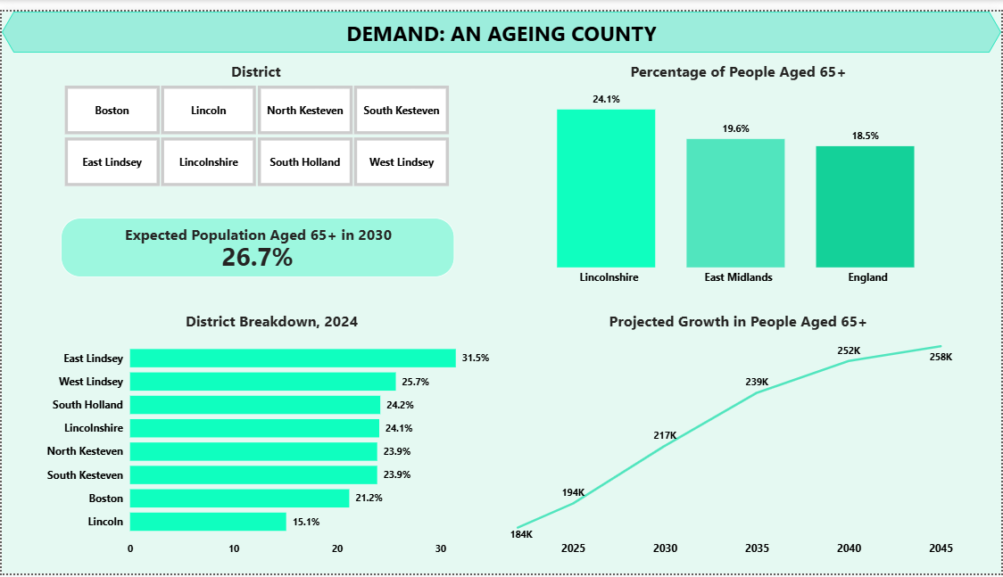
03 THE DASHBOARD
Page 1 | Demand: An ageing county
Straight from the live dashboard
24.1% today
Lincolnshire's 65+ share, already well above England's 18.5%.
26.7% by 2030
ONS projects the share itself keeps climbing, not just the headcount.
Click a district to explore it
See any of the 7 districts on its own, without leaving the page.
Why this matters: The proportion of people aged 65+ in Lincolnshire is already higher than the national average and is expected to increase from 24.1% today to 26.7% by 2030. This page helps managers understand how future demand for Adult Social Care is likely to change.
Susairaj Anthony | Adult Social Care Performance
04

Slide 5
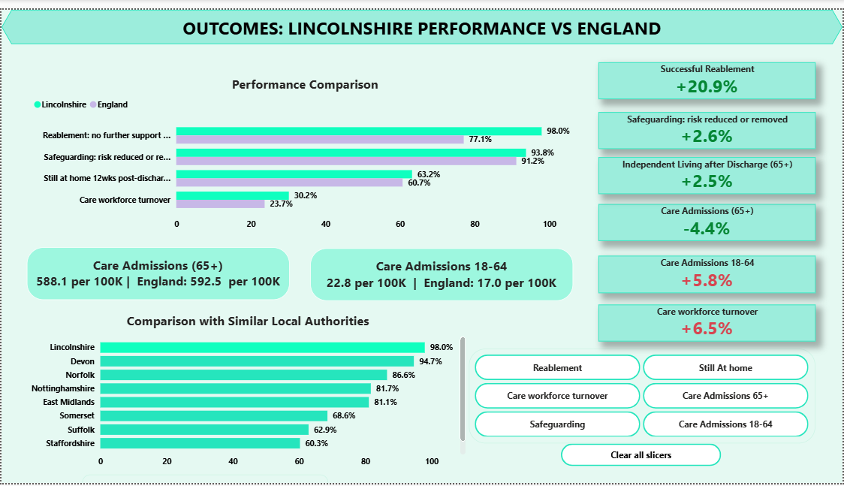
03 THE DASHBOARD
Page 2 | Outcomes: Lincolnshire vs England
What this page shows
Key Findings
Ahead of England on reablement and safeguarding. Behind England on staff turnover and on admissions to care for 18–64-year-olds.
Fair comparisons, not just numbers
Every measure sits right next to England's figure, so it's obvious whether we're ahead or behind.
Explore Individual Measures
Choose any one measure and both charts update to show just that comparison.
Understanding the data: These 2024/25 measures come from the new client-level dataset (CLD), which replaced SALT from April 2024, so they should not be compared with pre-2024 figures. Self-funders are not captured, which most affects wealthier areas.
Susairaj Anthony | Adult Social Care Performance
05

Slide 6
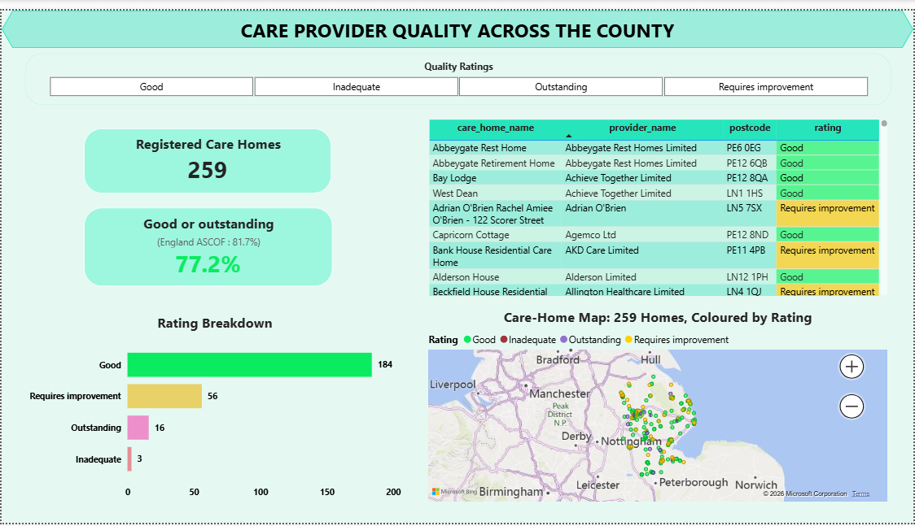

03 THE DASHBOARD
Page 3 | Care provider quality across the county
Built from the CQC care directory
Quality Ratings
259 rated Lincolnshire care homes: 184 Good, 16 Outstanding, 56 Requires Improvement, 3 Inadequate.
Care Provider Locations
Mapped by postcode, so clusters of weaker-rated homes are visible at a glance.
Supporting Better Planning
Links to Page 1, so you can see care quality alongside where demand is highest.
259 rated homes | 77.2% good or outstanding, vs 81.7% England (ASCOF 6B)
Susairaj Anthony | Adult Social Care Performance
06

Slide 7


04 MANAGING THE WORK
Delivering it end to end
01
02
03
Scoped
Prioritised
Delivered
Agreed the three questions the dashboard had to answer, then worked back to the data each one needed.
Built the shared model and the demand page first, so there was something usable early, then layered outcomes and providers.
Three linked pages, checked against the published source figures, documented on GitHub.
Managing people, not just data
Alongside this I lead a shift team as a Team Leader, coordinating people under time pressure, briefing them clearly and holding standards. That's the same skill any collaborative analytics role demands: partnering across teams and keeping several work streams moving at once.
Susairaj Anthony | Adult Social Care Performance
07

Slide 8



05 COMMUNICATION
Technical depth, plain-English delivery
Behind the Dashboard
What a service lead sees
SQL and Python to clean and join three sources
One shared way of matching up area and time, not separate spreadsheets
Formulas that work out rates and year-on-year change automatically
Saved and version-tracked on GitHub
Headlines in Plain-language, not technical terms
Clear notes wherever the data has limits
Colours chosen so everyone can read them, including colour-blind viewers
Filters anyone can click to find their own answer
Susairaj Anthony | Adult Social Care Performance
08

Slide 9
06 THE ANSWERS
Bringing It Back to the Three Questions
Is demand for care going up?
Yes. 24.1% of Lincolnshire is aged 65+ today, rising to 26.7% by 2030.
How well is the council actually doing?
Mostly ahead of England, but workforce turnover and care admissions for 18–64-year-olds need attention.
Is the local care market healthy?
Mostly. 77.2% of homes are rated Good or Outstanding, just behind England's 81.7%.
Read together: On their own, none of these tells the full story. Together, they show not just how a service is performing, but whether it can keep up with what's coming, and whether the local market can deliver it. That's how a real planning decision gets made.
Susairaj Anthony | Adult Social Care Performance
09

Slide 10

What This Project Demonstrates
Multiple Public Data Sources
One Interactive Dashboard
Better Decisions for Adult Care Teams
>
>
Spread across different places, just like council data
Brought together in one place people can trust
Access information quickly to support decision-making
Power BI · SQL · Python · Excel & PowerPoint.
Thank you
This project reflects an ongoing commitment to building real, practical skills in data analytics and business intelligence: collecting, cleaning, validating and presenting data in a way that genuinely supports decision-making. It's one piece of a continuing portfolio, built and refined through hands-on practice rather than theory alone.
Susairaj Anthony

