Slide 1

PERFORMANCE & INTELLIGENCE OFFICER | INTERVIEW PRESENTATION
Adult Social Care in Lincolnshire:
outcomes, demand and provider quality
Built from national data on care outcomes, population and care home quality
Susairaj Anthony
MSc Data Science (Distinction), University of Hertfordshire
Notes:
TITLE (about 20 sec) Good morning, and thank you for having me. I'm Susairaj. In the next eight minutes I'll walk you through one piece of work: a self-serve Power BI dashboard on Adult Social Care in Lincolnshire, built from three national open datasets. I picked it because it is, in miniature, exactly what this team does. [Slow down. Breathe. Don't rush the open.]

Slide 2




01 CONTEXT
The problem, in plain terms
One dashboard, three answers
The scenario
As a manager in Lincolnshire's Adult Care team, you need reliable answers to questions such as:
• Are we helping people recover well after a hospital stay?
• Will we have enough care home capacity in five years?
• Which care homes in the county need closer attention on quality?
At present, answering these questions means consulting three separate government sources, downloading spreadsheets, and working through the figures manually. That takes time, and it limits who can produce an answer to someone with analytical training.
Page 1 — “Is demand going up?”
Lincolnshire's population, and how much older it's getting.
Page 2 — “How well are we doing?”
Real outcomes, compared honestly against England.
Page 3 — “Is the care market healthy?”
Every care home in the county, mapped by quality.
Susairaj Anthony | Adult Social Care Intelligence
02
Notes:
SLIDE 1 / BRIEF (about 55 sec) Here's how I framed the brief for myself. As a manager in Lincolnshire's Adult Care team, you need reliable answers to questions such as: are we helping people recover well after a hospital stay, will we have enough care home capacity in five years, and which care homes in the county need closer attention on quality. At present, answering those questions means consulting three separate government sources, downloading spreadsheets, and working through the figures manually. That takes time, and it limits who can produce an answer to someone with analytical training. So this project brings those three answers into one dashboard, so a manager can click a few filters and get the answer themselves, in seconds, without waiting on anyone.

Slide 3





02 HOW IT WORKS
Three messy sources, one clean answer
Think of it like a factory line. Raw data comes in one end, a finished dashboard comes out the other.
ASCOF
ONS
CQC
DHSC / NHS England
Population & projections
Care directory & ratings
Outcomes at council, region and England level
Demand: the ageing population, by area and year
Provider quality across the county
Three stages, three tools
1. Clean — Python
2. Combine — SQL
3. Display — Power BI
The raw files are messy and don't talk to each other. Python fixes formats, matches up area names, fills in gaps.
SQL joins the three cleaned sources so they share the same area names and years, and works out rates and percentages.
Power BI turns the combined, clean data into the dashboard: charts, a map, filters you can click.
Nothing personal in this data. Every source here is public and already totalled up, so no individual is identifiable anywhere in this build. I'd bring that same care around GDPR and Freedom of Information requests to the real, person-level data this role works with.
Susairaj Anthony | Adult Social Care Intelligence
03
Notes:
SLIDE 2 / DATA & METHOD (about 65 sec) Think of it like a factory line. Raw data comes in one end, a finished dashboard comes out the other, in three stages. First, clean. The raw files are messy and don't talk to each other, so Python fixes formats, matches up area names, and fills in gaps. Second, combine. SQL joins the three cleaned sources so they share the same area names and years, and works out rates and percentages. Third, display. Power BI turns that combined, clean data into the dashboard you're about to see: charts, a map, filters you can click. One thing I'd flag early: every source here is public and already totalled up, so no individual is identifiable anywhere in this build. The same care around GDPR and Freedom of Information requests is exactly what I'd carry into the real, person-level data this role handles.

Slide 4
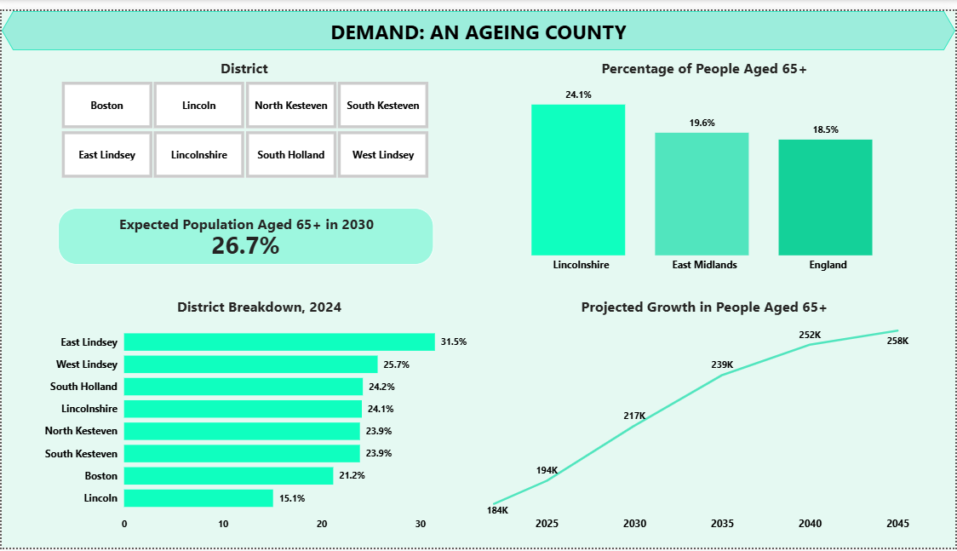

03 THE DASHBOARD
Page 1 | Demand: an ageing county
Straight from the live dashboard
24.1% today
Lincolnshire's 65+ share, already well above England's 18.5%.
26.7% by 2030
ONS projects the share itself keeps climbing, not just the headcount.
Click a district to explore it
See any of the 7 districts on its own, without leaving the page.
So what: the 65+ share is not just higher than average, it is projected to keep rising, from 24.1% today to 26.7% by 2030. This page is the pressure gauge the other two are read against.
Susairaj Anthony | Adult Social Care Intelligence
04
Notes:
SLIDE 3 / PAGE 1 DEMAND (about 70 sec) This is the pressure gauge, and every number here is verified against the source files, not estimated. Lincolnshire's 65 and over share is 24.1 percent today, well above the England average of 18.5 and the East Midlands at 19.6. And it isn't standing still: ONS's own projection has that share climbing to 26.7 percent by 2030, alongside a population heading past 815,000. The so-what is simple. An already older-than-average population that keeps ageing faster than the country as a whole means rising demand for reablement, home care and care-home beds. Everything on the next two pages is read against this. [This is your strongest, fully-defensible data, pulled directly from ONS. Point at the two charts. Own it.]

Slide 5
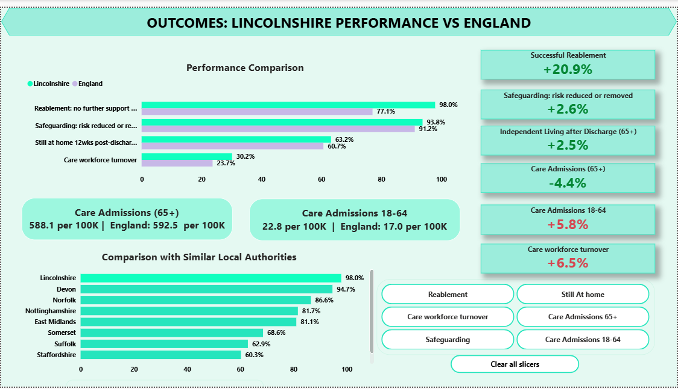
03 THE DASHBOARD
Page 2 | Outcomes: Lincolnshire vs England
What this page answers
The honest picture
Ahead of England on reablement and safeguarding. Behind on staff turnover and on 18-64 admissions to care.
Fair comparisons, not just numbers
Every measure sits right next to England's figure, so it's obvious whether we're ahead or behind.
Click a measure to compare it
Choose any one measure and both charts update to show just that comparison.
Reading the data honestly. These 2024/25 measures come from the new client-level dataset (CLD), which replaced SALT from April 2024, so they should not be compared with pre-2024 figures. Self-funders are not captured, which most affects wealthier areas.
Susairaj Anthony | Adult Social Care Intelligence
05
Notes:
SLIDE 4 / PAGE 2 OUTCOMES (about 75 sec) Page two is outcomes, and this is Lincolnshire's own data next to England's, not just national anchors. And it's a genuinely mixed picture, which I want to be upfront about. On reablement, Lincolnshire is well ahead: 98 percent of people who received reablement needed no further support, against 77 percent for England. On discharge outcomes we're also slightly ahead, 63 percent versus 61, and on safeguarding, just under 94 percent versus 91. But on two measures we trail. Workforce turnover is 30 percent against England's 24. And admissions to care for working-age adults, 18 to 64, run higher here too. Both are real pressure points, worth naming rather than hiding. Where lower is actually the better result, like admissions and turnover, I've coloured the card red even though the number itself is positive, so the colour always means "needs attention," not just "the number went up." I'd be upfront about the data too. These are 2024/25 measures from the new client-level dataset, which replaced SALT in April 2024, so they shouldn't be compared to older figures, and self-funders aren't captured. [Showing weaknesses unprompted is deliberate. The person spec explicitly asks for understanding the limits of data, and a scorecard that's all green looks curated, not credible.]

Slide 6
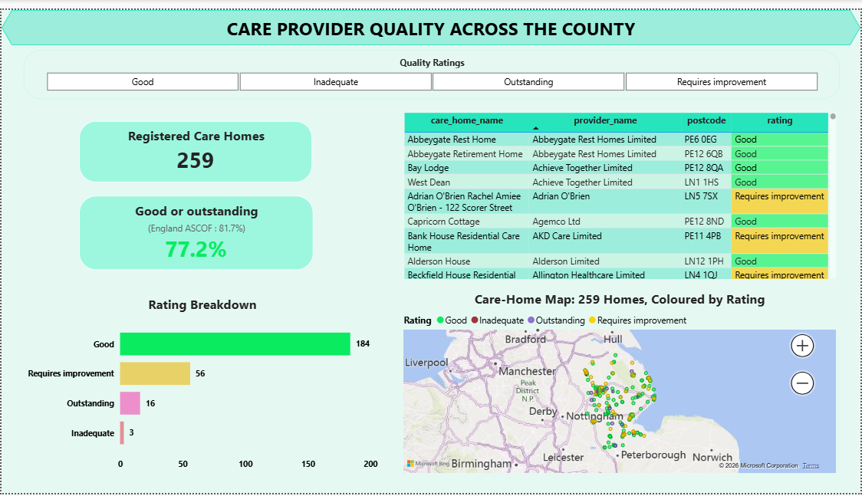

03 THE DASHBOARD
Page 3 | Care provider quality across the county
Built from the CQC care directory
Quality
259 rated Lincolnshire care homes: 184 Good, 16 Outstanding, 56 Requires Improvement, 3 Inadequate.
Geography
Mapped by postcode, so clusters of weaker-rated homes are visible at a glance.
Why this matters for planning
Links to Page 1, so you can see care quality alongside where demand is highest.
259 rated homes | 77.2% good or outstanding, vs 81.7% England (ASCOF 6B)
Susairaj Anthony | Adult Social Care Intelligence
06
Notes:
SLIDE 5 / PAGE 3 PROVIDERS (about 55 sec) Page three is the care market, built from the CQC directory, filtered down to Lincolnshire: 259 rated care homes. 77.2 percent are rated Good or Outstanding, which is a little behind England's ASCOF figure of 81.7 percent, so there's room to improve, and the map shows roughly where. The value for commissioning is putting this next to page one: an area where ratings are weaker and the older population is growing fastest is where you'd want to act first. That's the kind of question a service lead can answer here in seconds, by filtering the map. [Have your Power BI map screenshot in place before you send this.]

Slide 7



04 MANAGING THE WORK
Delivering it end to end
01
02
03
Scoped
Prioritised
Delivered
Agreed the three questions the dashboard had to answer, then worked back to the data each one needed.
Built the shared model and the demand page first, so there was something usable early, then layered outcomes and providers.
Three linked pages, checked against the published source figures, documented on GitHub.
Managing people, not just data
Alongside this I lead a shift team as a Team Leader, coordinating people under time pressure, briefing them clearly and holding standards. That is the same skill this role asks for: partnering with service teams across the council and keeping several work streams moving at once.
Susairaj Anthony | Adult Social Care Intelligence
07
Notes:
SLIDE 6 / MANAGING THE WORK (about 60 sec) This is also a project story. I scoped it around three clear questions, then worked back to the data. I prioritised: shared model and the demand page first, so there was something usable early, then outcomes and providers. And I delivered it end to end, checked against the published figures and documented on GitHub. It isn't only about data, either. Alongside this I lead a shift team, coordinating people under real time pressure and holding standards. That's the same muscle this role uses: partnering across service teams and keeping several work streams moving at once. [The spec asks about managing a project, workload and a team. You cover all three here.]

Slide 8



05 COMMUNICATION
Technical depth, plain-English delivery
Under the bonnet
What the reader sees
SQL and Python to clean and join three sources
One shared way of matching up area and time, not separate spreadsheets
Formulas that work out rates and year-on-year change automatically
Saved and version-tracked on GitHub
Plain-language headlines, no jargon
Clear caveats where the data has limits
Colours chosen to be easy to read, including for colour-blind viewers
Filters anyone can use to answer their own question
Susairaj Anthony | Adult Social Care Intelligence
08
Notes:
SLIDE 7 / COMMUNICATION (about 50 sec) The core skill is serving two audiences from one build. Under the bonnet there's real depth: SQL and Python, a modelled schema, DAX for rates per hundred thousand and year-on-year change. But the reader never has to see any of that. They get plain-language headlines, clear caveats where the data has limits, accessible colour and contrast, and filters so they answer their own questions. The national ASCOF tool openly says it doesn't fully meet accessibility needs, so building mine to a higher standard there was a deliberate choice.

Slide 9

Why this fits the role
Messy public data
One easy dashboard
Adult Care teams
>
>
Spread across different places, just like council data
Brought together in one place people can trust
Get answers without waiting on an analyst
Power BI and SQL daily · Excel advanced · Python and R · MS Access, quick to pick up
Thank you
I took three separate national datasets and turned them into one easy-to-use view of outcomes, demand and care home quality for Adult Care in Lincolnshire. I'd be glad to take any questions.
Susairaj Anthony
Notes:
SLIDE 8 / WHY IT FITS + CLOSE (about 35 sec) So, to bring it together. The pattern is the one you work in every day: fragmented public data, turned into a single self-serve Power BI view, so Adult Care teams can decide without waiting on an analyst. On tools I use Power BI and SQL daily, Excel to an advanced level, Python and R, and I'd pick up MS Access quickly. From three national datasets to one clear view of outcomes, demand and provider quality for Lincolnshire. Thank you, I'd be glad to take any questions. [Stop. Smile. Let the silence sit.] TIMING: about 8 minutes. If long, trim the method detail and one bullet on the communication slide.

