Slide 1


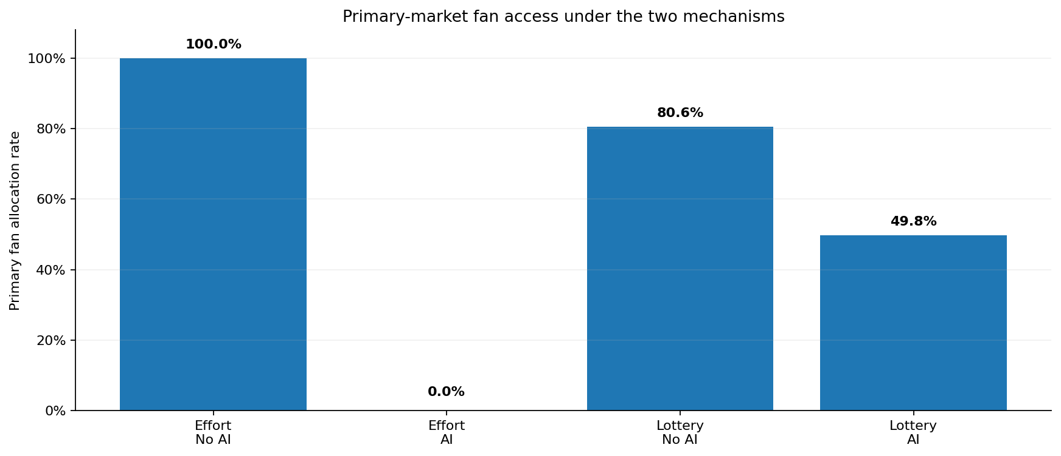
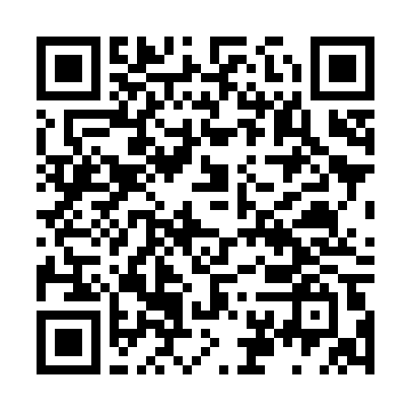
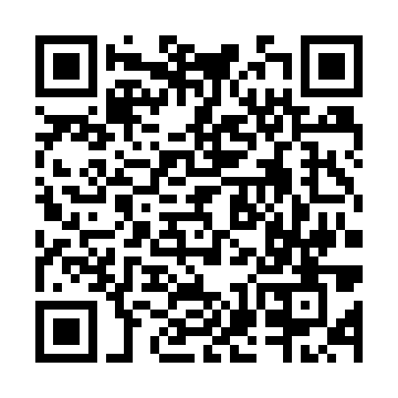
COMSCI / ECON 206 | FINAL RESEARCH PROJECT | AUTUMN 2026
AI, Rent-Seeking, and Ticket Allocation:
Mechanism Design under Asymmetric Participation Costs
Longfei Jing · Tian Liang · Jiayang Sun | Team FP6
Course instructor: Professor Luyao Zhang
A0 landscape · 1189 × 841 mm | Final Project working poster · verify official SDG artwork, full credits and final commit before release
FINAL PROJECT A0 POSTER
KEY MESSAGE
AI lowers strategic participation costs asymmetrically. Synthetic tests show effort contests can cross a sharp threshold, while lotteries resist speed advantages but remain vulnerable to cheap identities.
01 Question and foundations
02 Model and verified evidence
03 Practical impacts and roadmap
Research question & verified gap
INHERITED
Resale / rent-seeking
Booking and Sybil costs
OUR CONTRIBUTION
AI asymmetric cost shock
Contest vs. lottery
EVIDENCE
5,000-run synthetic tests
Sensitivity & welfare
Practical Impacts: SDG 10 · Target 10.3
RQ: How does AI cost asymmetry change genuine fan access and welfare?
Setting: 200 fans, 50 scalpers, one $100 ticket; resale $180.
Closest research: Leslie–Sorensen (2014), Hakimov et al. (2021), Mazorra–Della Penna (2023).
Gap: compare effort and verified randomization under an AI cost shock.
MECHANISM
Contest vs. lottery
INDICATOR
Primary fan access
Baseline (synthetic): 100.0% contest, 80.6% lottery.
Risk: privacy burden / false rejection; cheap identities.
Safeguards: appeals, auditability, accessible verification.
Proposed benefit ≠ demonstrated field impact.
Strategic model and Intellectual Merits
Players: fans and scalpers; platform commits to a rule first.
Effort contest: Pᵢ = eᵢ / Σeⱼ; utility = VᵢPᵢ − cᵢeᵢ; active-set Nash benchmark.
Verified lottery: one fan entry; scalpers may buy up to 8 identities at cost k.
Contribution: compare robustness under asymmetric AI costs, not an empirical AI effect.
Figure 1. Closest foundations [1–3] → bounded asymmetric-cost mechanism comparison → simulated outcomes. No real-market validation.
Future Research Roadmap — NEW diagram
ECONOMICS | Estimate effort / identity costs
Method: platform data + sensitivity · Partner: applied economics
Criterion: stable estimates · Milestone: calibrated sweep
COMPUTER SCIENCE | Test adaptive scalpers
Method: rule-based ABM; optional LLM agents / OpenRouter
Partner: agent modelers · Criterion: reproducible logs · Milestone: ABM prototype
Three complementary lenses
BEHAVIORAL SCIENCE | Test fairness perceptions
Method: structured pilot choices · Partner: behavioral researchers
Criterion: measured deviations · Milestone: pilot dataset
Game theory — predicts effort under strategic cost changes.
Social choice — separates primary access, final ownership and welfare.
Mechanism design — contrasts effort-based allocation with verified randomization.
Integration, limitations and team contributions
Auction or allocation comparison
Longfei Jing: strategic value and welfare accounting; symmetric hand check.
Tian Liang: exact Tullock computation and sensitivity; reproducibility checks.
Jiayang Sun: behavioral probe, poster integration, and primary-vs-final access interpretation.
All new ABM / LLM / pilot studies are PLANNED, not completed.
Scarce resource: one representative concert ticket.
Contest: players pay effort costs regardless of outcome.
Lottery: random draw among entries; winner pays $100.
Both allow stipulated resale at $180. One ticket is NOT an entire concert inventory.
Figure 2. Synthetic primary fan allocation: Effort Contest 100.0% → 0.0%; Verified Lottery 80.6% → 49.8% (no AI → AI stress).
Seed 2026; 5,000 runs per main condition; 500 per sensitivity point. Reproduce: GitHub commit ce6cb2b.
Sensitivity: effort threshold at scalper costs 3→2; lottery identity cost k=.05 gives 7 identities and 36.2% fan access. Final ownership stays 100% in four baselines.
OCT 12 Literature & duet defense • OCT 14 Roundtable feedback • OCT 21 Final release
Full acknowledgments
Selected references
OPEN MATERIALS
Prof. Luyao Zhang (mechanism and evidence guidance); Prof. Ken Rogerson (Sept 7 discussant); Han Zhang (course support). Reviewers: Yiqiao Liu, Xinrong Sun, Yongzhuo Wu, Muhan Chen (Sept 28 critiques); Zimu Zhou (Oct 12 literature/duet). Tencent Shanghai office; Shanghai Science and Technology Museum (field learning); COMSCI/ECON 206 class (discussion). Python, NumPy, pandas, Matplotlib, Colab, GitHub, Hugging Face, Overleaf; permitted ChatGPT assistance; authors checked claims.
[1] Leslie & Sorensen (2014), Review of Economic Studies. doi:10.1093/restud/rdt033
[2] Hakimov et al. (2021), American Economic Review. doi:10.1257/aer.20191204
[3] Mazorra & Della Penna (2023), arXiv:2301.12813. doi:10.48550/arXiv.2301.12813
[4] Nash (1950), PNAS. doi:10.1073/pnas.36.1.48
GitHub: github.com/dku-comsci-econ206-Autumn2026/PS2-Adaptive-Ticket-Auctions
Hugging Face: huggingface.co/spaces/dku-comsci-econ206-2026/ai-ticket-allocation
Baseline: ce6cb2b · Final commit to be recorded at release
Notes:
COMSCI/ECON 206 PS2 clean A0 poster template.
Brand guide: https://dku-web-admissions.s3.cn-north-1.amazonaws.com.cn/dkumain/wp-content/uploads/mainsite/2022/05/brand-guide-compressed_2021.pdf, linked from https://www.dukekunshan.edu.cn/media/. Guide pp. 5, 6, 12, 14, and 15 establish logo clear space/proportions, unchanged logo artwork, application colors #003399 and #006633 plus white, and Calibri as the office system font when InterstatePlus cannot be used. Official logo asset: https://www.dukekunshan.edu.cn/wp-content/uploads/2021/08/large_dku-Logo.png.
Calibri is specified in the editable PowerPoint. The exported PDF uses Carlito, a metric-compatible open-source substitute because Calibri is unavailable in the export environment. Re-export from PowerPoint with Calibri for institution-font-exact output.
Clean and annotated versions share all element positions. Keep A0 landscape 1189 x 841 mm, 100% print scale. Text and figure/QR placeholders are editable; preserve the embedded logo unchanged and keep at least half its height as clear space. Instructor belongs below authors, not in the author list. Replace all placeholders with actual work; distinguish observed results, inferences, and planned tests. QR codes are optional but full public URLs and tested access are required. References must be full and traceable; acknowledgments must name actual contributions and AI assistance. Sep 28: symposium, peer evaluation and real-world case impacts. Sep 30: final update. The PS1-style paper, LaTeX, and learning pathway are unchanged.

