Slide 1
🅿️ ParkSight
AI-Driven Parking-Congestion Intelligence for Targeted Enforcement
From reactive patrols to a predictive command center —
built on 298,445 real Bengaluru parking violations.
Flipkart Gridlock 2.0 · Round 2 · Theme 1

Slide 2
THE CHALLENGE
Parking chokes the city — and nobody can see it
• On-street & spillover parking near markets, metro and events blocks carriageways and junctions.
• Enforcement today is patrol-based and reactive — officers chase, they don't pre-empt.
• No heatmap of violations vs. congestion impact exists.
• Authorities can't prioritise which zones to enforce, or when.
“Where does illegal parking
actually hurt traffic flow —
and where do we send teams
tomorrow?”

Slide 3
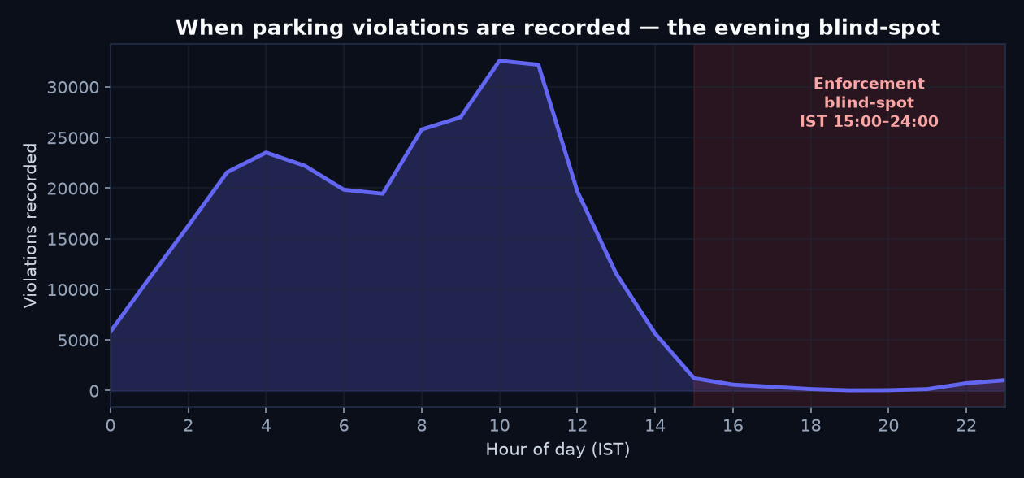
THE DISCOVERY
The Evening Enforcement Blind-Spot
• After converting timestamps UTC→IST, records collapse during 15:00-24:00 IST.
• That's exactly when commercial congestion peaks.
• Few tickets ≠ few violations → it's low enforcement VISIBILITY.
• This IS the 'poor visibility' the brief names — ParkSight closes it.

Slide 4
THE DATA
298,445 violations — a near-perfect fit
298,445
100%
54
violations
geo-located
police stations
168
34.2%
10.3%
junctions
from repeat offenders
carriageway-blocking
Nov 2023 → Apr 2024 · dominated by Wrong/No-Parking & Main-Road parking · 3,070 enforcement devices.

Slide 5
THE PLATFORM
Eight modules a command center would actually use
🧭 Executive Dashboard
🗺️ AI Hotspot Map
📊 PCIS Engine
🔮 Forecast
KPIs, impact, the blind-spot
H3 heat, density, zones, drill-down
explainable impact score, re-weightable
next-7-day per station + confidence
🎯 Prioritize
🧪 Simulator
🤖 AI Copilot
🚨 Offenders
ranked plan + PDF briefing
What-If deployment impact
plain-English, grounded answers
15% of vehicles → 34% of violations

Slide 6
THE MOAT
PCIS — quantifying impact without faking traffic data
PCIS = 100 × (0.30·Volume + 0.20·Severity + 0.20·Location + 0.20·PeakOverlap + 0.10·Trend)
• Volume — log-scaled violation count (heavy-tailed).
• Severity — carriageway-blocking weight: main-road / double / footpath > no-parking.
• Location — junction & commercial-keyword criticality (a junction block cascades).
• Peak-overlap — share in IST peak windows 08–11 & 17–21 (a 6 PM block hurts more than 3 AM).
• Trend — month-over-month growth, so rising hotspots are caught early.
• Weights are TUNABLE live in the app — a transparent policy lever, not a black box.

Slide 7
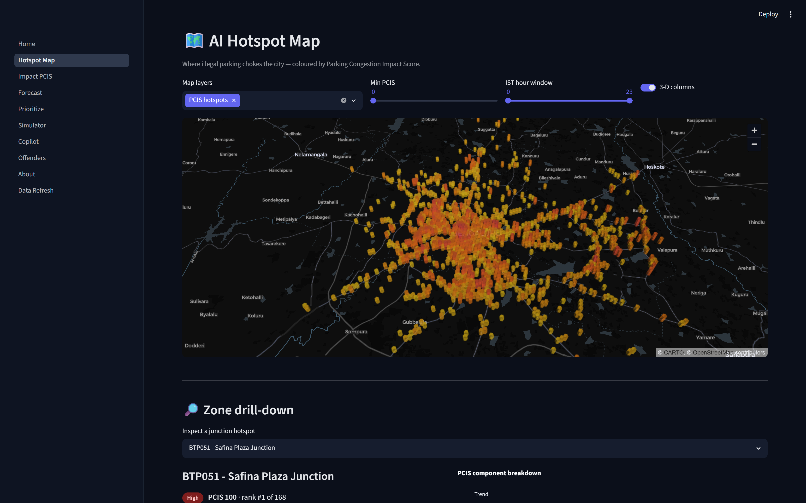
SEE IT
Hotspots ranked by real impact, not raw counts
• H3 hexagons + DBSCAN zones on a dark deck.gl map.
• Colour = PCIS, so a main-road evening hotspot beats a quiet residential one.
• Click any zone → component breakdown + recommended units & time window.

Slide 8
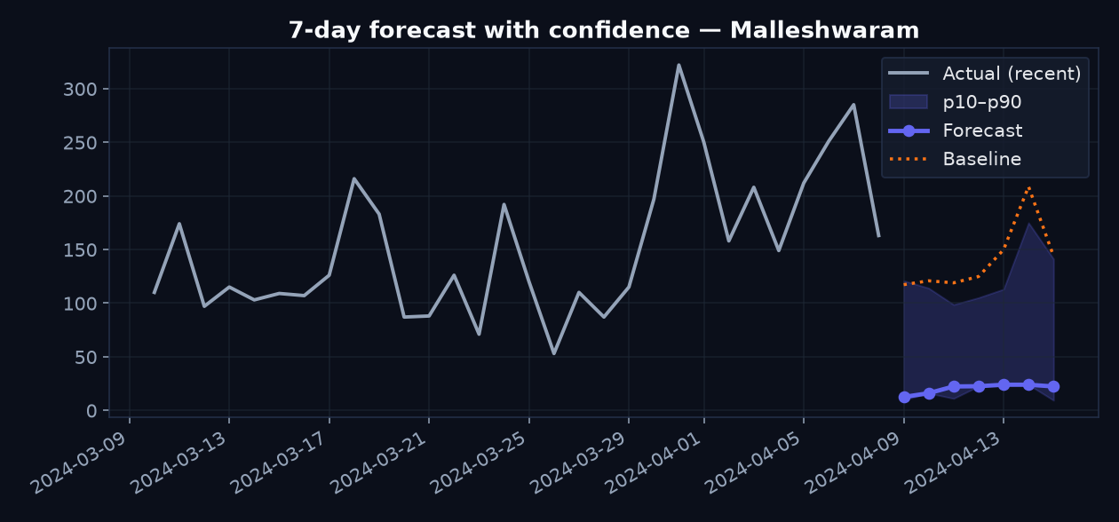
PREDICT
Tomorrow's hotspots, with confidence
• LightGBM, 7-day horizon, p10–p90 confidence bands.
• MAE 15.87 vs baseline 18.52 — 14.3% better.
• Benchmarked against climatology so the ML's value is explicit.
• Feature importance = explainability, not a black box.

Slide 9
ACT
Prioritise → Simulate → Brief
• Prioritize: ranked High/Med/Low per station & junction, each with a plain-English reason.
• Enforcement-Gap targets where predicted impact is high but current presence is low — the blind spot.
• Smart Simulator: pick zones, set an enforcement increase & deterrence elasticity → see violations prevented and % of citywide impact covered, live.
• One-click Daily Deployment Briefing PDF — a station officer can act on it this shift.

Slide 10
ASK
An AI Copilot, grounded in the data
• “Show the top 10 illegal parking zones.”
• “Which hotspot causes the highest congestion?”
• “Where should enforcement teams deploy tomorrow evening?”
• “What happens if we increase enforcement by 20%?”
Claude parses the question; our analytics compute the answer — every number is grounded in the dataset, never hallucinated. A deterministic fallback keeps the demo alive with no API key.

Slide 11
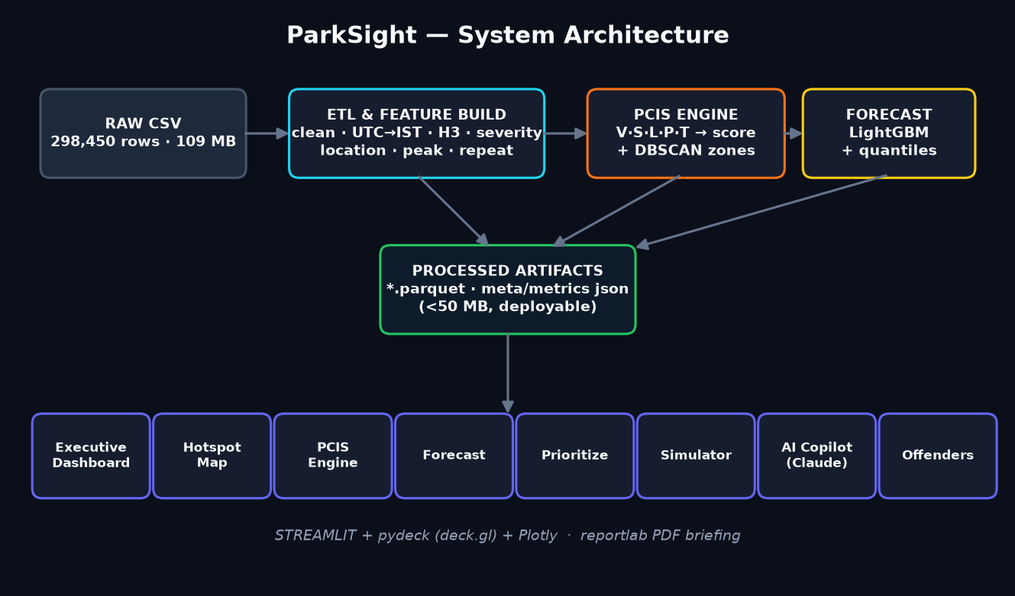
HOW IT'S BUILT
Precompute → tiny artifacts → instant app

Slide 12
IMPACT & HONESTY
Deployable, defensible, and honest
• A working, deployed product the Bengaluru Traffic Police could pilot now.
• PCIS is an explicit proxy — no traffic-flow column exists, and we say so.
• No closure/action timestamps → we don't overclaim response-time analytics.
• Roadmap: live SCITA/ITMS feed, OSM road-graph spillover, cell-level forecasting, patrol optimiser.
ParkSight
sees the blind spot,
scores the impact,
and deploys the plan.

