Slide 1
数字逻辑实验
王传胜、梁倬骞

Slide 2
编码器与译码器

Slide 3
实验目的
掌握用 Verilog HDL 进行数据流建模；
深入理解编码器与译码器的原理；
学会用 Verilog HDL 实现74LS148和74LS138；

Slide 4
实验内容
用Verilog HDL 语言实现74LS138的功能。
用Verilog HDL 语言实验74LS148的功能。

Slide 5
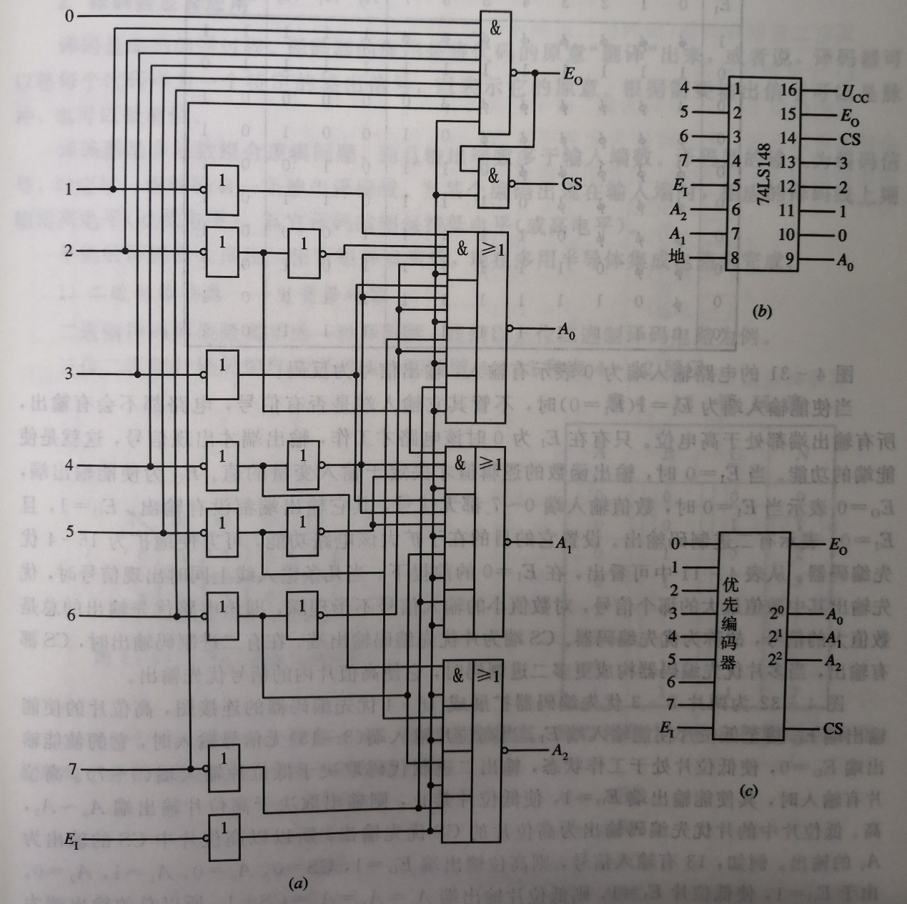
74LS148

Slide 6
74LS148功能表
输入 |  |  |  |  |  |  |  |  | 输出
E_{I} | I₀ | I₁ | I₂ | I₃ | I₄ | I₅ | I₆ | I₇ | A₂ | A₁ | A₀ | CS | E_{O}
1 | ╳ | ╳ | ╳ | ╳ | ╳ | ╳ | ╳ | ╳ | 1 | 1 | 1 | 1 | 1
0 | 1 | 1 | 1 | 1 | 1 | 1 | 1 | 1 | 1 | 1 | 1 | 1 | 0
0 | ╳ | ╳ | ╳ | ╳ | ╳ | ╳ | ╳ | 0 | 0 | 0 | 0 | 0 | 1
0 | ╳ | ╳ | ╳ | ╳ | ╳ | ╳ | 0 | 1 | 0 | 0 | 1 | 0 | 1
0 | ╳ | ╳ | ╳ | ╳ | ╳ | 0 | 1 | 1 | 0 | 1 | 0 | 0 | 1
0 | ╳ | ╳ | ╳ | ╳ | 0 | 1 | 1 | 1 | 0 | 1 | 1 | 0 | 1
0 | ╳ | ╳ | ╳ | 0 | 1 | 1 | 1 | 1 | 1 | 0 | 0 | 0 | 1
0 | ╳ | ╳ | 0 | 1 | 1 | 1 | 1 | 1 | 1 | 0 | 1 | 0 | 1
0 | ╳ | 0 | 1 | 1 | 1 | 1 | 1 | 1 | 1 | 1 | 0 | 0 | 1
0 | 0 | 1 | 1 | 1 | 1 | 1 | 1 | 1 | 1 | 1 | 1 | 0 | 1

Slide 7
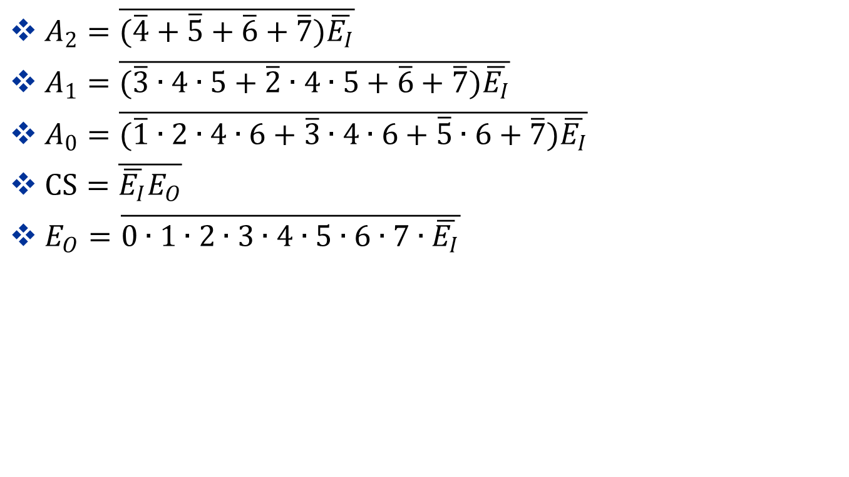
74LS148表达式
$A_{2}=\overline{(\overline{4}+\overline{5}+\overline{6}+\overline{7})\overline{E_{I}}}$
$A_{1}=\overline{(\overline{3}∙4∙5+\overline{2}∙4∙5+\overline{6}+\overline{7})\overline{E_{I}}}$
$A_{0}=\overline{(\overline{1}∙2∙4∙6+\overline{3}∙4∙6+\overline{5}∙6+\overline{7})\overline{E_{I}}}$
$CS=\overline{\overline{E_{I}}E_{O}}$
$E_{O}=\overline{0∙1∙2∙3∙4∙5∙6∙7∙\overline{E_{I}}}$

Slide 8
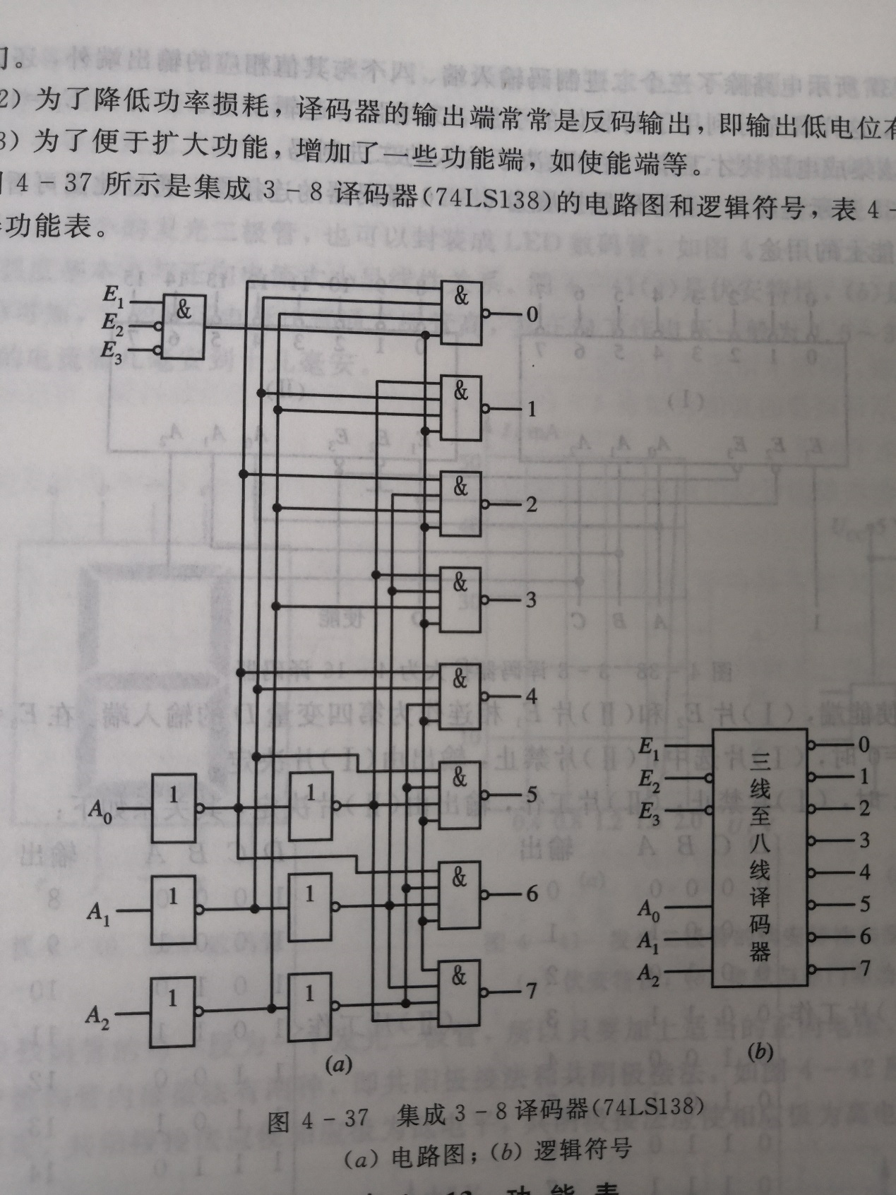
74LS138

Slide 9
74LS138功能表
片选信号 |  |  | 译码地址输入 |  |  | 译码输出
/G₃ | /G₂ | G₁ | A₂ | A₁ | A₀ | /Y₀ | /Y₁ | /Y₂ | /Y₃ | /Y₄ | /Y₅ | /Y₆ | /Y₇
H | ╳ | ╳ | ╳ | ╳ | ╳ | H | H | H | H | H | H | H | H
╳ | H | ╳ | ╳ | ╳ | ╳ | H | H | H | H | H | H | H | H
╳ | ╳ | L | ╳ | ╳ | ╳ | H | H | H | H | H | H | H | H
L | L | H | L | L | L | L | H | H | H | H | H | H | H
L | L | H | L | L | H | H | L | H | H | H | H | H | H
L | L | H | L | H | L | H | H | L | H | H | H | H | H
L | L | H | L | H | H | H | H | H | L | H | H | H | H
L | L | H | H | L | L | H | H | H | H | L | H | H | H
L | L | H | H | L | H | H | H | H | H | H | L | H | H
L | L | H | H | H | L | H | H | H | H | H | H | L | H
L | L | H | H | H | H | H | H | H | H | H | H | H | L

Slide 10
预习
数字比较器

