Slide 1

Comparison between the human reactions in a simulacrum and in a real fire situation
Fire and Evacuation Modeling Technical Conference (FEMTC) 2016
November 16 – November 18
Elisabete Cordeiro / António Leça Coelho / Miguel C. S. Nepomuceno
UBI / LNEC / UBI
eccordeiro@gmail.com / alcoelho@lnec.pt / mcsn@ubi.pt
Notes:
Good morning, my name is Elisabete Cordeiro and I am a PhD student at the University of Beira Interior in Portugal.

Slide 2
CONTENTS
Fire and Evacuation Modeling Technical Conference (FEMTC) 2016
Introduction
Summary of the Results of the Study
Comparison of occupant behavior between Type 1, Type 2 and Type 3 Surveys
Conclusion
Aware
Interpretation
Time Spent
Reaction
Assessment of the situation
Receive indication by someone
Take Something
Task
Way To Leave The Building
See Smoke
View the fire
Notes:
Today I will present some preliminary results of my PhD.
The results I will presented is the comparison of the human behavior in a real fire situation with the human behavior in a fire drill and what the occupants think they will do against a fire situation.

Slide 3
Introduction

Slide 4
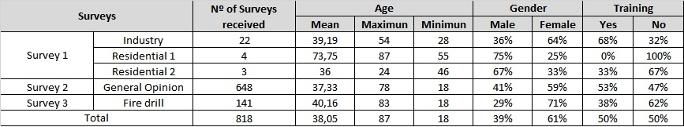
INTRODUCTION
Fire and Evacuation Modeling Technical Conference (FEMTC) 2016
It is necessary to train occupants so in an emergency situation they can react appropriately. These trainings are only possible through exercises/fire drills.
To understand if human behavior in fire drills reflects possible human behavior in a real fire situation it is necessary to compare the actions and behavior of the occupants in both situations.
TYPE 1
Distributed among people who were involved in a fire
The methodology used was based on 3 different surveys.
29
Distributed to the general population, no selection was made for this distribution
SURVEYS
TYPE 2
648
TYPE 3
People who took part in a fire drill at two shopping centers
84% were aware of the fire drill.
141
Notes:
To study the human behavior in a fire situation the methodology used was based on 3 different surveys.
The surveys had several comum question or very similares.
Survey type 1 was Distributed among people who were involved in a fire. In total we have 29 respondents.
Survey type 2 was Distributed to the general population, no selection was made for this distribution. In total we have 648 respondents.
Survey type 3 was Distributed among people who took part in a fire drill at two shopping centers. 141 respondents.
84% were aware of the fire drill.
In total we have 818 respondents.

Slide 5
Summary of the Results of the Study
Aware
Interpretation
Time Spent
Reaction
Assessment of the situation
Receive indication by someone
Take Something
Task
Way To Leave The Building
See Smoke
View the fire
Comparison of occupant behavior between Type 1, Type 2 and Type 3 Surveys

Slide 6
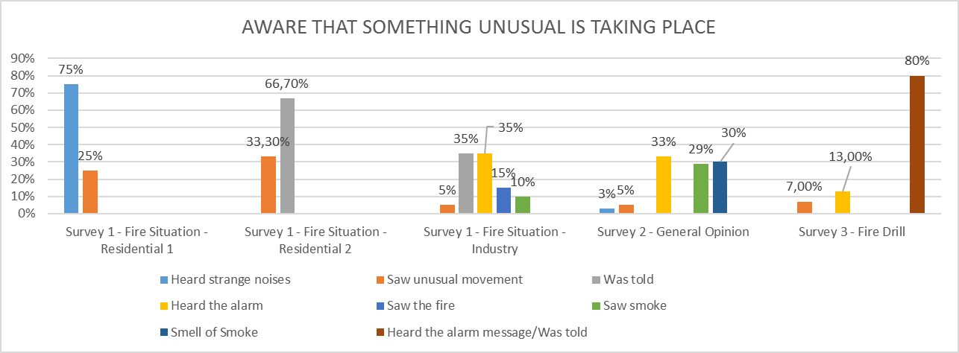
AWARE THAT SOMETHING UNUSUAL IS TAKING PLACE
Fire and Evacuation Modeling Technical Conference (FEMTC) 2016
"How did you know that something unusual was happening?”
NO ALARM
ALARM MESSAGE
What mainly caught your attention?
Notes:
AWARE THAT SOMETHING UNUSUAL IS TAKING PLACE

Slide 7
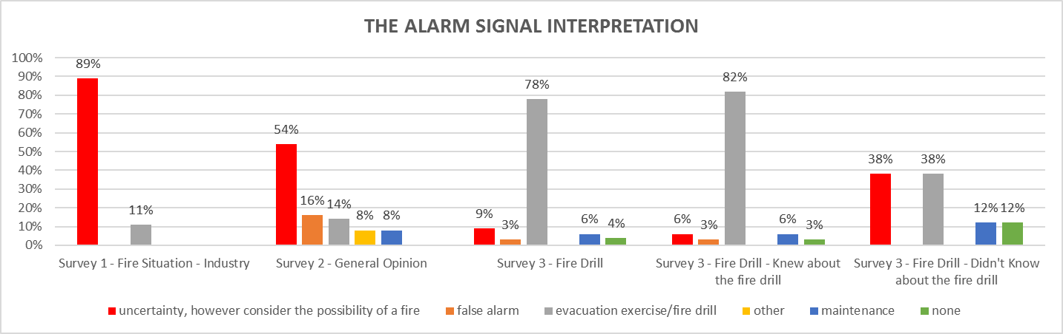
THE ALARM SIGNAL INTERPRETATION
Fire and Evacuation Modeling Technical Conference (FEMTC) 2016

Slide 8
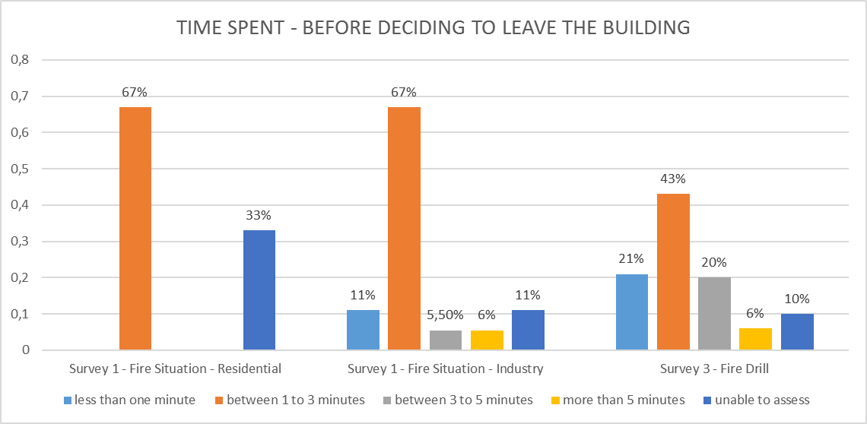
TIME SPENT - BEFORE DECIDING TO LEAVE THE BUILDING
Fire and Evacuation Modeling Technical Conference (FEMTC) 2016
“How much time passed between the moment you became aware that something unusual was happening and the moment you decided to leave the building?”

Slide 9
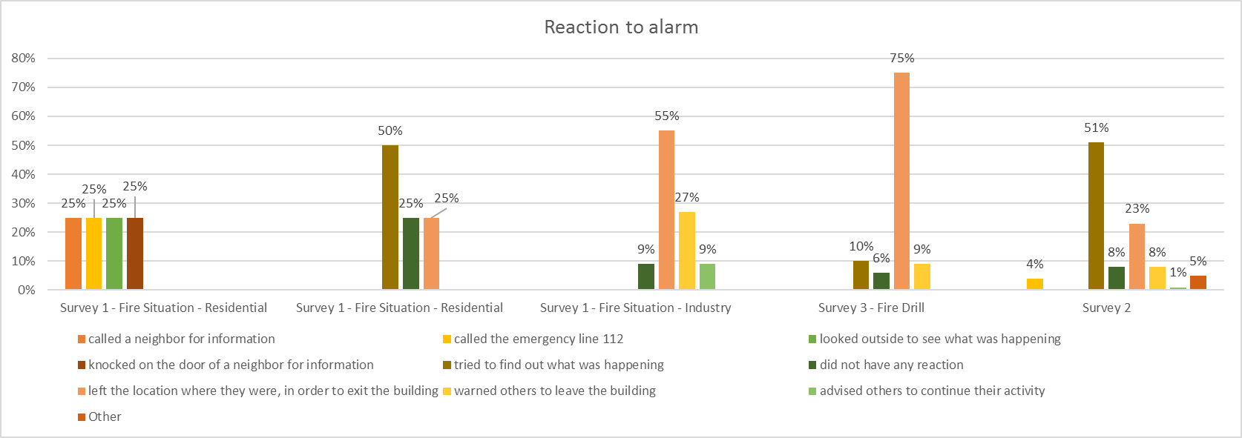
Reaction to alarm
Fire and Evacuation Modeling Technical Conference (FEMTC) 2016
“What did you do once you became aware that something unusual was happening?”
Left the location
Left the location
Find out
“What is usually your reaction to the alarm?”
Notes:
Residential fire gave 4 different responses to this question, one “called a neighbor for information”, another “called the emergency line 112”, another was “looked outside to see what was happening” and finally another “knocked on the door of a neighbor for information”. In the other residential fire 50% indicated “tried to ind out what was happening”, “did not have any reaction” and “left the location where they were, in order to exit the building” with 25% each. If the building had an alarm system the survey inquired “What was your reaction to the alarm?” Of the 11 respondents from the industrial ⍅ire survey who heard the alarm, 55% “left the place in order to exit the building”, 27% “warned others to leave the building” and 9% “had no reaction” or “advised others to continue their activity”. Gender and training in⍅luenced the answers given by respondents. In the case of the responses from the ⍅ire drill, 75% of the respondents who had heard the alarm or the alarm message “left the place in order to exit the building”, 10% “wanted to know what was happening”, 9% “warned others” and 6% “had no reaction”. In type 2 survey, when analyzing responses to the question, “What is usually your reaction to the alarm?”, 51% of the respondents indicated “⍅ind out what was happening”, while 23% “leave the building and the place where they are”, 8% “do not have reaction”, 8% “warn others to leave the building”, 5% "other”, 4% “Contact ⍅ire⍅ighters” and ⍅inally 6% “advise others to continue their activity”

Slide 10
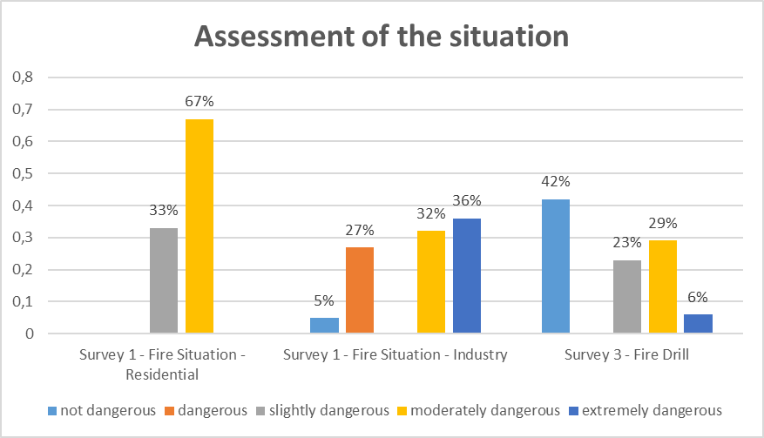
Assessment of the situation
Fire and Evacuation Modeling Technical Conference (FEMTC) 2016
“How dangerous do you think the situation was?”
Notes:
Regarding the question “How dangerous do you think the situation was?” 67% of the responses regarding the residential ⍅ire considered the situation 67% as “moderately dangerous” and 33% as “slightly dangerous”. In the case of the industrial ⍅ire, 36% evaluated the situation as “extremely dangerous”, 32% as “moderately dangerous”, 27% as “dangerous” and 5% as “not dangerous”. Regarding the ⍅ire drill 29% assessed the situation as “moderately dangerous”, 23% as “slightly dangerous”, 42% as “not dangerous” and 6% “extremely dangerous”

Slide 11
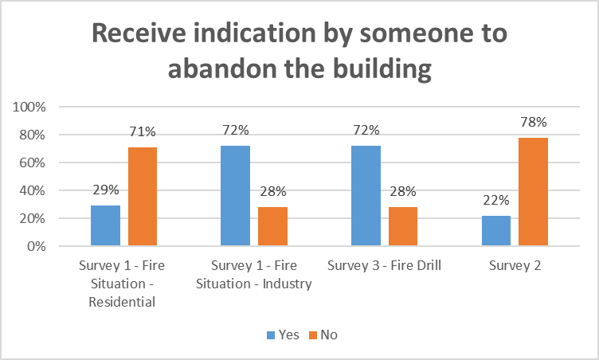
Receive indication by someone to abandon the building
Fire and Evacuation Modeling Technical Conference (FEMTC) 2016
“Did you decide to abandon the building because someone told you to?"
“Would you leave the building in case someone told you to?"
No Security staff
Both with Security staff
The message indicated to leave the building
Notes:
Survey Type 1 and 3 presented the following question “Did you decide to abandon the building because someone told you to?". Regarding the residential ⍅ire 71% said “No”. Regarding the industry ⍅ire 72% said “Yes”. As for the ⍅ire drill, 136 replied to this question and 72% “left the building because someone told them to do so” 2. Type 3 survey presented the question: “Would you leave the building in case someone told you to?" 637 individuals 78% replied to this question indicating “No”.

Slide 12
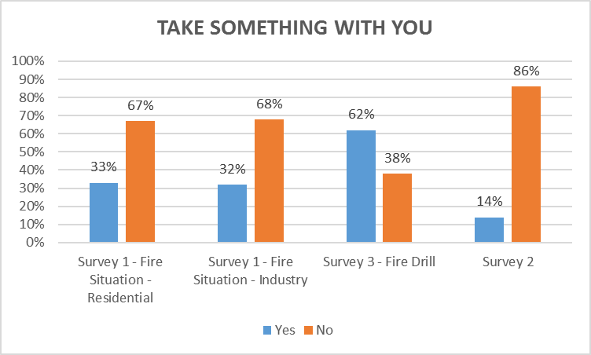
TAKE SOMETHING WITH YOU
Fire and Evacuation Modeling Technical Conference (FEMTC) 2016
“When you decided to leave the building, did you take anything with you?"
“Before leaving the building would you try to collect personal belongings?”
Notes:
Survey type 1 and 3 presented the following: “When you decided to leave the building, did you take anything with you?". 67% of the residential ⍅ire respondents said “No”. The respondents of the industrial ⍅ire 68% said “No”. the fire drill survey respondents namely 137 replied to this question and 62% said “Yes”. Survey type 2 asked “Before leaving the building would you try to collect personal belongings?” 86% said “No”. There were no major differences between gender, age group, education level and training in these answers. In this question there is a major difference between the ⍅ire drill (survey Type 3), the real situation (Survey Type 1) and what they think they would do (Survey Type 2). Results from Survey type 2 are similar to the results form Survey Type 1. In a ⍅ire drill the occupants can act differently due to the assessment made of the situation.

Slide 13
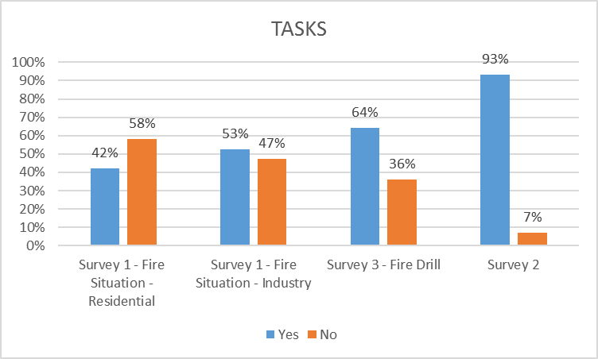
TASK
Fire and Evacuation Modeling Technical Conference (FEMTC) 2016
"Before deciding to abandon the building did you perform any of the following tasks (look for family members, warn others, contact the fire brigade, fight the fire, help others, pack your things)?"

Slide 14
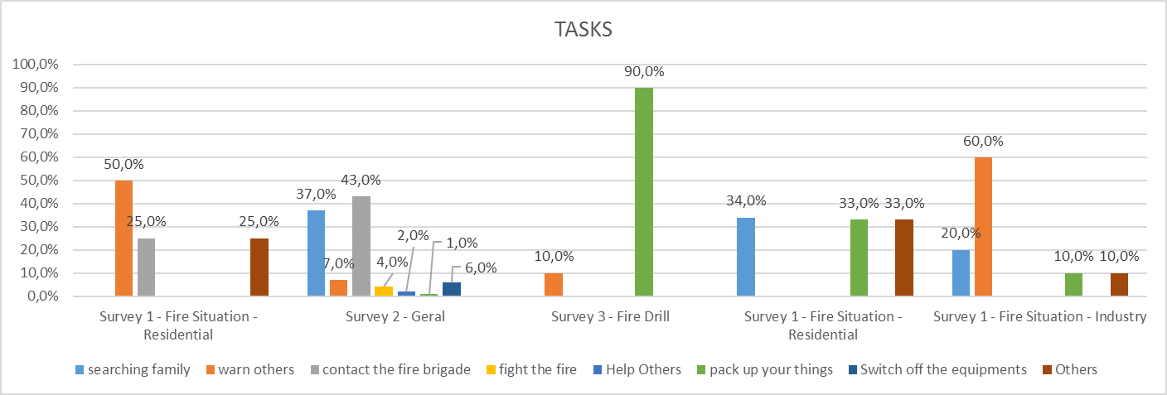
TASK
Fire and Evacuation Modeling Technical Conference (FEMTC) 2016
"Before deciding to abandon the building did you perform any of the following tasks (look for family members, warn others, contact the fire brigade, fight the fire, help others, pack your things)?"

Slide 15
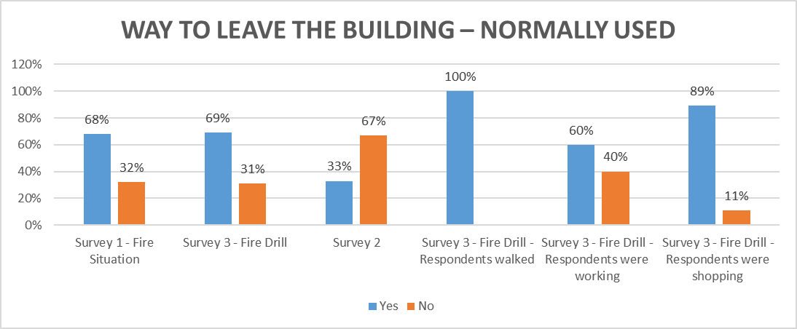
WAY TO LEAVE THE BUILDING – NORMALLY USED
Fire and Evacuation Modeling Technical Conference (FEMTC) 2016
“To leave the building did you use the way you normally use?”
“If you were in a building, which path would you use to exit the building?”
Notes:
Regarding the question “To leave the building did you use the way you normally use?” 68% of the respondents in survey Type 1 said “Yes”. In what regards the use of an emergency exit 78% indicated “Yes”. In survey Type 3, 69% of 137 respondents used the way they normally use. By analyzing the exit choice, 100% of the respondents walked, 89% of those who were shopping and 60% of those working used the way they normally use. When trying to understand if they used an emergency exit the survey inquired “In order to leave the building did you use an emergency exit?” In total 27% of 130 respondents indicated “Yes”. It appears that 100% of respondents who were walking did not use an emergency exit to leave the building nor did 96% of respondents who were shopping and or 66% of the respondents who were working. Survey type 3 presented the following question “During the ⍅ire drill did someone tell you what emergency exit to use?” The 131 respondents to this question, namely 59% said “No”, in that case 69% used the path they normally use. From the 41% respondents who was indicated an emergency exit, 61% did not use the path that normally use. Survey type 2 had a similar question “If you were in a building, which path would you use to exit the building?” 47% of the respondents, who answered this question mentioned they, “would seek the emergency exits to leave the building”, while 33% “would use the same way they used to enter the building”, 15% “would turn to emergency plants to ⍅ind emergency exits” and 5% “would ask someone to indicate the way out”.

Slide 16
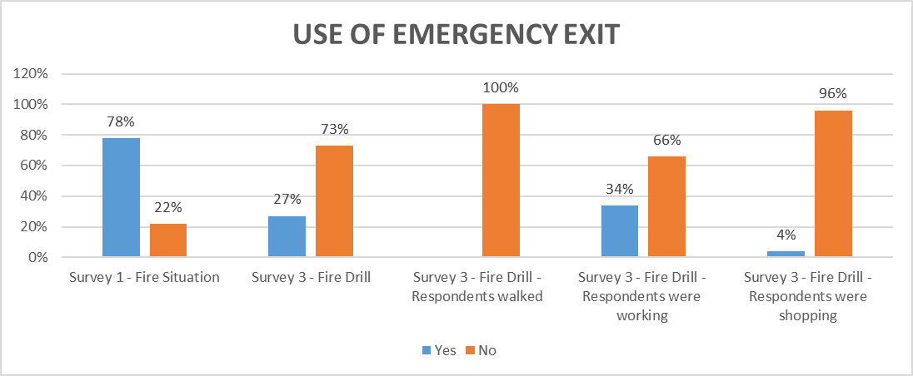
WAY TO LEAVE THE BUILDING – USE OF EMERGENCY EXIT
Fire and Evacuation Modeling Technical Conference (FEMTC) 2016
“To leave the building did you use an emergency exit?”

Slide 17
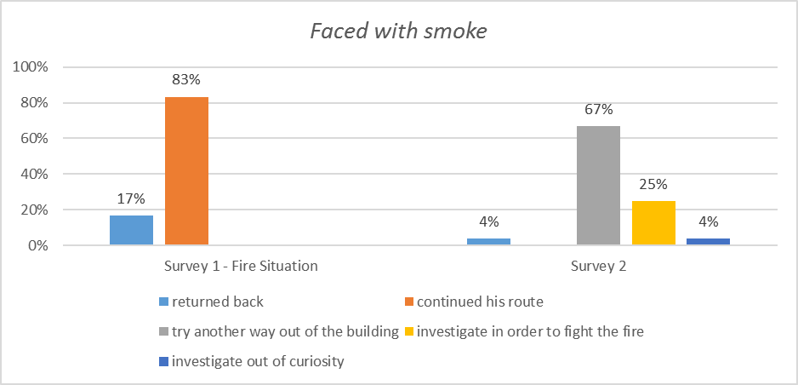
FACED WITH SMOKE
Fire and Evacuation Modeling Technical Conference (FEMTC) 2016
“If you were faced with smoke when trying to leave the building, what would your reaction be?
Reaction of the occupants when faced with the smoke

Slide 18
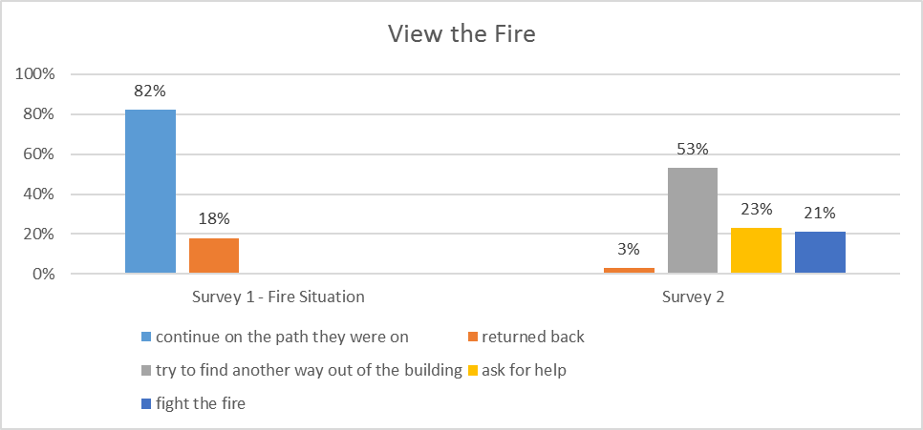
View the Fire
Fire and Evacuation Modeling Technical Conference (FEMTC) 2016
Reaction of the occupants when faced with the fire
“If you were leaving the building and you were faced with the fire. What would your first reaction be?”

Slide 19
Conclusion

Slide 20
Conclusion
Fire and Evacuation Modeling Technical Conference (FEMTC) 2016
Having in mind the conditionality, some of the observed tendencies have been observed as follows:
The behavior of occupants can depend on their knowledge of the situation as well as their assessment of it;
When the alarm is heard sometimes it is not enough to decide to leave the building;
Before leaving the building the occupants perform several tasks, the main tasks are “look for family” or “warn others” as well as “take personal items”;
In order to leave the building, occupants tend not always to use the most appropriate way, giving preference to the normal path they used to enter the building;
In a fire drill, the behavior of the occupants may be different compared to a real fire situation.

Slide 21

Conclusion
Fire and Evacuation Modeling Technical Conference (FEMTC) 2016
Emergency Situation
Human
Behaviour
Building Characteristics
Occupant Characteristics

Slide 22

Thank You!

