Slide 1
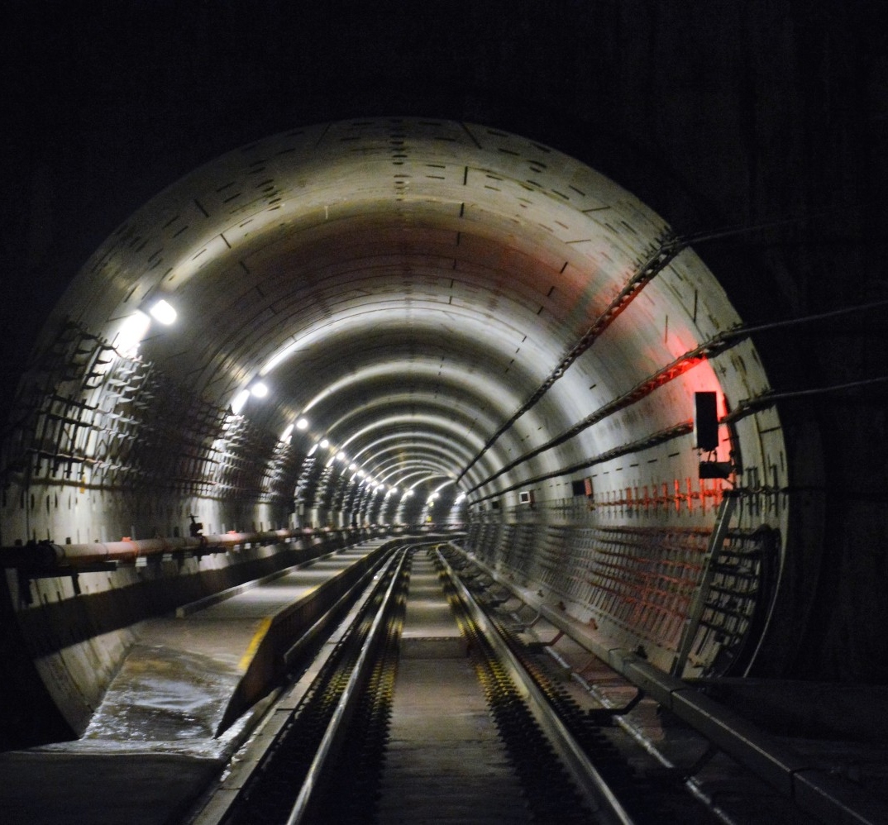
A COMPARATIVE STUDY OF FIRE SAFETY PROVISIONS EFFECTING EVACUATION SAFETY IN A METRO TUNNEL
Andrew Purchase
Karl Fridolf
Daniel Rosberg

Slide 2
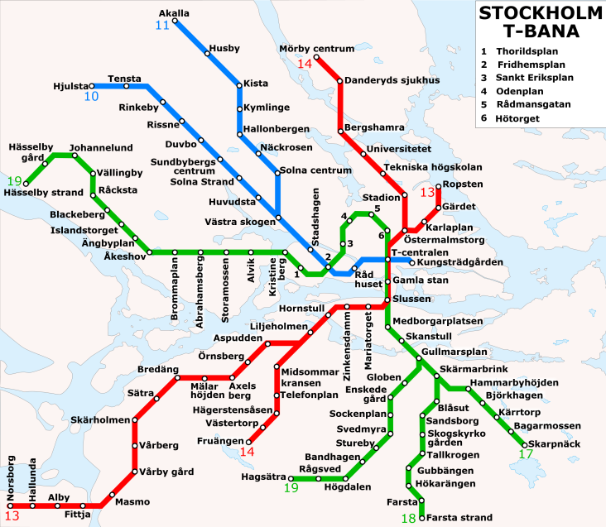
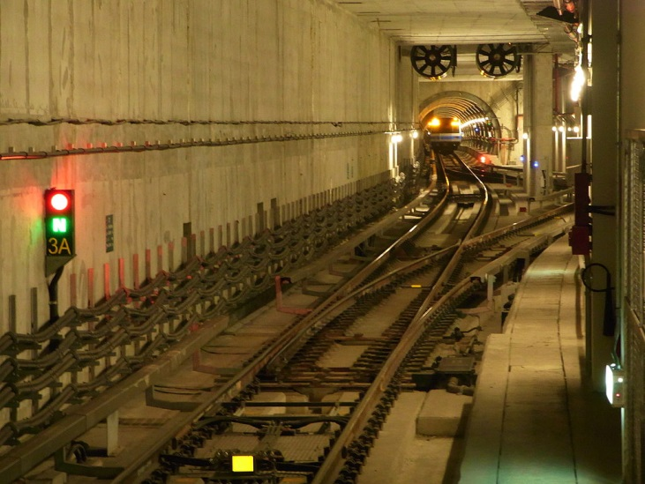
Background
Rail/metro tunnels
Geometrically simple – a tube / box
Aerodynamically complex – train movements, vent, winds, etc.
Fires in rail tunnels
Continue to the next station
Not always possible to reach station
Unlikely event, but generally credible enough to design for a train fire in a tunnel
Source: https://upload.wikimedia.org/wikipedia/commons/e/e9/
Stockholm_metrosystem_map.svg
Accessed 2016/10/19, reproduced under CC licence CC BY-SA 3.0
Source: https://en.wikipedia.org/wiki/Tunnel#/media/File:
A_crossover_on_the_south_side_of_Zhongxiao_Xinsheng_Station.JPG
Accessed 2016/10/19, reproduced under GNU Licence V 1.2.

Slide 3
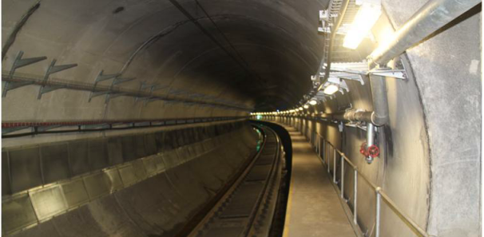
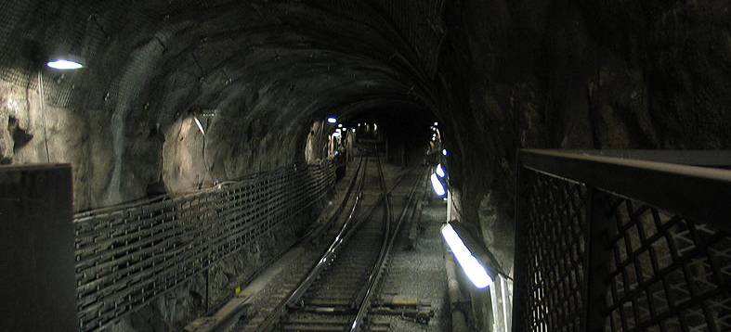
What is a ‘typical’ rail tunnel evacuation design?
Some provisions are typical:
Walkways with emergency lighting to assist with evacuation
Regular exits once tunnels are over a certain length
Some provisions vary around the world:
Longitudinal ventilation for smoke control
Walkway width: 0.7m – 1.5m
Walkway elevation: track or train floor level
Spacing of exits: 240m to >500m
Source: Author
Source: https://commons.wikimedia.org/wiki/File:Swe_subway_
switch_20050425_001.jpg/, accessed 19/10/16, public domain

Slide 4
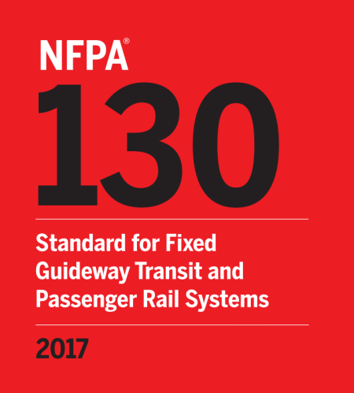

Why the variation in typical provisions?
Many reasons:
Standards for a particular jurisdiction
Each system has it’s own nuances
Difference in opinion / perceptions of safety
Driven by performance based design
Maintaining a strategy within a wider system
Stakeholder requirements, etc. etc.
But, can be misleading / confusing when a provision is viewed in isolation
Question: “Why do / don’t we have this provision?”
Other disciplines may not appreciate the implications of a change

Slide 5
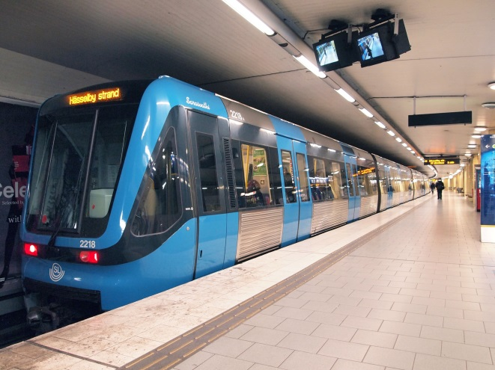
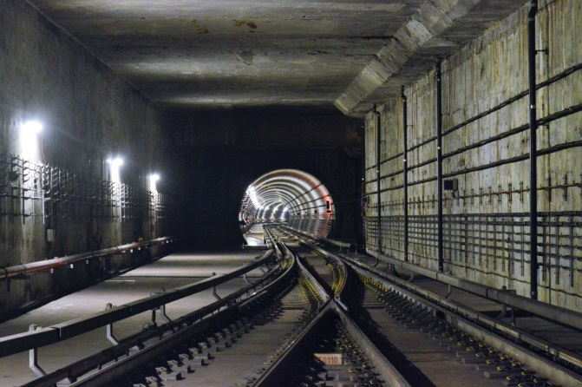
Purpose and use
What are you trying to achieve?
Investigate a range of tunnel evacuation design configurations and the impact that these have on evacuation safety. Focus on metro tunnels.
How do you do this?
CFD and evacuation modelling with results compared on the basis of visibility and the accumulated FED regarding asphyxiates.
What are the limitations?
Applies only to a specific set of inputs, assumptions and engineering simplifications.
How can I use this?
This paper is not intended to provide a 'solution' to rail tunnel evacuation, and this approach is in no-way advocated. Instead, this paper provides a comparative set of results that can be used by fire safety designers when developing their own options for further assessment.
Source: https://en.wikipedia.org/wiki/Stockholm_metro
Accessed 2016/10/19, CC licence CC BY-SA 3.0
Source: WSP Stock Photo

Slide 6
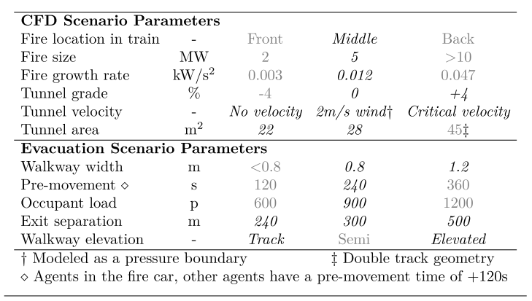
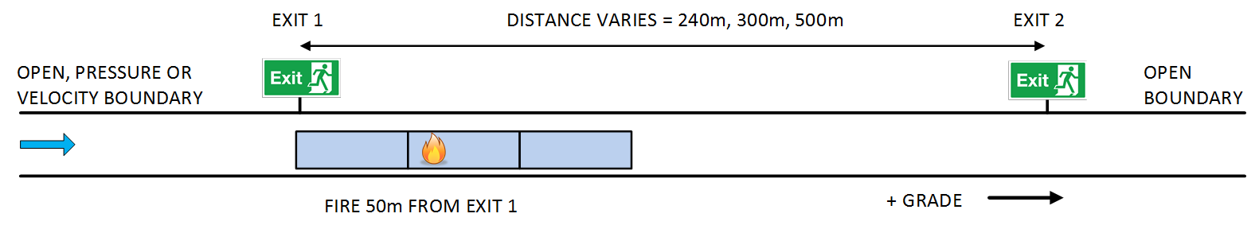
Scenario selection
12 CFD simulations, 144 evacuation scenarios

Slide 7

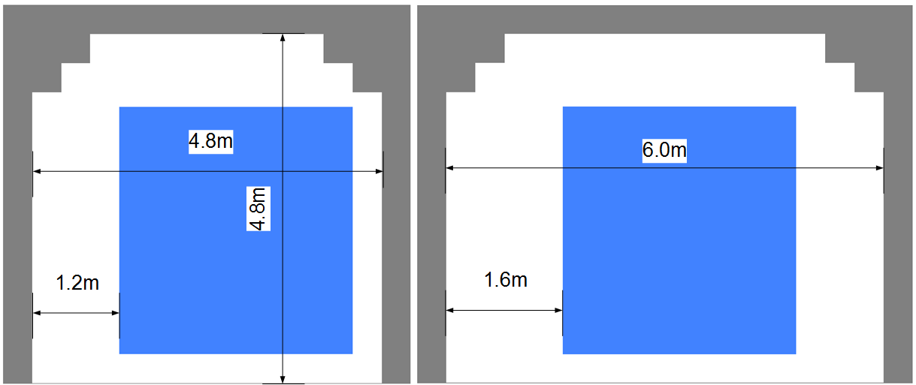
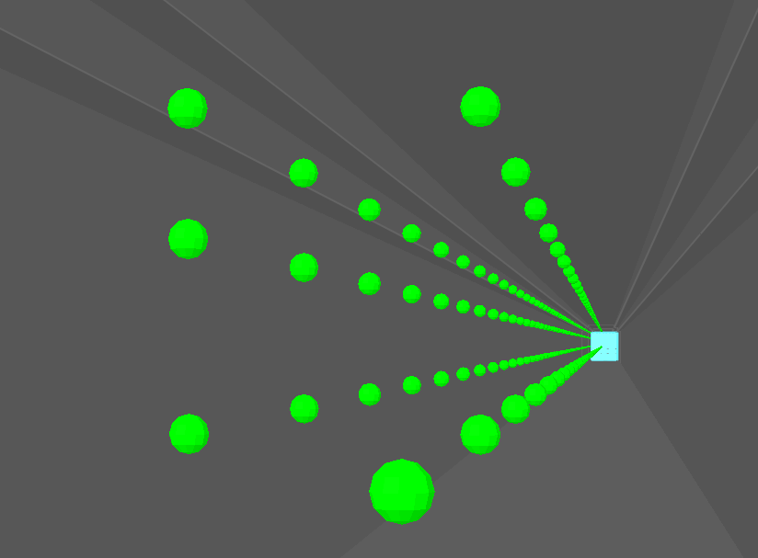
CFD modelling
FDS Version 6
900m long tunnel allows for 140m long train and 500m(+) exits
Two tunnel cross-sections, 12 models in total
Devices to record visibility, temperature, CO, CO₂, O₂
Results interpreted as space (X) vs time (T) figures
Snapshot of results in following slides
Train
900m

Slide 8
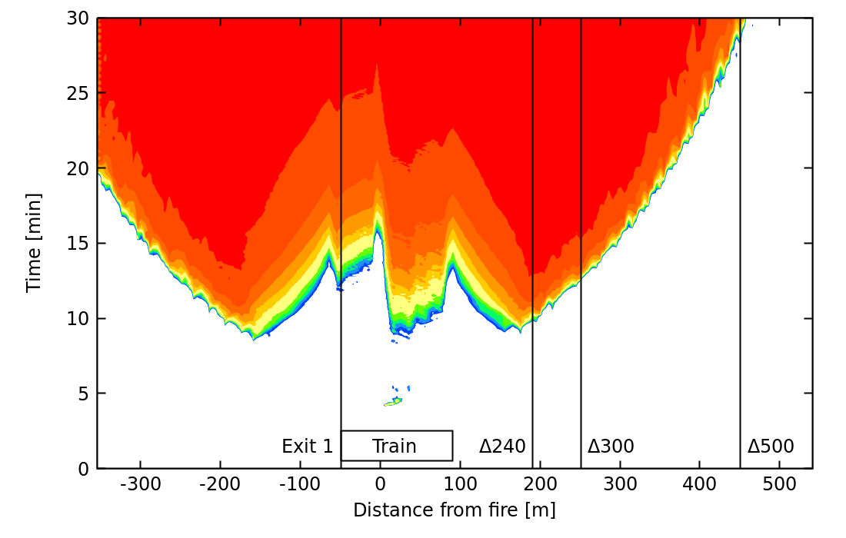
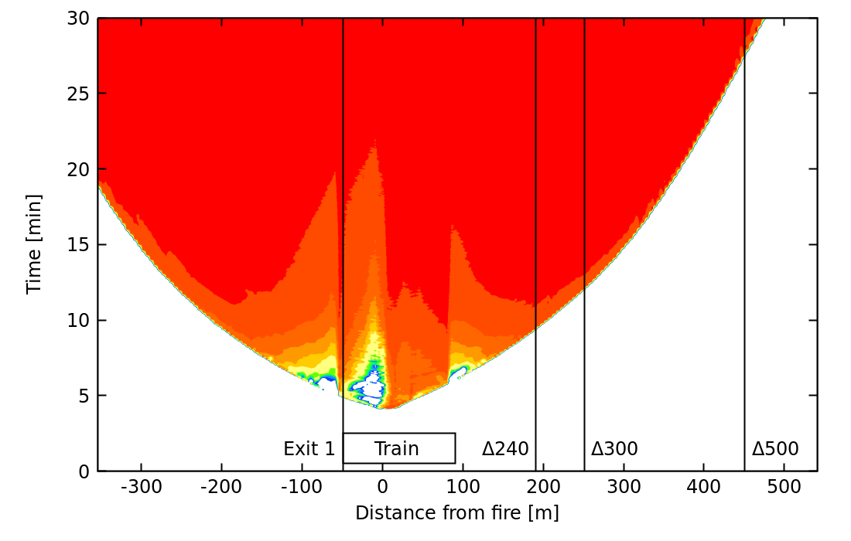
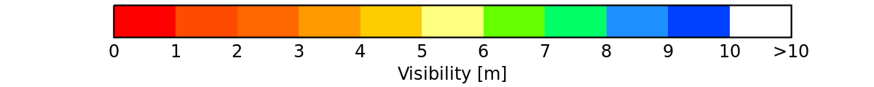
Visibility – walkway elevation
22m² cross-sectional area, still air, 0% grade tunnel
Track-level walkway
Elevated walkway

Slide 9
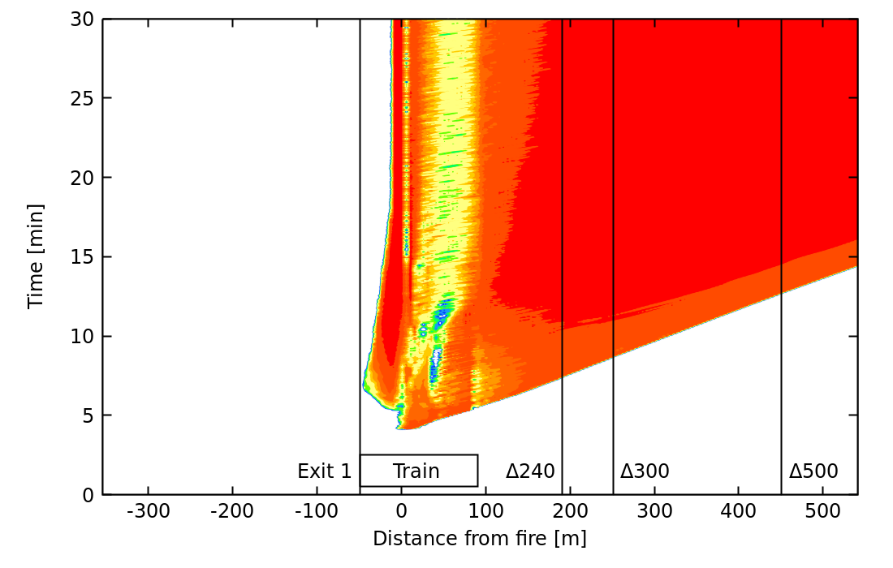
Visibility – grade effect
22m² cross sectional area, still air, walkway
0% grade
4% grade

Slide 10
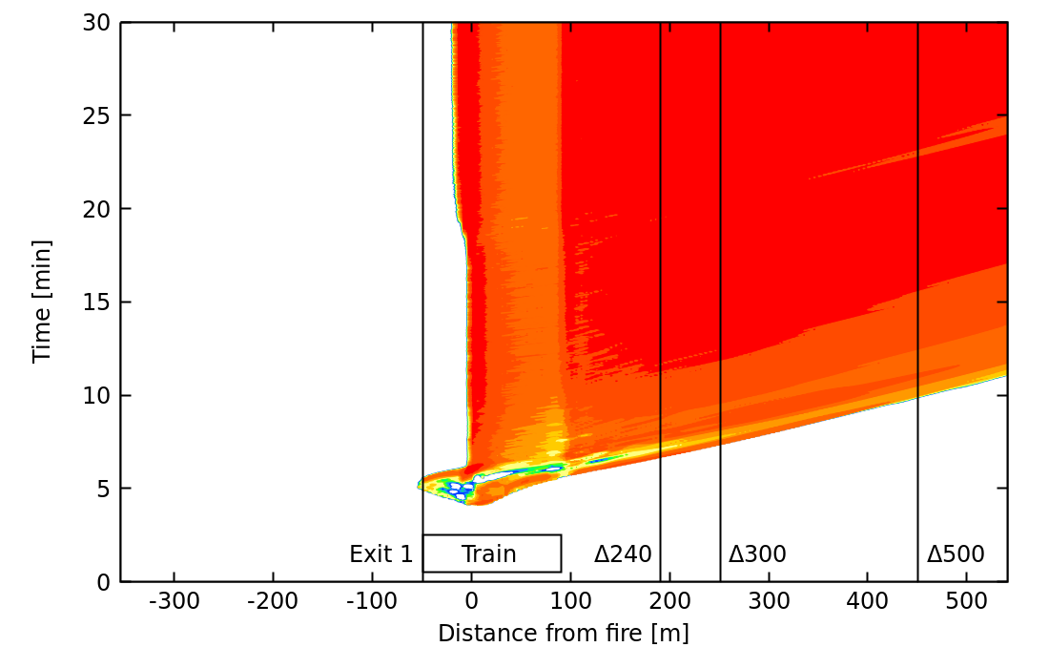
Visibility – longitudinal ventilation effect
22m² cross sectional area, 0% grade, elevated walkway
Still air
Critical velocity

Slide 11
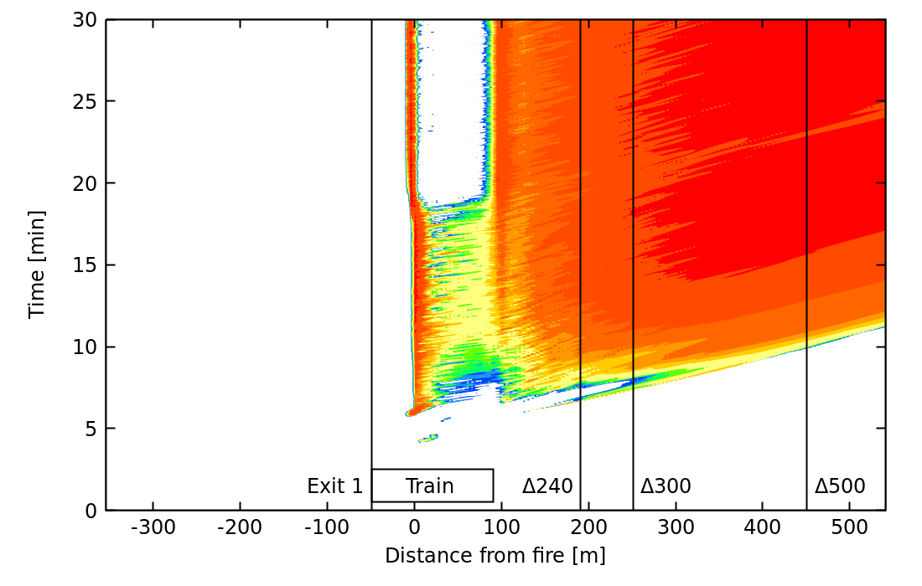
Visibility – walkway elevation, critical velocity
22m² cross sectional area, 0% grade
Track-level walkway
Elevated walkway

Slide 12
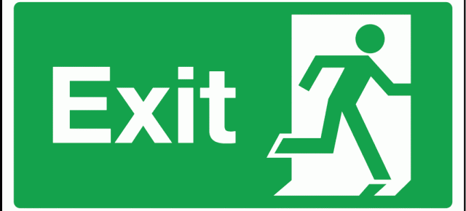
Evacuation modelling
1-D evacuation model
Purpose-built for rail tunnel evacuation
Developed in Perl, scripted
Flow rate along walkway (Lundström et al.)
Flow rate along walkway with train (BBRAD)
Walking speed in smoke (Fridolf et al.), = extinction coefficient
Walking speed = f(crowding, flow rate, visibility, agent characteristics)
Snapshot of results – see paper for more
22m² tunnel with 800mm walkway
28m² tunnel with 1200mm walkway

Slide 13
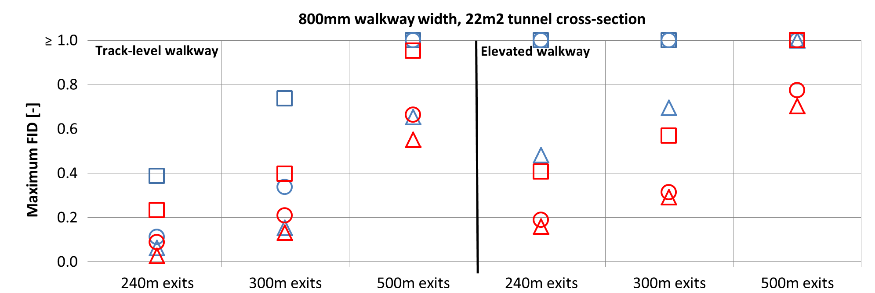
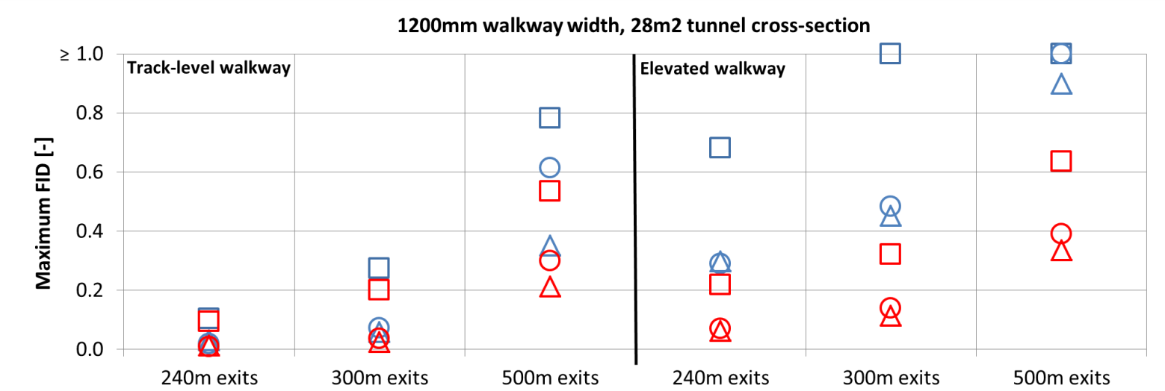
Maximum FIDs
Highest
500m exits
Elevated
22m² tunnel
Lowest:
240m exits
Track-level
28m² tunnel
Spread
varies with grade, velocity conditions, area

Slide 14
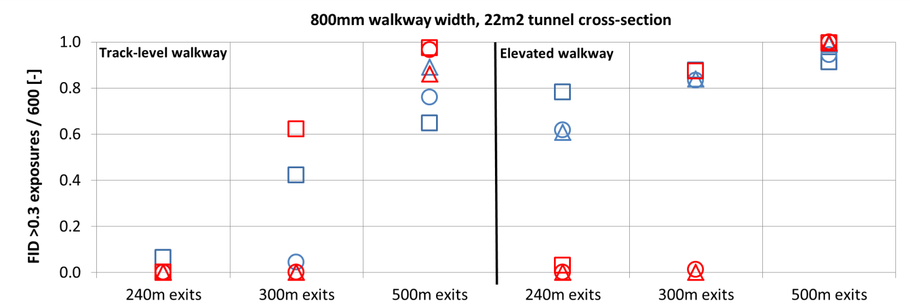
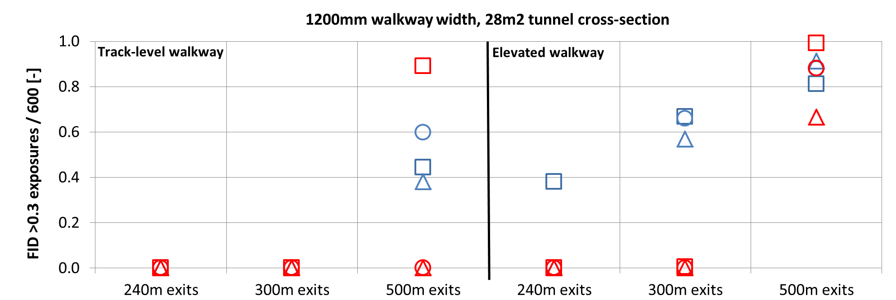
Number of exposures to FID ≥ 0.3
Highest
500m exits
Elevated
22m² tunnel
Lowest:
240m exits
Track-level
28m² tunnel
Spread
varies with grade, velocity conditions, area

Slide 15
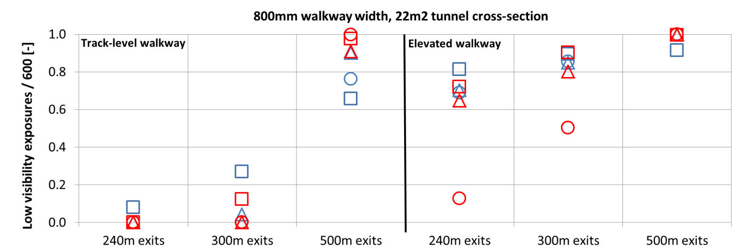
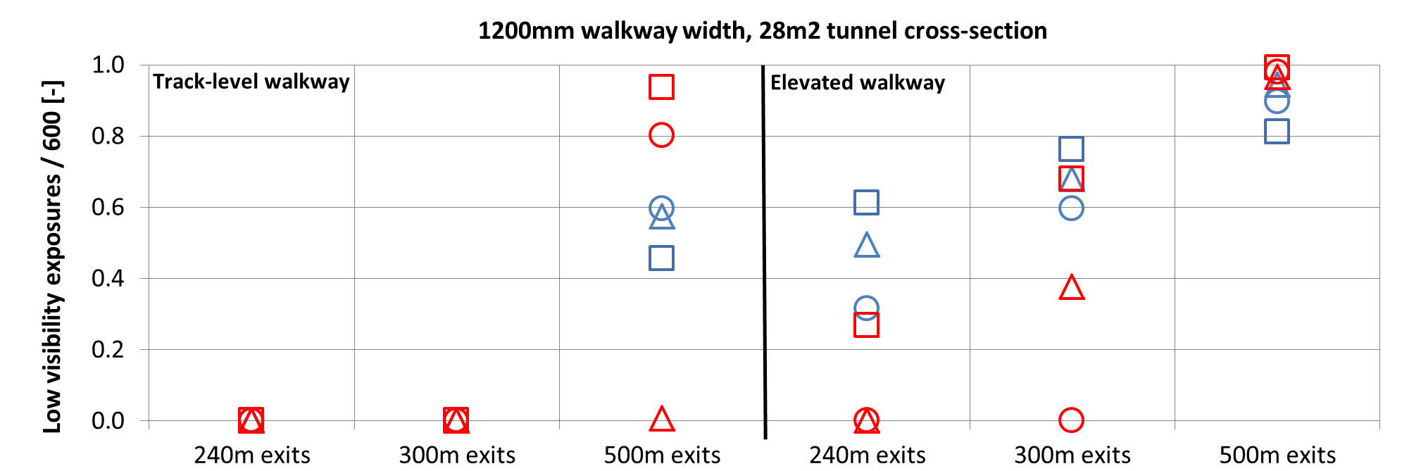
Low visibility exposures
Outcomes not always clear with different velocity conditions
Still air generally worse for short exit distances
Airflow (forced or grade effect) generally worse for long exit distances

Slide 16
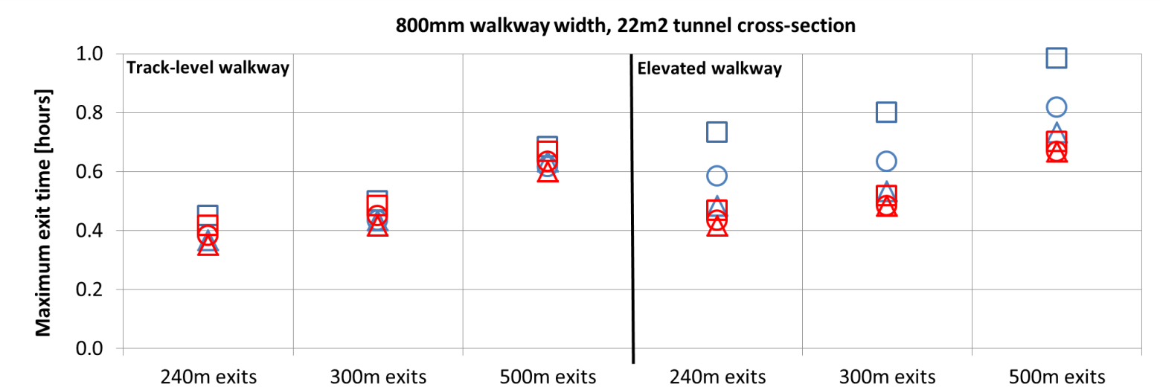
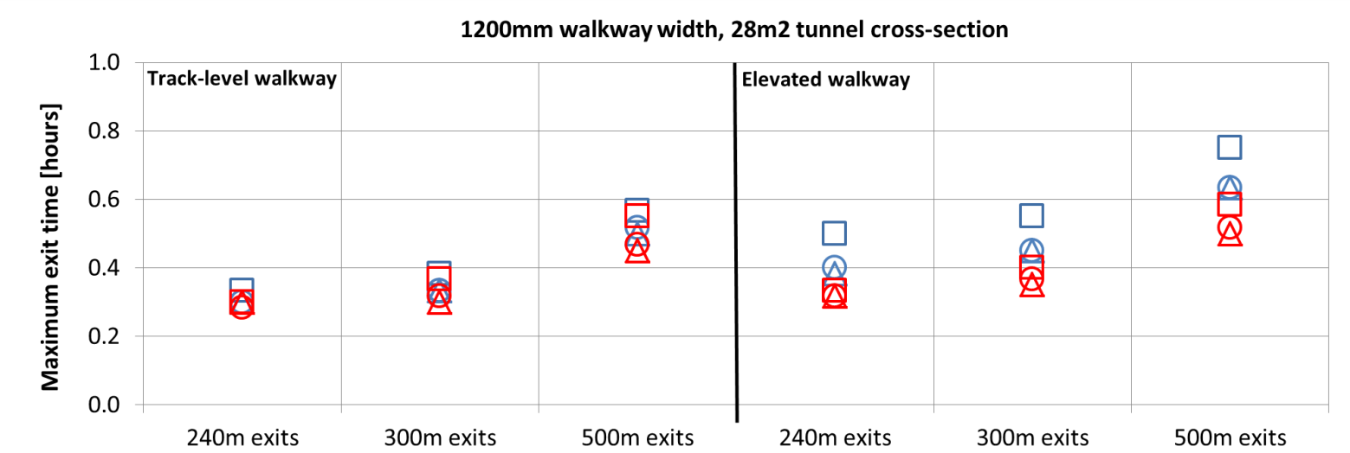
Total evacuation time
Evacuation times increased with increasing exit spacing, reduced walkway width
Longer times with elevated walkway due to reduced speed in lower visibility
Improved with larger tunnel cross-section

Slide 17
Conclusions
Outcomes likely obvious to an experienced practitioner
In general, and specific to the modelling undertaken:
Increase exit spacing, reduce walkway width ~ reduces tenability
Decrease exit spacing, wider / low-level walkway ~ increases tenability
Important to consider tunnel grade and area
Outcomes with different velocity conditions are not always obvious
So what is the ‘best’ configuration?
Depends on the specifics of a project
Perspectives: Ideal fire safety = cost effective? Probably not.
Trade-offs to arrive at an optimal solution → value in modelling

Slide 18

Thank you!
andrew.purchase@wspgroup.se

