Slide 1
Move to Gothenburg
Mobile App Prototype

Slide 2
Purpose
Based on user input, the app ‘generates’ a list of tailored benefits for the high taxation in Sweden, to attract foreign talent and convince them to stay.
Notes:
The aim of this app is to encourage international talent to move to Gothenburg and give them enough reasons to stay, in spite of the extraordinary Swedish taxes. The way it does this, is it takes input from the user, such as age, country they are coming from and marital status, and given more time on the project, we would have liked to implement more questions for the user, such as potential salary expectation and duration of stay. But nevertheless, based on the given input, the app lists the most relevant advantages and most significant personal benefits of living in Gothenburg.

Slide 3
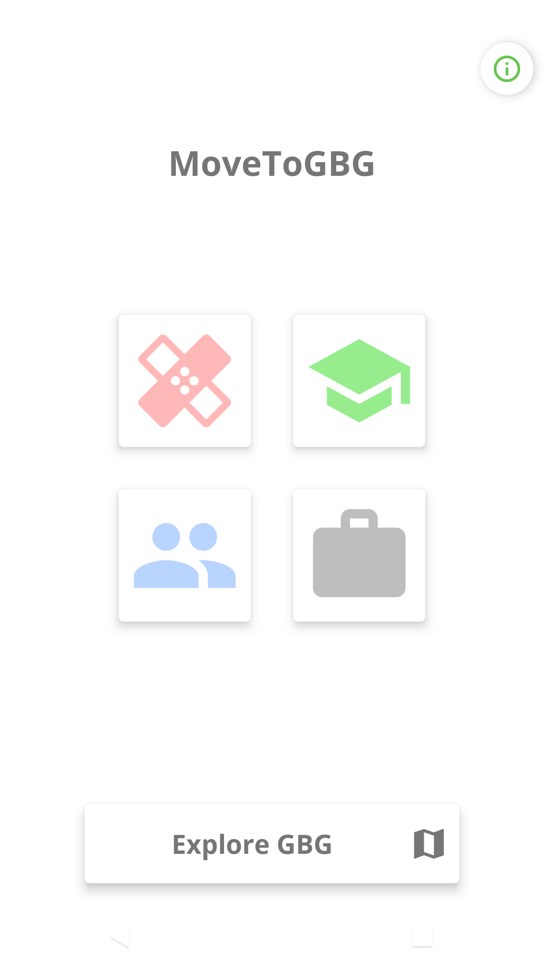
The general layout
Four titles representing aspects of living, containing subtitles and filtered, appealing details about Gothenburg and what it has to offer
A map button to show general points of interest (Explore GBG)
Notes:
For the aspect of the app, we have decided on grouping these benefits in categories: Health, Education, Work and Life & Society. These categories have subtitles, where the user is given a detailed explanation of the advantages of living here, and paying the high taxation. There is also a button that opens up a map which showcases important or exciting locations in the city, that could also appeal to the user.

Slide 4
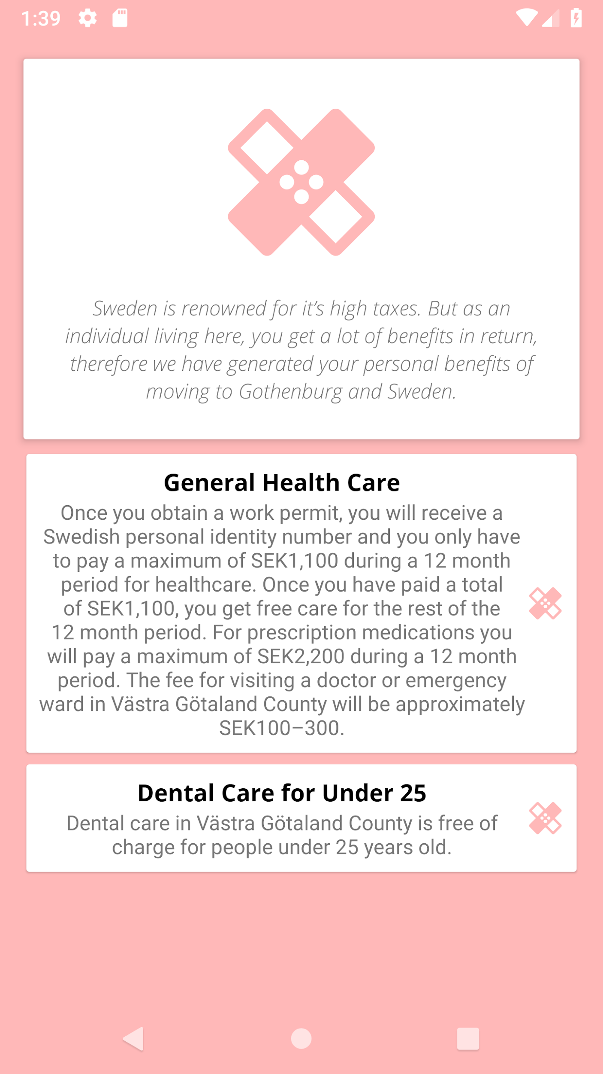
Demonstrative profile
Amelia
24 years old
Female
Singapore
Moving alone
Dental care for the appropriate age (under 25)

Slide 5
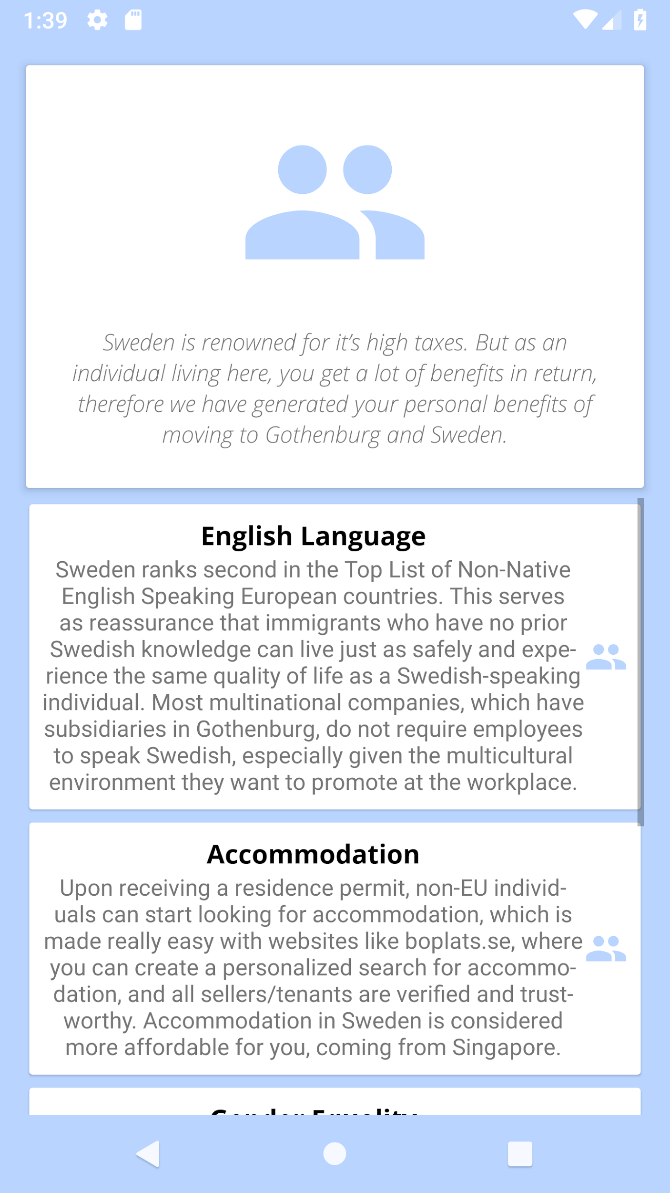
Demonstrative profile
Amelia
24 years old
Female
Singapore
Moving alone
Relevant accommodation cost comparison

Slide 6
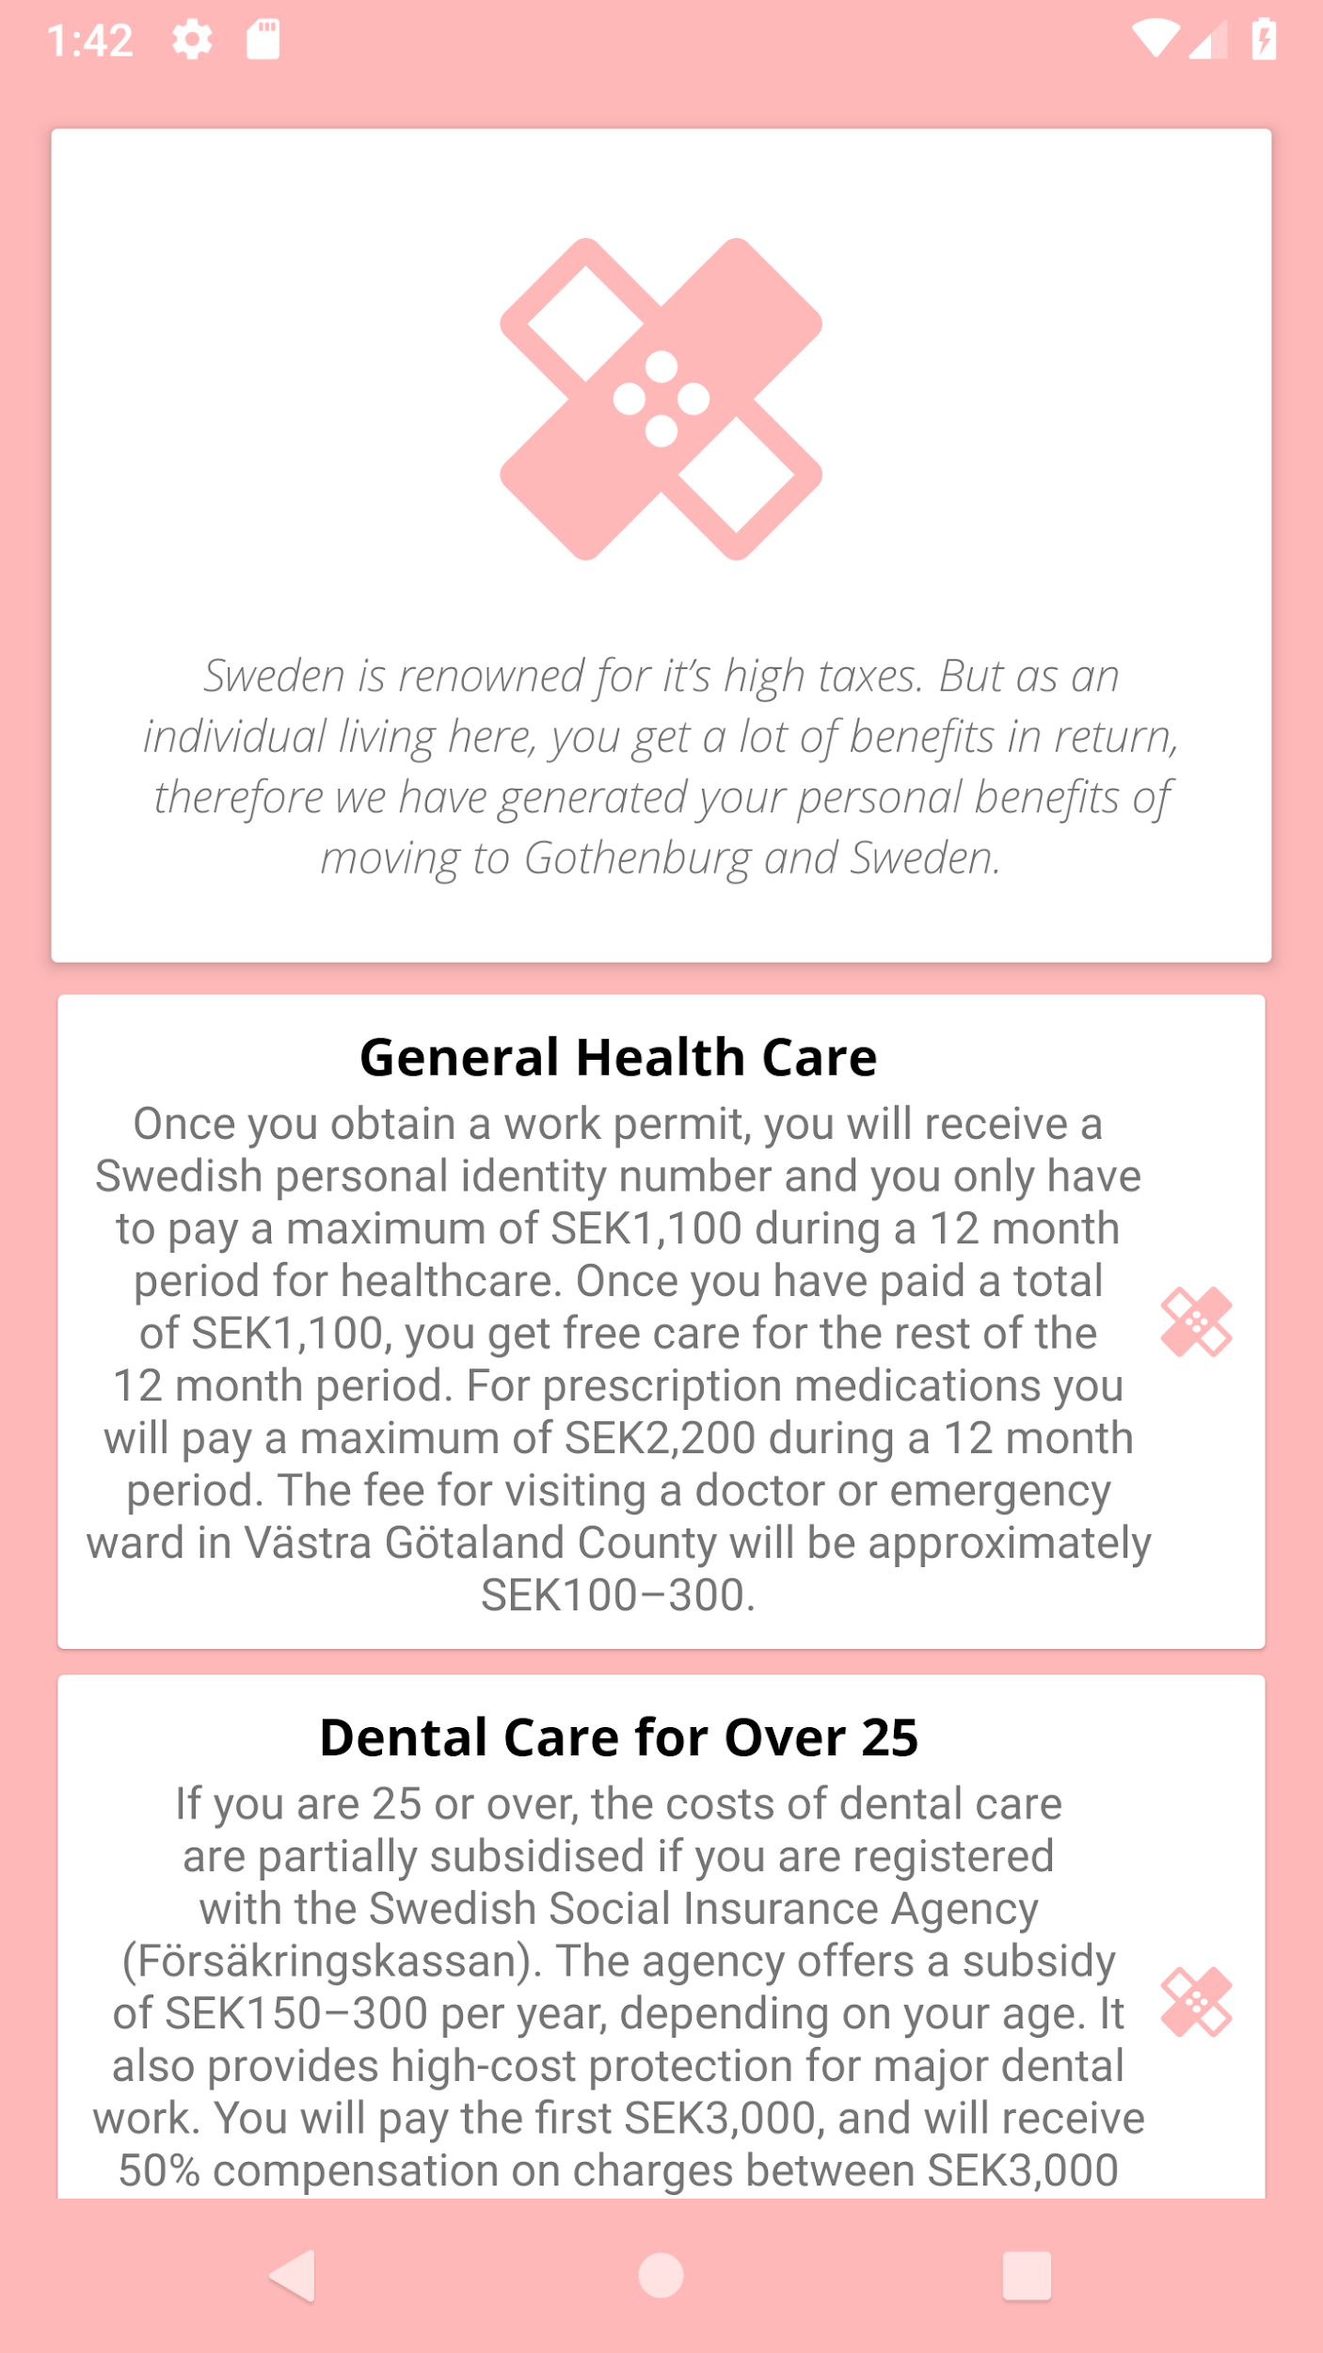
Demonstrative profile
Marko
41 years old
Male
Helsinki, Finland
Moving with family (wife, and child aged 6-17)
Dental care for the appropriate age (over 25)

Slide 7
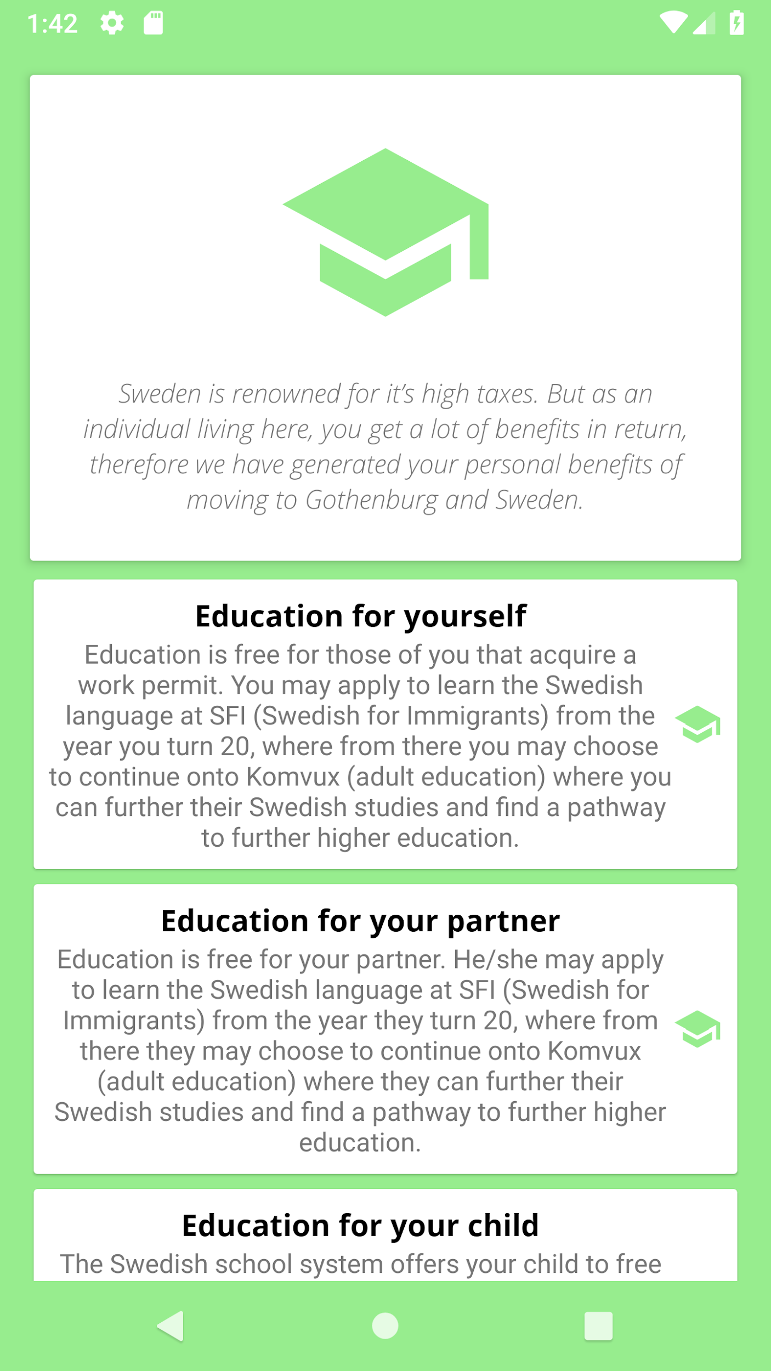
Demonstrative profile
Marko
41 years old
Male
Helsinki, Finland
Moving with family (wife, and child aged 6-17)
Education opportunities for user’s family

Slide 8
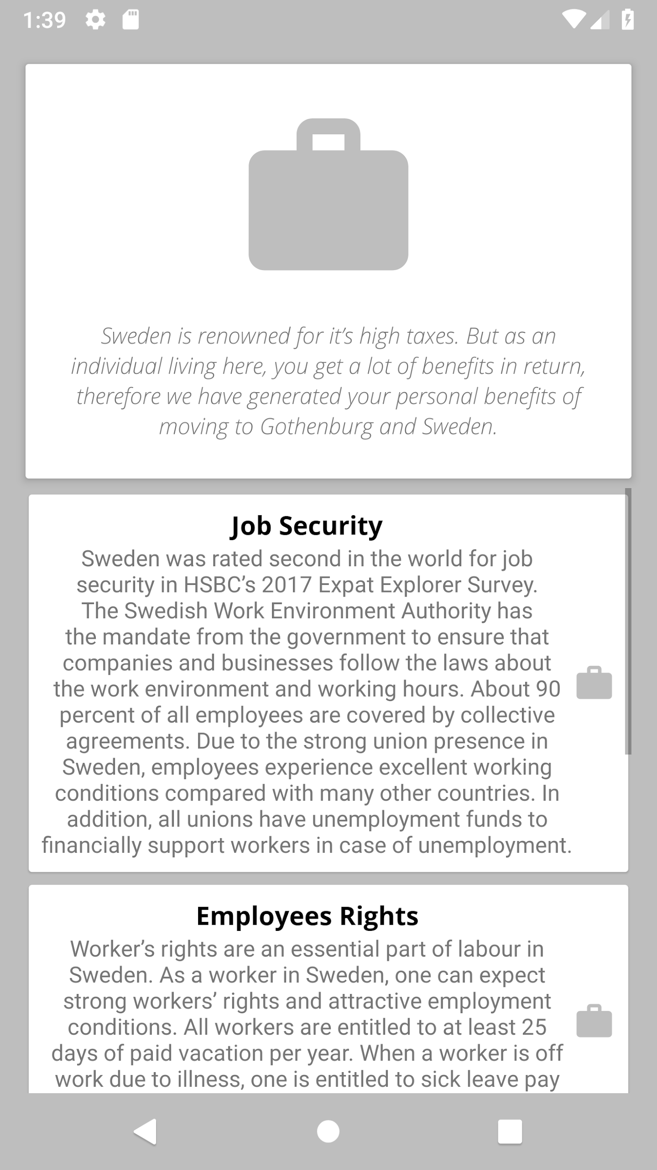
General information
Language: ~60% of Sweden’s population speaks English
General health care: yearly low-cost capped fees for health care and medication
Public transport: well-organized and easily accessible buses, trams and trains
Job security: strong labor union presence in Sweden protecting employees
Work environment: safe, equal and welcoming workplace for every individual
Notes:
*just say stuff along the lines of what is on the slide*

Slide 9
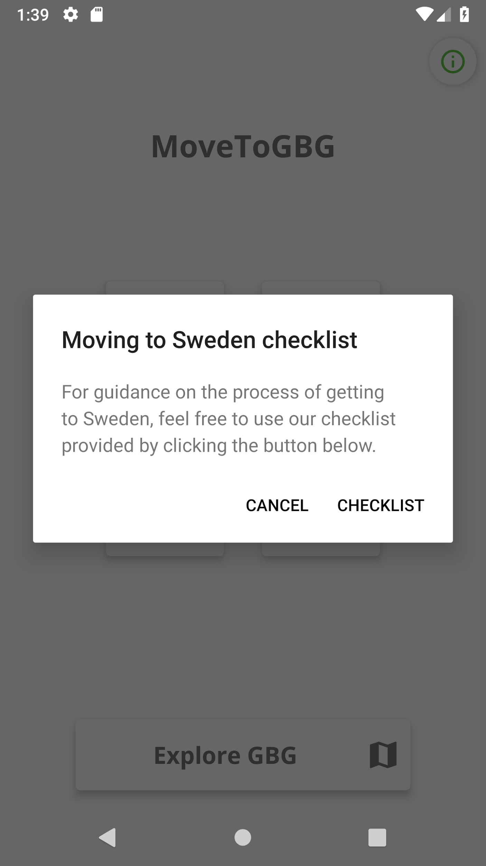
Information button
Notes:
The information button has the purpose of providing users with quick access to the ‘Move to Gothenburg immigration checklist’ website page, which would allow them to read the steps of the whole process in detail and tick tasks off as they go. We thought this would be useful because it offers useful additional information to the facts that we already present to them in the app.

Slide 10
Thank you for your attention!
Team Wise Snake, 2018
OpenHack

