Slide 1
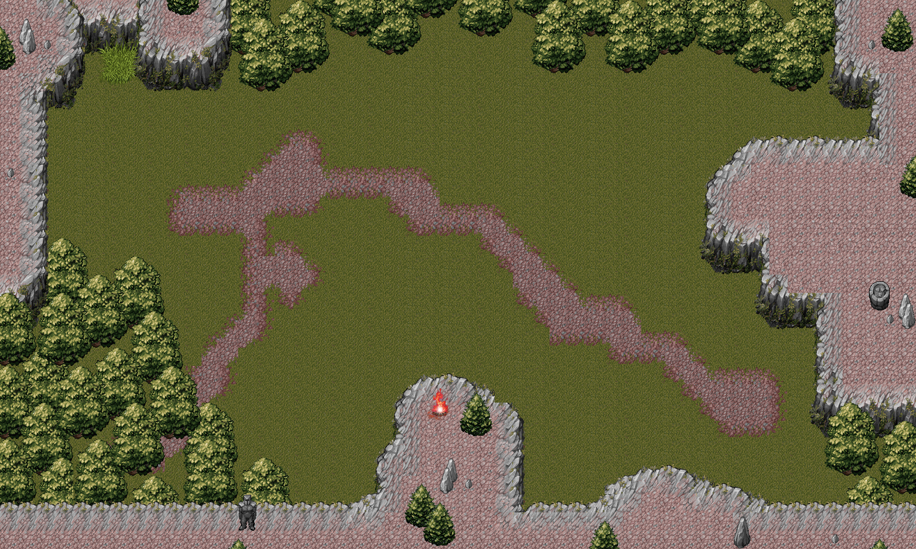
Blaze Brigade
SFWR ENG 3XA3 - Section L02
007 (Group 7)
November 30, 2016

Slide 2
Team Members
Jeremy Klotz - Algorithms Specialist, Developer
Asad Mansoor - Scribe, Developer, Tester
Thien Trandinh - GUI Developer, Gameplay Mechanic, Programmer
Susan Yuen - Git Master, Product Architect, Developer, Designer

Slide 3
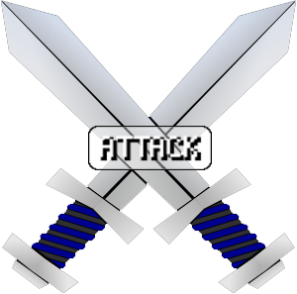
Outline
Team Members
Purpose
Scope
Background
Development Methodology
Project Management
Design
Demo
Maintainability
Robustness
Feedback
Next Steps
Conclusion
Questions? Comments?

Slide 4
Purpose
Tribute to popular game genre: tactical simulation role-playing game
Provide a form of entertainment through strategic challenges
Based on open-source freeware Tactics Heroes
Re-implementation to improve user experience:
Integration of new functionalities
Enhanced graphical display

Slide 5
Scope
Blaze Brigade is a turn-based multiplayer game
Game state is governed by constant interaction of moving and attacking units
Objective to win by eliminating all of the enemy units
Few functional requirements
The game shall be turn-based
One side will be victorious when the other side has no playable units left
Few non-functional requirements
The game shall be playable by persons who can operate a computer and pointing device (mouse or touchpad)
The game shall be playable on computers running Windows operating system, with a screen size greater than 1600 x 960

Slide 6


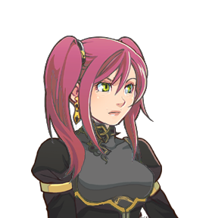



Background
Blaze Brigade to refurbish Tactics Heroes, an open source freeware
Integrating new features that were missing in Tactics Heroes to enhance experience
Largely inspired by Japanese game series Fire Emblem published by Nintendo
Fire Emblem revolutionized the genre by incorporating RPG Element
Blue Team vs Red Team
Warrior Mage Archer Archer Mage Warrior

Slide 7
Development Methodology
Technology
Visual Studio
XNA Game Studio
Version Control System
Git
Git Repository Manager
GitLab
259 Commits
12 Branches
5 Tags

Slide 8
Project Management
Project Time and Resource Allocation
Gantt Chart
Decomposed Task Allocation
GitLab Issues
Created and closed 69 issues
5 milestones being 100% completed
Communication
Slack
Skype

Slide 9
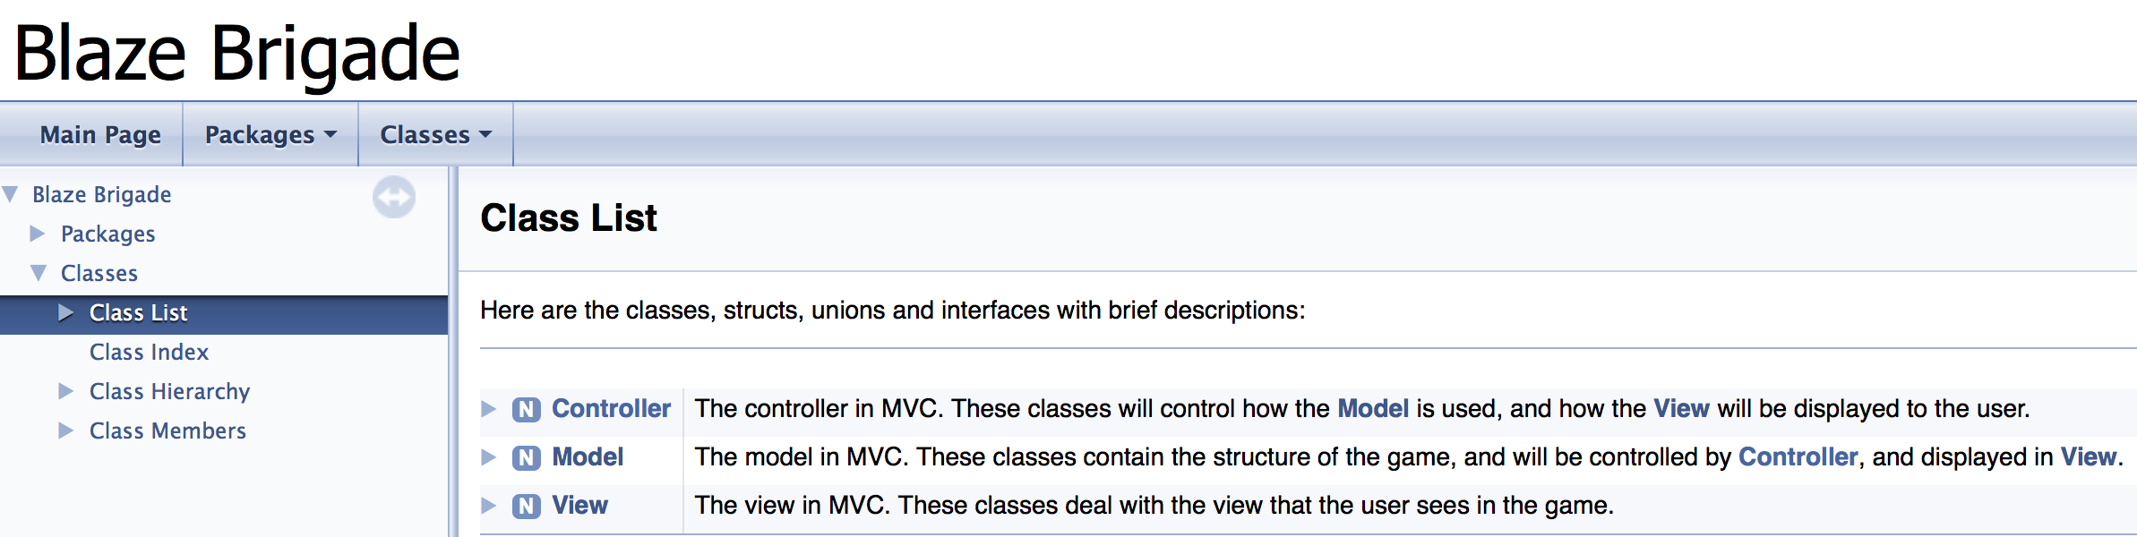
Design
The system follows the MVC architecture
Composing the modules as a Model, View and Controller
Any addition of new classes can easily be integrated into the current system
The Module Guide further decomposes the system into a modular structure to define design pattern and anticipated changes during development

Slide 10
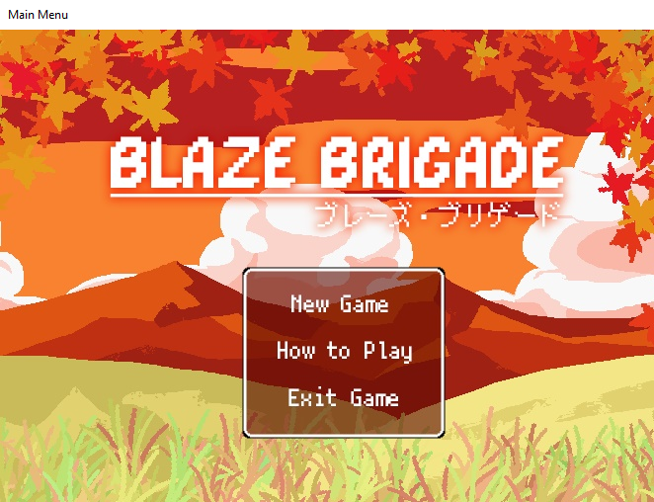
Demo

Slide 11
Maintainability
The system follows the MVC architecture separating model, view and controller
This ensures that the software can be easily modified when adding new features
Also helps the software evolve, with the addition of new classes, weapons and inventory items
These changes would not cause the software to go under excessive changes in the source code and design

Slide 12
Robustness
Ensuring the software system is stable in extreme conditions and faulty user input
Manual testing on various machines
Stress testing on various machines
Inputs are encapsulated to only a mouse click, which holds the majority of the scope of testing

Slide 13
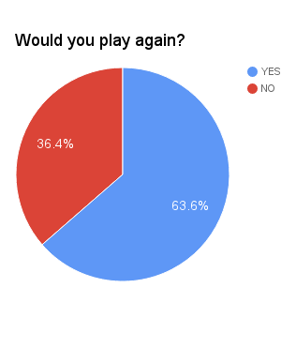
Feedback
Usability Survey
73% of the responses rated 8 stars or above on the easiness of the game controls
82% of the responses rated 8 stars or above on the visuals of the game
73% of the responses rated 8 stars or above on the overall rating of the game
Testimonial
“Really nice visuals, overall a great game”
“Opening screen looks great and the art in the game looks great as well. Easy to play, but not my style of game”

Slide 14
Next Steps
Here are the following items that would be addressed if the project continues:
Integrating story component
Adding missions to make the game more enjoyable
Allowing users to go through a tutorial
Implementing an AI for single player games
Bootstrapping graphics and sound
Increase level of inventory - portions, items and weapons
New maps

Slide 15
Conclusion
Blaze Brigade was implemented to provide form of good entertainment
A tribute to the popular genre, by refurbishing to enhance user experience by integrating new features and graphical enhancements
Gameplay
Moving units
Attacking units
Inventory
Graphics
Main Menu
Animation
Sound

Slide 16
Questions?
Comments?

