Slide 1
Sourcetracker 2
DAWG Workshop
Apr 14 2023

Slide 2
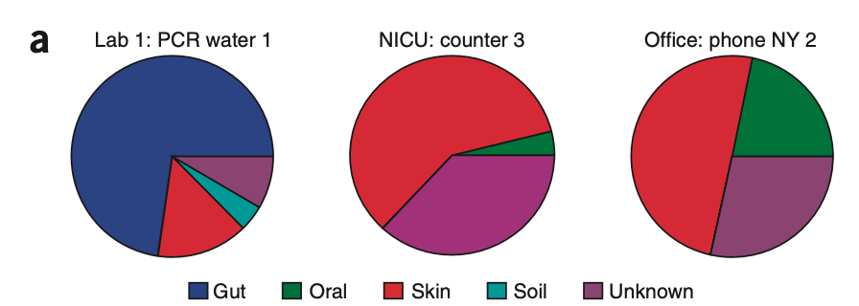
Sourcetracker2
To estimate the proportion of sources to a given sink --- identify the source of microbes in a given environment
Source: consists multiple samples that came from an environment of interest
Sink: a single sample
Knights, D et al. 2011

Slide 3
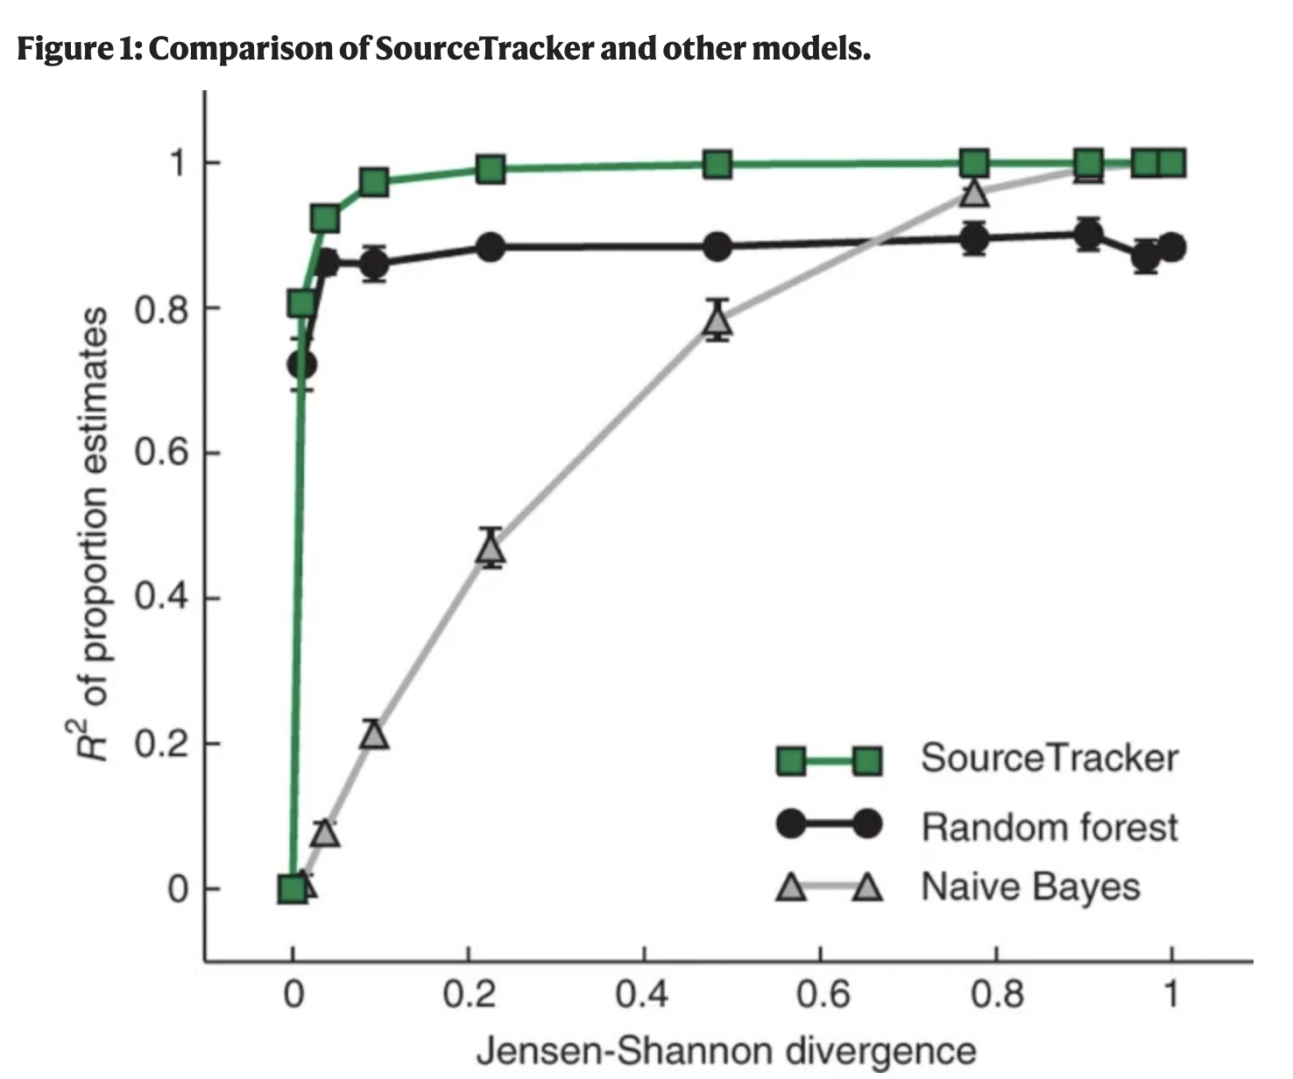
Why sourcetracker2?
Can handle complex mixture of bacterial sources
soil may contain animal feces and plant DNA and etc.
out-performs other models
Compatible with multiple data type (16S and WGS)

Slide 4
How does sourcetracker2 work?
J1
J2
J3
???
???
???
Imagine you have 3 jar filled (J1, J2, and J3) with colored balls, and your mission is to figure out the distribution of each color in each jar.
To do that, you randomly sampled from each jar, and that is your sample jar (sink).
The underlying mechanism of sourcetracker2—Gibb’s sampler, can estimate the source proportion of all three jars, including any unknown source.
?
Gibbs sampler

Slide 5
Applications and limitations
Applications
Source tracking, microbial interactions with environment === disease transmission, food microbiology, and microbial forensics
Allow us to understand the compositions in the environment
Limitations:
One source can contain of multiple sources
Found skin microbes in soil samples, it could be from my fingers or someone else’s fingers

Slide 6
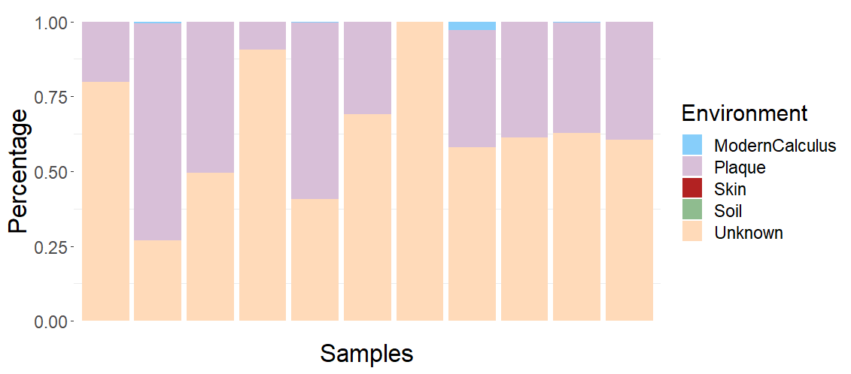
Result

