Slide 1
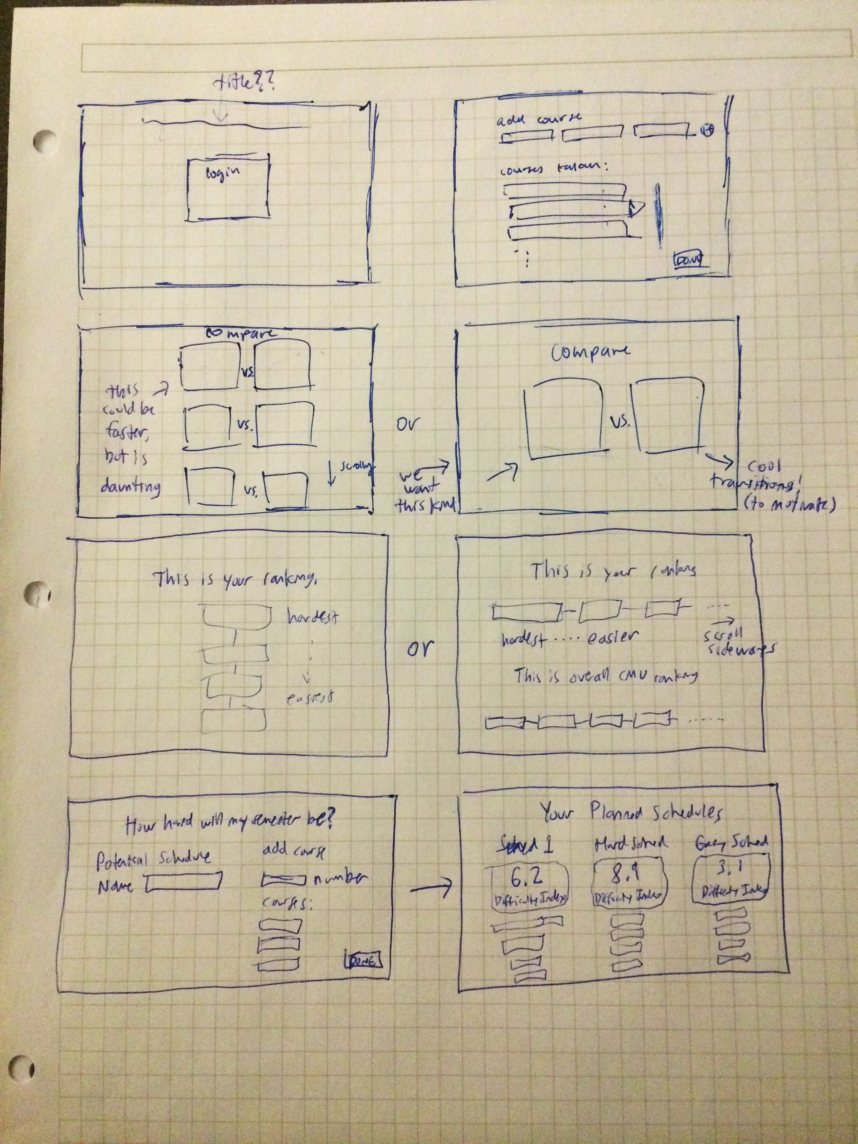
home/login
enter your classes
1
2
compare
3
results
4

