Slide 2
COLLISION BETWEEN BEES
BY:
Susana Álvarez
Mariajose Franco
Ingeniería Matemática

Slide 3
DATA STRUCTURE
double Xmax double Xmin double Ymax double Ymin double Zmax double Zmin Octant dad
double Xmax double Xmin double Ymax double Ymin double Zmax double Zmin Octant dad
Bee 1 double x double y double z
Bee 2 double x double y double z
Bee 3 double x double y double z
……….
……….
Bee n double x double y double z
double Xmax double Xmin double Ymax double Ymin double Zmax double Zmin Octant dad
double Xmax double Xmin double Ymax double Ymin double Zmax double Zmin Octant dad

Slide 4
OPERATIONS OF THE DATA STRUCTURE
Read and save data
For(number of bees in text file)
Creation of the main octant assigning its min x, min y, min z and max x, max y, max z.
Reading of the data set
Assignation of this LinkedList of bees to the main octant
Splitting each line by commas (Str.split())
First data | Second data | Third data
File that contains data set
double x | double y | double z
Bee 1
…….
Bee n
Creation of the bees Bee(x,y,z)
Insertion of the bees to
the LinkedList

Slide 5
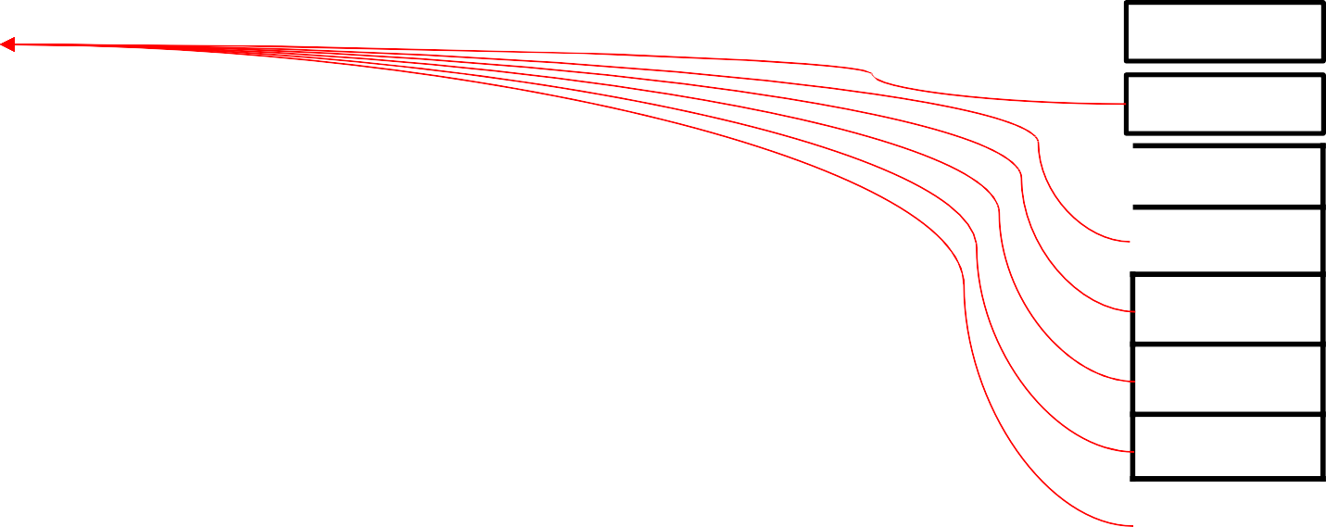
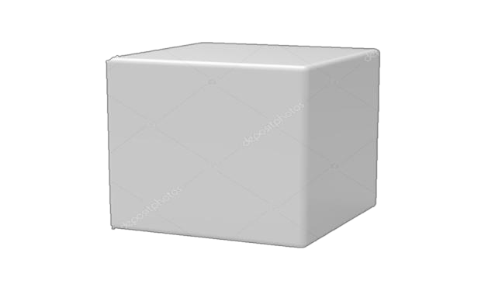


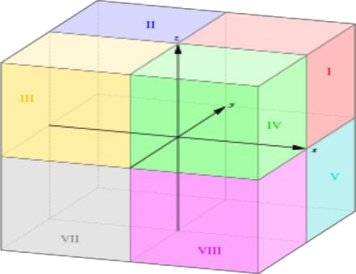
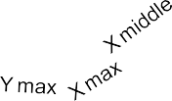

OPERATIONS OF THE DATA STRUCTURE
Detecting Collisions
collisionDetector(Octant o)
Octant o8
Octant o
Octant o7
Octant o6
Octant o5
Octant o4
Octant o3
Octant o2
If its diagonal measures 100 or less
Else
Creates 8 new octants
If the size of the
LinkedList of bees in this octant is bigger than 1
If the size of the LinkedList of bees in this octant is 1
Z max
All the bees in this octant are in risk of collision
Access the LinkedList of bees in the dad octant
Octant o1
With a for each cycle, compare the only bee in the octant with all the bees in the dad octant
When all the bees are relocated in the 8new octants:
Z max
If the distance between the bee and any other bee in the dad octant is less than 100 but different than 0
Else
With a for each cycle, the bees in the octant are visited and according to their coordinates, they are inserted in the corresponding new octant’s LinkedList of bees
The bee is in risk of collision
Break the for cycle

Slide 6
WHY OUR DATA STRUCTURE IS THE IDEAL?
We decided to implement this data structure since it is not difficult to interpret and understand; we think it is a very useful data structure for what we want to achieve. It works well and the complexity of its methods are O(n) and O(n*x), which allows it to be fast in its execution.
n = number of bees
x = larger number between the longitude,
latitude and height of the space were the
bees are located in. Time complexity:
T(n*x)=8n*T(x/8)+c. However, this equation in big O notation equals O(n*x).
The time complexity of detecting collisions not only depends on the number of bees, but also on how big the space were the bees are located is.
Method | Complexity
readAndSaveData() | O(n)
collisionDetector() | O(n*x)

Slide 7
TIME CONSUMPTION
Time consumption in detecting collisions between bees in Colombia:
Time consumption in detecting collisions between bees in Bello:
Number of bees in data set | Average time (ms) | Maximum time (ms) | Minimum time (ms)
15 | 0 | 1 | 0
150 | 1 | 5 | 0
1,500 | 25 | 114 | 2
15,000 | 333 | 1180 | 19
150,000 | 1326 | 3817 | 286
1,500,000 | 6477 | 50423 | 1668
Number of bees in data set | Average time (ms) | Maximum time (ms) | Minimum time (ms)
10 | 0 | 1 | 0
100 | 1 | 7 | 0
1,000 | 16 | 53 | 1
10,000 | 204 | 411 | 13
100,000 | 654 | 2068 | 109
1,000,000 | 5521 | 19101 | 599

Slide 8
MEMORY CONSUMPTION
Memory consumption in detecting collisions between bees in Colombia:
Memory consumption in detecting collisions between bees in Bello:
Number of bees in data set | Average memory consumptio n (bytes) | Maximum memory consumptio n (bytes) | Minimum memory consumptio n (bytes)
15 | 1581889 | 2268224 | 1501800
150 | 2319488 | 3328800 | 1444976
1,500 | 13587445 | 23506208 | 3787488
15,000 | 125064289 | 226554160 | 24661424
150,000 | 290214425 | 501598064 | 34990000
1,500,000 | 864622235 | 1079491184 | 577702712
Number of bees in data set | Average memory consumptio n (bytes) | Maximum memory consumptio n (bytes) | Minimum memory consumptio n (bytes)
10 | 1506222 | 2176096 | 1433072
100 | 2073384 | 2866976 | 1558168
1,000 | 10130280 | 16733168 | 2909576
10,000 | 83864497 | 153037704 | 18197352
100,000 | 257127238 | 391560296 | 12917168
1,000,000 | 676561120 | 998138408 | 188690616

