Slide 1
Credit One
Credit Card Default | Analysis Framework
November 11, 2019

Slide 2
Objectives
Examine customer demographics to better understand what traits might relate to whether or not a customer might default on their current credit obligations
Identify which attribute(s) relate significantly to customer default rates and build predictive model to better classify potential customers as being ‘at-risk’
Improve upon previous credit scoring models currently in place due to an increase in number of defaults seen with various credit partners.
Credit One

Slide 3
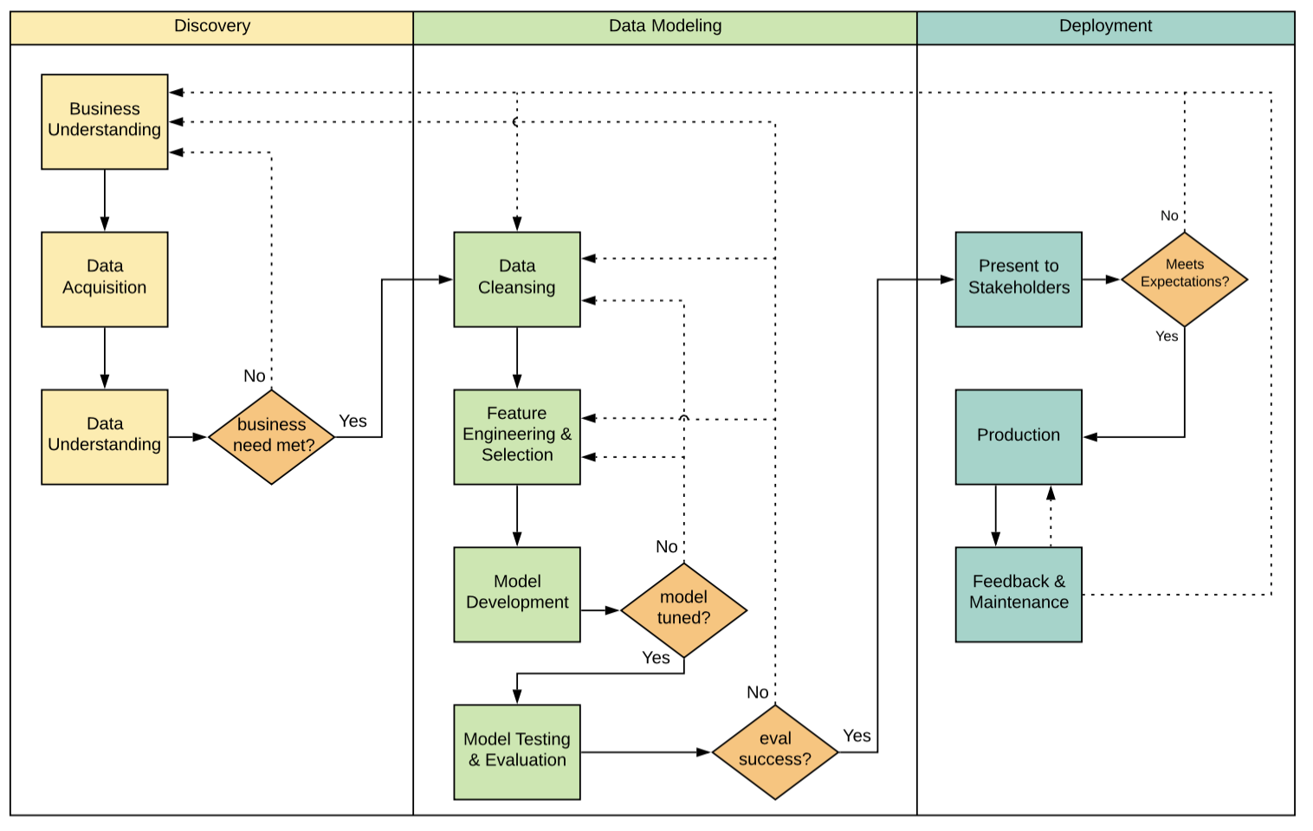
Process Framework
Zumel and Mount data science process will be utilized for this project
Appropriate for predicative models.
Needed detail level from discovery to deployment.
Iterative process.
Credit One

Slide 4
Data Description
Data set includes 30,000 credit card clients with default status (yes or no)
Available attributes include
Demographics
Payment History
Repayment Status
Billing History
Previous Payment History
Default flag
No data issues identified in initial review
Credit One

Slide 5
Next Steps
Import the data and perform initial analysis, ensuring the business and data is well understood.
Begin data cleansing, feature selection, and feature engineering.
Revisit business needs and understanding, as needed.
Credit One

