Slide 1



BUSINESS BASICS
IPL Magazine 2025
SUSANDHYA NARAYANEE DAS

Slide 2

Business Basics – Who We Are
A leading business blogging platform with a strong online following.
Specializes in analytical and thought-provoking content on business, finance, advertising, and social impact.
Known for simplifying complex topics with a balanced, data-backed perspective.
Readership includes professionals, policymakers, students, and ethical brand leaders.
In 2025, focused on responsible business practices and industry accountability.
Committed to exploring how business growth can align with public interest.

Slide 3
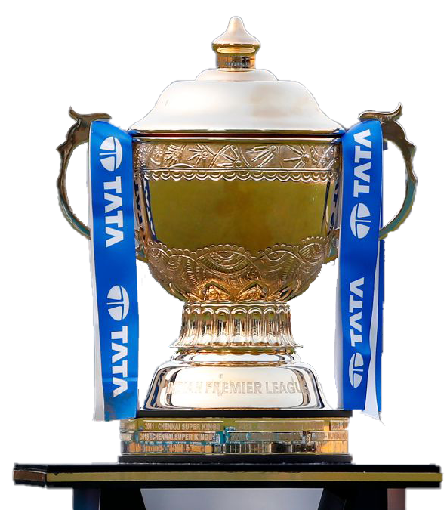
IPL 2025: More Than a Game
Business Basics Content:
The Indian Premier League (IPL) is not just a cricket tournament — it's a multi-billion-rupee ecosystem that drives seasonal employment, media revenue, and brand visibility.
In 2025, the IPL generated over ₹10,000 crore through central contracts alone, highlighting its massive economic impact.
However, public sentiment has turned cautious as more than 50% of advertisements during IPL are dominated by fantasy gaming platforms and pan masala brands — raising alarms around public health and financial well-being.
This edition by Business Basics offers a balanced view of IPL 2025 — highlighting its economic power and the ethical, social, and health concerns driven by its advertising ecosystem.

Slide 4
Primary Analysis
What is the total revenue generated by IPL 2025 from central contracts, and who are the top contributing partners by percentage?
Which brands featured in IPL 2025 advertisements carry the highest health or social risk, and how is their risk quantified?
What is the projected CAGR (Compound Annual Growth Rate) until 2030 for the top high-risk advertisers (e.g., pan masala, fantasy gaming apps)?
What percentage of the population is estimated to be negatively impacted by high-risk advertising during IPL 2025?
Which top celebrities endorsed these high-risk brands, and have they consistently supported similar products in recent years?

Slide 5
Secondary Analyses
📉 Public Health & Ethical Impact
What are the estimated public health costs associated with heavily advertised products (e.g., pan masala)?
How do fantasy sports and betting ads impact gambling behavior and financial stress among viewers?
How does IPL’s ad policy compare with global sporting event regulations (e.g., Olympics, FIFA, NFL)?
💼 Economic Ecosystem Evaluation
How many seasonal jobs are generated by the IPL advertising ecosystem?
What is the contribution of IPL advertising to India’s tax revenue in 2025 (e.g., GST collections from high-risk brands)?

Slide 6
What is the total revenue generated by IPL from Central contracts in the year 2025? List the revenue contributors by %.
In 2025, IPL earned a total of ₹10,215 crore from its central contracts. The biggest contributors were:
Digital Streaming Partner – 46.5%
TV Broadcaster – 46.1%
Title Sponsor – 4.9% Other partners like Associate, Timeout, and Umpire sponsors contributed very little by comparison. This shows how major media rights drive most of IPL's revenue.
Notes:
In 2025 IPL made over ₹10,000 crore from central contracts. Most of it came from digital and TV broadcasting — over 90% combined. Other sponsors contributed only a small share.

Slide 7
What is the health / social risk index for each of the top advertising brands?
I ranked IPL 2025 advertisers on a 1 to 10 Health & Social Risk scale, where 10 reflects extremely high risk. Vimal Elaichi scored 10 due to its pan masala association, while My11Circle, PokerBaazi, and Amazon Prime scored 8 for promoting fantasy gaming and potentially addictive digital content. These brands dominated IPL advertising — raising important concerns about their impact on youth, low-income groups, and long-term public health.
Notes:
These are the brands with the highest health or social risks. Vimal Elaichi has 10 out of 10. My11Circle, PokerBaazi, and Amazon Prime also scored high at 8 out of 10. These brands were advertised a lot during IPL 2025 and can be harmful — either to health or by encouraging gambling.

Slide 8
What is projected CAGR until 2030 for the top 5 companies with a high health/social risk index?
Based on industry reports and market trends:
Fantasy gaming brands like Dream11, My11Circle, and PokerBaazi are projected to grow at around 13% CAGR
Pan masala brands, like Vimal, are expected to grow slightly slower — around 9% CAGR
Despite their risks, these brands show strong commercial growth, which is why they continue to dominate IPL advertising space.
Notes:
Dream11, My11Circle, and PokerBaazi are projected to grow at around 13% Compound Annual Growth Rate, while Vimal Pan Masala is close to 9%.

Slide 9
Estimate the total population being negatively impacted by these high-risk brands ?
To understand the social impact, I estimated the number of people exposed to high-risk advertising categories. Based on IPL ad targeting and demographic data:
Pan Masala ads potentially affect over 80% of the exposed population — primarily lower-income groups with higher health vulnerability.
Fantasy apps account for the remaining 19%, largely targeting youth and young adults prone to gambling addiction.
This highlights how the advertising choices during IPL may have long-term consequences on both public health and financial stability for millions.
Notes:
Over 80% of the IPL ad-exposed audience is influenced by pan masala promotions — a product group directly linked to long-term health risks like oral cancer. The majority of this audience belongs to lower- and middle-income brackets, making this a serious and avoidable public health issue.

Slide 10
List the top 5 celebrities who have been promoting the brands with high social risk in 2025.
Ajay Devgn, Shah Rukh Khan, Akshay Kumar, Sourav Ganguly and Shubman Gill. They endorsed brands in categories like pan masala and fantasy gaming, both of which carry high social or health risks. Their continued involvement raises ethical concerns around celebrity responsibility in advertising.
Notes:
These are the top 5 celebrities who promoted high-risk brands in IPL 2025 Ajay Devgn, Shah Rukh Khan, Akshay Kumar, Sourav Ganguly and Shubman Gill. They have been associated with similar brands for the past few years

Slide 11
Estimate the potential public health costs associated with products heavily advertised during IPL.
Pan masala brands, which were heavily advertised during IPL 2025, are directly linked to serious health issues like oral cancer. Based on reported user exposure and estimated treatment costs, the potential public health burden from pan masala ads alone could exceed ₹13,000 crore. This highlights the long-term social cost of allowing harmful products to dominate prime-time advertising.
Notes:
Pan masala ads can cause serious health issues like oral cancer. The public health cost is estimated to be over ₹13,000 crore.

Slide 12
Analyses the impact of fantasy sports and betting app advertisements on gambling behavior on affected populations.
Fantasy sports and betting app ads were heavily shown during IPL 2025, targeting youth and middle-income groups. These platforms, while legal, encourage frequent betting behavior that can lead to financial stress, addiction, and loss of productivity. The affected population includes an estimated “100 million” users, many of whom are vulnerable to compulsive gambling patterns over time.
Notes:
Fantasy sports ads can encourage addictive betting — especially among youth — leading to stress and financial loss.

Slide 13
Compare IPL advertising regulations with global sporting event standards.
League | Gambling Ads | Pan Masala Ads | Alcohol Ads | Ethics Score
Olympics | ❌ Not Allowed | ❌ Not Allowed | ⚠️ Restricted | 90
NFL (USA) | ❌ Not Allowed | ❌ Not Allowed | ✅ Post-match | 85
FIFA | ❌ Not Allowed | ❌ Not Allowed | ⚠️ Limited | 88
IPL | ✅ Allowed | ✅ Allowed | ✅ Surrogate | 65
Notes:
Global events like the Olympics and NFL ban harmful ads, but IPL still allows pan masala and fantasy gaming ads — showing weaker regulation.

Slide 14
Analyses seasonal employment generated by the IPL advertising ecosystem.
The IPL advertising ecosystem supports thousands of seasonal jobs each year. From ad agencies and digital marketing teams to production crews and ground installers, many roles are created temporarily during the IPL season. Based on estimated ad spend, the 2025 season likely generated over 6,000 short-term jobs across creative, media, and event support industries.
Notes:
IPL ads create thousands of seasonal jobs every year — from ad agencies to production crews. In 2025, it’s estimated that over 6,000 temporary jobs were supported by the advertising ecosystem.

Slide 15
Assess the contribution of IPL advertising to tax revenue.
In IPL 2025, Fantasy App and Pan Masala brands together spent over ₹4,329 crore on advertising. This resulted in an estimated ₹779 crore in GST, with Fantasy Apps contributing the most. It shows that while these ads are risky, they also generate substantial tax revenue.
Notes:
IPL ads from fantasy apps and pan masala brought in ₹779 crore in GST. It shows that these ads also help increase tax revenue.

Slide 16
Key Takeaways – IPL 2025
IPL 2025 reinforced its role as a powerful economic engine, with over ₹10,000 Cr in central revenue
However, over 50% of ads came from high-risk categories like pan masala and fantasy gaming
These ads pose serious public health and financial risks, especially for vulnerable groups
IPL lags behind global ethical standards in advertising regulation
Going forward, a balance between profit and public responsibility is essential for sustainable growth
Closing Thought:
The future of IPL lies not just in runs and revenue, but in how responsibly it influences its millions of viewers.

Slide 17
Thank You!
Can commercial success coexist with social responsibility?

