Slide 1
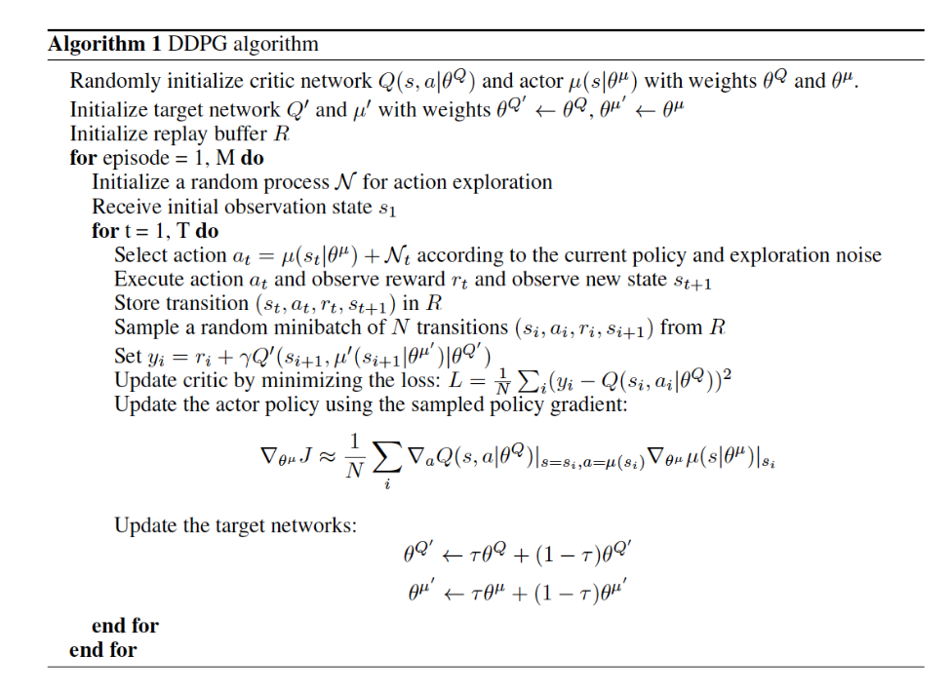
Use target networks to do off-policy updates
Action selected using Deterministic Actor
Experience Replay
Slow updates, but highly stable

Slide 2
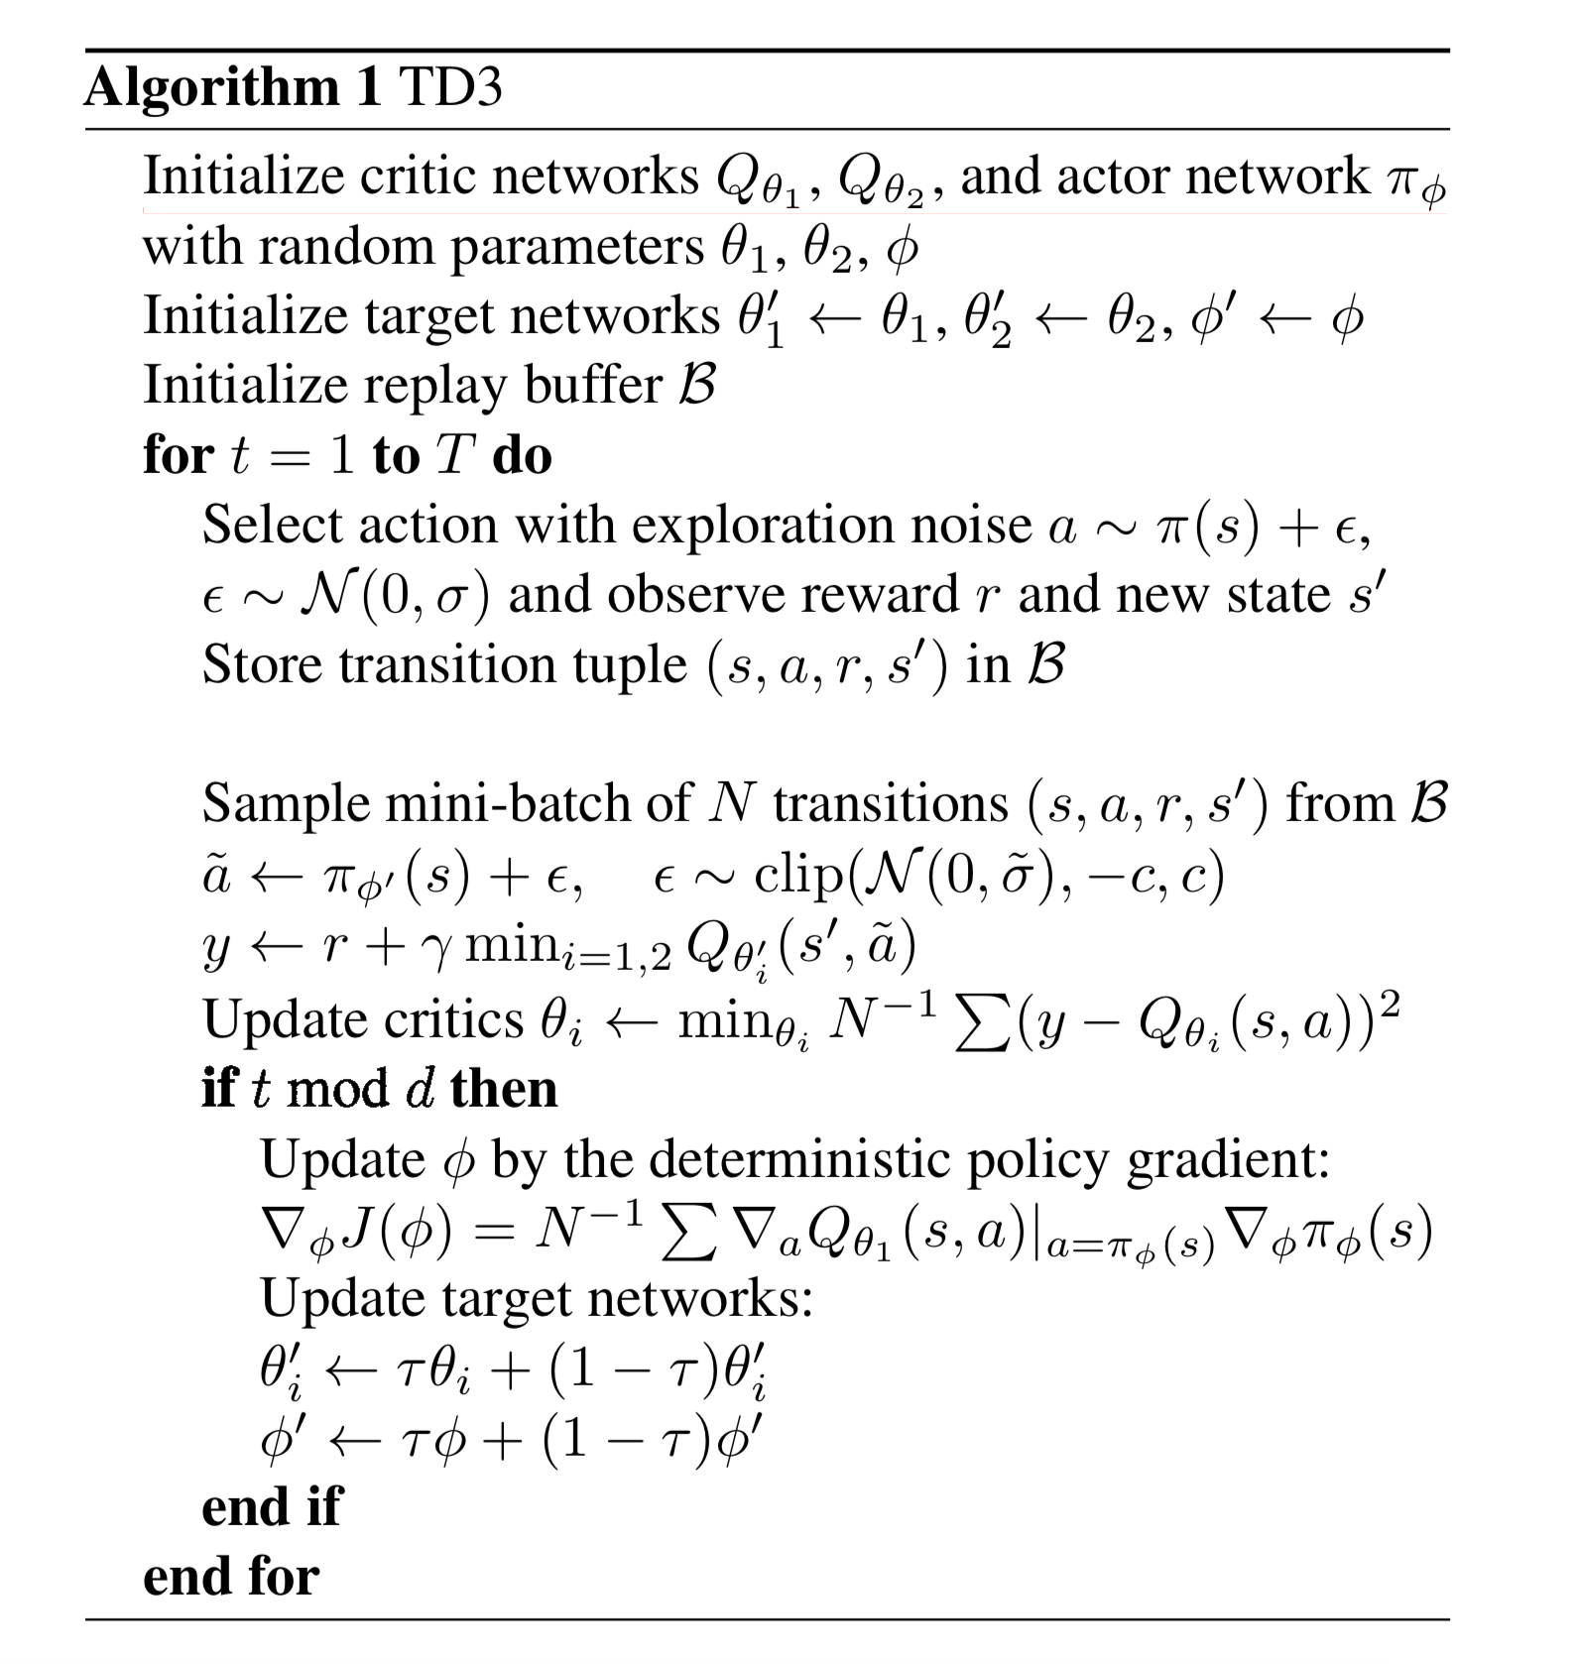
Use target networks to do off-policy updates
Use target networks to do off-policy updates
Target policy smoothing
Clipped Double Q-Learning
Delayed update of target and policy networks

Slide 3
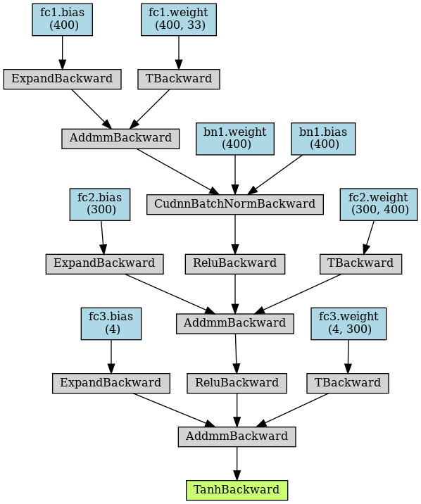
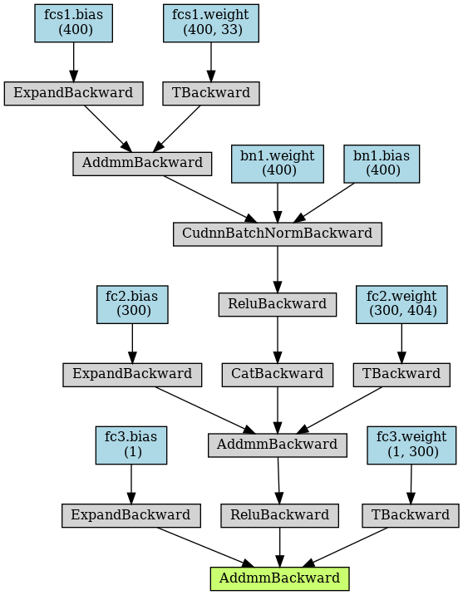
Actor
Critic

Slide 4
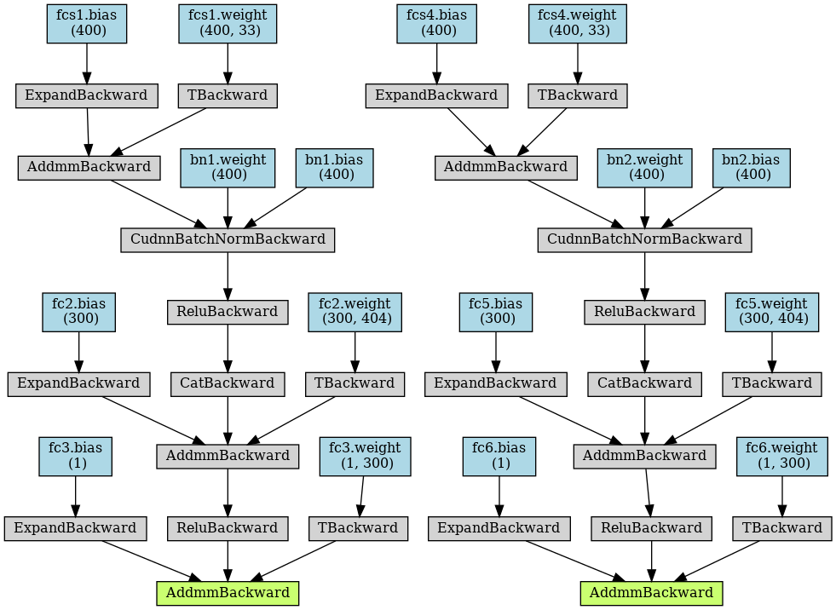
Actor
Critic

