Slide 1
Wicked Cool Apache Java Projects … and so can you!
Matt Burgess
February 6, 2017

Slide 2

Agenda
What is the Apache Software Foundation?
What are some cool Java-based Apache projects?
Groovy
Tinkerpop
NiFi
Beam
Streams
How do I get involved?

Slide 3
Who dat?
Senior Software Engineer @ Hortonworks
Joined November 2015
Member of Apache NiFi / Hortonworks DataFlow (HDF) team
Member of Apache NiFi Project Management Committee (PMC)
Groovy evangelist
Me likey the data

Slide 4
The Apache Software Foundation (ASF)
The ASF is an “open innovation community”, non-profit org
Open
Stewards and supporters of the Apache Community of open-source software projects
Provide software products for the public good
Innovation
Projects are defined by collaborative consensus-based processes
Apache Software License
Provide high-quality software that leads the way in the field
Community
Not just a bunch of projects on the same server
Not just a community of developers, but also users
http://apache.org/

Slide 5
ASF Project Organization
Apache Board
Delegates all technical direction to Project Management Committee
Project Management Committee (PMC)
Panel of elected committers
PMC elects new committers and PMC members
Committers
Contributors with authority to merge/change official codebase
Individual contributors
Anyone who actively improves the project
Not just code!

Slide 6
Wicked Cool Apache Java Projects
Lots of categories
Big Data, Build Management, Cloud, Content, DB, FTP, Graphics, Web/HTTP, Identity, Security… the list goes on!
Great survey of some Apache projects
https://prezi.com/ily_ihlsacak/a-survey-on-apache-projects
Current # of Java projects = 226

Slide 7

Apache Groovy
Programming language for the JVM
Interpreted or compiled
Aims to be “the” scripting language alongside Java
Groovy Development Kit (GDK)
Lots of goodies to make the JDK more “groovy”
Great syntax for Domain-Specific Languages
Spock
Apache Camel
Groovy 3 in development now!

Slide 8
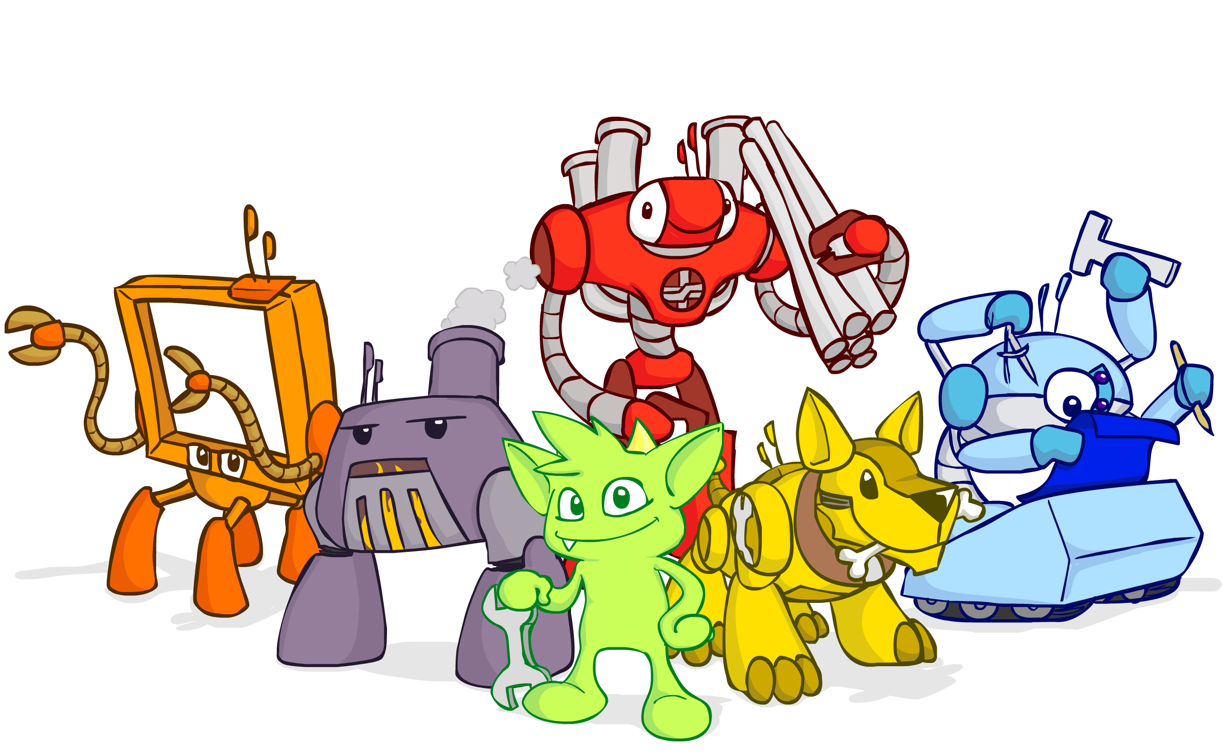
Apache Tinkerpop
Graph computing framework
Graph Databases (OLTP)
Neo4J
Titan / IBMGraph
BlazeGraph
Graph processing systems (OLAP)
Hadoop (Apache Spark, Apache Giraph)
Titan
Stardog
Gremlin
Groovy-based DSL for graph traversal

Slide 9

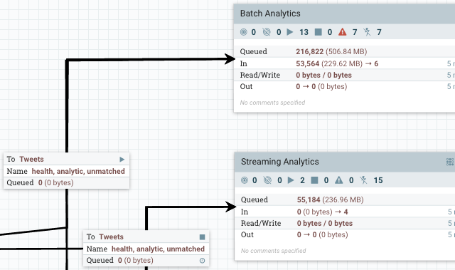
Apache NiFi
Easy to use, powerful, and reliable system to process and distribute data
Highly configurable
Loss tolerant vs guaranteed delivery
Low latency vs high throughput
Dynamic prioritization
Flow can be modified at runtime
Back pressure
Data Provenance
Highly Extensible
Secure

Slide 10

Apache Beam
Unified programming model
Batch
Streaming
Portable pipeline execution
Apache Apex
Apache Flink
Apache Spark
Google Cloud Dataflow
Highly extensible

Slide 11

Apache Streams (incubating)
Two-way data interchange
Social media / popular REST APIs
YouTube, Instagram, Google, Facebook, Twitter, etc.
Big Data sources/targets
Elasticsearch, Cassandra, HDFS, HBase, AWS Kinesis, etc.
Standard internal representation
ActivityStreams
Schema converters/generators
Resistant to / insulated from external API changes

Slide 12
Let’s Get Involved!

Slide 13
How to get started
Pick a Project
What are you passionate about?
Dig In
Download and run/include it
Examples, tutorials, etc.
Get the code
Star/Fork/Clone
Join the Mailing Lists
Most projects have users and dev lists
Examples: users@nifi.apache.org, dev@streams.incubator.apache.org

Slide 14
Contribute!
RTFM, contribute to doc
Add Unit Tests
Great way to incrementally learn about the code
Look for issues/Jira cases tagged “beginner” or “easyfix”
Ask the dev list
Let them know what area you’re interested in

Slide 15

Thank You!
Matt Burgess
mattyb149@apache.org
@mattyb149
http://funnifi.blogspot.com

