Slide 1
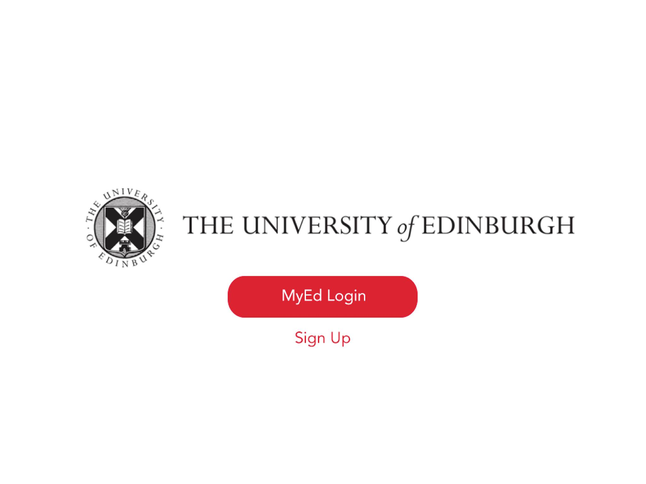
#ILWHACK
Re – imagining MyEd

Slide 2
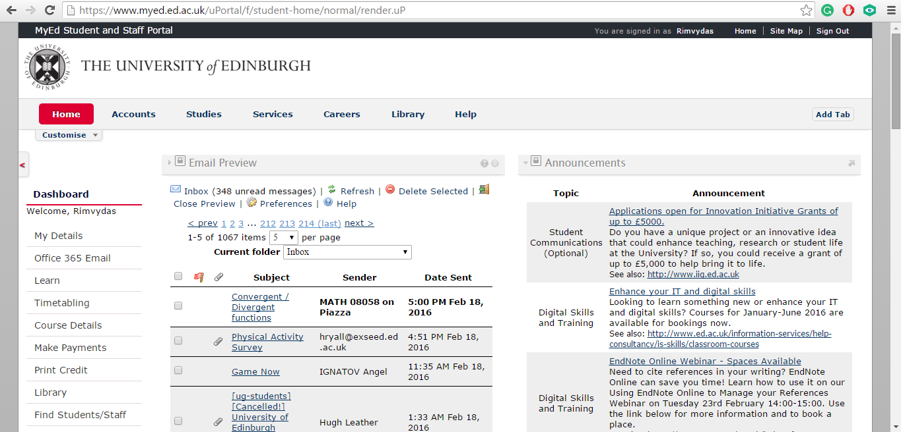

Slide 3
CURRENT ISSUES
Complexity
Too much information
Not well-structured
Interface
Not well-designed
Not for 21st century

Slide 4
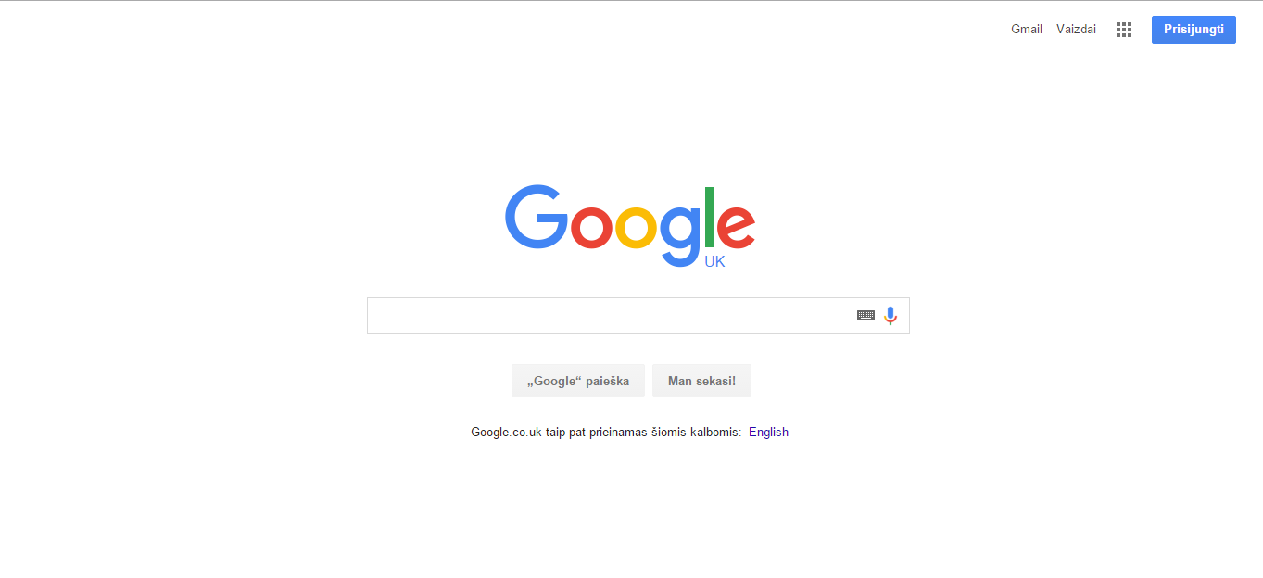
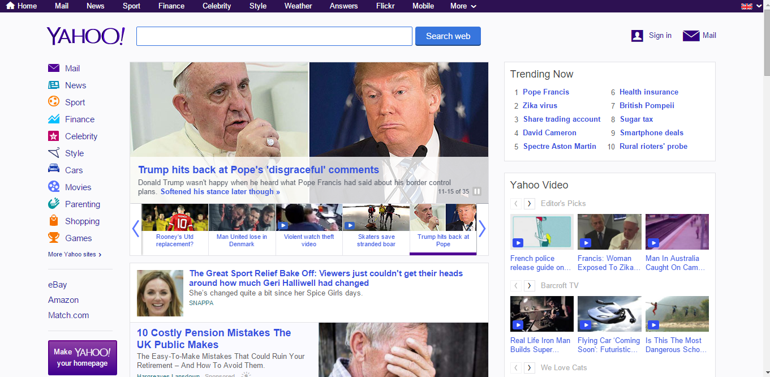

Slide 5
The team
Cecilia Sam
Graphic Design
Nora Vazbyte
CS
Sussane Koster
CS and Mathematics
Rimvydas Rubavicius
Software Engineering

Slide 6
Ideas
Simple
Modern
Familiar

Slide 7
The route
Navigation
Implementation
Visualization

Slide 8
Navigation
Home
Personal Info
EUCLID
Finance Channel
Courses
Learn
Library
Book it
Accommodation
Personal Tutor
Career
Help
MyEd
Email
Student card
Announcements
EUSA elections/Surveys
Path
School website
Discover Ed
Print credit
Study space
Short courses
Events
Student Accommodation Hub
Student home
Cashless catering
Who is he?
Contacts
MyCareerHub
Resources
Others
MyEd’s intro to Career
Information service
Uni desk self service
eScript
Course evaluation survey
Collaborate
Pebblepad
Changing EASE password
Get library smart
What is library?
Library blog
Library’s Facebook
Library’s Twitter
BookEd

Slide 9
Implementation
HTML
CSS
Bootstrap
XML

Slide 10






Visualisation

Slide 11
DEMO

Slide 12
Future references
Personal design by School
Implementing real working database
Better announcement & event system
Merge the functionalities of Path, Web timetables and course timetable browser

Slide 13
Thank you!

