Slide 1
Git
A distributed version control system

Slide 2
Version control systems
Version control (or revision control, or source control) is all about managing multiple versions of documents, programs, web sites, etc.
  Almost all “real” projects use some kind of version control
  Essential for team projects, but also very useful for individual projects
Some well-known version control systems are Subversion and Git
  Subversion use a “central” repository;
  users “check out” files, work on them, and “check them in”
  Git treat all repositories as equal
Distributed systems like Git is newer and are gradually replacing centralized systems like Subversion

Slide 3
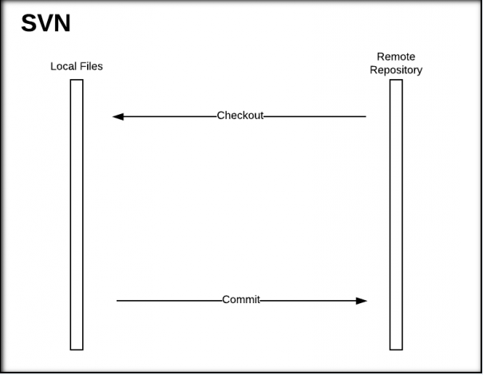
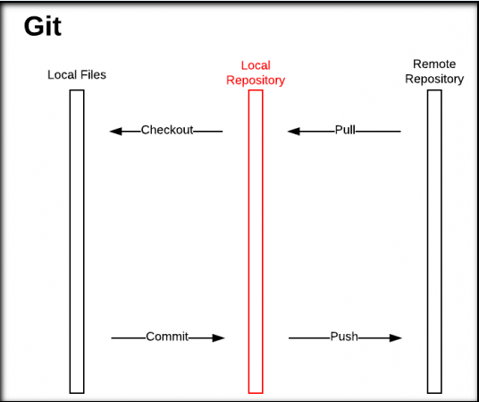
Difference between SVN and GIT

Slide 4
Why Git?
Git has many advantages over earlier systems such as Subversion
  Working offline
  Fast to Work With
  Repositories Are Smaller
  Moving or Adding files
  Ignore Certain Files
  Check the Status of Your Changes

Slide 5
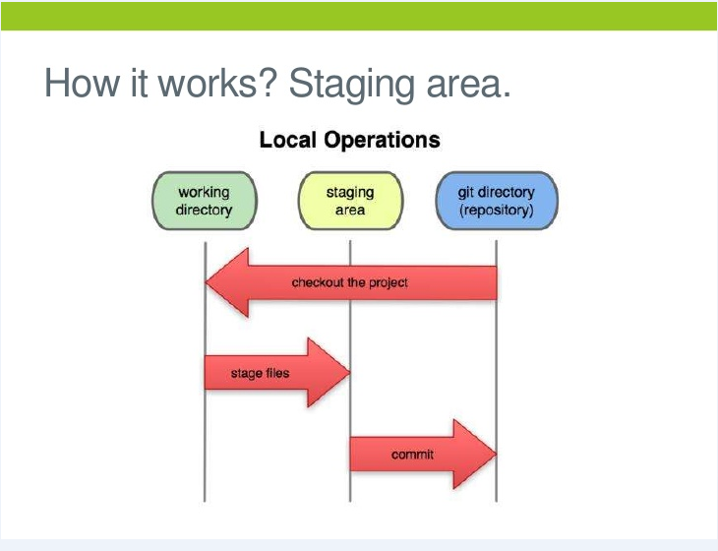
How Git works

Slide 6
Introduce yourself to Git
Enter these lines (with appropriate changes):
  git config --global user.name "John Smith"
  git config --global user.email jsmith@seas.upenn.edu
If you want to use a different name/email address for a particular project, you can change it for just that project
  cd to the project directory
  Use the above commands, but leave out the --global

Slide 7
Create and fill a repository
cd to the project directory you want to use
Type in git init
  This creates the repository (a directory named .git)
  You seldom (if ever) need to look inside this directory
Type in git add .
  The period at the end is part of this command!
    Period means “this directory”
  This adds all your current files to the repository
Type in git commit –m "Initial commit"
  You can use a different commit message, if you like

Slide 8
Clone a repository from elsewhere
git clone URL
  These make an exact copy of the repository at the given URL
git clone git://github.com/rest_of_path/file.git
  Github is the most popular (free) public repository
All repositories are equal
  But you can treat some particular repository (such as one on Github) as the “master” directory
Typically, each team member works in his/her own repository, and “merges” with other repositories as appropriate

Slide 9
The repository
Your top-level working directory contains everything about your project
  The working directory probably contains many subdirectories—source code, binaries, documentation, data files, etc.
  One of these subdirectories, named .git, is your repository
At any time, you can take a “snapshot” of everything (or selected things) in your project directory, and put it in your repository
  This “snapshot” is called a commit object
  The commit object contains (1) a set of files, (2) references to the “parents” of the commit object, and (3) a unique “SHA1” name
  Commit objects do not require huge amounts of memory
You can work as much as you like in your working directory, but the repository isn’t updated until you commit something

Slide 10
init and the .git repository
When you said git init in your project directory, or when you cloned an existing project, you created a repository
  The repository is a subdirectory named .git containing various files
  The dot indicates a “hidden” directory
  You do not work directly with the contents of that directory; various git commands do that for you
  You do need a basic understanding of what is in the repository

Slide 11
Making commits
You do your work in your project directory, as usual
If you create new files and/or folders, they are not tracked by Git unless you ask it to do so
  git add newFile1 newFolder1 newFolder2 newFile2
Committing makes a “snapshot” of everything being tracked into your repository
  A message telling what you have done is required
  git commit –m “Uncrevulated the conundrum bar”
  git commit
    This version opens an editor for you the enter the message
    To finish, save and quit the editor
Format of the commit message
  One line containing the complete summary
  If more than one line, the second line must be blank

Slide 12
Commit messages
In git, “Commits are cheap.” Do them often.
When you commit, you must provide a one-line message stating what you have done
  Terrible message: “Fixed a bunch of things”
  Better message: “Corrected the calculation of median scores”
Commit messages can be very helpful, to yourself as well as to your team members.

Slide 13
Working with others
All repositories are equal, but it is convenient to have one central repository in the cloud
Here’s what you normally do:
  Download the current HEAD from the central repository
  Make your changes
  Commit your changes to your local repository
  Check to make sure someone else on your team hasn’t updated the central repository since you got it
  Upload your changes to the central repository

Slide 14
Typical workflow
git pull remote_repository
  Get changes from a remote repository and merge them into your own repository
git status
Work on your files (remember to add any new ones)
git commit –m “What I did”
git push

Slide 15
Multiple versions
Initial commit
Second commit
Third commit
Bob gets a copy
Fourth commit
Bob’s commit
Merge

