Slide 1
XGBoost
Gradient boosting regression trees are based on the idea of an ensemble method derived from a decision tree. The decision tree uses a tree structure. Starting from tree root, branching according to the conditions and heading toward the leaves, the goal leaf is the prediction

Slide 2
start
Data collection
Data Divison
Training set
Testing set
Xgboost
Model
Evaluation
End

Slide 3
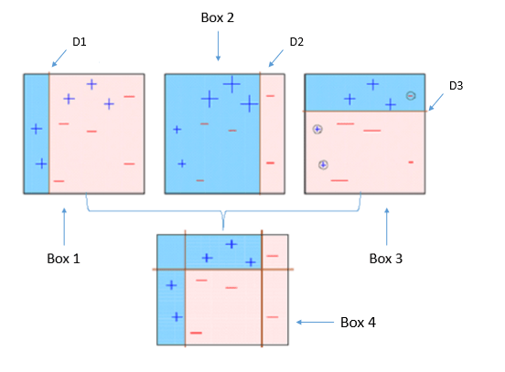

Slide 4
XGBoost Parameters
Before running XGBoost, we must set three types of parameters: general parameters, booster parameters and task parameters.
General parameters relate to which booster we are using to do boosting, commonly tree or linear model
Booster parameters depend on which booster you have chosen
Learning task parameters decide on the learning scenario. For example, regression tasks may use different parameters with ranking tasks.
Command line parameters relate to behavior of CLI version of XGBoost.

Slide 5
Advantages:
XGBoost is fast and efficient. It can handle large datasets with ease and has been proven to be faster than other algorithms.
XGBoost is highly accurate. It has the highest accuracy among all other algorithms and can be tuned to achieve better results.
XGBoost is flexible. It allows for parallel and distributed computing and can run on any platform.
XGBoost provides a number of features to customize your model, including regularization, cross-validation, and early stopping.

Slide 6
Disadvantages:
XGBoost is a complex algorithm and can be difficult to interpret.
XGBoost can be slow to train due to its many hyperparameters.
XGBoost can be prone to overfitting if not properly tuned.
XGBoost can be memory intensive and is not suitable for low-end systems.

