Slide 1
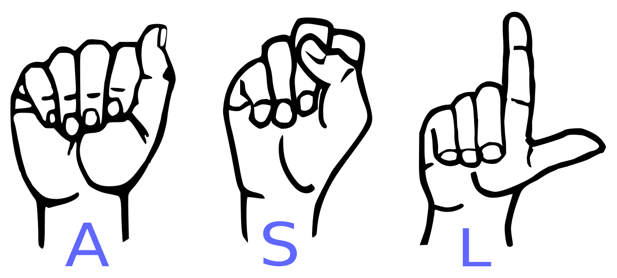
SIGN LANGUAGE CONVERTER
Presented by:
Sushamita M Patil (U15BR22S0053)
Seeba Z Maldar (U15BR22S0046)

Slide 2
OBJECTIVE
Bridges the Communication Gap: Enabling better interaction between deaf/mute individuals and those who don't know sign language.
Promotes Inclusion: Helps ensure equal access to communication, education, and services for people with hearing and speech disabilities.
User-Friendly Interface: Designed as a simple Human-Computer Interface (HCI) that uses a camera to recognize hand gestures in real time.
Improves Accessibility: Aims to support over 70 million deaf people globally by making everyday communication more efficient and inclusive.

Slide 3
SCOPE
Accessibility: Enables real-time sign-to-text/speech translation for deaf and hard-of-hearing individuals.
Human-Computer Interaction: Allows gesture-based control in apps, devices, and VR/AR environments.
Healthcare: Assists in speech therapy and remote consultations using sign language.
Legal and Government Services:Ensures deaf citizens understand and exercise their legal rights.

Slide 4
EXISTING SYSTEM
Traditional sign language detection systems rely on hardware devices and conventional machine learning techniques.
These systems commonly use:
Glove-based sensors to capture hand gestures.
Camera-based tracking using 2D or 3D vision (e.g., Microsoft Kinect).High cost and complexity due to specialized hardware.

Slide 5
PROPOSED SYSTEM
The proposed system aims to overcome the limitations of traditional approaches by using modern, camera-only solutions and advanced deep learning models.
Key features include:
Use of standard cameras (e.g., webcam or smartphone) — no special sensors required.
Hand and body pose detection using tools like MediaPipe or OpenPose.
Gesture-to-text and text-to-speech conversion for broader accessibility.
Cost-effective and hardware-independent.

Slide 6
HARDWARE AND SOFTWARE REQUIREMENTS
Hardware:
Computer
Webcam
GPU
Software:
Python
TensorFlow/Keras, OpenCV
Linux/Windows

Slide 7
MODULES
Data Acquisition
Data pre-processing
Gesture Classification
Text and Speech Translation

Slide 8
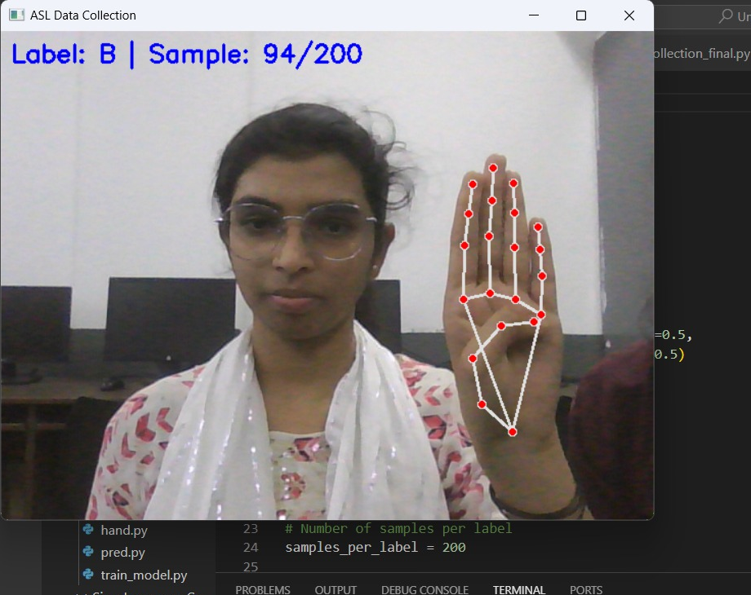
1. DATA ACQUISATION
Glove-Based Approach: Uses special electromechanical gloves to precisely track hand movements and configurations but is costly and less practical for everyday use.
Vision-Based Approach: Utilizes a standard webcam to capture hand gestures, making it more affordable and accessible for users without the need for specialized hardware.
Challenges in Vision-Based Detection: Includes variations in hand size, skin tone, lighting conditions, background noise, camera angles, and motion speed, which affect accuracy.

Slide 9
2. DATA PRE PROCESSING
Initial Method: We use MediaPipe to detect the hand in a webcam image, crop the hand area, convert it to grayscale, apply blur, and then make the image black and white using thresholding.
Challenges: This method only works well with a clean background and good lighting, which isn't always the case in real-world situations.
Improved Solution: We detect 21 hand landmarks using MediaPipe, then draw and connect these landmarks on a simple white background, making the method work in any environment.
Advantages: This approach doesn't depend on background or lighting, making it more reliable and accurate in real-world conditions.

Slide 10
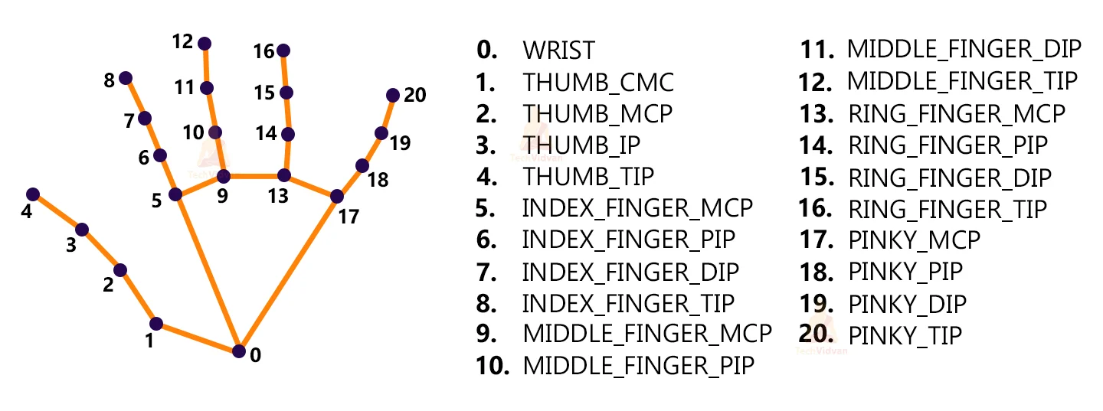
MEDIAPIPE LAND MARK SYSTEM
Improved Approach with Landmarks: Instead of relying on backgrounds or lighting, we use MediaPipe to detect hand landmark points, and then draw these points on a plain white background using OpenCV.
Data Collection: We have collected 180 skeleton images representing the A to Z alphabet in various hand gestures to train the model on different sign language gestures.
Benefits: This method ensures consistency and accuracy in hand gesture detection, regardless of real-world lighting or background issues.

Slide 11
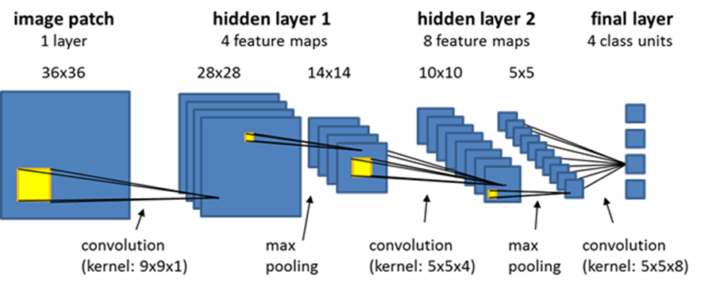
3. GESTURE CLASSIFICATION
What is CNN?- A Convolutional Neural Network (CNN) is a deep learning model used to process and recognize images. It uses filters to scan images and detect features like edges or shapes, starting with simple ones and gradually identifying more complex patterns.

Slide 12
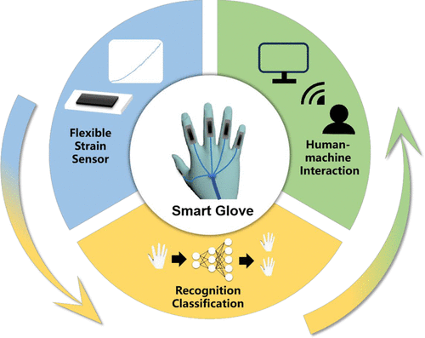
1
CNN Layers: CNNs consist of different layers like convolution, pooling, and dense layers. These layers work together to break down the image and extract features, eventually converting the image into a vector of class scores for classification.
Grouping the Alphabets: To improve accuracy, the 26 alphabets are divided into 8 classes based on similar hand shapes. This grouping reduces the complexity and makes the model better at recognizing gestures.
Final Prediction: The model assigns a probability to each letter in the class. The letter with the highest probability is chosen as the predicted label. For example, if the model detects gestures for letters like A, E, M, N, S, or T, it will select the letter with the highest likelihood.

Slide 13
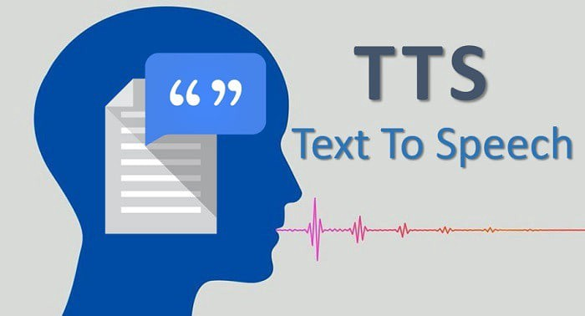
4. TEXT TO SPEECH
Gesture to Word Translation: The model detects and translates known hand gestures into corresponding text (words) by recognizing specific sign language gestures.
Text-to-Speech Conversion: We use the pyttsx3 library to convert the recognized text into speech, allowing the system to "speak" the translated word aloud.
Real-Life Dialogue Simulation: This text-to-speech feature creates a more natural interaction by simulating real-life conversation, making it easier for users to understand the recognized sign language gestures.

Slide 14
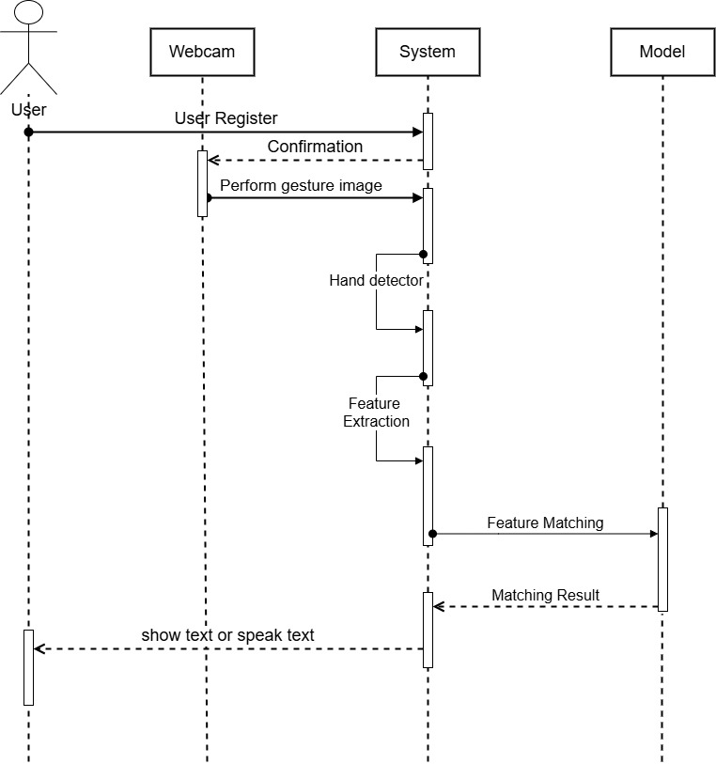
SEQUENCE DIAGRAM

Slide 15
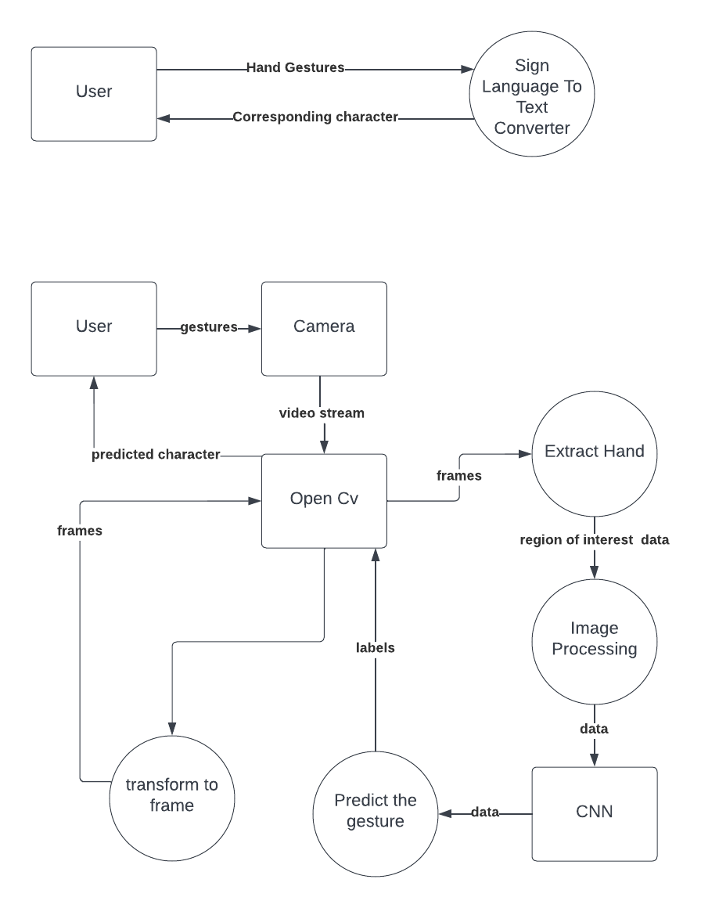
DFD DIAGRAM
LEVEL - 1
LEVEL - 0

Slide 16
CONCLUSION AND FUTURE WORK
Finally, we are able to predict any alphabet[a-z] with 97% accuracy (with and without clean background and proper lightning conditions) through our method. And if the background is clear and there is good lightning condition then we got even 99% accurate results.
In future work we will make one android application in which we implement this algorithm for gesture prediction.

Slide 17
THANK YOU

