Slide 1

A PROJECT PROPOSAL
TRACK NUMBER
Web-Based Vehicle Registration Lookup System
Tribhuvan University
Faculty of Humanities and Social Sciences — Department of Computer Application
Xavier International College
Sushank Karki
Symbol No: 54602170
Kushal Karki
Symbol No: 54602164
BCA 4th Semester • Submitted to the Department of Computer Application

Slide 2




OVERVIEW
Introduction
Track Number is a web-based vehicle registration lookup system that makes vehicle identification faster and easier. Users search by entering a registration number, and the system instantly returns the matching vehicle record.
BUILT WITH
Python + FastAPI
Backend API
Built with Python, FastAPI, HTML, CSS, and PostgreSQL, the system runs in any modern browser — accessible from both mobile phones and desktop computers.
PostgreSQL
Data storage
HTML & CSS
Responsive UI
Example Lookup — Plate 123Abc
Hayabusa X3 · 2026 Model · Owner: Sushank Karki · Registered 2021
Search-first UX
Fast lookup
TRACK NUMBER
2

Slide 3

THE CHALLENGE
Problem Statement
Vehicle information today is scattered across paper files, spreadsheets, and disconnected systems. Finding basic details for a single vehicle by its registration number is slow, manual, and error-prone — creating friction in record management and identification.
KEY PAIN POINTS
Records stored manually or in scattered spreadsheets
Slow, error-prone manual checking process
Track Number solves this
by giving users a single web-based platform to search and instantly view vehicle records — reducing manual work and improving accuracy.
No unified way to search by registration number
Difficult to keep data updated and accurate
TRACK NUMBER
3

Slide 4





PROJECT GOALS
Objectives
Simple & user-friendly
Search by plate number
Rich vehicle details
Build an intuitive vehicle lookup website.
Let users query records by registration number.
Show name, model, owner, and registered year.
PostgreSQL storage
FastAPI backend
Fully responsive
Store and manage vehicle data reliably.
Beginner-friendly, well-structured backend API.
Runs smoothly on both mobile and PC browsers.
TRACK NUMBER
4

Slide 5


METHODOLOGY
Requirement Identification
The system needs a frontend for entering a registration number and viewing results, a backend API for processing search requests, and a PostgreSQL database for storing records.
Open website
Enter number
Validate input
Search database
Return result
Existing approach
Manual paper files, Excel sheets, or asking an authorized person — slow and error-prone.
Track Number approach
A single web-based search bar with instant, database-backed results.
TRACK NUMBER
5

Slide 6
METHODOLOGY
System Requirements
Device & Platform
Software Stack
Web application — no special hardware required
Runs on any mobile, tablet, laptop, or desktop with a modern browser
Internet connection required once hosted online
Local development possible on any standard computer
OS
Windows 10/11, Linux, macOS
Frontend
HTML & CSS
Backend
Python with FastAPI
Database
PostgreSQL
Editor
Visual Studio Code
Browser
Chrome, Edge, Firefox, Safari
TRACK NUMBER
6

Slide 7


METHODOLOGY
Feasibility Analysis
The required technologies are available, beginner-friendly, and cost-effective — making the project practical for academic development using open-source tools.
Operational
Technical
Economic
Simple search-bar interface for users
Admin can add, update, delete records
Reduces manual searching effort
FastAPI + Python fit web API needs
PostgreSQL safely stores structured data
Can be tested locally, hosted later
All core tools are free & open-source
No licensing costs for the stack
No special hardware required
TRACK NUMBER
7

Slide 8
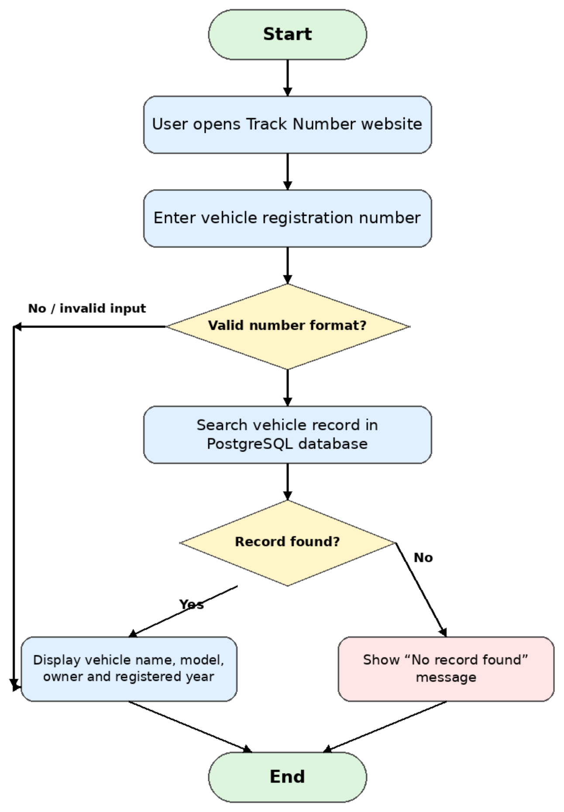
FLOWCHART DIAGRAM
System Flow
The flow validates the entered registration number, searches PostgreSQL, and returns either the matching vehicle record or a clear “not found” message.
Start / End
Process step
Decision point
No-record path
TRACK NUMBER
8

Slide 9
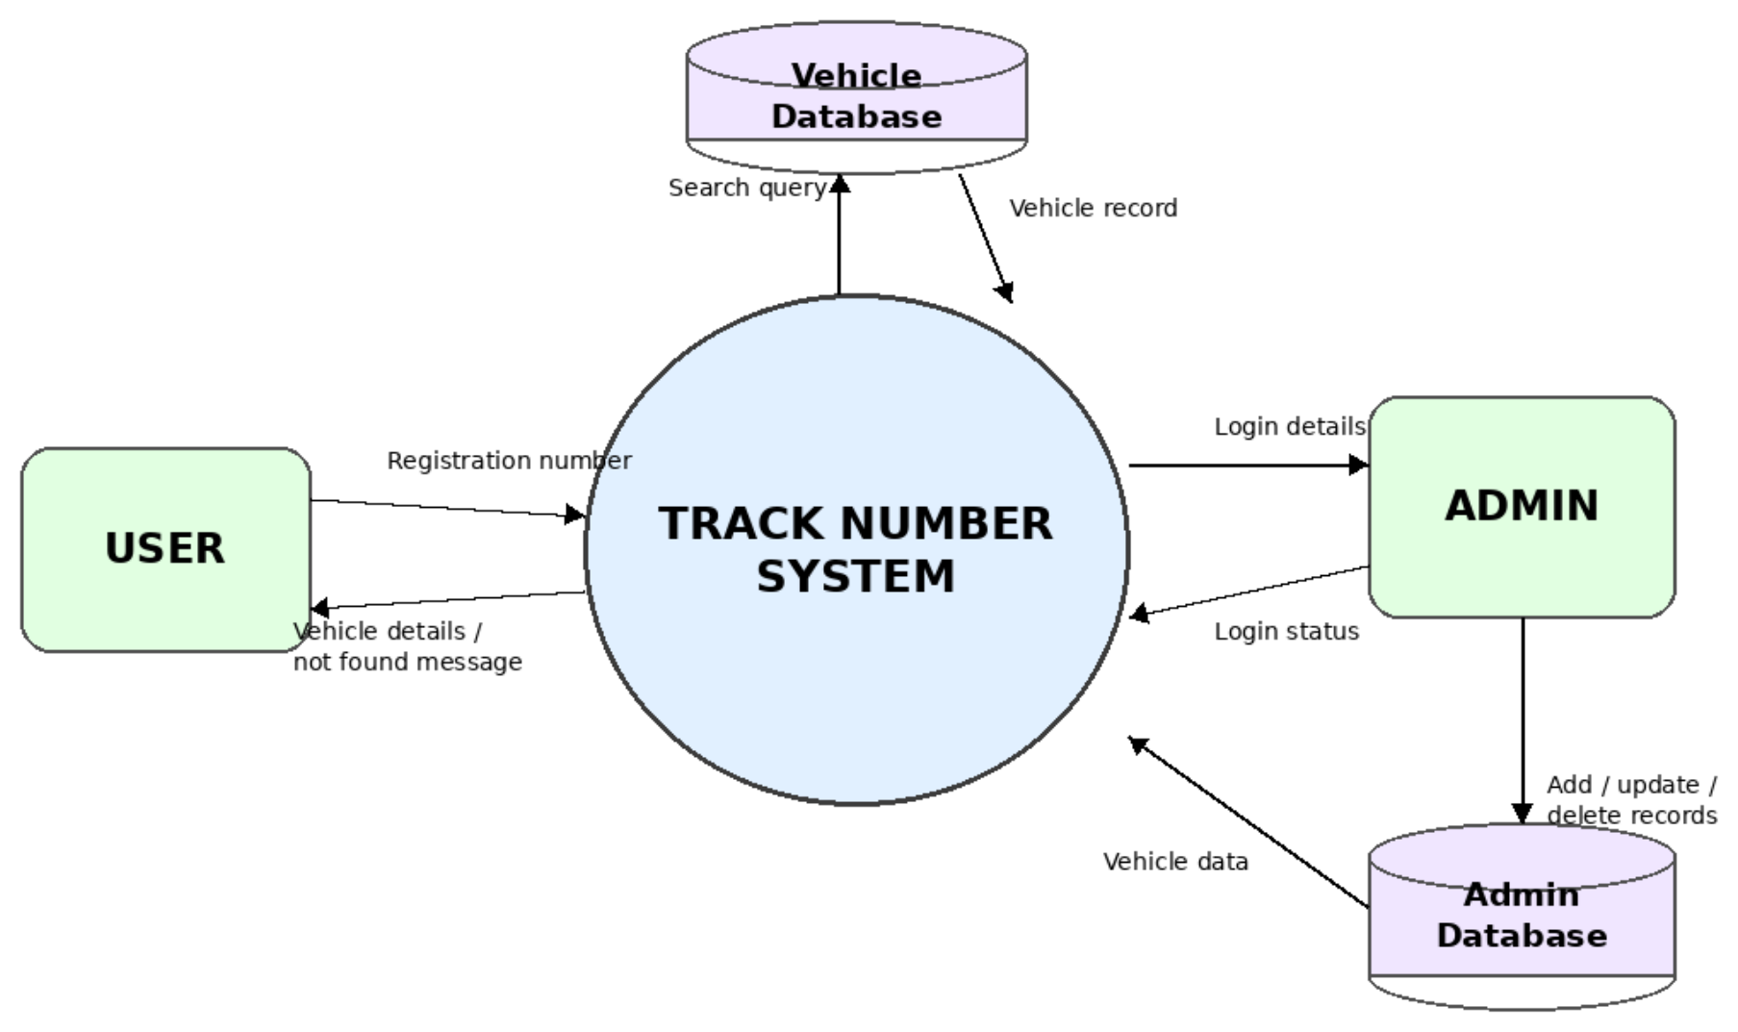
SYSTEM ARCHITECTURE
Data Flow Diagram
TRACK NUMBER
9

Slide 10
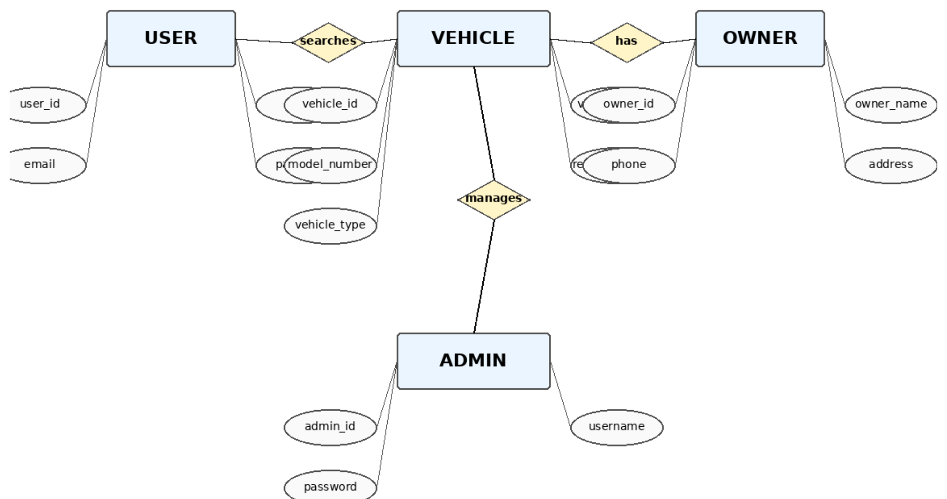
DATABASE DESIGN
Entity Relationship Diagram
TRACK NUMBER
10

Slide 11
GANTT CHART
Project Timeline
1
Study about the project
Asar (2083)
2
System design of the project
Asar (2083)
3
Database and API development
Shrawan (2083)
4
Frontend coding of website
Bhadra (2083)
5
Testing of project
Bhadra (2083)
6
Report writing
Bhadra (2083)
TRACK NUMBER
11

Slide 12

RESULTS
Expected Outcome
Track Number is expected to deliver a simple, effective way to search vehicle information by registration number — accessible from mobile or PC, with organized, accurate records stored in PostgreSQL.
Faster lookup
Organized records
Higher accuracy
Learning value
Instant results instead of manual searching.
Structured, reliable storage in PostgreSQL.
Fewer errors than manual record checks.
Hands-on practice with frontend, API & DB integration.
TRACK NUMBER
12

Slide 13

REFERENCES
Thank You
W3Schools — HTML & CSS Tutorials — w3schools.com
FastAPI — Official Documentation — fastapi.tiangolo.com
PostgreSQL — Official Documentation — postgresql.org/docs
Python — Official Documentation — docs.python.org/3
MDN — Web Development Docs — developer.mozilla.org
TRACK NUMBER
TRACK NUMBER
13
13

