Slide 1

SYSTEM CALLS IN OPERATING SYSTEM
- BY SUSHANT AGAWANE

Slide 2
INTRODUCTION
To use the functionality of operating system we need to access the kernel mode.
Hence , in this xv6 operating system system calls are the way to get shift from user mode to the kernel mode . This kernel mode is invoked by the system calls.
system call is the programmatic way in which a computer program requests a service from the kernel of the operating system it is executing on. I needed the kernel. I needed a system call.
Now, for adding new system call in xv6 generally we need to change five to six files . These files generally are ,
1. syscall.h
2. syscall.c
3. sysproc.c
4. usys.S
5. user.h

Slide 3
Currently there are 21system calls are present in xv6 operating system.
Now we will see the files that we need to change to make our own new system call to be generated.
A. syscall.c
In this file we define our own system call and give the count of system call. For e.g. #define SYS_getyear 22
B. syscall.c
This file contains function pointer like sys_getyear which generally has index which will call the system call function. Also, this file contains function prototype of typical system call.
For e.g extern int sys_getyear(void);
C. sysproc.c
This is the most important file which has implementation of our newly added system call.
D. usys.S
This file is generally used by user level mode as in this file we are adding an interface in order for a system call to get called by a user.

Slide 4
E. user.h
This file generally consists of functions which are nothing but user program calls. And one main thing these program calls get mapped by its own system call.
Thus , all these steps are required to add our newly created system call.
Now, in order to test the functionality of our system call, we would need to add user level program which calls that system call.
Now how to add this user level program ?
To add our user level program, we need to modify the Makefile and put the our file into the xv6 main directory. In the Makefile of xv6 we need to make several changes.

Slide 5
Hence, overall we come to know that,
sysproc.c add the real implementation of your method here
syscall.h define the position of the system call vector that connect to your implementation
user.h define the function that can be called through the shell
syscall.c external define the function that connect the shell and the kernel, use the position defined in syscall.h to add the function to the system call vector
usys.S use the macro to define connect the call of user to the system call function

Slide 6
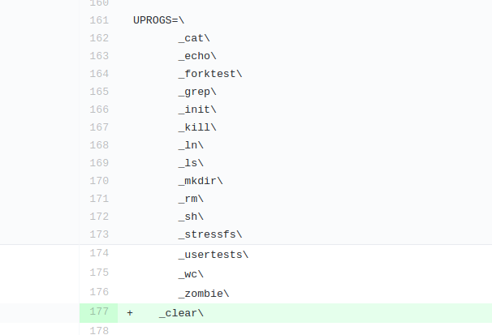
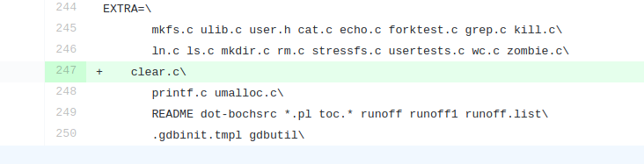
Here let’s take example of user level program clear.c . Below images will show where do we have to make changes in the Makefile.

Slide 7
Project Goal:
Understand the system calls in xv6:
Understand how to write a system call: To add functionality to change the priority or ticket number and implement the “ps” command for understanding the scheduling.
Following are the Implemented basic system calls :
1. (my_print) -> It takes arguments on bash and prints them till Enter key is pressed.
2. (my_pgm_get_year) -> Prints the string containing Year of xv6 when it was published with the help of system call.
3. (my shutdown), (my_new_shutdown)-> For these system calls ACPI shutdown code for exit the QEMU emulator . Generally for exit the terminal we type (control + a then x) . But with the help of them we can just call system call and exit the QEMU Emulator.
In a computer, the Advanced Configuration and Power Interface provides an open standard that operating systems can use to discover and configure computer hardware components, to perform power management by putting unused components to sleep, and to perform status monitoring.

Slide 8
4. (child_proc) -> This is system call which helps to print the no of child processes present in the system and return their count.
5. (actual_proc) -> This system call prints the total number of parent and child processes present within the system call.
6. (my_print_pid) -> This system call prints the pid of each processes with their corresponding states from the five states .
7. (my_add_two) -> This system call should take two integer arguments and return their sum.
8. (no_proc_xv6) -> This system call calculates total number of processes in the system.

Slide 9
9. (my_space_size) -> This system call get the total space occupied by the processes.
10. (simple) -> This system call just prints the all the arguments after argv[0] that is the string present after writing system call name.

Slide 10
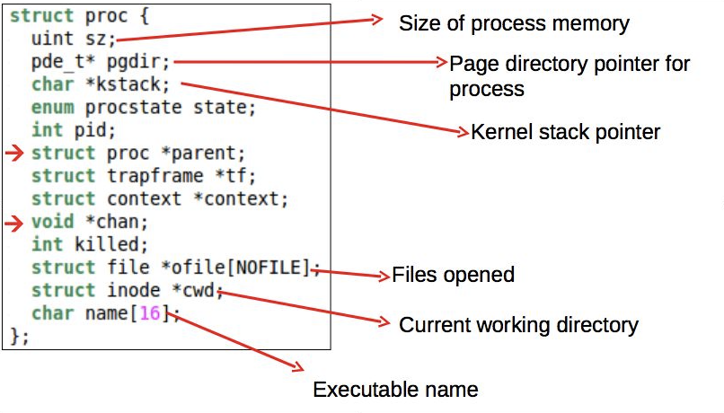
Design Architecture for system calls :
Process information for system calls

Slide 11
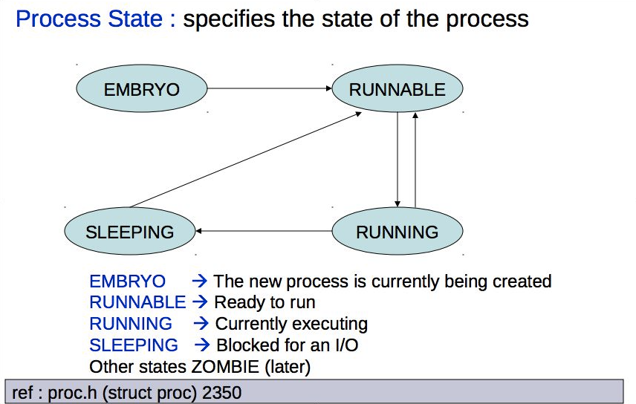
Process States:

Slide 12
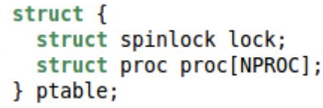
Storing procs in xv6
Storing procs in xv6
In a globally defined array present in process table.
NPROC is the maximum number of processes that can be present in the system (#define NPROC 64)
Also present in process table is a lock that serializes access to the array.

Slide 13
User level Files associated with each system call :
Makefile -> This file contains all user level programs for system calls.
1. (my_print) -> my_print.c
2. (my_pgm_get_year) -> my_pgm_get_year.c
3. (my_shutdown) -> my_shutdown.c
4. (my_new_shutdown) -> my_new_shutdown.c
5. (child_proc) -> child_proc.c
6. (actual_proc) -> actual_proc.c
7. (my_print_pid) -> my_print_pid.c
8. (my_space_size) -> my_space_size.c
9. (my_add_two) -> my_add_two.c
10. (no_proc_xv6) -> no_proc_xv6.c
11. (my_space_size) -> my_space_size.c
12. (simple) -> simple.c

Slide 14
OUTCOME :
In terms of understanding of the XV6 operating system, I have learnt the how to add and write a system call .
I learnt how process management system calls works in xv6 operating system.

Slide 15
Thank You !

