Slide 1
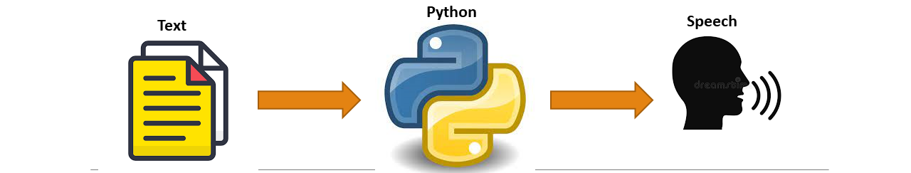
WELCOME
Text To Speech Synthesis
Prepared By : Guided By :
Sushant Ashok Bagul (TEIT04) Prof. P.C. Latne
Himanshu Rajesh Patel (TEIT41) (IT Department , SIT Lonavala)

Slide 2
TABLE OF CONTENTS
ABSTRACT
INTRODUCTION
METHODOLOGY
ADVANTAGE
FUTURE SCOPE
CONCLUSION
REFERENCES

Slide 3
ABSTRACT
A Text-to-speech synthesizer is an application that converts text into spoken word, by analyzing and processing the text using Natural Language Processing and then using Digital Signal Processing technology to convert this processed text into synthesized speech representation of the text. Here, we developed a useful text-to-speech synthesizer in the form of a simple application that converts inputted text into synthesized speech and reads out to the user which can then be saved as an mp3.file.
Keywords
Text-to-speech synthesis, Natural Language Processing, Digital Signal Processing

Slide 4
INTRODUCTION
Text-to-speech synthesis is the automatic conversion of a text into speech. Text-to speech synthesizer is the technology which lets computer speak to you.
The system gets the text as the input and then a computer algorithm which called TTS engine analyses the text, pre-processes the text and synthesizes the speech with some mathematical models.
The input text is transcribed into a phonetic representation, and another is the generation of speech waveforms, where the output is produced from this phonetic and prosodic information. Speech sound is finally generated with the low-level synthesizer by the information from high-level one.

Slide 5
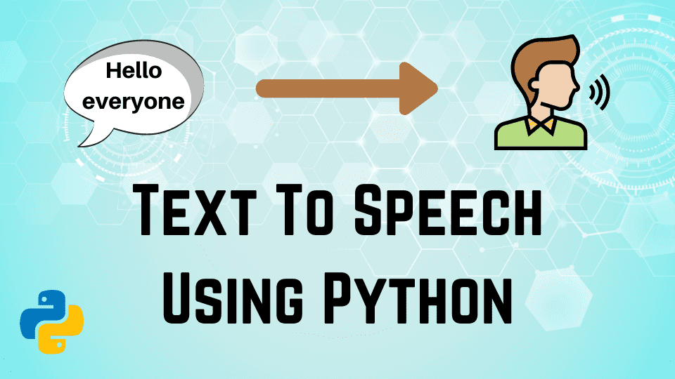
Convert Text to Speech in Python
METHODOLOGY
The API used for this “Text to Speech synthesizer” is the Google Text to Speech API commonly known as the gTTS API.
gTTS is a very easy to use tool which converts the text entered, into audio which can be saved as a mp3 file.
The gTTS API supports several languages including English, Hindi, Tamil, French, German and many more.
The speech can be delivered in any one of the two available audio speeds, fast or slow.

Slide 6
ADVANTAGES
Ease of communication
Multitasking.
Reads Multiple Language.
Helps kids to read.
Reads E-books like Human.
Helps person with disabilities.
Telephone inquiry service.

Slide 7
FUTURE SCOPE
Improvement of the smoothness of the sound.
Inclusion of prosody and the naturalization of the voices like human expressions.
Reading of special cases like date and number.
Inclusion of different kinds of voices and graphical faces.
Import and Export of documents.
Controlling the reading speed.
Plan to make efforts to create engines for other language.

Slide 8
CONCLUSION
We have identified the various operations and processes involved in text to speech synthesis. Our system interfaces with a text to speech engine developed for American English.

Slide 9
REFERENCES
www.python.org
www.geeksforgeeks.org
www.researchgate.net

Slide 10
  Thank You !

