Slide 1
Presentation on Backend Project
Topic
RentWheels
by
G-04
Sushant Gupta 2310991061
Toran 2310991070
Shreeya 2310991132
Vasav Sharma 2310991159
Supervised by:
Rahul Sir
Department of Computer Science and Engineering,
Chitkara University, Punjab

Slide 2
Table of Contents
1. Problem Statement
2. Objective / Purpose
3. Main Topics / Sections
4. Future Scope
5. Project Snippets
6. Conclusion
7. References

Slide 3
Problem Statement
With the rising cost of vehicle ownership and the growing need for flexible mobility, many individuals prefer renting vehicles rather than buying them. However, existing rental systems are often outdated, involving lengthy paperwork, hidden charges, and limited accessibility. Customers face difficulties in finding available vehicles quickly, while service providers struggle with efficient fleet management, tracking, and secure transactions. To overcome these challenges, RentWheels is developed as a MERN-based web application that provides a seamless, transparent, and user-friendly platform for customers to search, book, and rent vehicles, while enabling service providers to manage their fleet effectively in real time.

Slide 4
Objective / Purpose
The main objective of RentWheels is to create a modern, efficient, and user-friendly vehicle rental platform using the MERN stack that simplifies the process of renting vehicles for customers while providing powerful management tools for service providers. The system aims to offer real-time vehicle availability, transparent pricing, secure online transactions, and flexible booking options to enhance customer convenience. At the same time, it enables service providers to track their fleet, monitor bookings, manage records, and streamline operations effectively. The overall purpose of RentWheels is to bridge the gap between customers’ need for affordable and accessible mobility and providers’ need for efficient and secure fleet management through a smart digital solution..

Slide 5
Main Topics / Sections
1. User-Centric Design
Responsive Interface: Built with React to provide a smooth experience across all devices.
Enhanced User Experience: Intuitive layout, fast load times, and easy navigation for stress-free vehicle booking.
2. Efficient Backend Architecture
Scalable and Real-Time Operations: Developed using Node.js and Express.js to handle real-time bookings, vehicle availability updates, and customer-provider interactions.
Dynamic Data Management: Enables efficient handling of user data, bookings, and transactions for a seamless experience.
3. Secure and Scalable Database
MongoDB Integration: A robust and scalable database to store user profiles, vehicle details, bookings, and transaction records securely.

Slide 6
Main Topics / Sections
4. Advanced Features Implementation
Search and Filter: Users can filter vehicles by type, price, location, or availability for easy selection.
Booking and Payment System: Secure online payments integrated with multiple gateways.
Admin / Provider Dashboard: Monitor vehicle status, booking history, payment records, and fleet management.
5. Robust Testing and Deployment
Comprehensive Testing: Ensures scalability, security, and performance across multiple devices.
Continuous Monitoring: Iterative updates based on feedback to maintain smooth operations.

Slide 7
Future Scope
Integration of AI-based recommendations for vehicle suggestions based on user preferences.
Adding a mobile application for Android and iOS users.
Implementation of loyalty programs and discounts for frequent customers.
Incorporation of GPS tracking and real-time traffic updates for improved vehicle tracking.
Expansion to support multi-city or country-wide rentals.

Slide 8
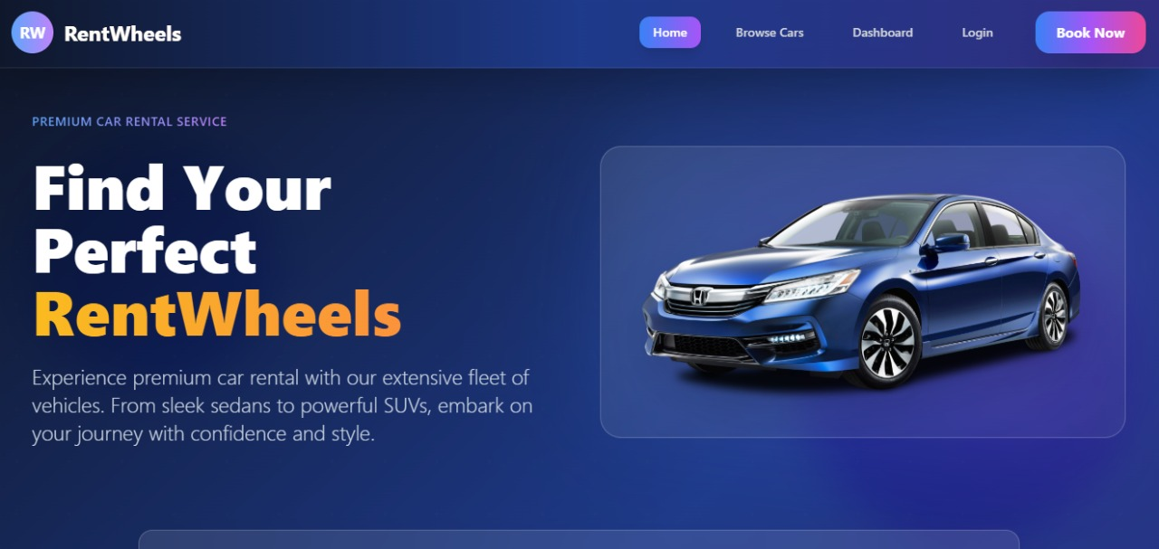
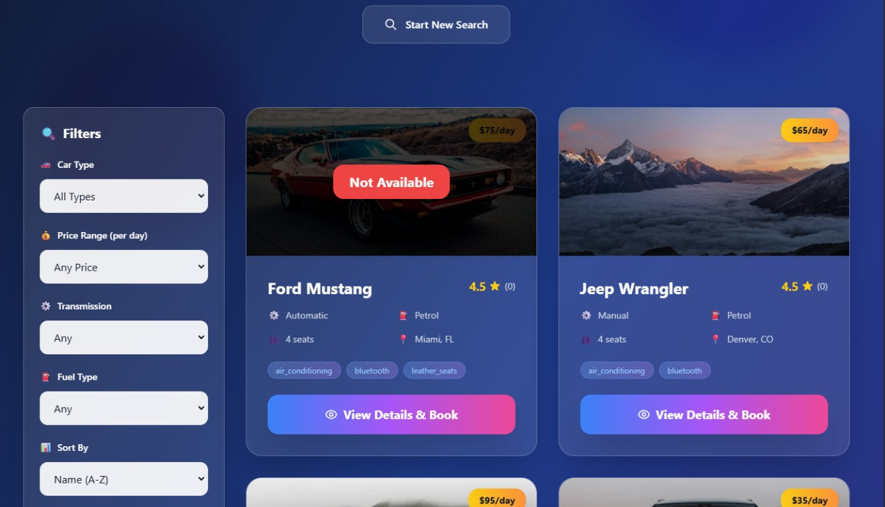
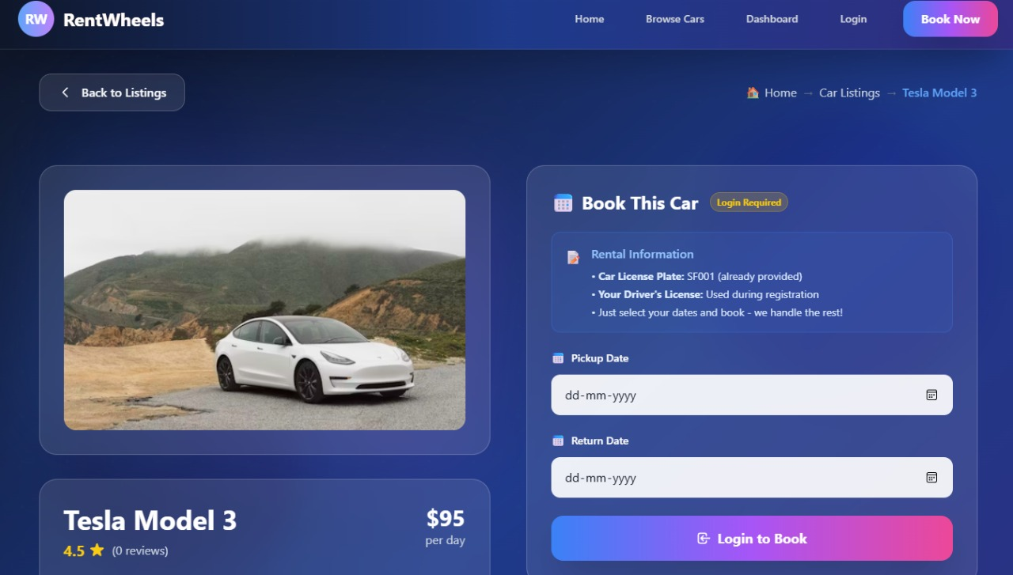
Project Snippets

Slide 9
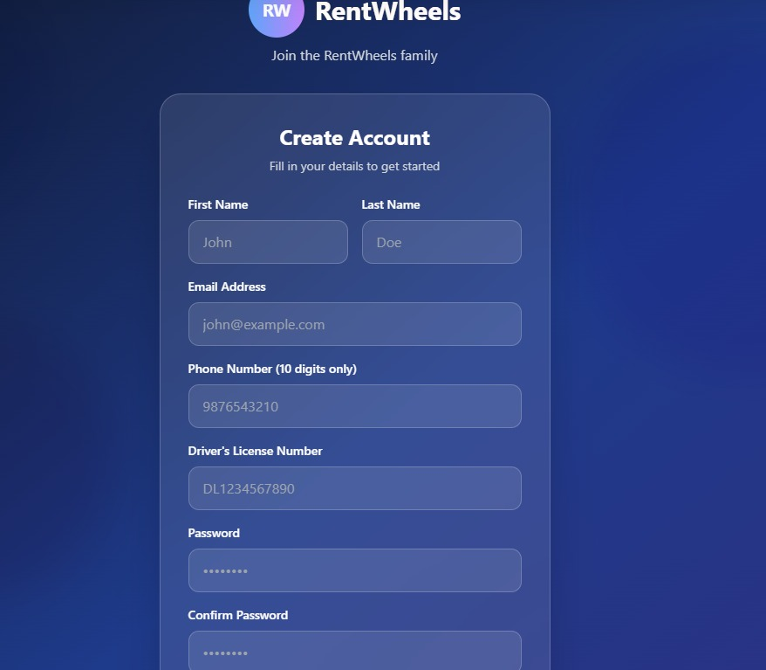
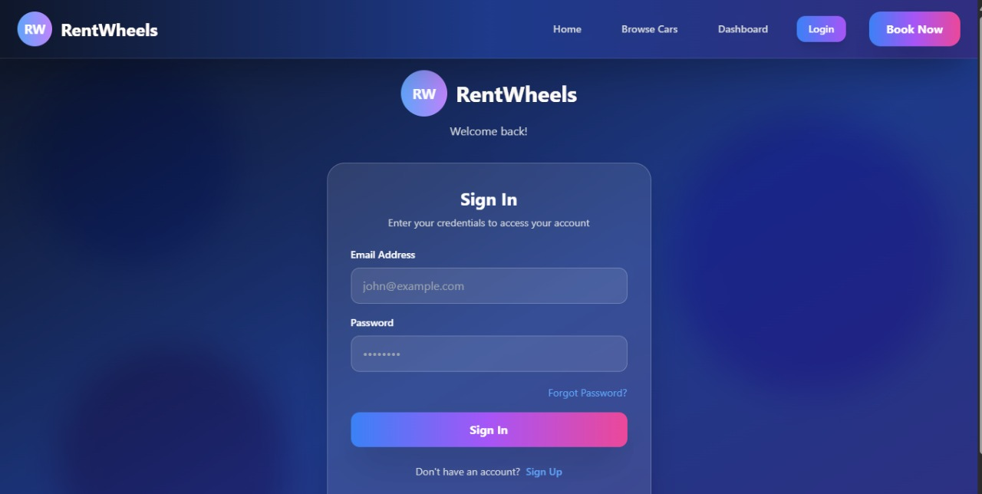
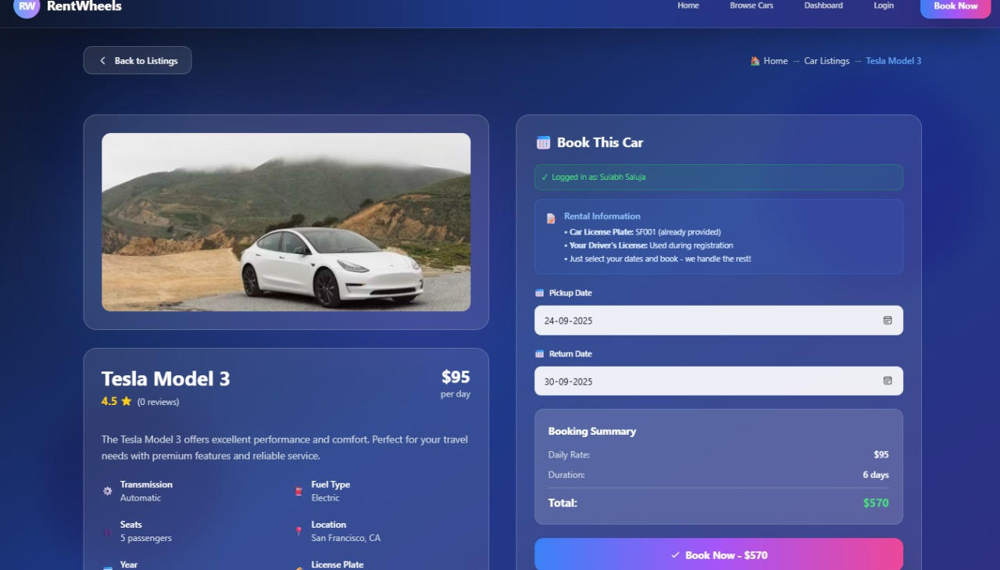
Project Snippets

Slide 10
Conclusion
RentWheels provides a modern, seamless, and secure vehicle rental platform that effectively addresses the numerous limitations of traditional rental systems. By leveraging the power of the MERN stack, it integrates real-time operations, secure payment gateways, and robust fleet management to deliver a smooth and efficient experience for both customers and service providers. The platform not only allows users to search, book, and rent vehicles quickly and conveniently but also enables service providers to manage their fleets, track bookings, monitor vehicle availability, and maintain accurate records with ease. Furthermore, RentWheels emphasizes transparency, reliability, and scalability, ensuring that as user demand grows, the system remains responsive and secure. This project demonstrates how technology can revolutionize mobility solutions, enhance user satisfaction, reduce operational complexities, and create a smarter, more efficient approach to vehicle rentals in today’s fast-paced world.

Slide 11
References
  Official Documentation: Documentation for libraries, frameworks, and tools used in the project, as well as APIs or services integrated.
  https://www.google.com/
  Tutorials and Guides: Online tutorials, guides, blog posts, and educational videos that
provided assistance or insights during development.
  https://www.geeksforgeeks.org/
  Code Repositories: GitHub repositories or other code repositories where code snippets,
examples, or inspiration were found.
  https://chat.openai.com/
  Personal Communication: Mentors, peers who provided guidance, feedback, or support
during development.

