Slide 1
Ninety
WC26
61.4
A live football exchange for the World Cup.
CAN — MAR · 74' · HOME
Trade live win-probability on every match. Priced by TxLINE. Settled trustlessly on Solana.
Play-money — 1,000 free credits a match. No deposits. No payouts. Ever.
SOLANA
TxLINE
PLAY-MONEY
Notes:
Ninety. A live football exchange for the World Cup. You trade live win-probability on any match — priced by TxLINE's consensus feed, settled trustlessly on Solana. It's play money: a thousand free credits a match, no deposits, no payouts, ever. That constraint isn't a limitation — it's the whole strategy, and I'll come back to it.

Slide 2
A billion watch. Almost none play.
The World Cup is the largest shared live event on earth — and the audience just sits there.
Scores apps
Sportsbooks
Prediction markets
Passive. You refresh a number. Nothing you do changes anything.
Gated, licensed, predatory, and banned from most app stores. Most fans can't or won't.
Built for traders, not fans. Cold, sparse, and nobody's watching the match.
The gap
A live market a fan can actually play — with the drama of a real exchange and none of the money, the licences, or the harm.
Notes:
A billion people watch the World Cup and almost none of them participate. Scores apps are passive — you refresh a number. Sportsbooks are gated, licensed, predatory, and banned from most app stores. Prediction markets are built for traders, not fans. The gap is a live market a fan can actually play — with the drama of a real exchange and none of the money, the licences, or the harm.

Slide 3
Price is probability.
Every outcome trades from 0 to 100. The price IS the market's live read of the chance.
1,000 free credits, every match
HOME
No deposit. No wallet funding. Just play.
61.4
LMSR automated market maker
Always a price, always liquid — no counterparty needed.
Home / Draw / Away
Canada are a 61.4% chance right now.
Buy at 61.4. A winning share settles at 100 credits.
Buy below the true chance — that's the edge.
One market, three outcomes, prices always summing to 100.
We say price, trade, credits
Never the other words. That is a product decision, not a euphemism.
Notes:
The core idea is one line: price is probability. Every outcome trades from zero to a hundred, and the price is the market's live read of the chance. Canada at 61.4 means the market rates them a 61.4% chance. A winning share settles at 100 credits — so buying below the true chance is the edge. You get a thousand free credits every match. An LMSR market maker means there's always a price and always liquidity. And notice the language: price, trade, credits. Never the other words. That's a deliberate product decision.

Slide 4
The 90 seconds that make this product.
A goal goes in. Watch what happens.
01
02
03
GOAL
HALT
REPRICE
TxLINE's signed feed carries the goal in milliseconds.
The market freezes. Nobody can trade a price that's already dead.
The engine re-anchors. The cliff lands on the chart.
04
05
06
SPREAD DECAYS
THE BOOTH
SETTLE
Liquidity walks back in over 60 seconds.
An AI commentator narrates the swing, quoting the real move.
Full time. Solana verifies TxLINE's proof. Nobody is trusted.
Notes:
This is the ninety seconds that make the product. A goal goes in. TxLINE's signed feed carries it in milliseconds. The market halts — nobody gets to trade a price that's already dead. The engine re-anchors and the cliff lands on the chart. The spread decays as liquidity walks back in over sixty seconds. The Booth — our AI commentator — narrates the swing, quoting the real move. And at full time, Solana verifies TxLINE's cryptographic proof and settles it. Nobody is trusted at any point in that chain.

Slide 5
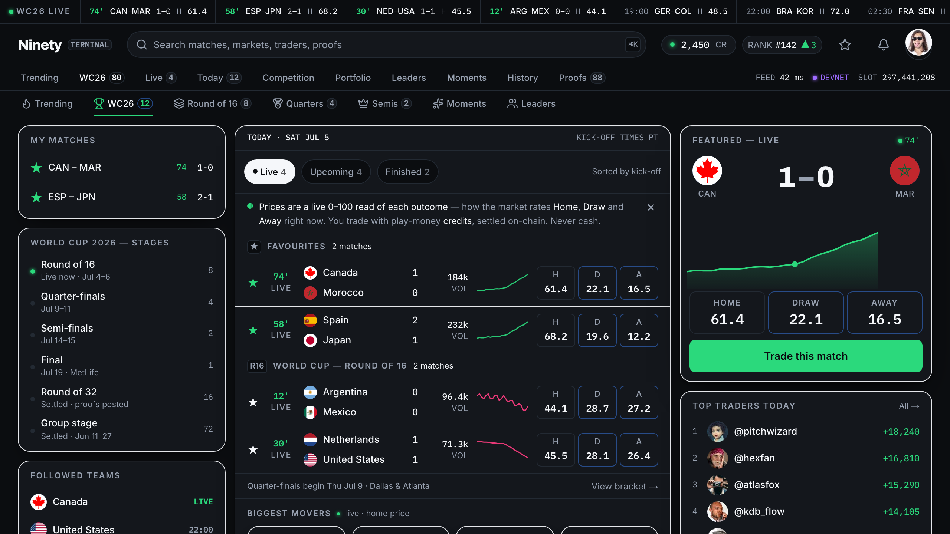
The board
Every live match, every price, one glance. Real WC26 data — no placeholders.
Notes:
This is the board. Every live match, every price, one glance. Grouped by competition, sparklines on every row, the featured match with the Momentum River running live. This is real World Cup 2026 data — there is not a placeholder anywhere on this screen.

Slide 6
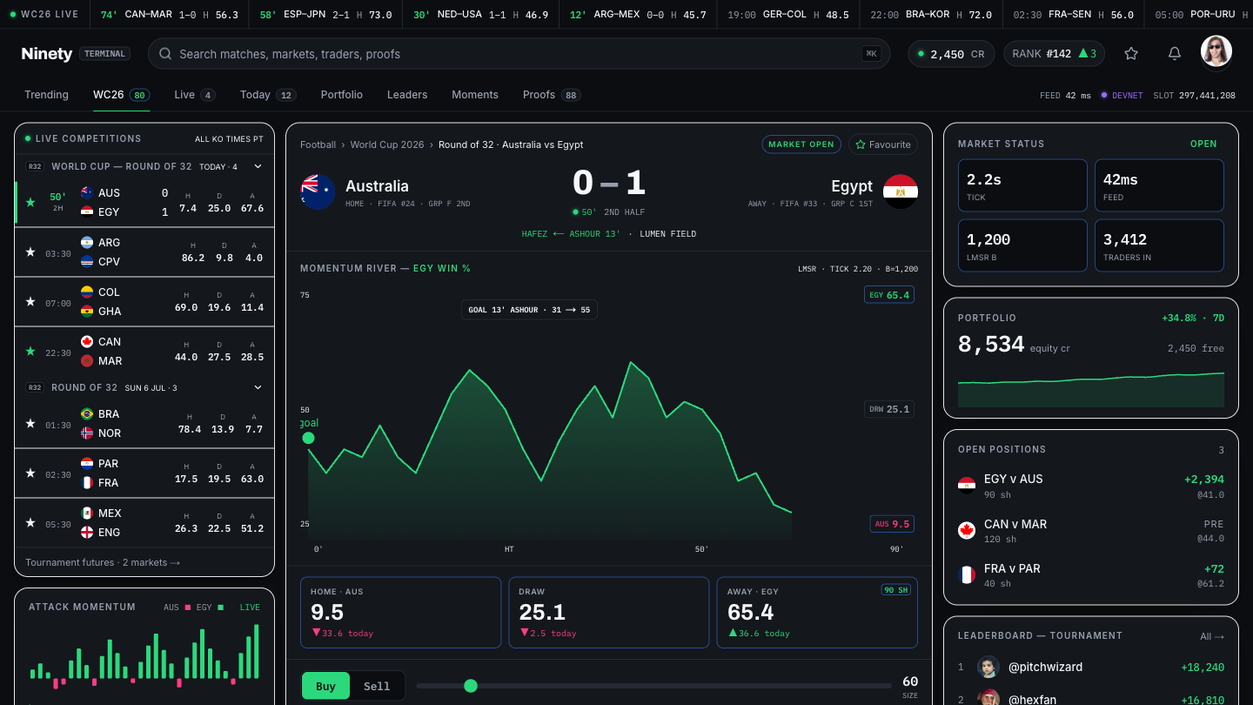
The Terminal
The Momentum River is the hero. Price, depth, position, and the Booth — one surface, one decision.
Notes:
And this is the Terminal — where you actually trade. The Momentum River is the hero of the screen: a live win-probability curve over ninety minutes, with the goal cliff marked. Buy or sell, see your cost, your average price, your maximum payout. Your position and P&L on the right. And at the bottom, the Booth, calling the match. One surface, one decision.

Slide 7
Why Solana. Why TxLINE.
Because the alternative is asking you to trust us — and you shouldn't have to.
SOLANA
TxLINE
Our Anchor program is the referee.
settle_market is permissionless and one-shot. It refuses to settle unless a TxLINE proof verifies on-chain, by CPI. There is no admin key. There is no override. We could not cheat our own market if we wanted to.
Sub-second finality and sub-cent fees are what make per-match settlement, leaderboard roots, and on-chain Moments economically possible at all. On any other chain this product does not exist.
Every price we quote traces to a signed feed.
Consensus odds de-vigged into fair marks. Live scores that trigger the halt. And the same feed that moves the price is the one that proves the result — cryptographically, on-chain.
That is the thing no other data provider gives you: the price and the proof come from one source. Nine TxLINE endpoints, live-verified on devnet, every response schema-validated.
Notes:
Why Solana, and why TxLINE — because the alternative is asking you to trust us, and you shouldn't have to. Our Anchor program is the referee. settle_market is permissionless and one-shot, and it refuses to settle unless a TxLINE proof verifies on-chain by CPI. There is no admin key. There is no override. We could not cheat our own market if we wanted to. Solana's sub-second finality and sub-cent fees are what make per-match settlement economically possible at all. And TxLINE is the only feed where the price and the proof come from the same source — the data that moves the market is the data that proves the result.

Slide 8
The stack
Seven layers, one law: every input becomes a signed event on the bus. No service calls another directly.
TxLINE
Signed odds + scores. SSE.
81
INGEST
Normalise → bus. Gap recovery, exactly-once.
commits
CORTEX
Python. Shin de-vig → fair marks + hazard.
53
ADRs
ENGINE
LMSR. Single-writer. Journal-then-ack.
API + WS
Fastify. Read model. Live tape.
7
days
SOLANA
Anchor. Proof-verified settlement.
407
WEB
Next 15. The board + the Terminal.
source files
Notes:
The stack. Seven layers, and one law that holds all of them together: every input becomes a signed event on a bus, and no service ever calls another service directly. TxLINE in. Ingest normalises with exactly-once guarantees and gap recovery. Cortex — that's Python — de-vigs the consensus odds into fair marks. The engine is the single writer of market state: LMSR pricing, journal-then-ack, fully replayable. The API serves the read model and the live tape. Solana settles. And the web renders. Eighty-one commits, fifty-three architecture decision records, four hundred and seven source files — in seven days.

Slide 9
Built for a fan, not a quant.
The terminal is the engine. This is the experience wrapped around it.
Wallet, or no wallet
Free games on the live feed
Phantom if you want it. Email-and-OTP if you don't. A custodial key is derived for you — you're trading in ten seconds, not ten minutes.
Next Goal. Beat the Market. Bracket Pick'em — scored by an on-chain proof, not by us.
Moments
The whole tournament
The biggest swing of the match, rendered as a card. Yours to keep, minted on Solana.
48 teams, 12 groups, 16 stadiums, all 104 fixtures — through to the Final at MetLife, July 19.
Notes:
This is built for a fan, not a quant. Wallet or no wallet — connect Phantom if you want, or just use email and a one-time code, and we derive a custodial key for you. You're trading in ten seconds, not ten minutes. Free mini-games running on the same live feed: pick the next goal, beat the market, fill the bracket — and the bracket is scored by an on-chain proof, not by us. Moments: the biggest swing of a match, rendered as a card you keep. And the whole tournament — forty-eight teams, sixteen stadiums, all hundred-and-four fixtures, through to the Final at MetLife on July nineteenth.

Slide 10
We broke our own settlement.
And then we shut it off rather than ship it.
The finding
The sanctioned settlement path selects the finalised score record OFF-chain, by sequence number. On-chain, validate_stat proves a stat leaf is in the Merkle root — but it never sees the record's Action field. So a caller can pick a mid-match sequence and produce a proof that verifies identically. Finality is asserted, not proven.
What we did
Why it matters
SETTLEMENT_LIVE = false. Hard-gated in the program itself. We shipped the proof path fail-closed rather than ship a settle we could not prove was safe.
Two independent adversarial audits, and the question is now with TxODDS. This is what building on a new oracle actually looks like — and we would rather be the team that found it than the team that shipped it.
Notes:
Now the part most demos skip. We tried to break our own settlement, and we succeeded. The sanctioned path selects the finalised score record off-chain, by sequence number. On-chain, validate_stat proves a stat leaf is in the Merkle root — but it never sees the record's Action field. So a caller can pick a mid-match sequence and produce a proof that verifies identically. Finality is asserted, not proven. Two independent adversarial audits found it. So we hard-gated settlement off — in the program itself — and raised it with TxODDS. We would rather be the team that found this than the team that shipped it.

Slide 11
Seven days. One engineer. An agent team.
Not vibe-coded. Governed.
Laws, not prompts
A CLAUDE.md constitution — design law, architecture law, the play-money invariant — enforced by git hooks that block a violating write before it lands.
Specialist agents
engine-guardian on the trading core. proof-auditor on the Anchor program — it found the settlement forge. design-cop judges every screen against a rubric. quant-reviewer on the pricing math.
53 ADRs
Every decision is written down before it is coded. Chat is not memory. That is why seven days of work didn't collapse into mud.
The loop that mattered
Screenshot the render → look at it → judge it → fix it. Every real UI improvement came from seeing the page, never from writing blind.
Notes:
Seven days, one engineer, and an agent team. This wasn't vibe-coded — it was governed. The repo has a constitution: design law, architecture law, the play-money invariant — and git hooks that block a violating write before it lands. Specialist agents own specialist surfaces: engine-guardian on the trading core, proof-auditor on the Anchor program — that's the agent that found the settlement forge — design-cop judging every screen against a rubric. Fifty-three ADRs, because chat is not memory and a decision that isn't written down doesn't survive the next session. That discipline is the only reason seven days of work didn't collapse into mud.

Slide 12
Where this goes
The Final is July 19. That's the start, not the finish.
NOW
Live wiring + the Final
Ninety monitors the World Cup Final live — real TxLINE prices, real halts, real settlement.
NEXT
Prize money → infrastructure
A managed Postgres and Redis, a Helius key, and a Bubblegum tree so Moments mint on mainnet. Every dollar goes into keeping the feed and the proofs running.
THEN
Beyond football
TxODDS is multi-sport. The engine, the bus, and the proof path don't know or care that this is football. The next tournament is a config change.
THE MOAT
The clean top-of-funnel
Play-money is app-store safe and licence-free. That makes Ninety the acquisition channel a sportsbook cannot legally build — and the one they'll want to partner with.
Notes:
Where this goes. Right now: finish the live wiring and have Ninety monitoring the World Cup Final on July nineteenth — real prices, real halts, real settlement. Next: prize money goes straight into infrastructure — managed Postgres and Redis, a Helius key, a Bubblegum tree so Moments mint on mainnet. Then: beyond football — TxODDS is multi-sport, and the engine, the bus and the proof path don't care what sport this is. The next tournament is a config change. And the moat: play-money is app-store safe and licence-free, which makes Ninety the clean top-of-funnel a sportsbook cannot legally build — and the one they'll want to partner with.

Slide 13
Ninety
The market moves the moment the ball does.
Priced by TxLINE. Settled by Solana. Free to play, forever.
TRY IT
GITHUB
SOLSCAN
Ninety is free to play. Credits are play money and have no cash value.
Notes:
Ninety. The market moves the moment the ball does. Priced by TxLINE, settled by Solana, free to play forever. Thank you.

