Slide 1
Differential Gene Expression in ALS Immune Cells Types
-By Sushant Agellu

Slide 2


Slide 3



Slide 4
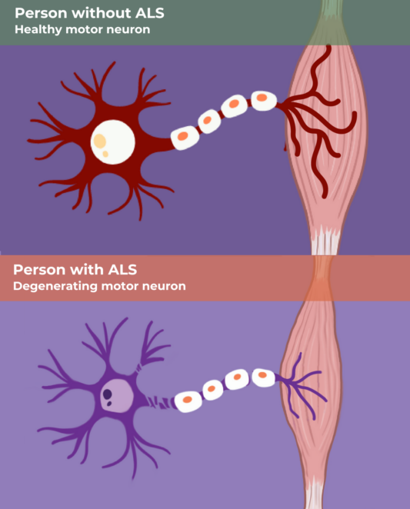
  B A C K G R O U N D
Amyotrophic lateral sclerosis (ALS) is a fatal neurodegenerative disease that causes progressive loss of motor neurons in the brain and spinal cord. Patients experience muscle weakness, paralysis, and respiratory failure, with median survival of 2–5 years after diagnosis. ALS was traditionally viewed as a disease confined to the nervous system, but mounting evidence now shows that the peripheral immune system plays a critical role in disease progression.
ALS is now considered a systemic immune disorder

Slide 5
02
R E S E A R C H
Q U E S T I O N

Slide 6
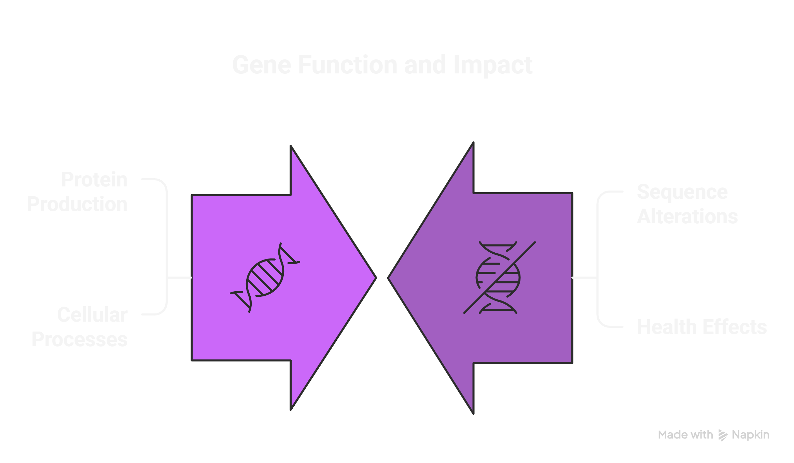
Q U E S T I O N 1
Which genes are differentially expressed in circulating immune cells of ALS patients compared to healthy controls, and which cell types carry the strongest transcriptional signature?

Slide 7

Q U E S T I O N 2
Are any differentially expressed genes shared across multiple immune cells, making them more robust candidate markers?

Slide 8
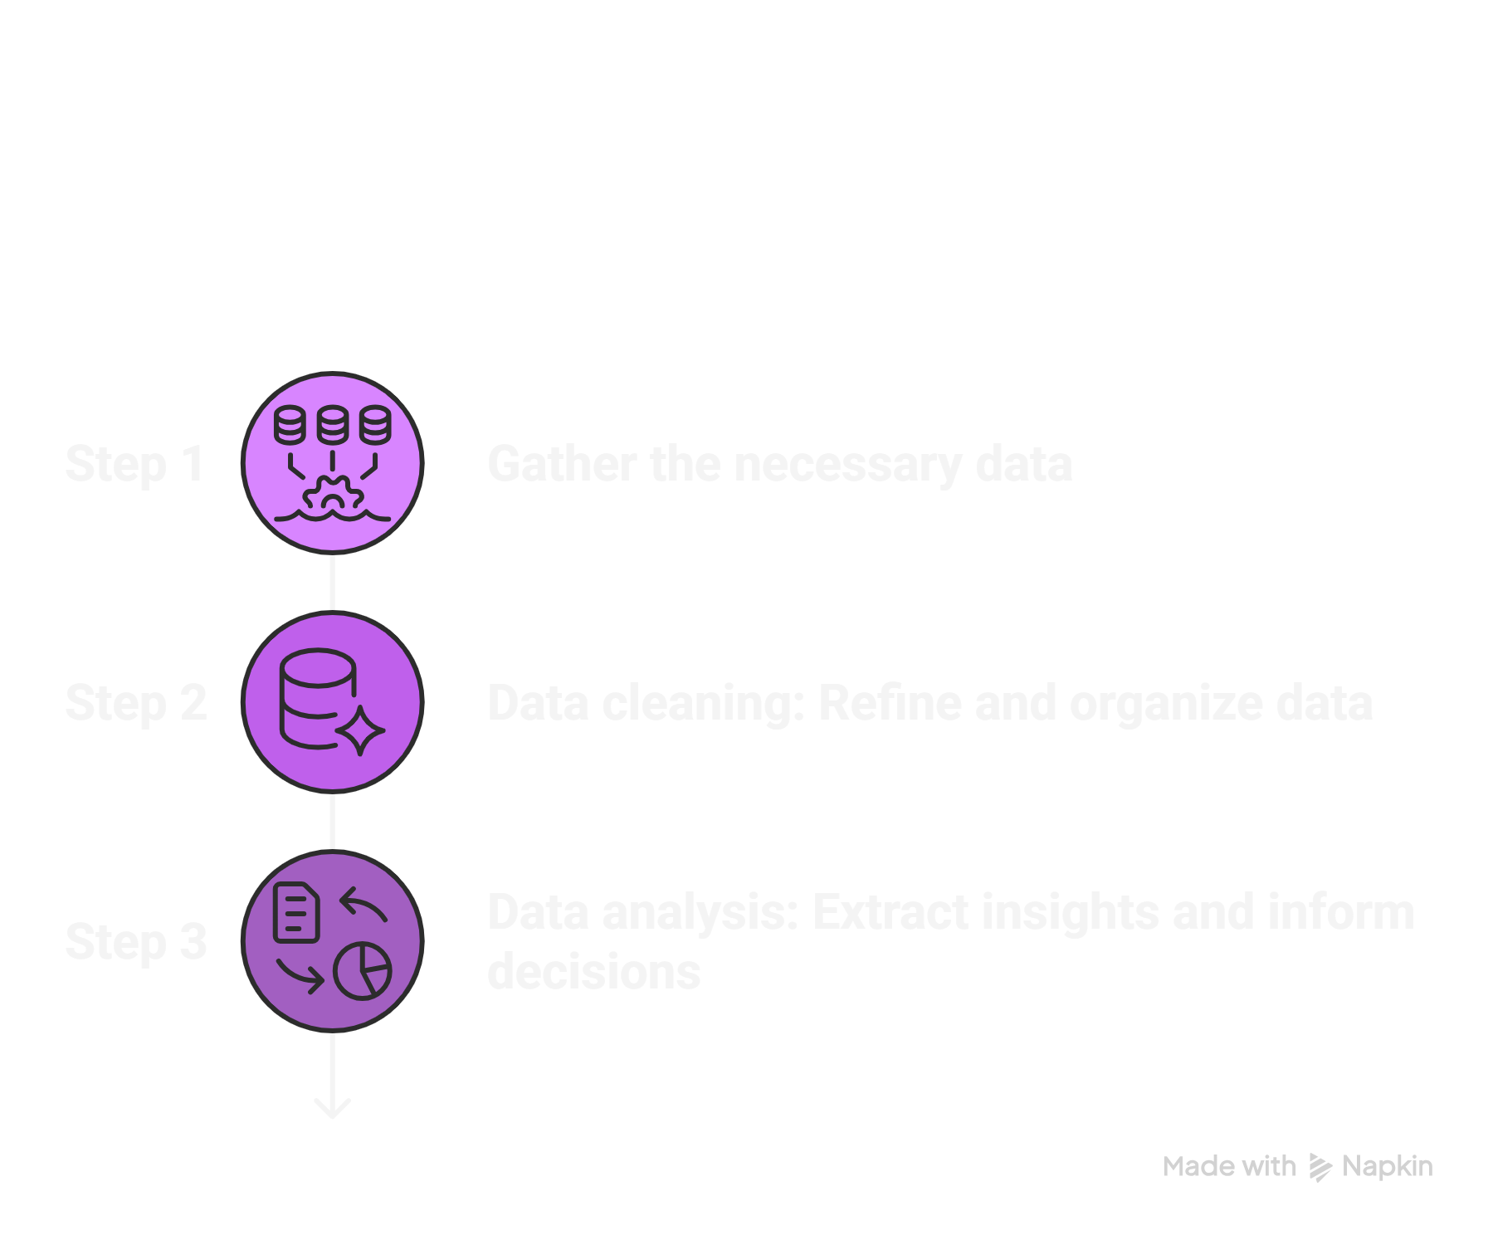
M E T H O D S
& R E S U L T S
03

Slide 9
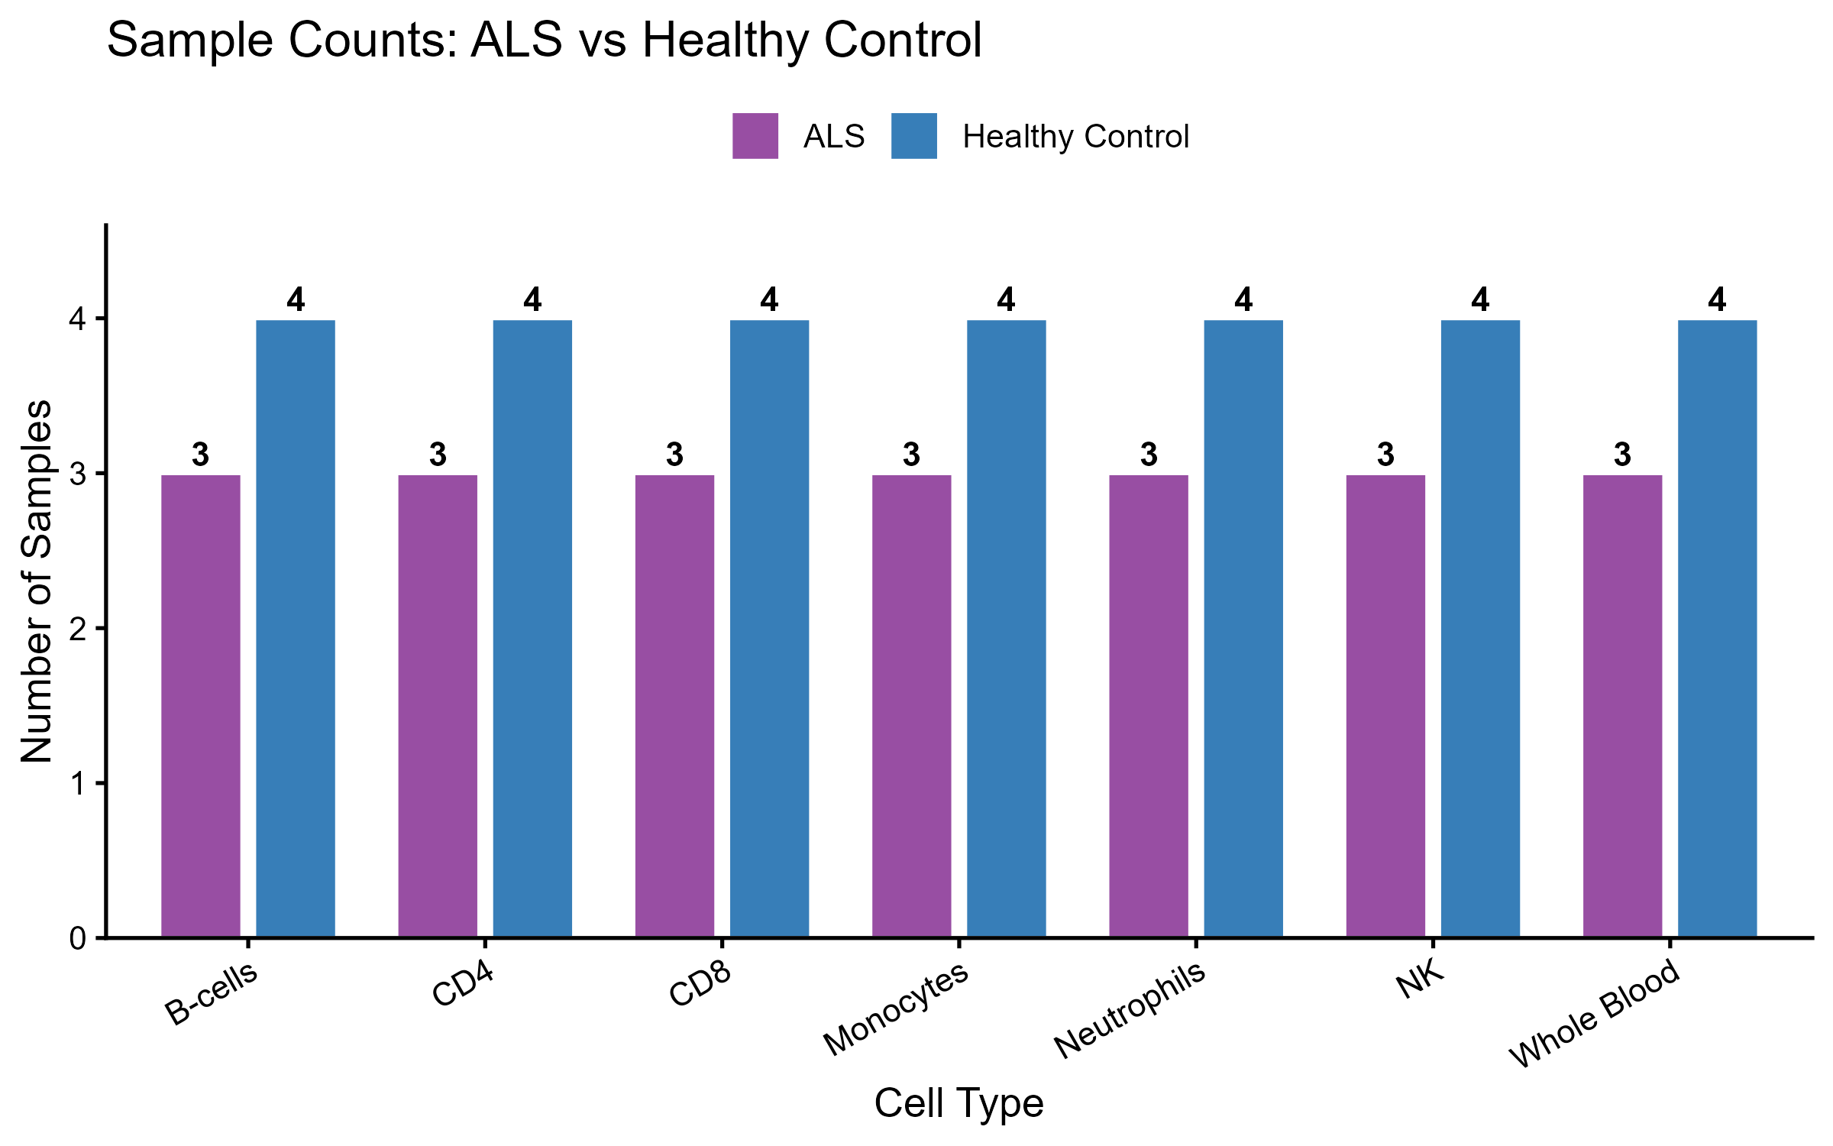
D A T A
GEO
134
Individuals overall RNA-seq data
7
Cell Population Data Analysed
3 vs 4
ALS Healthy

Slide 10
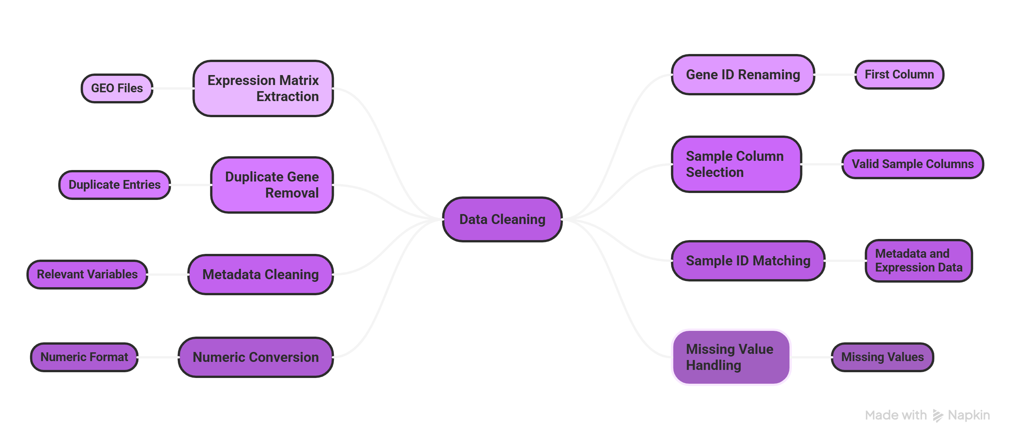
DATA CLEANING

Slide 11
DATA ANALYSIS
Test / Step | Purpose | Output
Low-count gene filtering | Remove genes with insufficient data for reliable testing | 7,215–9,637 genes retained per stratum
Median-of-ratios normalization | Correct for library-size and composition differences between samples | Per-sample size factors
Dispersion estimation & shrinkage | Estimate gene-wise variance; shrink toward fitted mean–dispersion trend (stabilizes small-n estimates) | Shrunken per-gene dispersions
Negative binomial GLM fit | Fit count model with disease as predictor: design = ~ disease | Per-gene coefficients + standard errors
DESEQ2 Analysis | Label genes Up / Down / NS based on significance + effect size | log2FC
Variance-stabilizing transformation (VST) | Prepare counts for visualization (PCA, heatmaps) | Homoscedastic expression matrix
Principal Component Analysis (PCA) | Explore sources of variation; confirm cell-type vs disease structure | PC scores + % variance per PC
HeatMaps | Order heatmap rows/columns by similarity | Row/column dendrograms
Consensus HeatMaps | Identify DEGs shared across Neutrophils AND Monocytes | 17 consensus genes
Negative GLM : Variance is greater than the mean, which violates normal and Poisson assumptions.
The negative binomial model accounts for this by modeling variance as a function of the mean.
Notes:
“For statistical testing, we used a negative binomial generalized linear model implemented in DESeq2.
RNA-seq data are counts and show overdispersion, meaning the variance is greater than the mean, which violates normal and Poisson assumptions.
The negative binomial model accounts for this by modeling variance as a function of the mean.
We used a design formula of disease, so for each gene the model estimates how expression changes between ALS and healthy samples.
A Wald test is then applied to determine if that change is significantly different from zero, and p-values are adjusted using false discovery rate correction.”

Slide 12
R E S U L T S
Component | Method Used | Result | Interpretation
Model | DESeq2 | Negative binomial GLM applied per cell type | Suitable for count data with overdispersion
Design | GLM (~ disease) | ALS vs Healthy comparison | Isolates disease effect on gene expression
Statistical Test | Wald test | p-values computed per gene | Tests if expression difference ≠ 0
Multiple Testing | Benjamini–Hochberg FDR | padj values obtained | Controls false positives across ~8,000 genes
Significance Threshold | padj < 0.05, |log2FC| > 1 | Genes classified as DEGs | Ensures statistical + biological relevance
Neutrophils Results | DEGs identified | 38 total (10 up, 28 down) | Strongest ALS signal
Monocytes Results | DEGs identified | 34 total (18 up, 16 down) | Second strongest signal
Other Cell Types | DEGs identified | 13–28 DEGs | Weaker disease signal
Direction of Change | Up vs Down regulation | More genes downregulated | Suggests suppression of immune pathways
Consensus Genes | Intersection analysis | 17 shared DEGs | High-confidence ALS-associated genes
Model Validation | Dispersion analysis | Mean-dependent variance observed | Justifies negative binomial model

Slide 13
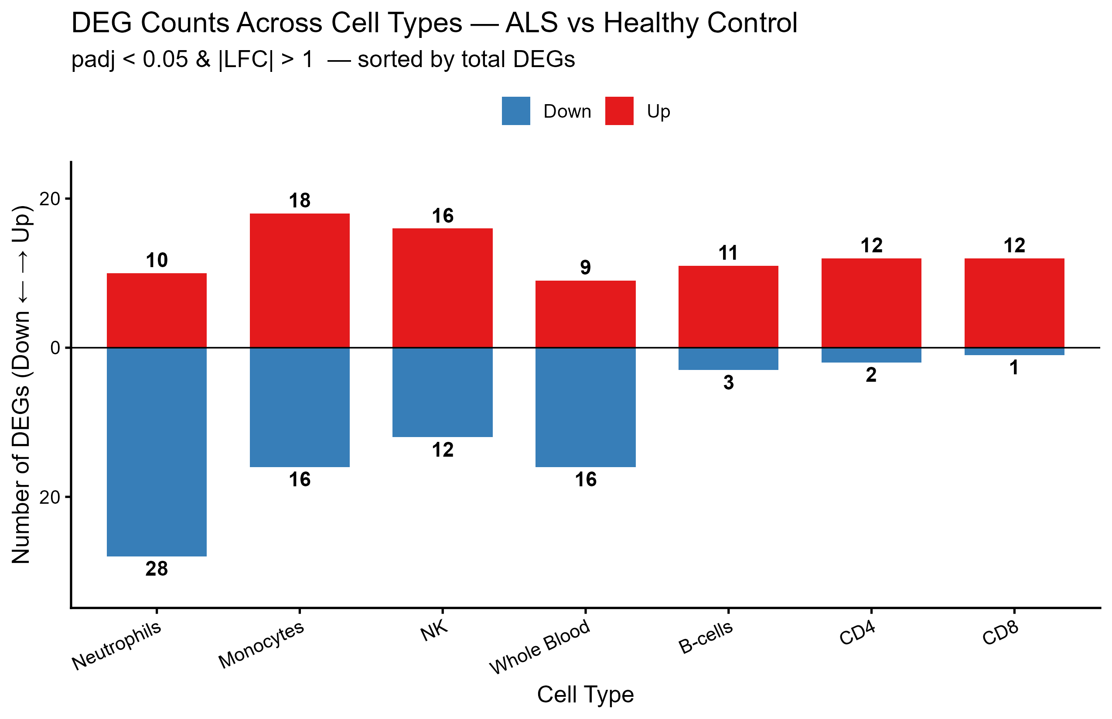
Neutrophils: 38 significant genes
Monocytes: 34 significant genes
Other cell types: fewer changes (~10–25 genes)
Majority of genes are downregulated in ALS
Notes:
Innate immune cells show strongest signal
Adaptive immune cells show weaker changes
Suggests ALS effects are cell-type specific

Slide 14
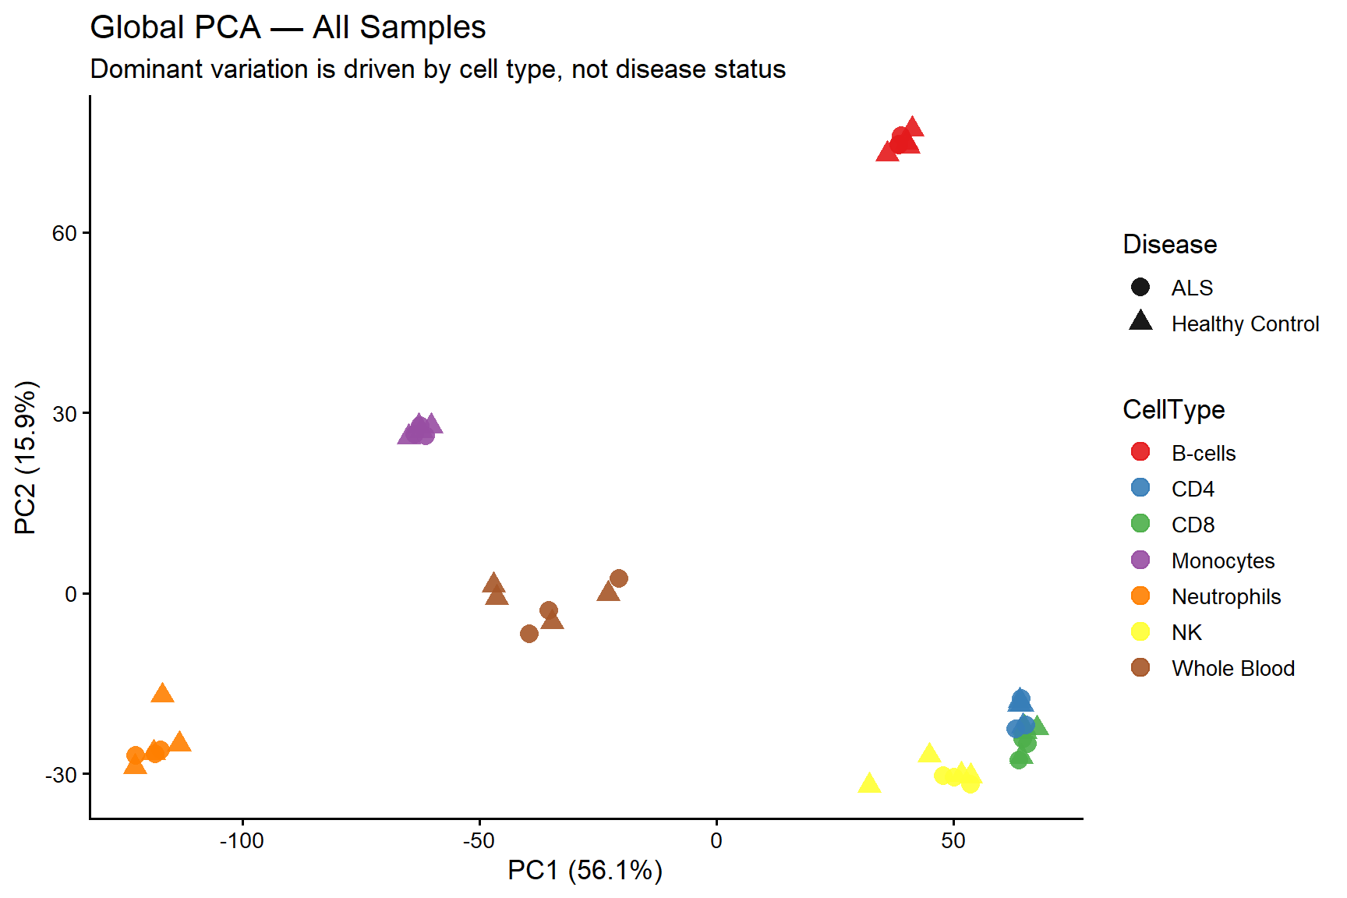
Samples cluster strongly by cell type
Disease signal is weaker than the cell-type effect
Partial separation seen in:
Neutrophils
Monocytes

Slide 15
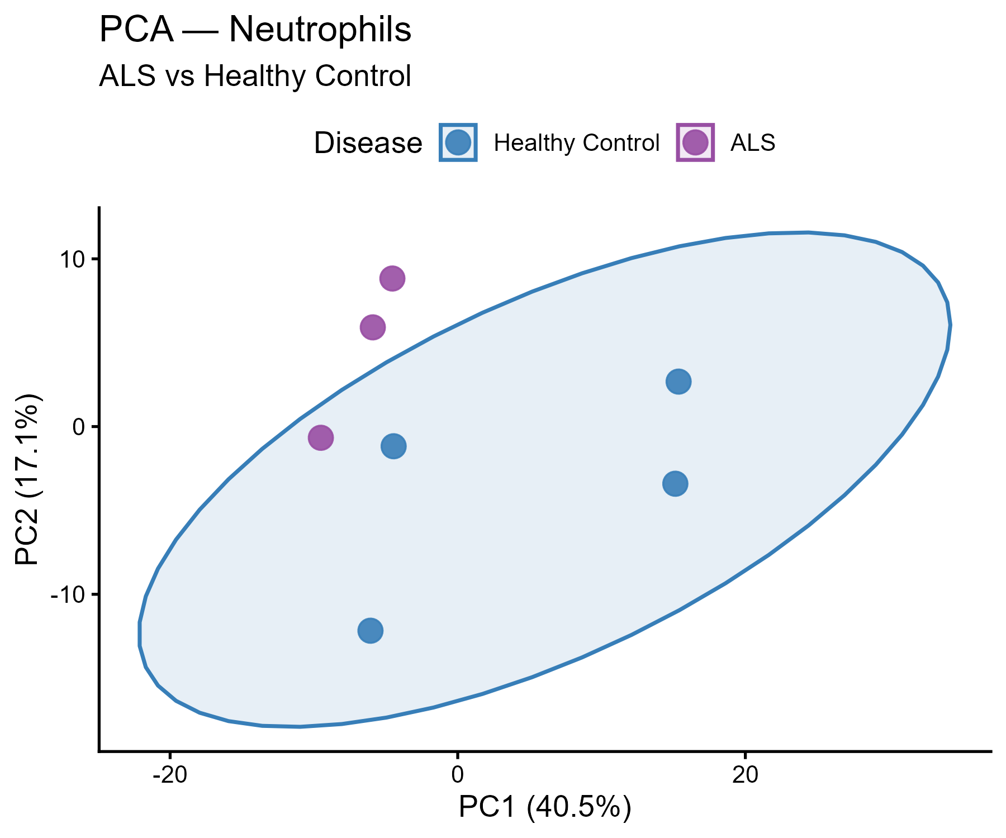
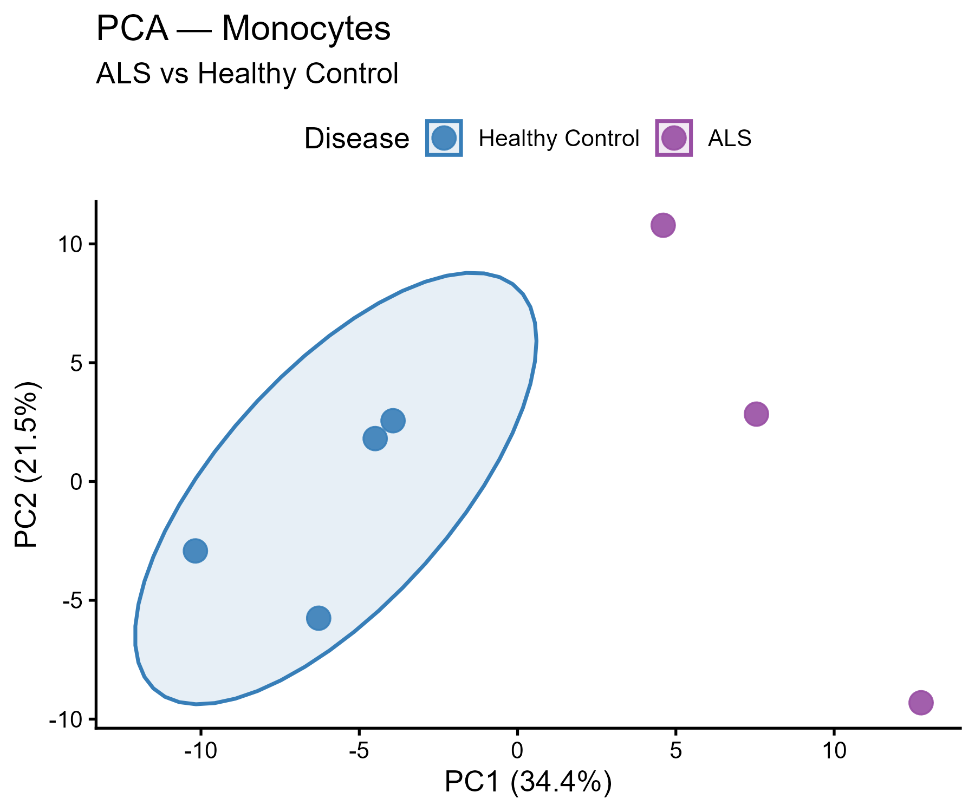
Both plots show partial clustering, meaning disease has an effect, but it’s not the dominant source of variation.
Notes:
Variance-stabilized counts (VST) used instead of raw counts
Top 2,000 most variable genes selected
Analysis performed per cell type (not pooled)
Data centered and scaled before
PCA Principal components (PC1, PC2) used for visualization
Samples colored by disease (ALS vs Healthy)
Checked clustering and separation patterns

Slide 16
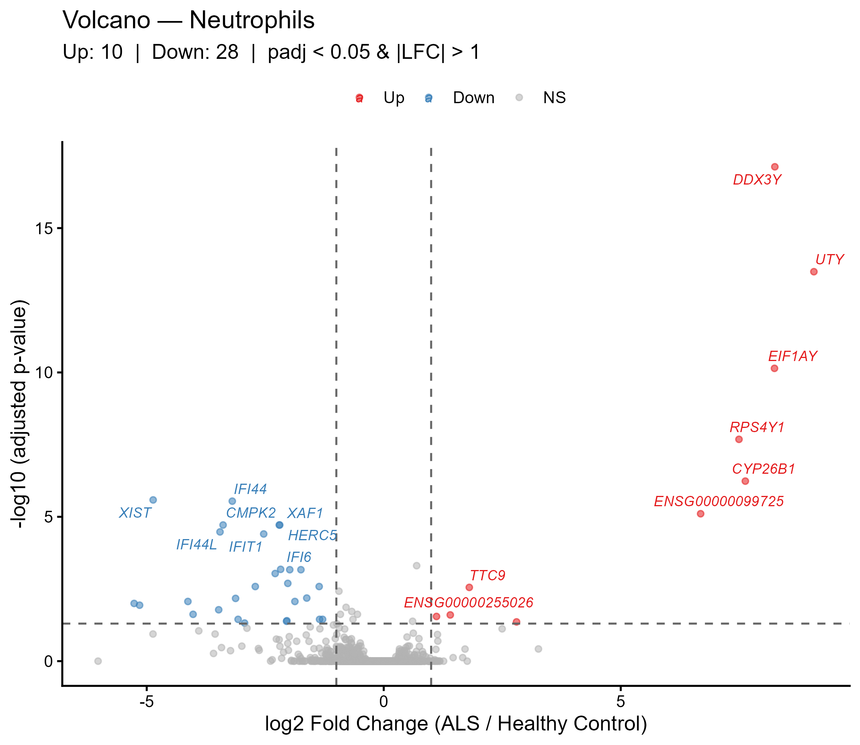
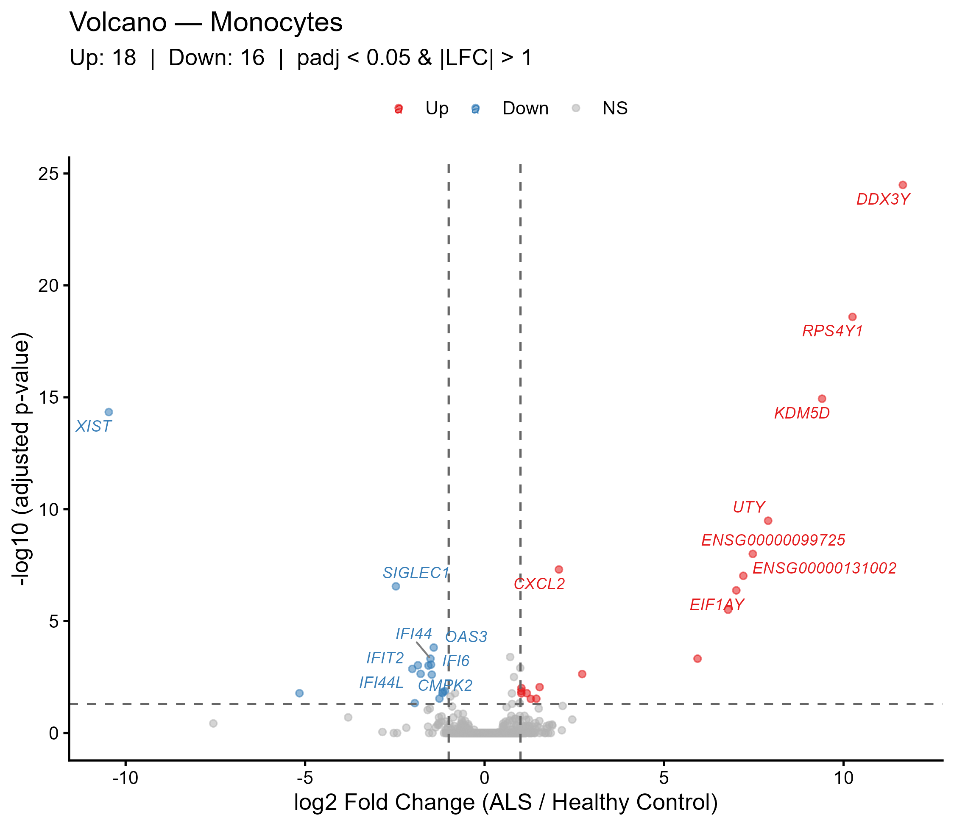
Clear separation of significant vs non-significant genes
Strong signal in:
  Downregulated genes
Key genes appear consistently across cell types

Slide 17
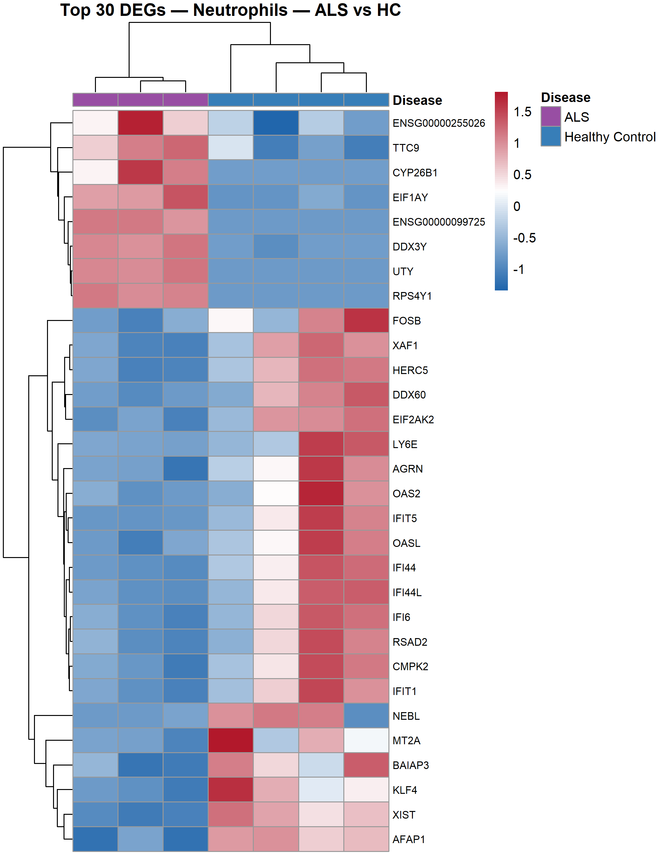
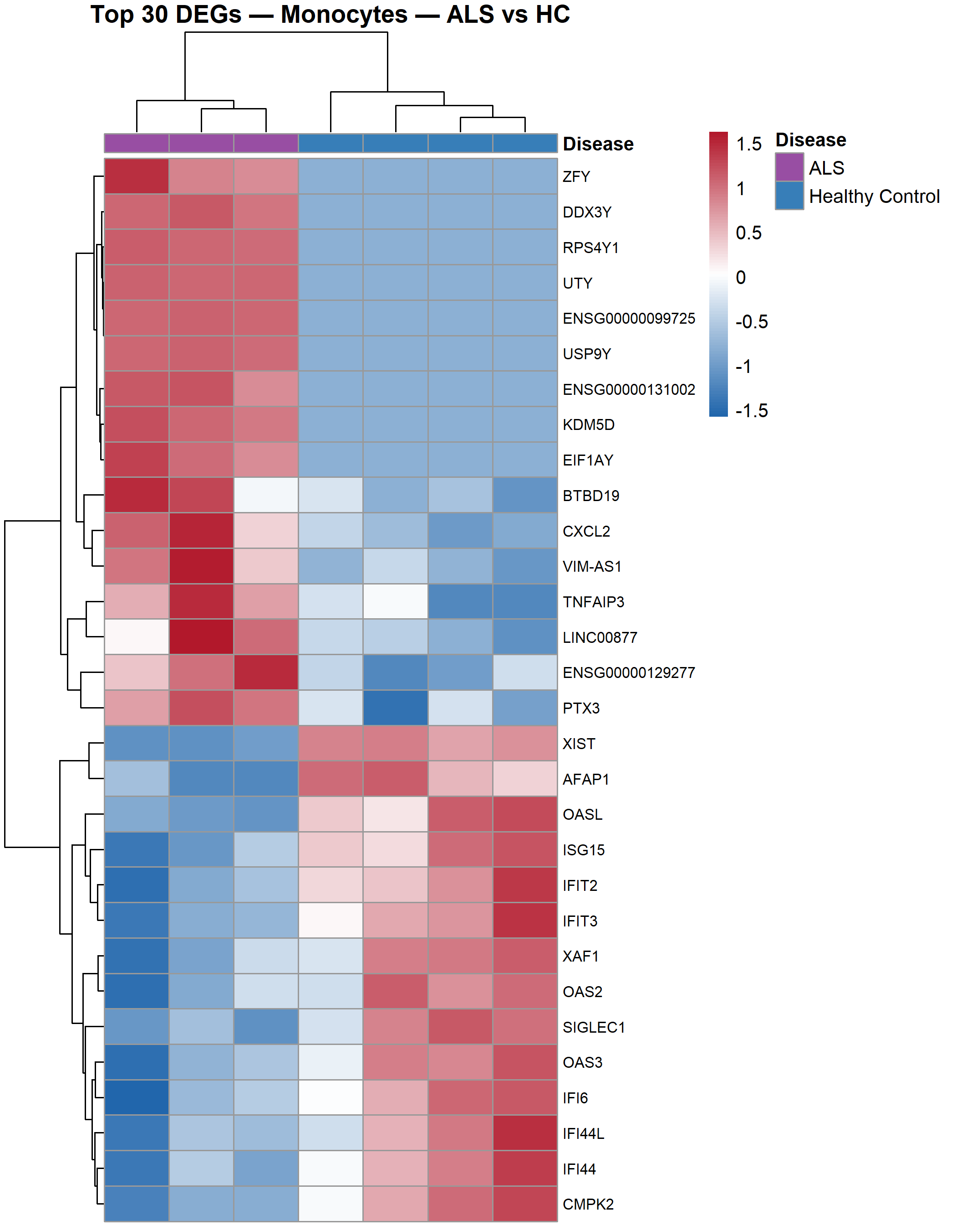
Top genes show distinct expression patterns
ALS and Healthy samples form separate clusters
Signal visible at individual sample level

Slide 18
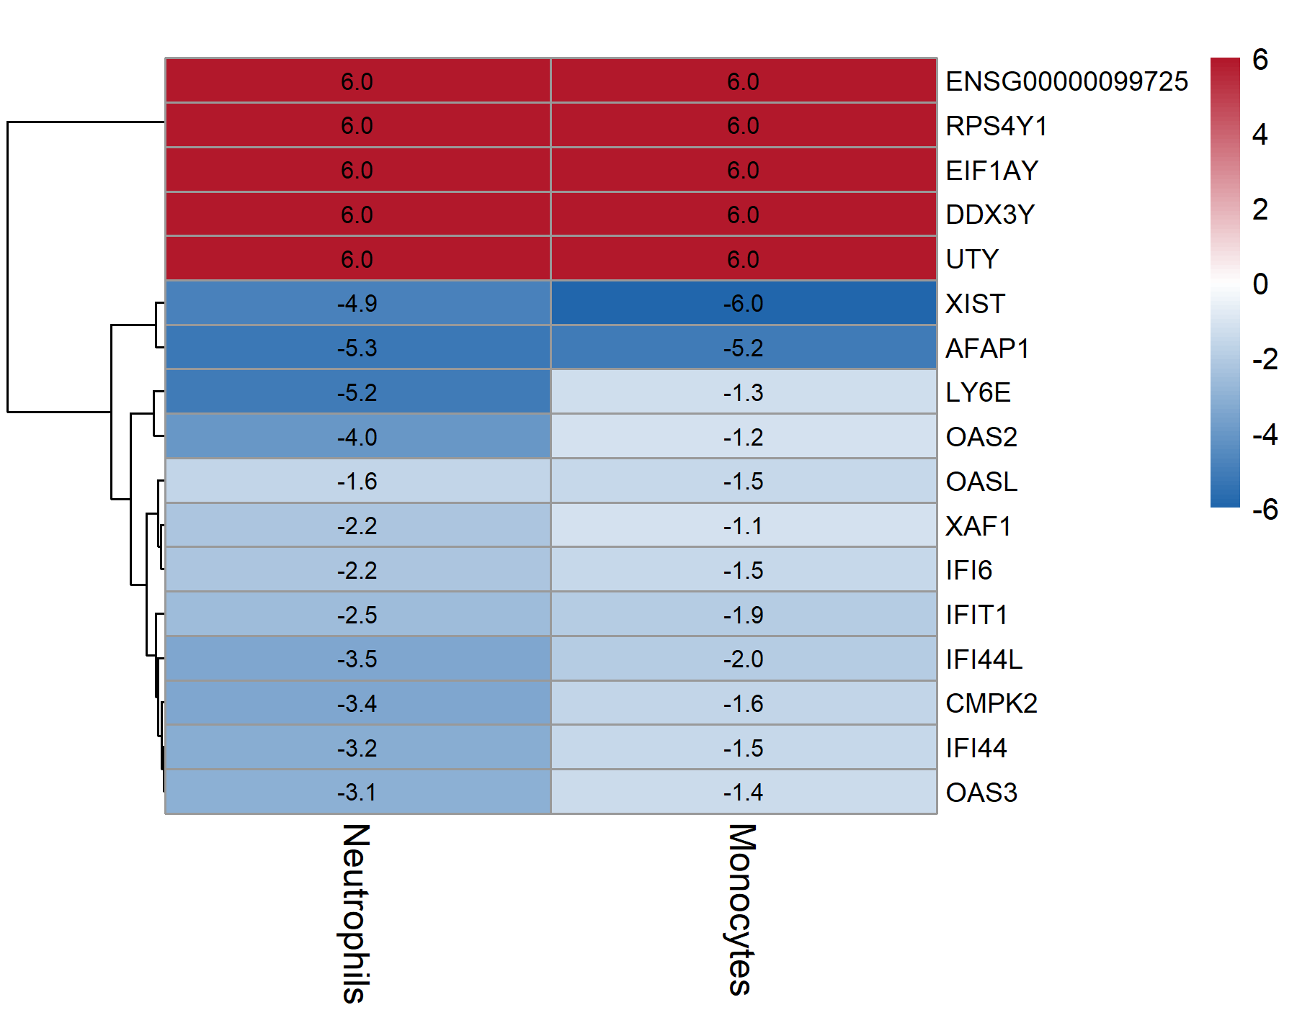
Overlap of Genes
17
genes
Cross-cell-type concordance =
stronger evidence

Slide 19
04
I M P L I C A T I O N S

Slide 20
GENES FOUND
Other genes
IFI Family
CMPK2
XAF1
LY6E
AFAP1
TNFAIP3
IFI44
IFI44L
IFIT1
IFI6
ISG15
OAS family
Sex Genes
OAS2
OAS3
OASL
UTY
DDX3Y
RPS4Y1
Notes:
Group 1 — Type-I Interferon Response (ISGs) (9 genes, all DOWN in ALS)
IFI44, IFI44L, IFIT1, IFI6, OAS2, OAS3, OASL, CMPK2, XAF1

Slide 21
CONCLUSION
IMMUNE GENES
SEX CHROMOSOME GENES
Interferon response
The immune system is weaker
Reduced response to infection or inflammation
Sex Imbalance
Upregulation in male genes
The affected sample was donated by males
The differential genes can be used as a Marker in diagnostics

Slide 22
WERE QUESTIONS ANSWERED ?
Question 1
Question 2
Yes
Families Like OAS, IFI are seen
Yes
The Genes were seen across Cell types
(Neuteophils And Monocytes)

Slide 23
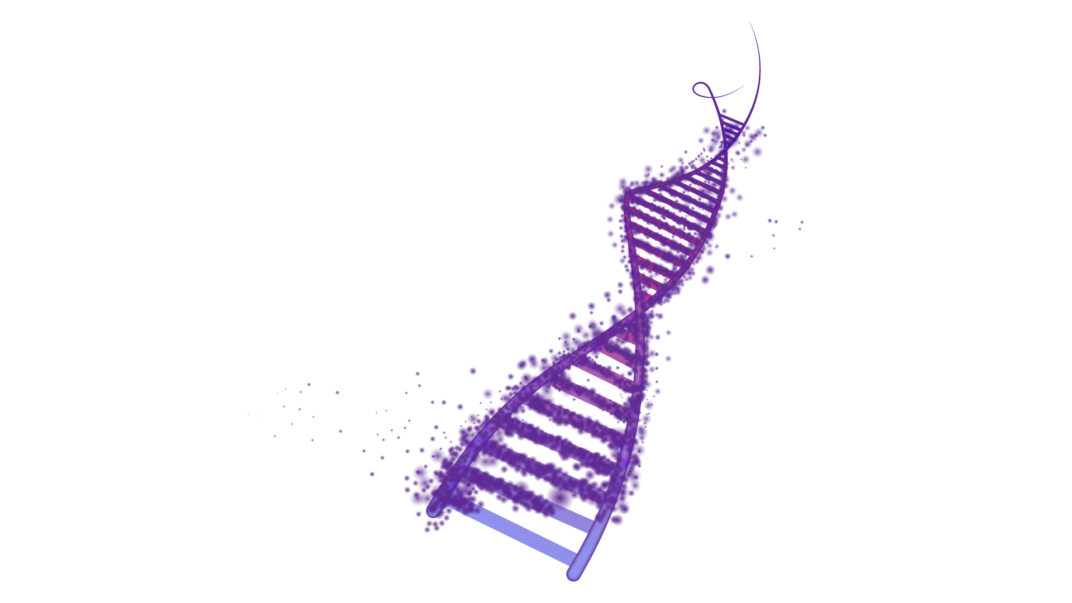
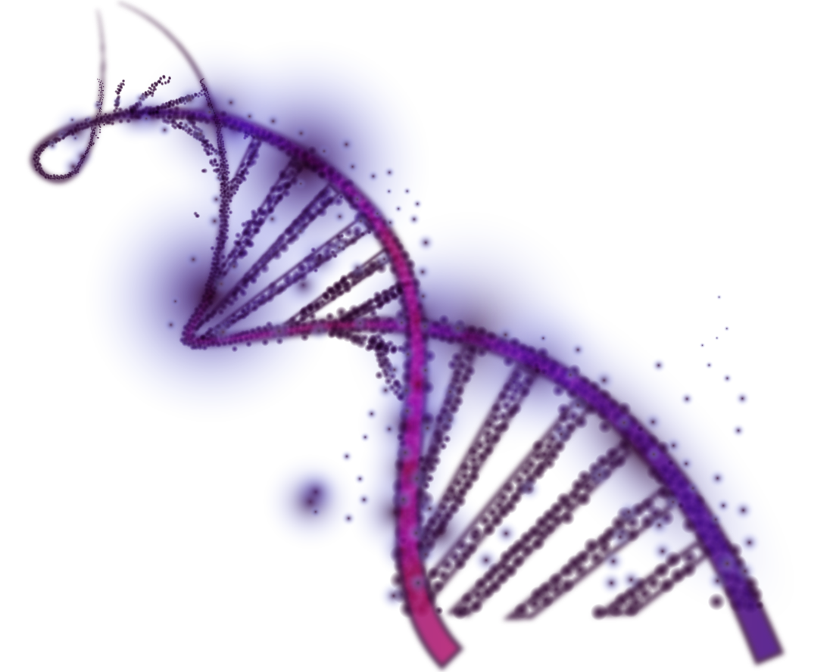
REFERENCE
https://www.ncbi.nlm.nih.gov/geo/query/acc.cgi?acc=GSE60424
Linsley PS, Speake C, Whalen E, Chaussabel D. (2014). Copy number loss of the interferon gene cluster in melanomas. PLoS One 9(10): e109760. [GSE60424 deposit]
Beers DR, Appel SH. (2019). Immune dysregulation in amyotrophic lateral sclerosis. Lancet Neurology 18(2): 211–220.

Slide 24
THANK YOU

