Slide 1
Artificial Intelligence-CSN-371
Assignment-Phase-2
Ankiteshwar Dev Atri-18116011
Sushant Gour-18117107
Nihal Choudhary-18116052

Slide 2
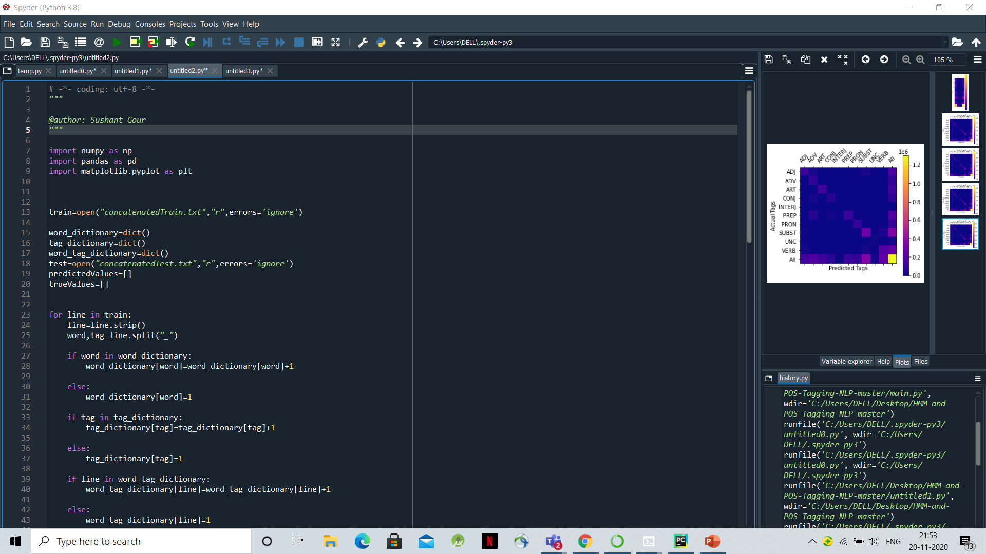
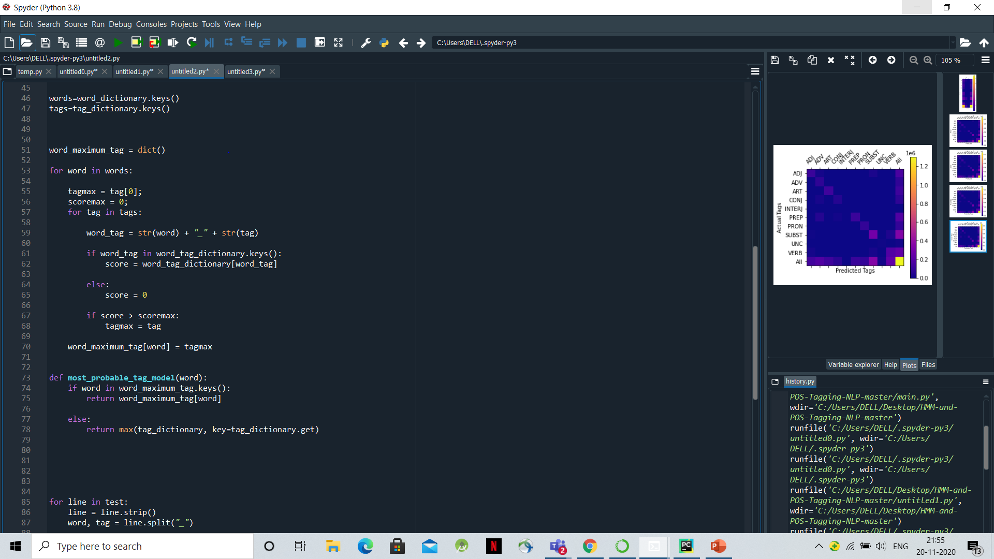
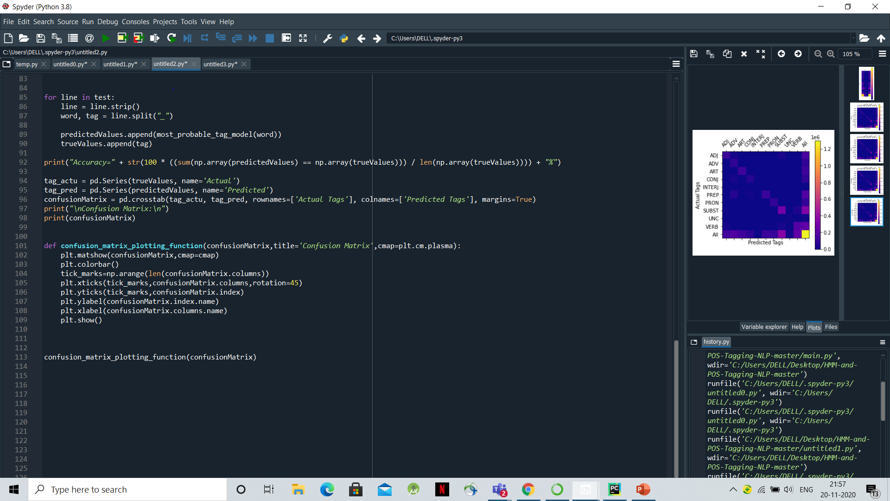
Model To Generate Best Tag for a Given Word
Screenshot of the main code

Slide 3
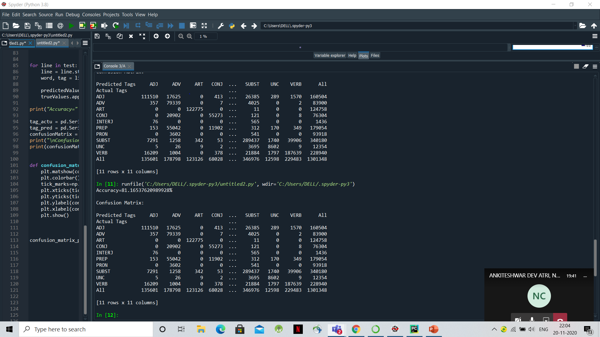
Overall Accuracy Of The Model On The Test Data
The overall Accuracy of our model is : 81.16537620989928%

Slide 4
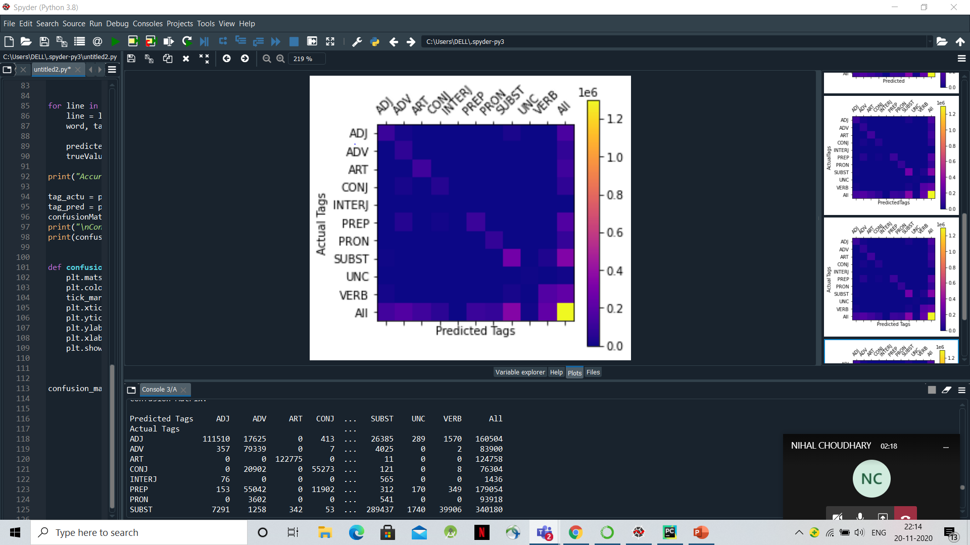
Confusion Matrix for the Tags in the Tagset

Slide 5
Analysis Of Our Code
(1) Determining the best Tag for a given Word:
We created a dictionary word_maximum_tags which stores word as key and the tag which occurs most number of times with that word as value. In this dictionary, the data is taken from the Train Corpus.
In our model, for an input word, if the word is present in the Train Corpus, then the most probable tag for that word can be determined from the word_maximum_tags dictionary directly. And if the word is not present in the Train Corpus then we assign the tag which has highest frequency in the Train Corpus to it.
(2) Accuracy:
We made two lists, one is trueValues which contains true values of the tags in the test data and the other is predictedValues, which contains the predicted tags for the words in test data. These predicted tag values are predicted by our model. We can simply calculate accuracy by dividing the number of correct predictions by the total number of comparisons.
(3) Confusion Matrix:
We used pandas and matplotlib libraries for plotting the confusion matrix.
The top 5 most confused tags are: INTERJ, ADV, ADJ, VERB and SUBST.
The tag ART is the least confused tag.

