Slide 1
Artificial Intelligence
Assignment-Phase3
Group Members:
(1)Ankiteshwar Dev Atri-18116011
(2)Sushant Gour-18117107
(3)Nihal Choudhary-18116052

Slide 2
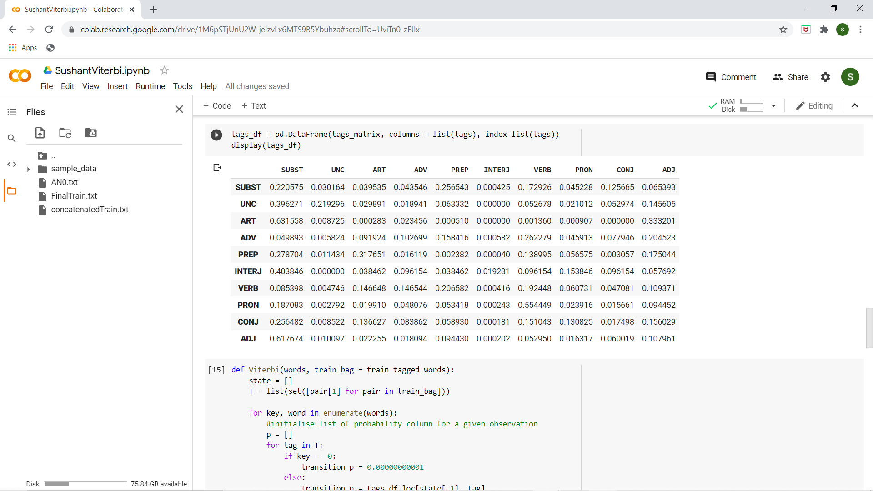
Transition Probability Matrix
Below is a screenshot of the transition probability matrix. Matrix[i,j] represents probability of occurrence of jth tag after ith tag.

Slide 3
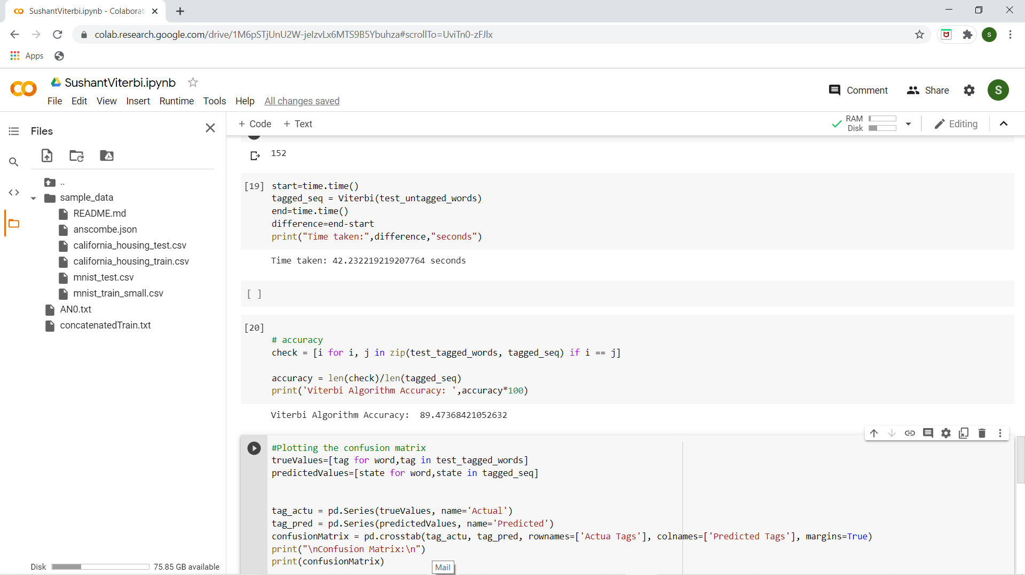
Accuracy
In our code, we trained our model on the train data and tested it on a small part of the test data having 1878 words, as it will take a lot of time to test the model on the whole test corpus. The accuracy over our test data came out to be: 89.4736842%

Slide 4
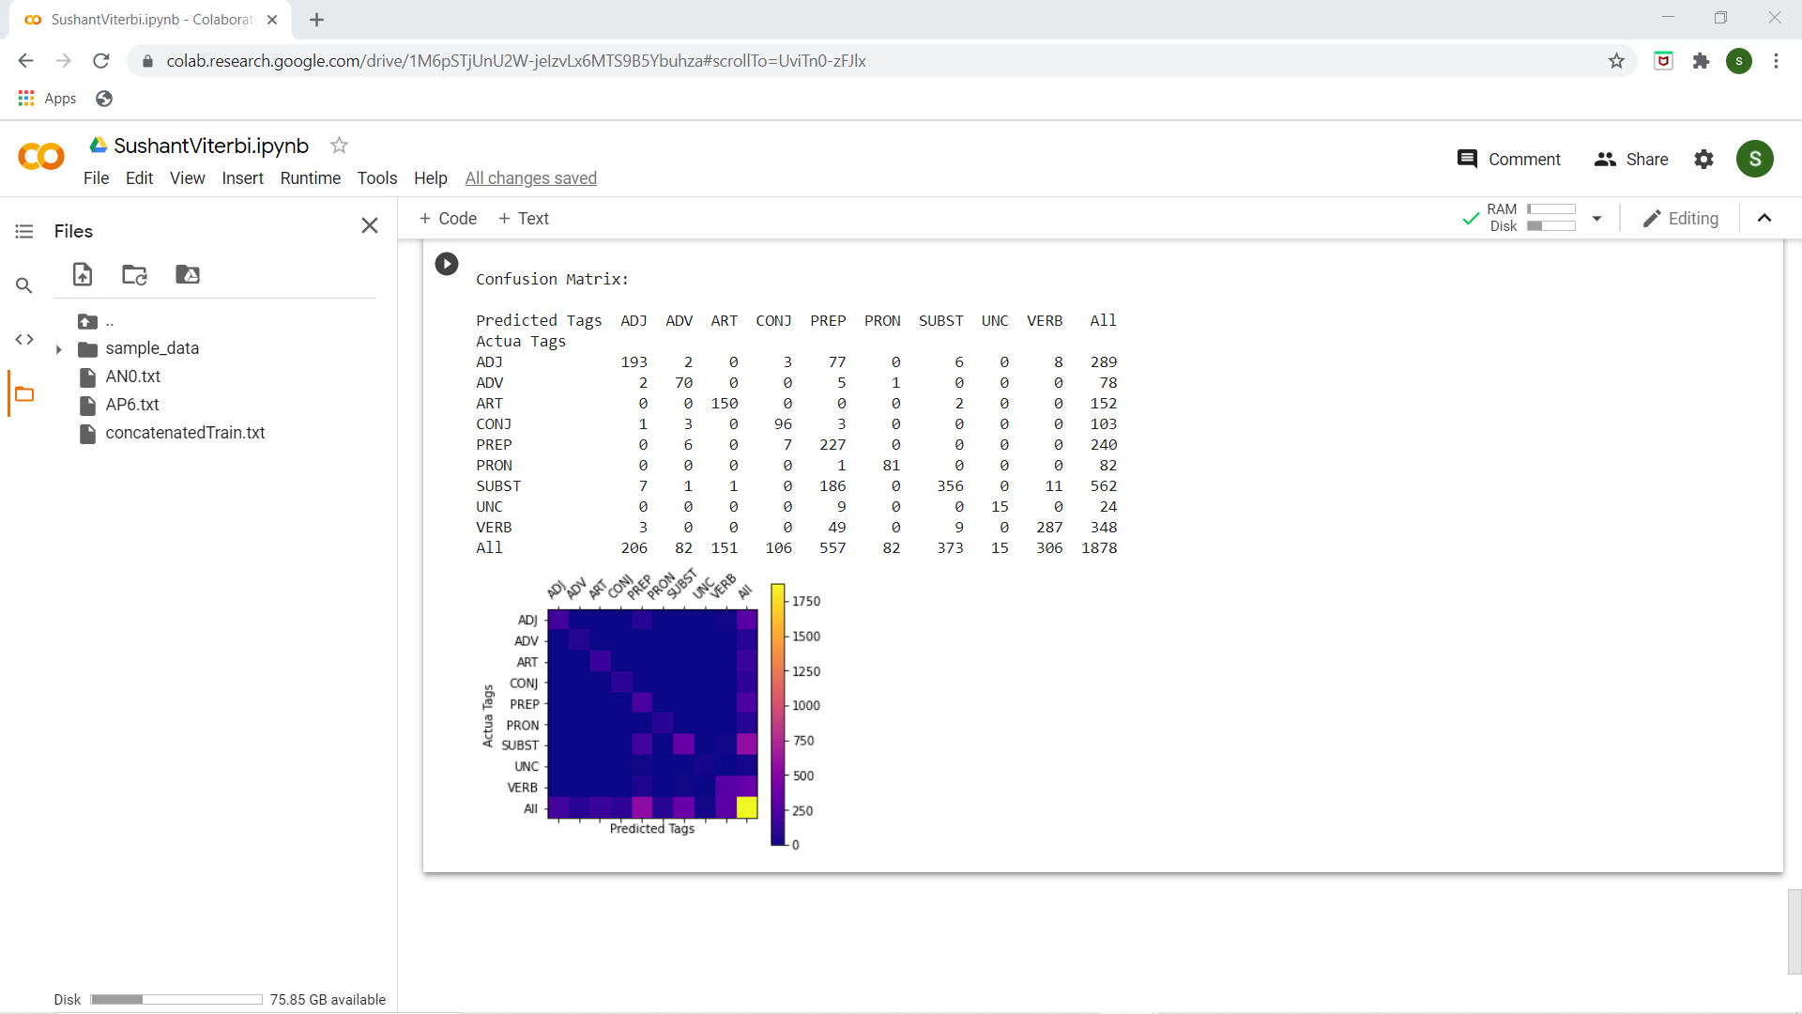
Confusion Matrix
The Confusion Matrix over our test data of 1878 words is given below:

