Slide 1
Fusion Strategy for Prosodic and Lexical Representations of Word Importance
Sushant Kafle sushant@mail.rit.edu
Cecilia O. Alm coagla@rit.edu
Matt Huenerfauth matt.huenerfauth@rit.edu
20th Annual Conference of the International Speech Communication Association
INTERSPEECH 2019

Slide 2
Introduction
Many speech-based models consider words as a fundamental unit of meaning and prosody.
However, words contribute differently to the meaning of an utterance; some words may be crucial for understanding a turn while others may be less so.

Slide 3

Introduction
Many speech-based models consider words as a fundamental unit of meaning and prosody.
However, words contribute differently to the meaning of an utterance; some words may be crucial for understanding a turn while others may be less so.
: it was really not very good uh-
Image Source: https://www.writermag.com

Slide 4
Introduction
Many speech-based models consider words as a fundamental unit of meaning and prosody.
However, words contribute differently to the meaning of an utterance; some words may be crucial for understanding a turn while others may be less so.
: it was really not very good uh-
: it was really not very good uh-
1
Image Source: https://www.writermag.com

Slide 5
Introduction
Many speech-based models consider words as a fundamental unit of meaning and prosody.
However, words contribute differently to the meaning of an utterance; some words may be crucial for understanding a turn while others may be less so.
: it was really not very good uh-
: it was really not very good uh-
: it was really not very good uh-
1
2
Image Source: https://www.writermag.com

Slide 6
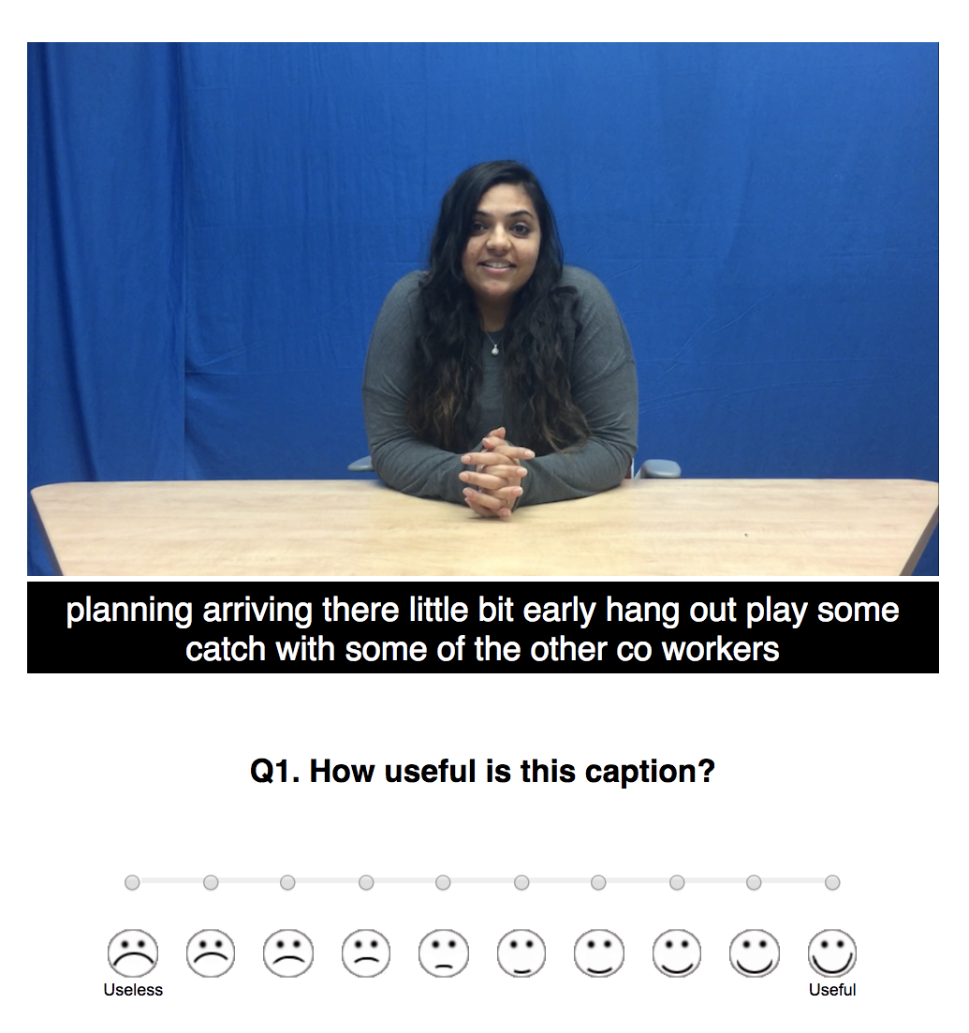
Motivation
Automatically predicting the importance of words in spoken language is useful for tasks such as:
Speech Recognition (ASR) evaluation
Text Classification, and,
Summarization.
Differential treatment of errors, based on word importance, is shown to correlate better with human subjective judgement of ASR quality in captioning applications for d/Deaf and Hard-of-hearing users. (Kafle and Huenerfauth, 2017)
(Figure from: Kafle and Huenerfauth, 2017)

Slide 7
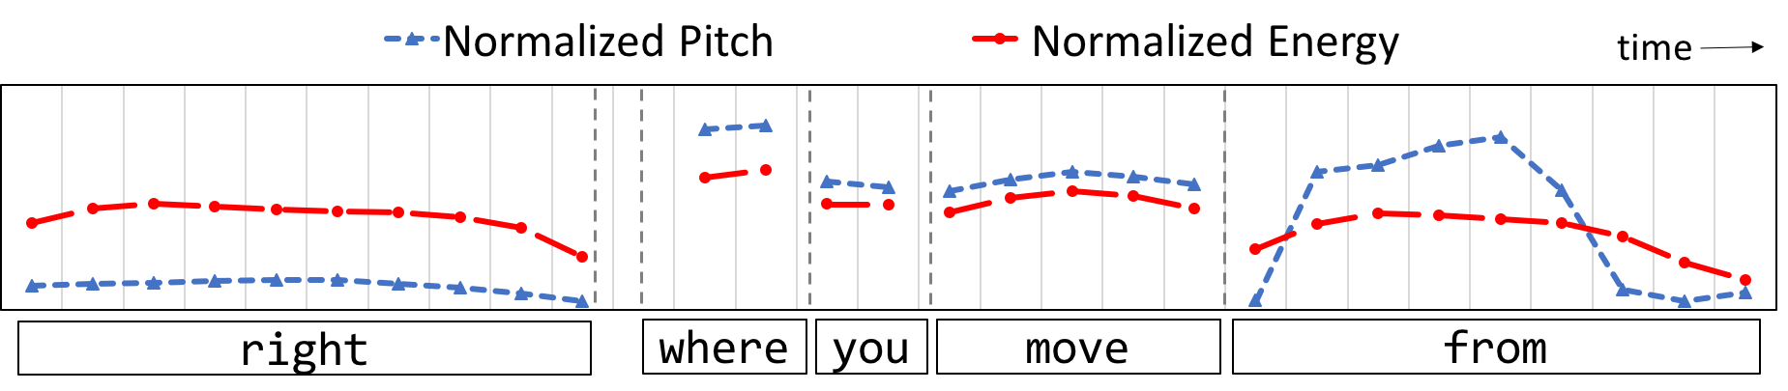
Importance of Prosody
(Figure from: Kafle et. al, 2019)
Spoken messages include prosodic cues that focus a listener's attention on the most important parts of the message to help disambiguate meaning.
It also informs listeners about the relation of the word to the discourse and to the mutual belief built up by interlocutors during the course of the discourse.
Notes:
There is evidence that prosodic cues shouldn’t be ignored… (Note to self: Practice the example beforehand.)

Slide 8
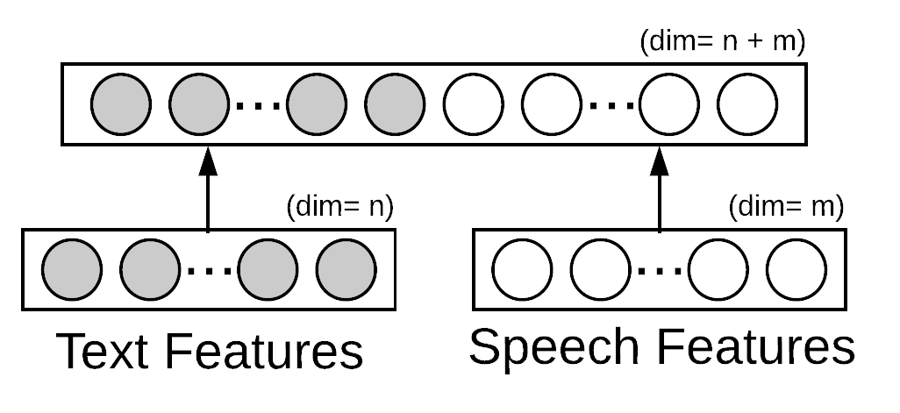
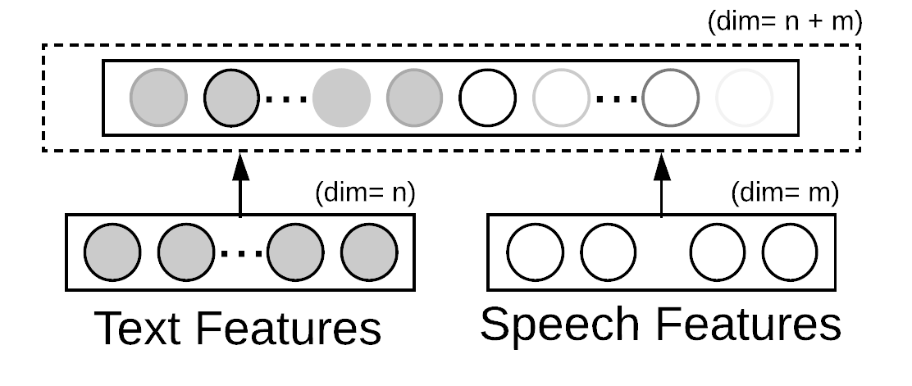
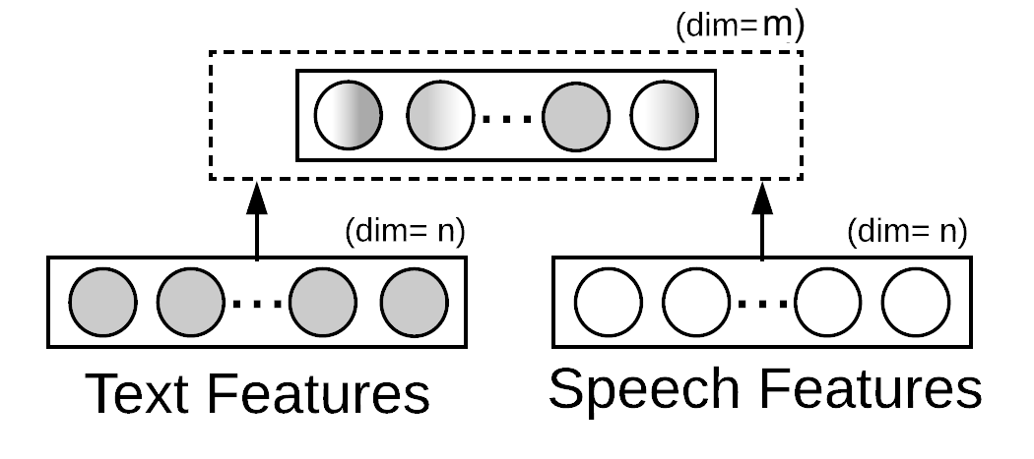
Goal of this work
Starting from the assumption that acoustic-prosodic cues help identify important speech content, this investigates:
Representation strategies for combining lexical and prosodic features at the word-level
Performance of each when predicting word importance
(i) Concatenation
(ii) Modality-specific Attention
(iii) Cross-modal Interaction

Slide 9
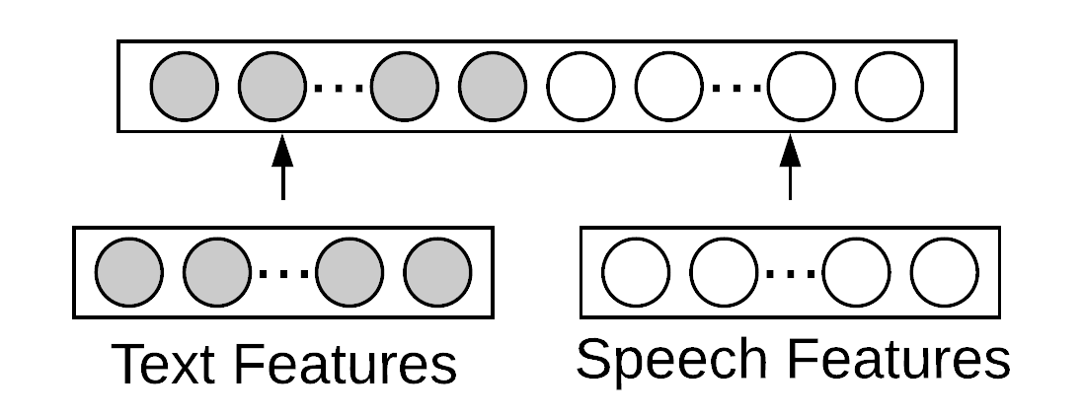
Prior Work: Joint Feature Representation
The most common strategy for joint representation of features is through concatenation. However, it fails to fully capture cross-feature (cross-modal) interactions. (Zadeh et. al., 2017; Liu et. al., 2018)
This work explores text-and-speech representations for word importance prediction.
Consequently, several other feature representation strategies, that consider cross-modal interaction, has been investigated. (Zadeh et. al., 2017; Liu et. al., 2018; Wang et. al.)
Concatenation

Slide 10
Prior Work: Word Importance Prediction
Portrayal of word importance prediction as keyword extraction task:
Considers importance of words at a document level rather than at a sentential or a phrase level. (Liu, 2011; Hulth, 2002; Sheeba, 2012)
This setup treats each word as a term in a document such that all words identified by a term receive a uniform importance score, without regard to their local context.
Recently, models that consider contextualized word representation has been proposed. However, they consider unimodal features (lexical or prosodic, not both) which may be insufficient for conversational speech-based application.

Slide 11
Lexical-Prosodic Representation
for word importance prediction

Slide 12
Attention-based Feature Fusion
This feature fusion architecture captures how prosody impacts the lexical semantics of the spoken word.
Uses architecture to learn a composition vector that controls the contribution of prosodic features on word meaning:

Slide 13
Attention-based Feature Fusion
This feature fusion architecture captures how prosody impacts the lexical semantics of the spoken word.
Uses architecture to learn a composition vector that controls the contribution of prosodic features on word meaning:
S: Acoustic-prosodic feature representation.
L: Lexical feature representation.
Z: Lexical-Prosodic Representation

Slide 14
Attention-based Feature Fusion
This feature fusion architecture captures how prosody impacts the lexical semantics of the spoken word.
Uses architecture to learn a composition vector that controls the contribution of prosodic features on word meaning:
S: Acoustic-prosodic feature representation.
L: Lexical feature representation.
Z: Lexical-Prosodic Representation
Lexical Shift

Slide 15
Attention-based Feature Fusion
Positive sentiment space
Negative sentiment space
Neutral word
(e.g., Dogs)
Composition vector projects lexical embeddings into an appropriate semantic space, based on their prosodic character.

Slide 16
Attention-based Feature Fusion
lexical shift due to prosody
Positive sentiment space
Negative sentiment space
Neutral word with positive connotation (e.g., Dogs are the best.)
Composition vector projects lexical embeddings into an appropriate semantic space, based on their prosodic character.
Notes:
For instance, inherently neutral words like dog can bear both positive and negative sentiment as a part of a discourse. The shift in connotative meaning is often conveyed through prosody that informs listeners about the relation of the word to the discourse and to the mutual belief built up by interlocutors during the course of the discourse which might influence its connotative meaning in context.

Slide 17
Experimental Setup
Dataset: Word Importance Corpus (Kafle et. al, 2018)
Consists of over 25k unique words with manually annotated importance information on a dialogue turn label.
Lexical Representation: GloVe (Pennington et. al., 2014)
Acoustic-Prosodic Representation: bi-RNN based subnetwork (Kafle et. al, 2019) operating over features such as:
Energy-related features (RMS min, max, mean, median, time of max, etc.)
Frequency-related features (F0 min, max, mean, median, time of max, etc.)
Voicing features (HNR, VUR, Spectral-tilt, etc.)
Spoken-lexical features (word duration, articulation rate, etc.)
Notes:
this is a _baseline_ that only considers one type of features (not prosody).

Slide 18
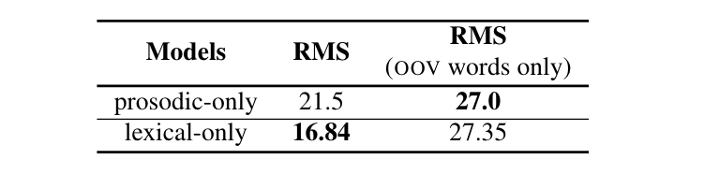
Exp. 1: Error Analysis of Unimodal Models
Lexical-only model had a lower RMS error when predicting word importance, but it performed poorly for OOV words. For OOVs, the prosodic-only model did better.

Slide 19
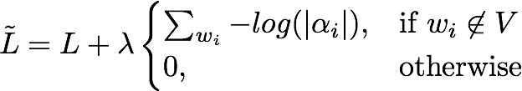
Intervention: Attention Supervision
Allows incorporation of heuristic constraints into a model.
We supervised attention during training to rely on prosodic features when the word is an out-of-vocabulary (OOV) word.

Slide 20
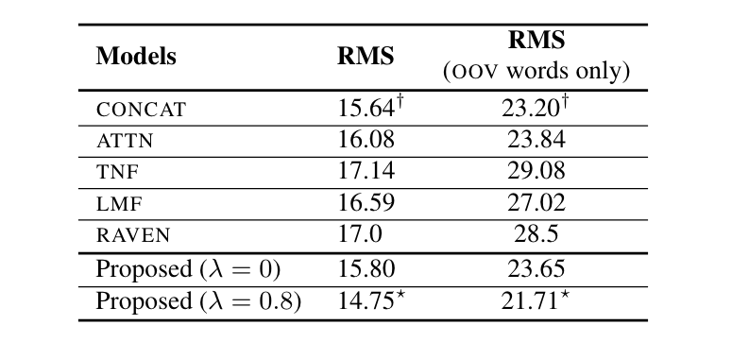
Exp. 2: Comparison of Fusion Strategies (1 of 2)
Comparison of different models combining lexical and prosodic cues. Per column, the top two results are marked with (∗) and (†) symbols. Our model has lower RMS error overall AND for OOVs.

Slide 21
Exp. 2: Comparison of Fusion Strategies (1 of 2)
wo/ Attention Supervision
Comparison of different models combining lexical and prosodic cues. Per column, the top two results are marked with (∗) and (†) symbols. Our model has lower RMS error overall AND for OOVs.

Slide 22
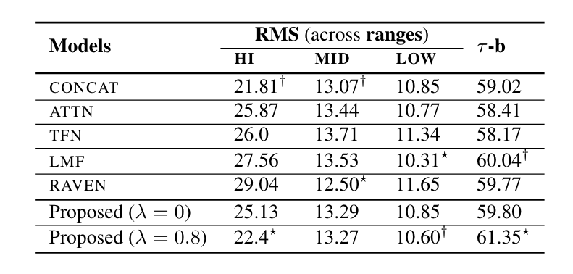
Exp. 2: Comparison of Fusion Strategies (2 of 2)
22.81
Comparison of models on ordinal-range classes, and Kendall-tau (𝛕-b) rank prediction correlation. The top two results per column are marked with (∗) and (†) symbols. Our proposed model performs better for high and low importance words.

Slide 23
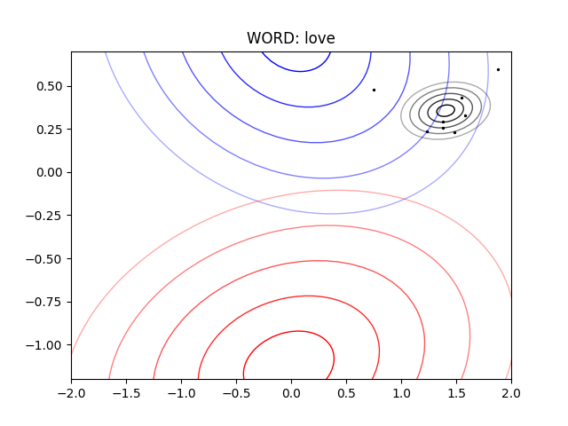
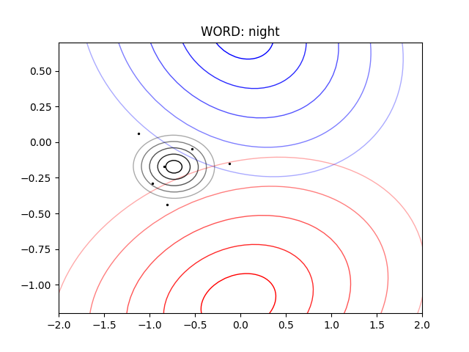
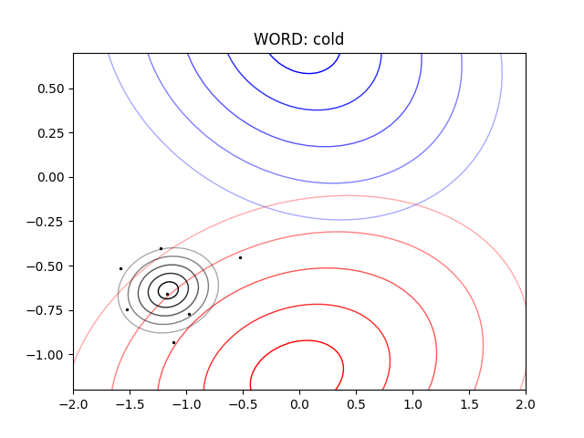
Exp. 3: Prosodic Deviation
Word: Love
Word: Night
Word: Cold
Visualization of the combined representation of words love, night, cold in difference spoken contexts. The blue (top) and red (bottom) contours represent the distribution of all positive and all negative sentiment words, respectively.
Notes:
For each word, the black contour shows its distribution for different spoken contexts. Individual instances of the spoken word are shown as dots. Proximity to the blue or red contours illustrates how a word adopts positive (love) or negative (cold) connotations, or straddle both (night).

Slide 24
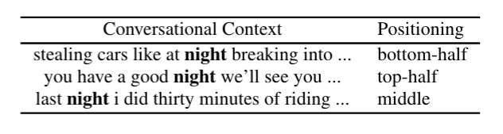
Exp. 3: Prosodic Deviation
Word: Night
The word night in different spoken contexts with corresponding positioning in the contour plot.

Slide 25
Conclusion
Showed that by incorporating features from speech into the lexical embeddings, we can enhance the performance of word-importance prediction systems.
Proposed an attention-based feature representation strategy that learns to adjust lexical feature representation of spoken words to reflect the post-lexical meaning conveyed through prosody.
Demonstrate the utility of incorporating modality-specific heuristic into training.

Slide 26






































Any Questions?
This material was based on work supported by the Department of Health and Human Services under Award No. 90DPCP0002-01-00, by a Microsoft AI for Accessibility (AI4A) Award, and by a Google Faculty Research Award.
 |  | CAIR brings together researchers working on computer accessibility and assistive technology for people with disabilities, technology for older adults, and educational technologies. http://cair.rit.edu/
Faculty
Some CAIR Researchers
 | Sushant Kafle Ph.D. Student Rochester Institute of Technology Golisano College of Computing and Information Sciences Computing and Information Sciences Ph.D. Program Email: sxk5664@rit.edu
 | Cecilia O. Alm Associate Professor Rochester Institute of Technology Comp Ling & Speech Proc Lab Email: coagla@rit.edu
 | Matt Huenerfauth Professor Rochester Institute of Technology School of information (iSchool) Email: matt.huenerfauth@rit.edu

