Slide 1
BLIP
(label=1)
BLIP Caption (more weight) + GPT2 caption (less weight)
Dataset
(4.1)
Data Preparation
(4.2.1)
Data Preprocessing and Feature Extraction
(4.2.2)
ANN
(4.2.2)
Weighted Summarization
(4.2.4)
Post Processing
(4.2.6)
Final
Caption
GPT2 Caption (more weight) + BLIP caption(less weight)
GPT2 (label=0)

Slide 2
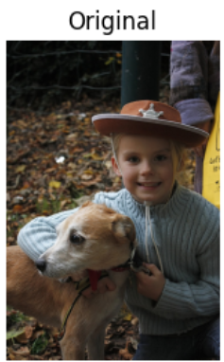
Data Preparation
(4.2.1)
Downloaded COCO Dataset
Unzipping the train ,test and validation data and annotation files
Extracting images
Extracting captions
1.a girl wearing a cowboy hat while holding a dog.
2.A young boy wearing a sheriff costume poses with his dog.
3.there is a young boy wearing a cowboy hat hugging a dog.
4.A young boy sitting next to a brown and white dog.
5.A boy in a cowboy had posing for a picture with a dog.

Slide 3
Data Preparation
(4.2.1)
Extracted Images
Downloaded FLICKR Dataset
Custom Data Set
Extracting images
Extracted Captions
Extracting captions
1.a girl wearing a cowboy hat while holding a dog.
2.A young boy wearing a sheriff costume poses with his dog.
3.there is a young boy wearing a cowboy hat hugging a dog.
4.A young boy sitting next to a brown and white dog.
5.A boy in a cowboy had posing for a picture with a dog.

Slide 4
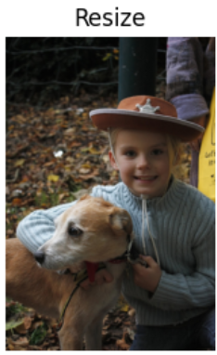
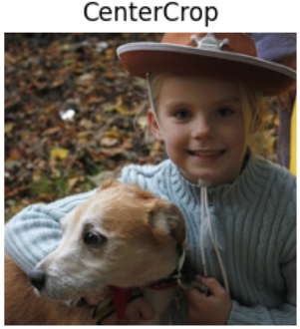

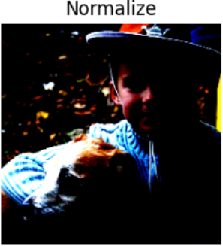
Data Preprocessing and Feature Extraction
(4.2.2)
Resnet-50
1x1 conv,512
3x3 conv,512
1x1 conv ,2048
1x1 conv,64
3x3 conv,64
1x1 conv ,256
1x1 conv,128
3x3 conv,128
1x1 conv ,512
1x1 conv,256
3x3 conv,256
1x1 conv ,1024
77 fc,softmax
7x7 conv, 64 strides 2
Output Image features
Avg.
pool
Dataset Images
Image Augmentation

Slide 5
Hidden Layer 1
(256 neurons)
ANN
(4.2.2)
Hidden Layer 2
(128 neurons)
Hidden Layer 3
(64 neurons)
Output
(Sigmoid function)
Input
Output

Slide 6
Weighted Summarization
(4.2.4)
BLIP Generated Caption
Full Caption (from more weight transformer)+ few words from less weight transformer.
SUMMARIZER
(Distil BART)
Summarized Caption
GPT-2 Generated Captions

Slide 7
BLIP Generated Caption:
Sentence A
Summarized Combined Caption: [Sentence C.Sentence D.Sentence E]
Original Captions
Calculating scores for each image
Compare and calculate the evaluation metrics.
GPT-2 Generated Caption : Sentence B

Slide 8
Compare and calculate the evaluation metrics.
BLIP Generated Caption:
Sentence A
Original Captions
Sentence C
Summarized Combined Caption: [Sentence C.Sentence D.Sentence E]
Calculating Average scores for each image
Sentence D
Original Captions
GPT-2 Generated Caption : Sentence B
Sentence E
Original Captions

Slide 9
Post Processing
(4.2.6)
Post Processing
Summarized Caption
Grammer and Spelling Correction
Sentence Trimming and Cleaning
Final Caption

Slide 10
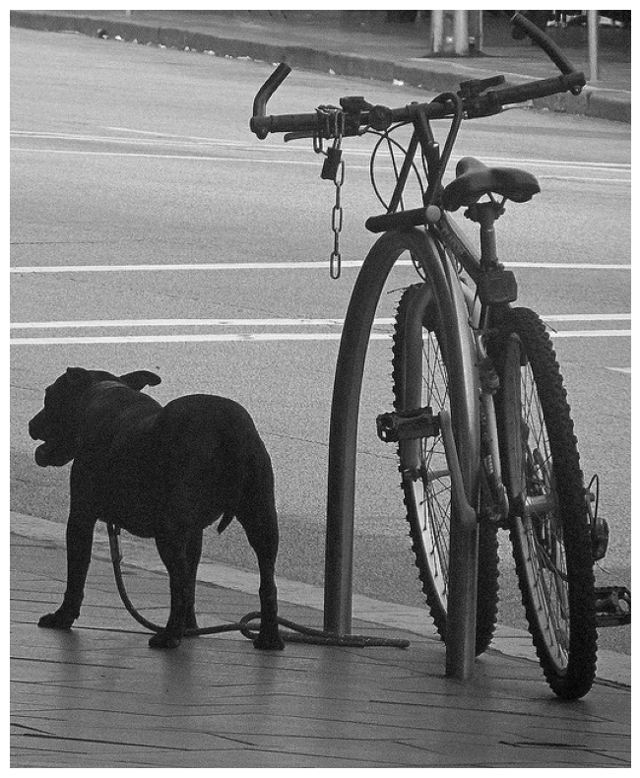
'a bike leaning on a pole'
a dog standing on a leash next to a bike a bike leaning . a dog
COCO Dataset Image
BLIP
(label=1)
BLIP Caption (more weight) + GPT2 caption (less weight)
ANN
(4.2.2)
Weighted Summarization
(4.2.4)
Post Processing
(4.2.6)
Final Caption: A dog standing on a leash next to a bike leaning.
Original captions:
GPT2 Caption (more weight) + BLIP caption(less weight)
1.'A small black dog on a leash next to a bike.’,
2.'Dog standing next to bike while tied to the bike rack.’,
3.'A dog is chained to a bike post locked up.’,
4.'A dog with a rope attached to its neck is standing on a sidewalk next to a bicycle.’,
5.f 'A dog on a leash is next to a bicycle.'
GPT2 (label=0)
'a dog standing on a leash next to a bike’
BLEU : 0.669
METEOR: 0.807
ROUGE-1 f:0.800
ROUGE-2 f:0.600
ROUGE-l f:0.800

Slide 11
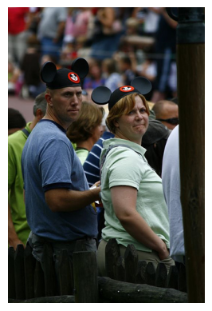
'there is a man and a woman that are wearing mickey mouse ears'
There is a man and a woman that are wearing mickey mouse ears .a man and woman standing next to each other.
FLICKR Dataset Image
BLIP
(label=1)
BLIP Caption (more weight) + GPT2 caption (less weight)
ANN
(4.2.2)
Weighted Summarization
(4.2.4)
Post Processing
(4.2.6)
Final Caption: There is a man and woman that are wearing mickey mouse ears standing next to each other.
Original captions:
GPT2 Caption (more weight) + BLIP caption(less weight)
1.A man and a woman wear mickey mouse ears at an event .
2.A man and woman wearing Mickey Mouse ears stand in a crowd.
3.A man and woman wear Mickey Mouse hats.
4.a man and woman wearing Mickey Mouse ears in a crowd .
5.Two spectators are adorn with Mickey Mouse ears while looking back at an angle from a stadium .
GPT2 (label=0)
a man and woman standing next to each other '
BLEU : 0.280
METEOR: 0.560
ROUGE-1 f:0.483
ROUGE-2 f:0.222
ROUGE-l f:0.414

