Slide 1

WearTwin: A Smart Wearable Device for Soldier Health, Fatigue and Readiness Monitoring
Group 3 : Suyash Shirsat, Priyanka Vaidya, Devesh Shelatkar, Sairaj Sawant
Guide : Dr. Bharti Ingale
Thadomal Shahani Engineering College

Slide 2
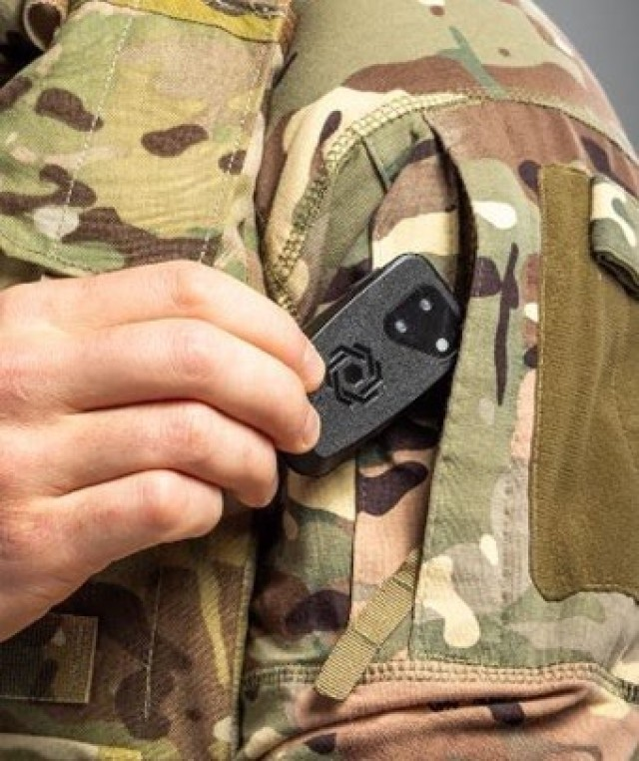
Introduction
5
  Soldiers operate in physically demanding and extreme environmental conditions where heat, fatigue, and prolonged exertion can compromise their safety and operational readiness. Monitoring individual parameters such as heart rate or temperature may not provide a complete picture of a soldier’s physiological condition. Furthermore, many existing monitoring systems lack a continuously evolving solider-specific physiological model that captures the relationships among multiple physiological signals and represents how a soldier's condition changes over time during recovery.
  WearTwin proposes an AI-driven wearable monitoring system that combines physiological and environmental data to estimate a soldier’s evolving state. Using an ESP32-based wearable, multimodal sensors, AI-based state estimation, and a Soldier Digital Twin, the system aims to identify increasing physiological strain and present actionable insights through a dashboard for medical personnel and commanders
  .

Slide 3
Problem Statement and Objectives
5
To develop an integrated wearable system and Digital Twin model that continuously monitors a soldier's multimodal physiological data in real time, enabling personalized detection of fatigue, thermal strain, and cardio-respiratory stress without relying on subjective self-reporting.
Design a multimodal wearable monitoring unit using an ESP32 to acquire ECG, PPG, SpO₂, respiration, skin temperature, and IMU motion data.
Apply digital signal processing (DSP) techniques to extract clean, reliable physiological features and filter out motion-induced artifacts.
Develop a continuous Digital Twin framework that integrates multi-sensor data to represent a soldier’s personalized physiological and functional state.
Implement AI-based analysis to estimate operational readiness and classify conditions like fatigue, thermal strain, and cardio-respiratory stress.
Provide actionable decision-support information to commanders and medical personnel for casualty triage and squad-level prioritization.
Build an interactive, real-time tactical dashboard to visualize individual telemetry, historical trends, and dynamic health alerts.

Slide 4
Architecture and Working
5
5.1 System Architecture and Requirement Analysis
The system architecture of WearTwin was established as an AI-assisted wearable monitoring and digital-twin prototype for physiological-state estimation and readiness monitoring. The architecture integrates data acquisition, preprocessing, feature engineering, synthetic-data generation, machine-learning inference, and dashboard visualisation into a unified pipeline.
5.2 Physiological Feature Engineering
A feature-engineering module was developed to transform physiological and environmental measurements into a structured set of 34 features. These include sensor measurements, deviations from individual resting baselines, rolling statistical summaries, temporal trends, and activity-related indicators. The pipeline supports causal processing using current and preceding observations, with an initial 10-minute calibration period for establishing individual baselines.
5.3 Synthetic Dataset Generation
A synthetic dataset was generated using the engineered feature representation to support supervised model development and preliminary evaluation. The dataset incorporates simulated individual variability, sensor noise, motion artefacts, and sensor dropouts. Eight input parameters are considered: heart rate, heart-rate variability (RMSSD), peripheral oxygen saturation (SpO₂), respiratory rate, skin temperature, ambient temperature, relative humidity, and IMU acceleration. Simulated physiological-state labels and readiness targets were used for model training.
5.4 Machine-Learning Model Development
A machine-learning pipeline based on HistGradientBoosting was developed for physiological-state classification and readiness-score estimation. The classifier identifies four simulated states: Normal, Fatigue, Thermal Strain, and Cardio-Respiratory Stress, while the regression model estimates readiness on a scale of 0–100. The models were trained using synthetic data representing 48 simulated individuals, evaluated on 12 held-out individuals, and additionally assessed on 12 individuals representing a shifted simulated population. Sensor-loss augmentation was incorporated to examine model behaviour under partial input-channel unavailability.

Slide 5
Architecture and Working
5
5
5.5 Model Evaluation and Verification
The classifier achieved a macro-F1 score of 0.842, compared with 0.487 for the rule-based baseline on the held-out synthetic test set. The readiness estimator achieved a mean absolute error (MAE) of 4.5 points on the 0–100 scale. Verification included shuffled-label testing, input perturbation analysis, sensor-dropout evaluation, and comparison of batch and streaming inference. Both inference implementations produced identical outputs across 1,506 evaluated windows. These results demonstrate consistency within the simulated evaluation environment; real-world physiological validation remains necessary.
5.6 Interactive Digital-Twin Dashboard
An interactive dashboard was developed to demonstrate the software pipeline and visualise its outputs. The interface incorporates biometric simulation controls, physiological-state indicators, readiness scores, strain indices, temporal plots, mission-profile presets, and simulated multi-individual telemetry replay. Input modification and sensor-disconnection simulation enable the model’s behaviour to be examined under different operating conditions.
5.7 Embedded Sensing, Signal Processing and Integration
Supporting development work involved interfacing the ESP32 with the MAX30102 photoplethysmography (PPG) sensor and MPU6050 inertial measurement unit (IMU) for acquiring optical and motion-related measurements. Stationary and motion-affected PPG recordings were collected and analysed to investigate signal quality, sampling consistency, and motion-induced artefacts. A preprocessing pipeline was explored for filtering PPG signals and recalculating heart-rate estimates. Additionally, a two-channel convolutional denoising autoencoder was trained to process infrared and red PPG signals and generate denoised outputs. The effectiveness of the denoising approach remains subject to further quantitative evaluation against independent reference measurements.

Slide 6
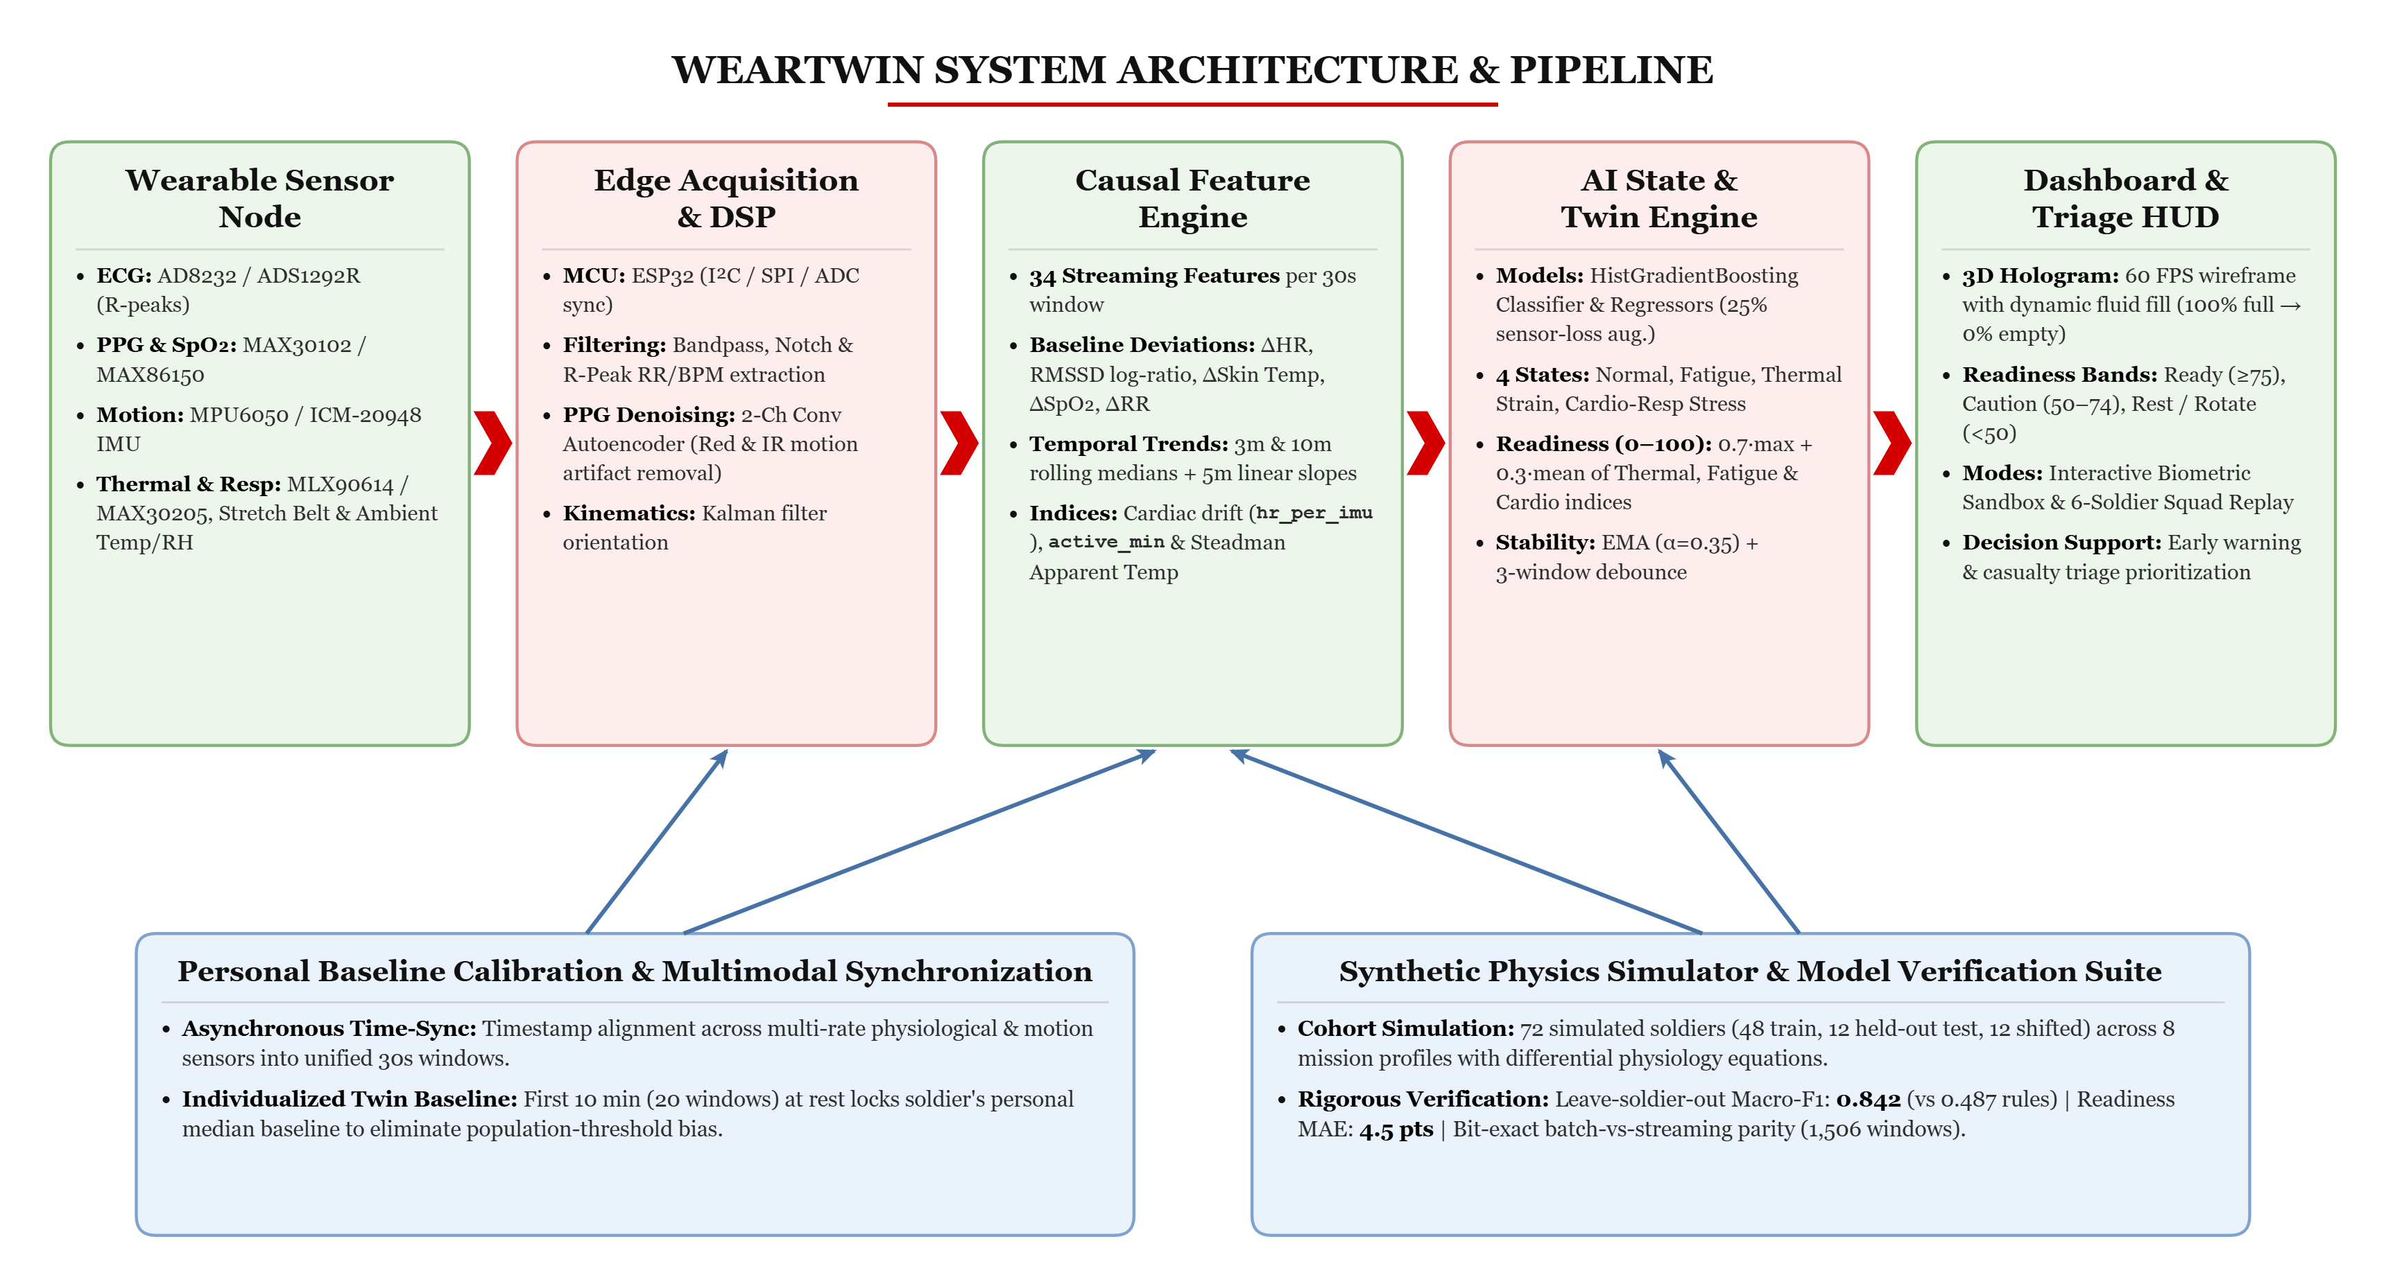
5

Slide 7
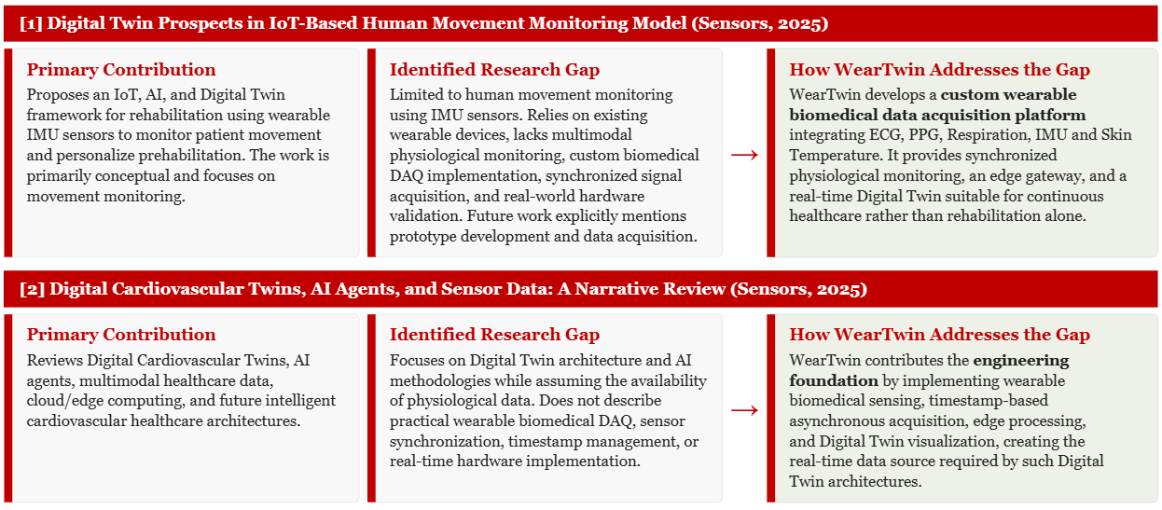
Literature Review Part 1
2
5

Slide 8
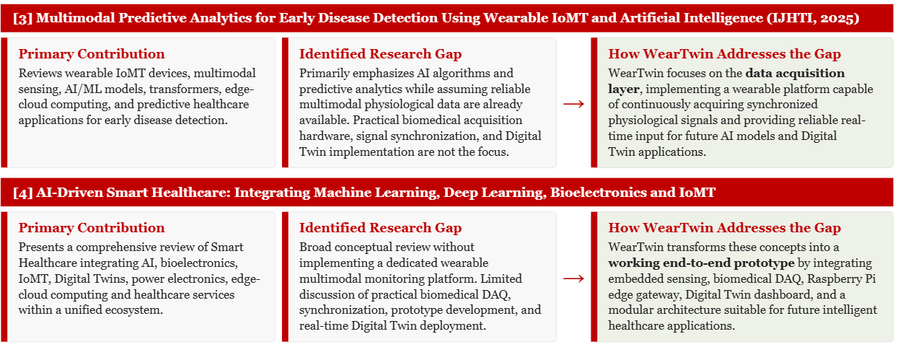
Literature Review Part 2
3
5

Slide 9
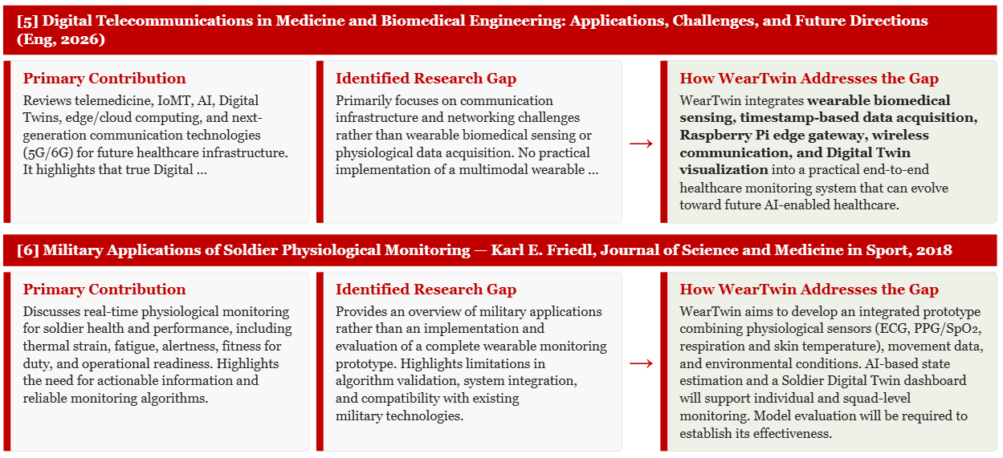
Literature Review Part 3
4
5

Slide 10
SENSOR SELECTION
5
5
Measurement | Selected component | Function
ECG | AD8232 | Acquires cardiac electrical activity for heart rate and RR interval analysis.
PPG / SpO₂ | MAX30102 | Provides optical pulse measurements and supports blood oxygen saturation estimation.
Respiration | Stretch / respiratory belt sensor | Measures chest or abdominal expansion to monitor breathing patterns.
Skin temperature | MLX90614 | Measures temperature for monitoring changes in skin temperature.
Motion / Activity | MPU6050 | Provides inertial measurements for movement, posture, and orientation analysis.
Embedded processing | ESP32 | Interfaces with sensors, processes data, and supports communication with external software modules.

Slide 11
THANK YOU

