Slide 1
PYTHON CONNECTIVITY WITH MONOGODB
Presentation on
Presented by :
Chikane Rushabh Trimbak 243510
Chopkar Chitresh Vikas 243511
Chougule Sushant Shivaji 243512
Dhavale Alisha Satish 243513
Institute for Advanced Computing & Software Development, Akurdi, Pune

Slide 2
Contents
Aim
Objective
Overview of MongoDB
Overview of Python
Why Use MongoDB with Python?
Python Connectivity with MonogoDB
PyMongo
Implementation
Limitations
Conclusion
Reference

Slide 3
Aim
To connect MongoDB with python using PyMongo.
To provide a comprehensive understanding of integrating Python applications with MongoDB, a NoSQL database, highlighting the setup, connection, CRUD operations, and advanced features to build scalable and efficient applications.

Slide 4
Objective
Gain a basic understanding of MongoDB as a NoSQL database.
Establishing connectivity: Demonstrate how to connect Python applications to a MongoDB database, both locally and remotely.
Show how to perform Create, Read, Update, and Delete operations using PyMongo.

Slide 5
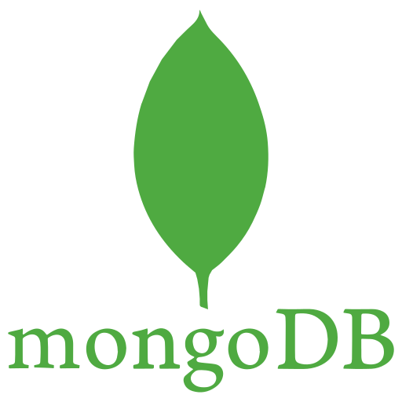
Overview of MongoDB
MongoDB (formerly 10gen) was founded in 2007.
Eliot Horowitz and Dwight Merriman invented MongoDB as a database.
MongoDB is written in C++, Java and python.
MongoDB is a NoSQL, document-oriented database.
MongoDB stores data records as BSON documents.
Use Cases: Big data, content management, social networks, real-time analytics.

Slide 6
Advantages of MongoDB
Document queries are used because it is a document-oriented language, which is important for allowing dynamic queries.
Schema-less database High performance, high availability, and easy scalability

Slide 7
Disadvantages of MongoDB
Unlike traditional relational databases, MongoDB doesn’t support joins in the same way.
MongoDB imposes a maximum document size limit of 16 MB.
Unlike traditional relational databases, MongoDB doesn’t support joins in the same way.

Slide 8
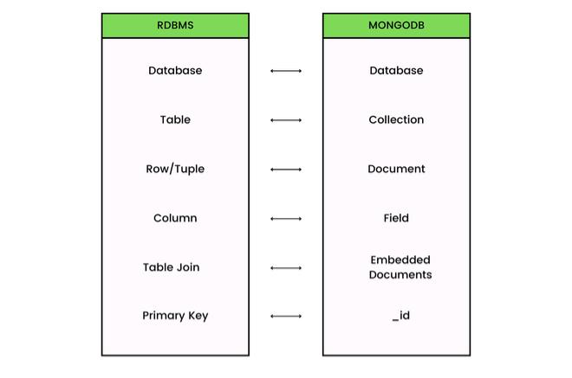
Terminologies in MongoDB

Slide 9
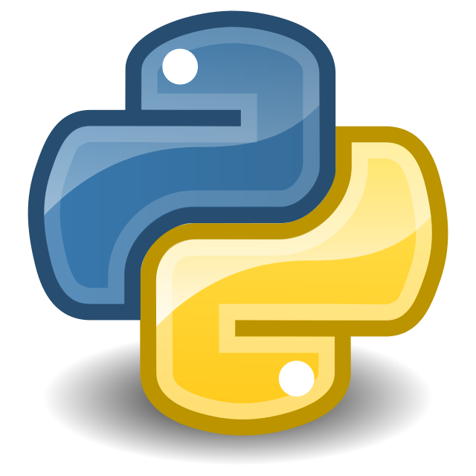
Overview of Python
Python is a high-level, interpreted programming language.
Characteristics :-
Simple and easy to learn syntax
Versatile (web development, data science, automation, etc.)
Extensive libraries and frameworks

Slide 10
Why Use MongoDB with Python?
Flexibility: Schema-less structure of MongoDB fits Python’s dynamic nature.
Scalability: Both Python and MongoDB can handle large-scale applications.
Community and Support: Large communities and abundant resources for both technologies.

Slide 11
Python connectivity with MongoDB
Install MongoDB:
Download from the official MongoDB website
Follow installation instructions for your OS (Windows, macOS, Linux)
Install Python:
Download from the official Python website
Ensure you have pip (Python package installer) installed

Slide 12
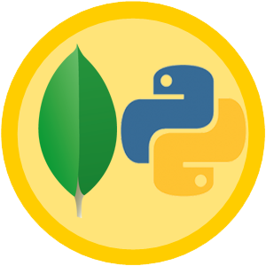
PyMongo
PyMongo is the official MongoDB driver for synchronous Python applications.
It is a Python library that enables us to connect with MongoDB.
It facilitates database operations such as creating, reading, updating, and deleting documents, as well as more complex tasks like indexing and aggregation.
PyMongo supports various authentication mechanisms to secure database connections.

Slide 13
Advantages of PyMongo
MongoDB uses BSON (Binary JSON) to store data, which aligns closely with Python dictionaries, making it intuitive for developers to work with the database.
PyMongo provides a straightforward API that makes it easy to perform CRUD (Create, Read, Update, Delete) operations.

Slide 14
Disadvantages of PyMongo
Keeping the PyMongo driver up to date with the latest MongoDB server releases can be challenging.
Python’s performance can lag behind Pymongo when dealing with large-scale data operations, leading to slower execution times for some tasks.

Slide 15
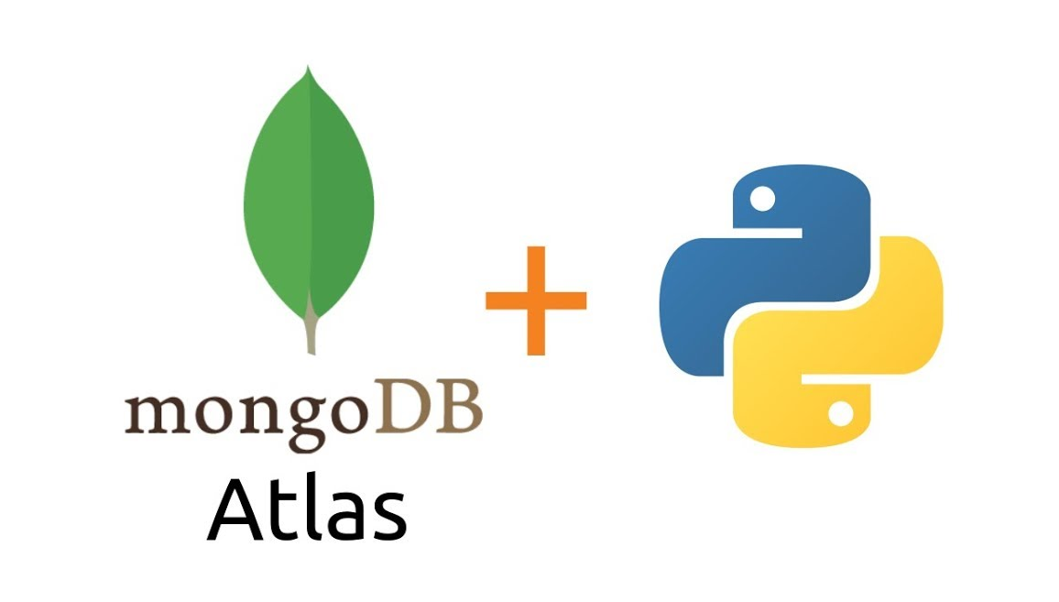
Implementation

Slide 16
Advantages of Python-MongoDB Connectivity
Flexibility in Deployment: MongoDB can be deployed in various environments, including on-premises and cloud platforms like MongoDB Atlas.
Concurrency and Transactions: With MongoDB’s support for multi-document transactions, Python applications can perform complex operations while maintaining data consistency.
Active Community: Python and MongoDB have large, active communities. This means a wealth of resources, tutorials, and third-party tools are available, making problem-solving and learning easier.

Slide 17
Limitations of Python-MongoDB Connectivity
Inefficiency in Heavy Computation: For applications requiring heavy computation or handling massive data operations.
Memory Consumption: Python, being a compiled and interpreted language, can consume more memory compared to compiled languages.
Driver Compatibility: Keeping the MongoDB drivers (like PyMongo) up to date and compatible with the latest versions of MongoDB can be a challenge.

Slide 18
Conclusion
Through real-world examples, we demonstrated the practical applications of integrating Python with MongoDB, emphasizing its value in various industries like e-commerce, social media, and IoT.

Slide 19
References
https://docs.python.org/3/
https://www.mongodb.com/docs/
https://en.wikipedia.org/wiki/Python_(programming_language)
https://en.wikipedia.org/wiki/MongoDB
https://pymongo.readthedocs.io/en/stable/
https://www.mongodb.com/docs/drivers/pymongo/?_ga=2.191141801.2016488885.1716477126-544842140.1712132118

Slide 20
Thank You!

