Slide 1

CROWDSOURCED BUG REPORT SYSTEM
Project Supervisor: Dr. R.M. Gomathi
Name of the Student: Sushant Kumar
Register Number: 39120124

Slide 2
PRESENTATION OUTLINE
▣ Internship Certificate
▣ Introduction
▣ Objectives
▣ System Architecture / Ideation Map
▣ Module Implementation
▣ Application Snapshots
▣ Results and Discussions
▣ Conclusion & Future work
▣ References

Slide 3
CERTIFICATE

Slide 4
INTRODUCTION
▣ Deploying large software and maintaining it might be very tough and the same can
be said in regards of how the whole bug reporting and patching of experience
breaking bugs can be for customers
▣ isThis-a-Bug is another small step in the same direction to help companies and their
customer access to best reporting and best services.

Slide 5
PROBLEM STATEMENT
▣ To demonstrate the use of MERN stack by building up an Crowdsourced Bug Reporting System with it
▣ Under isThis-a-Bug we will touch topic of:
User login management
Data storage and its usage
Bridging gap between user and developers

Slide 6
OBJECTIVES
▣ Reporting bugs doesn’t need to be difficult. Creating a great bug report means that
bugs will get fixed faster too
▣ Going with MERN stack is the perfect to buid a bug reporting app where growing collection of integrated cloud services are also available for various needs which is easy to use and deploy.
▣ The user/bug-reporter should be able to sign up, login, raise a complaint and see their past reports on the console linked to their profile

Slide 7
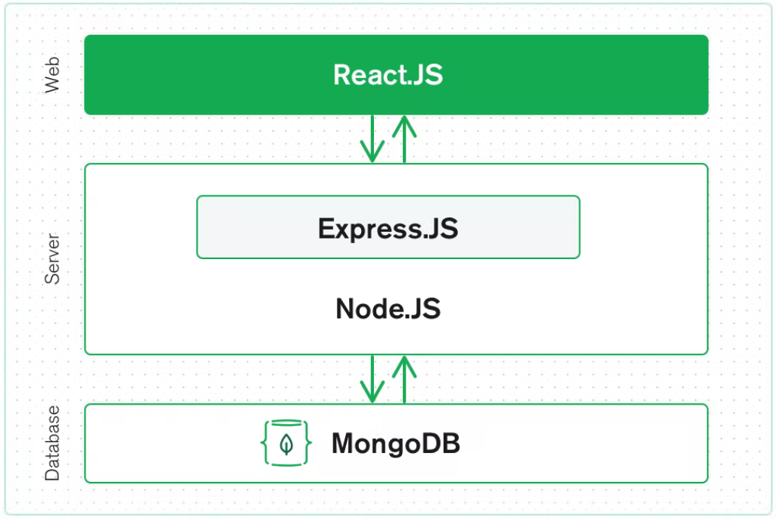
SYSTEM ARCHITECTURE

Slide 8
PROJECT IMPLEMENTATION
▣ This Project has three major part :
> Client-side with React
> Backend computing and Interface
> Database
Implementation
▣ Project is involved in developing a dynamic web app.
▣ Website includes with the Information about past reports, the current status of the reports.
▣ A laptop or desktop is needed as hardware requirement part.
▣ Software Used: Web Browser for accessing service and project webapp, with all needed packages installed.

Slide 9
METHODOLOGY
▣ Create a website using HTML, CSS, Bootstrap, JavaScript and other assets.
▣ Make the website responsive and mobile friendly to easily access.
▣ Implement all the information and content for web page.
▣ Port everything into scalable React components
▣ Use verification with Node and Express to authenticate user
▣ Give access to sign-up if the user doesn’t already has an account
▣ The user is now able to post any form of bug report as per their specification
▣ A user can access the console so as to see the past and present status

Slide 10
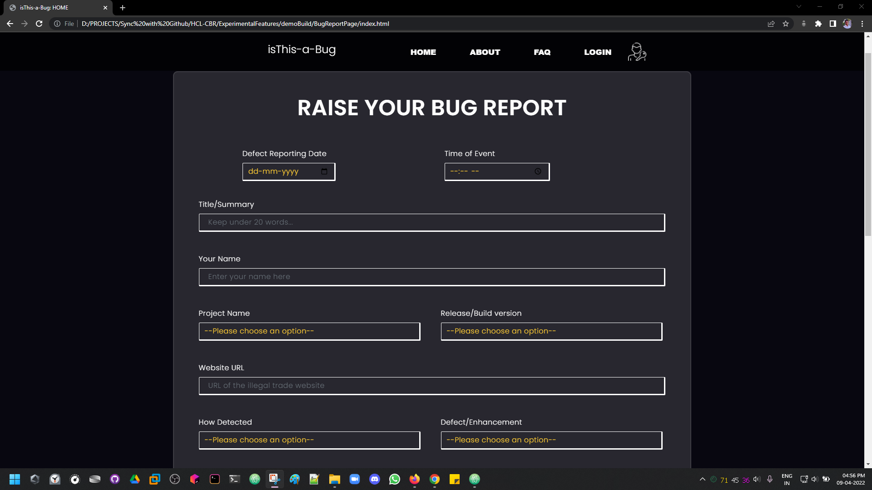
RESULT AND DISCUSSION
▣ After completing the project we will get a responsive and dynamic website.

Slide 11
CONCLUSION
▣ There are numerous architectural and conceptual considerations when you are
contemplating a working bug reporting system model for any major application deployment.
▣ As clear by now the benefits of having an effective, highly scalable bug reporting
infrastructure that grows with your product, isn’t just limited to bug fixes but to the edge
customer satisfaction and experience; A link and path of transparency between the users
and the developers so as to learn maintain and grow together

Slide 12
REFERENCES
[1] https://www.mongodb.com/mernstack

