Slide 1
AI-Powered Transcript Analysis & Eligibility Evaluation
Automated GPA Extraction & Program Eligibility Assessment
Presented by Sushanth Arunachalam for Capstone Presentation

Slide 2
The Challenge: Manual Transcript Review
Slow & Error-Prone Processes
Diverse Document Formats
Manual review of academic transcripts is a time-consuming and often inaccurate task, leading to significant delays in admissions.
Transcripts arrive in various formats, including PDFs, scanned documents, and even mobile photos, each presenting unique challenges for data processing.
OCR Limitations
Need for Automation
Traditional Optical Character Recognition (OCR) struggles with low-quality images, blurry text, and inconsistent layouts, common in received transcripts.
Academic institutions urgently require an automated, accurate, and efficient solution for extracting critical information from transcripts.

Slide 3






Ambitious Project Goals
Extract Key Data Points
Develop robust methods to accurately extract student names, cumulative GPAs, and individual subject grades from varied transcript types.
Handle Varied Inputs
Ensure compatibility with diverse source materials, from clean PDFs to scanned documents and even less-than-perfect mobile photographs.
Leverage LayoutLMv3
Utilize and contribute to research by fine-tuning LayoutLMv3, a state-of-the-art deep learning model, for document understanding.
Build Eligibility Engine
Integrate an intelligent rule-based engine to assess program eligibility automatically based on extracted GPA and subject data.
Deliver Intuitive UI
Create a functional and user-friendly interface tailored for admissions teams, streamlining their workflow and decision-making.
Generate Synthetic Data
Address data scarcity by developing a generator for synthetic transcripts, crucial for training deep learning models effectively.

Slide 4

Navigating Data Scarcity: The Core Challenge
FERPA Compliance Restrictions
This scarcity of data underscored the need for innovative solutions like synthetic data generation to make deep learning viable for this project.
1
Due to stringent FERPA regulations, publicly available, annotated transcript datasets are non-existent, posing a significant hurdle for ML research.
Limited Annotated Data
2
Our initial dataset comprised a mere nine manually annotated pages, a minuscule amount for effective deep learning model training.
Sparse GPA Samples
3
Critical GPA information appeared on only three of the nine available pages, severely limiting data for GPA-specific model training.
Deep Learning's Data Hunger
4
Effective deep learning models demand vast, high-quality annotated datasets, a requirement we struggled to meet with real-world data.

Slide 5




Model Evolution: From Noise to Nuance
1) OpenCV: Initial Attempt
Our first approach using OpenCV struggled significantly. It proved highly sensitive to image noise and structural variations, resulting in unreliable extractions.
2) Donut: Improved Structure
Donut showed promise with better structural understanding but still failed to generalize across noisy photographic inputs, limiting its real-world applicability.
3) LayoutLMv3: State-of-the-Art
LayoutLMv3 emerged as the most effective deep learning model, successfully extracting NAME and SUBJECT data even from complex layouts.
GPA: Persistent Challenge
Despite LayoutLMv3's strengths, GPA extraction remained difficult due to the low sample count and OCR token mismatches, requiring further refinement.

Slide 6
Precision Annotation with Label Studio
To fine-tune LayoutLMv3 for optimal performance, a meticulous annotation process was undertaken using Label Studio. This involved defining and labeling specific entities within the transcript documents:
B-NAME, I-NAME
B-GPA, I-GPA
Bounding boxes for the beginning and continuation tokens of a student's name, crucial for accurate identification.
Annotations for the start and subsequent tokens of the Grade Point Average, targeting this key eligibility metric.
B-SUBJECT, I-SUBJECT
Labels for the beginning and continuation of subject names, vital for course-specific analysis and program requirements.
These detailed annotations enabled LayoutLMv3 to learn the contextual and spatial relationships of information on a transcript.

Slide 7

Integrated System Architecture
Input Documents
Transcript Processing
Data Extraction
Eligibility & UI
This modular architecture ensures robust processing of diverse inputs and intelligent decision-making, culminating in an intuitive user experience for admissions personnel.

Slide 8
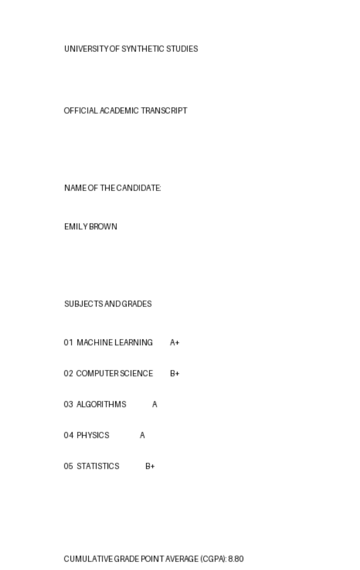




Solving Data Scarcity: Synthetic Transcript Generation
Unlimited Realistic Data
Our custom generator creates an endless supply of transcripts that mirror real-world documents in structure and content.
Dynamic Data Variation
Each synthetic transcript features randomized names, GPAs, and subject lists, ensuring rich diversity for training.
Overcoming Dataset Limitations
This innovation directly addresses the scarcity of real, FERPA-compliant annotated data, making deep learning feasible.
Future-Proof Model Training
The synthetic data provides a continuous, scalable resource for training and refining future iterations of LayoutLM models.

Slide 9





User Interface: Empowering Admissions Teams
Seamless Transcript Upload
Automated GPA Extraction
GPA Confidence Indicator
Admissions officers can easily upload transcript files in various formats (PDF, JPG, PNG).
The system quickly processes the uploaded document to identify and extract the cumulative GPA.
A confidence score accompanies the extracted GPA, providing transparency on extraction accuracy.
Instant Eligibility Results
OCR Text Preview
Program eligibility is evaluated in real-time based on predefined criteria, reducing manual assessment time.
Users can review the underlying OCR-generated text for verification or troubleshooting purposes.

Slide 10
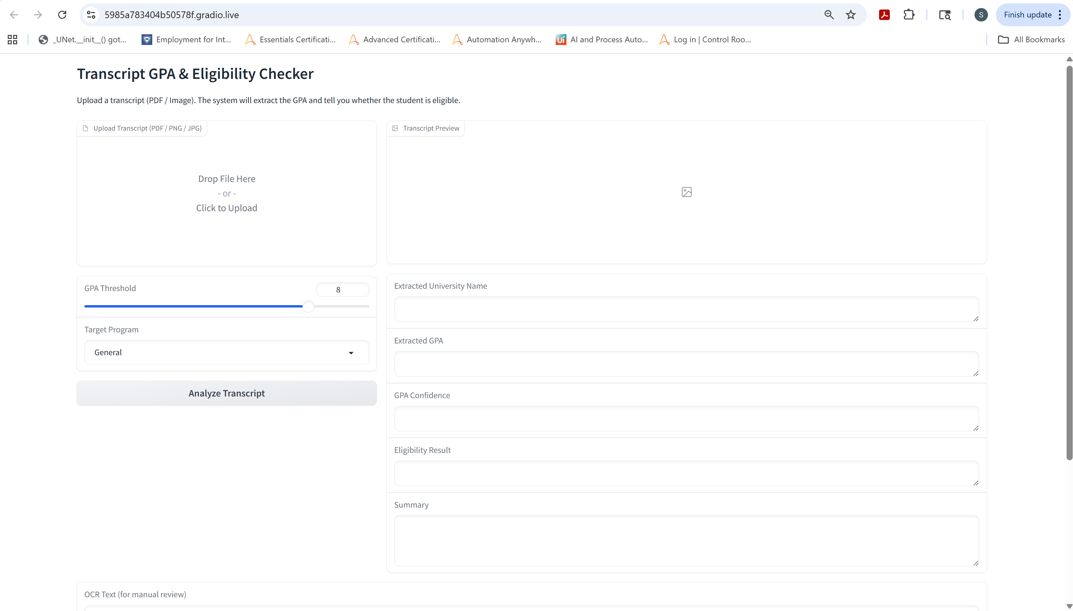
User Interface: Empowering Admissions Teams

Slide 11
Key Achievements and Future Outlook
95%
This project demonstrates the significant potential of AI to revolutionize academic admissions, making processes faster, more accurate, and more scalable. Future work will focus on enhancing GPA extraction for noisy documents and expanding the system to handle more diverse document types and languages.
GPA Extraction Accuracy
Achieved ~95% accuracy for GPA extraction on clean and well-formatted transcript documents.
100%
Multi-Format Compatibility
Successfully processes transcripts from both high-quality PDFs and challenging photographic inputs.
100%
Eligibility Engine Validated
The rule-based eligibility engine consistently delivers accurate program assessments.
80%
LayoutLMv3 Region Recognition
LayoutLMv3 effectively identifies and extracts NAME and SUBJECT regions from complex layouts.

Slide 12
Future Enhancements
Improve Name and GPA extraction accuracy
Add more program-specific eligibility rules
UI upgrades: PDF preview, batch upload
Train LayoutLMv3 using synthetic annotated transcripts
Introduce OCR-free models (Donut 2.0) for comparison
Multi-page transcript analysis
Build FERPA-compliant synthetic transcript dataset
Deploy system as secure cloud service
Support GPA normalization across grading scales
Integrate workflow tools for admissions teams

