Slide 1
AIRA – AI Infrastructure Resilience Assistant
An Agentic AI Solution for Smart Infrastructure Reporting
Built with IBM watsonx Orchestrate
Team_Name : Katz_2025
Team Members :
  Sushanth Arunachalam
  Dhwani Patel
  Srujan Dasari
  Kousik Gunasekaran
  Shivendra Gupta

Slide 2
Problem Statement
Urban infrastructure reporting is fragmented and inefficient.
Citizens face delays, confusion, and lack of updates when reporting issues like potholes or water leaks.
Departments work in silos, causing redundant tasks and missed responsibilities.
There's a growing need for intelligent automation to streamline issue collection and routing.

Slide 3
The AIRA Solution
AIRA is a no-code assistant built with IBM watsonx Orchestrate.
- Citizens report issues via chatbot
- Classification agent identifies issue type (Road, Water, Electrical)
- Orchestration agent assigns the task, generates ticket, and routes to the correct department
- Status agent provides follow-up updates to citizens
All logic is handled visually through flows—no backend or Python code used.

Slide 4
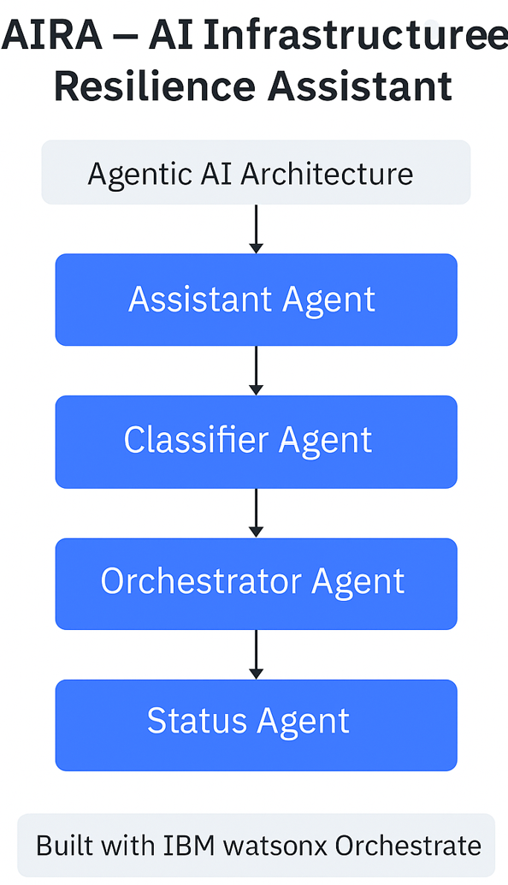
Agentic AI Architecture
Conversational Agent (Watson Assistant): Collects input
Classification Agent: Simulates issue type detection
Orchestrator Agent: Routes, assigns, and confirms task
Status Agent: Provides follow-up and status updates
All agents operate independently but collaborate through orchestrated logic.

Slide 5
Built with IBM watsonx Orchestrate
Built entirely using the Assistant Builder (no code)
Used question blocks, message blocks, conditional branches, and custom actions
Demonstrates agent collaboration without skills-based or AI-based actions
Future-ready: can integrate Skills and watsonx.ai once access is available

Slide 6
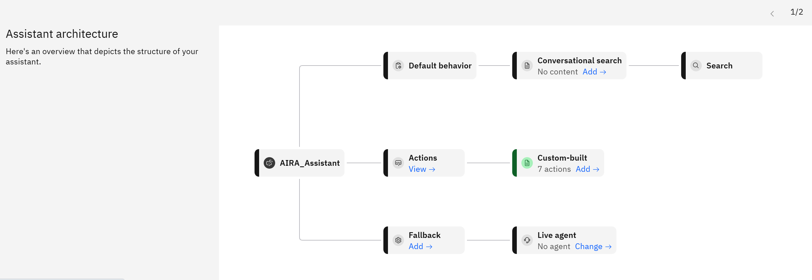
Visual Diagram of aira

Slide 7
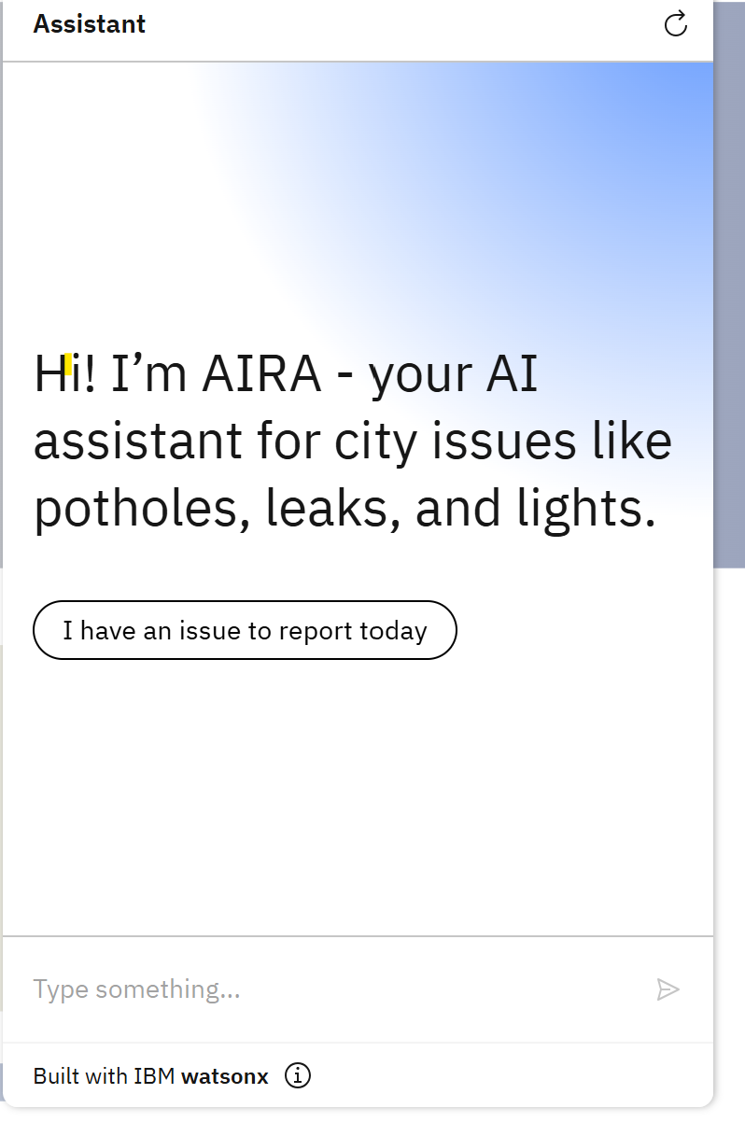
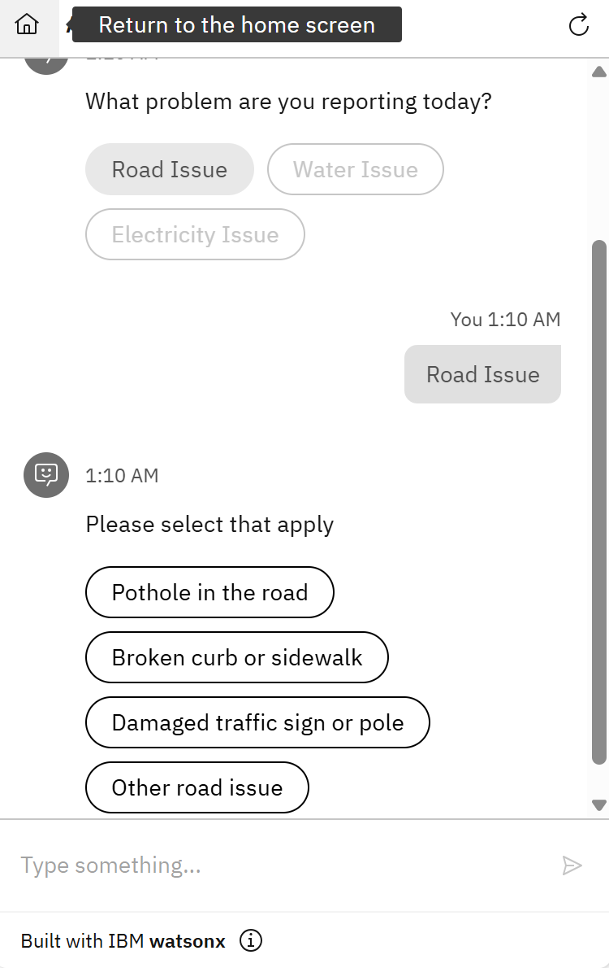
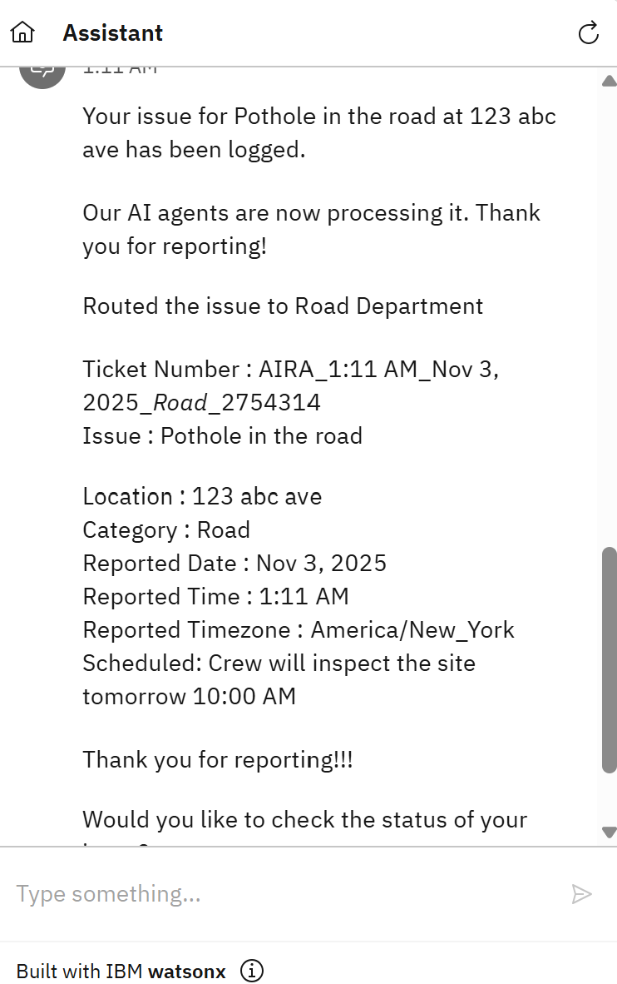
Visual Diagram of aira_Assistant

Slide 8
Future Plans and Impact
Integrate Watsonx.ai for dynamic classification using LLMs
Use skills-based actions to trigger real work orders and emails
Create real-time dashboards for city officials
Expand to multilingual support and regional customization
AIRA reduces friction in civic reporting and brings departments into alignment.

Slide 9
This solution is designed for Track 2 : Industry, Innovation & Infrastructure, powered by orchestrated AI agents aligned with Track 1: Agent Mode Activated.
We thank IBM and the Call for Code team for this amazing opportunity and guidance throughout the journey.
We are Team Katz_2025.
Thank you

