Slide 1


ECOLOGY-PROJECT
- Group - 9
Smart Air-Quality Monitoring using Low-cost sensors
6-MAY 2025

Slide 2



Contributors
Hardware development team
8 out of 17
EE23B044,EE23B011,EE23B025,
EE23B024,ME23B039,ME23B040,EE23B012,EE23B009
Software development team
9 out of 17
CS23B012,CS23B011,CE23B011,
CE23B006,CS23B032,EE23B019,
EE23B030,EE23B005,CE23B013

Slide 3


Background
Air pollution is a growing concern worldwide, affecting human health, ecosystems, and overall quality of life. Urbanization, industrialization, and vehicular emissions contribute to rising levels of harmful pollutants like PM10, PM2.5, NO₂, CO and NH₃.
Traditional air quality monitoring stations are often expensive, sparsely located, and unable to provide real-time localized data. This lack of accessibility leaves individuals and communities uninformed about the air they breathe daily.
Air quality monitoring using technologial methods helps assess pollution levels, identify sources, and implement measures to protect public health, the environment, and overall quality of life. It also provides essential data to understand pollution, mitigate its impact, and create healthier environments for people and nature.

Slide 4
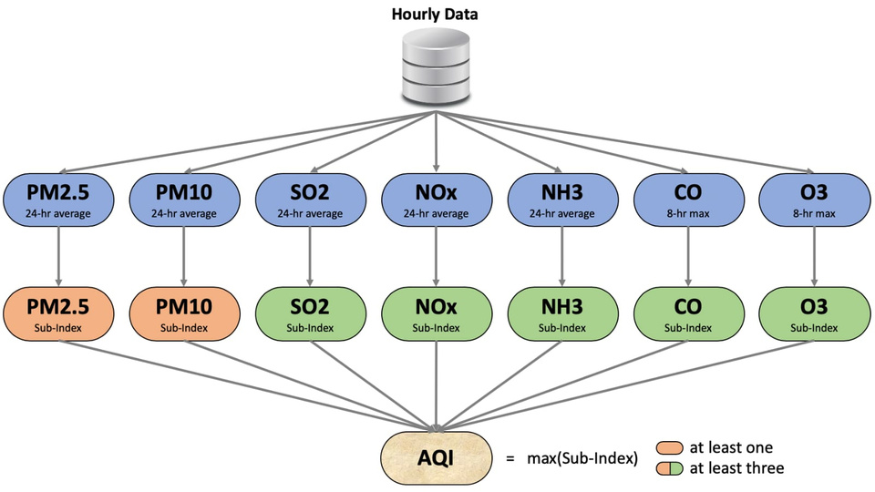
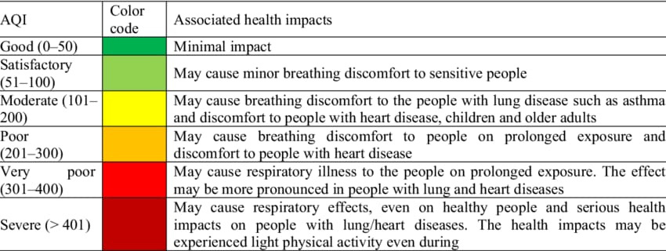

Air Quality Index
The Air Quality Index (AQI) is a numerical scale that indicates air pollution levels by measuring key pollutants like PM2.5, PM10, CO, NO₂, SO₂, and O₃. It categorizes air quality into different levels (Good, Moderate, Unhealthy, etc.) to help assess health risks and guide necessary precautions.
Fig-1 : AQI Calculation
Importance of AQI: -
Helps people understand air pollution levels and their impact on health
Guides outdoor activities based on air quality conditions
Fig-2 : Health impact table based on AQI

Slide 5
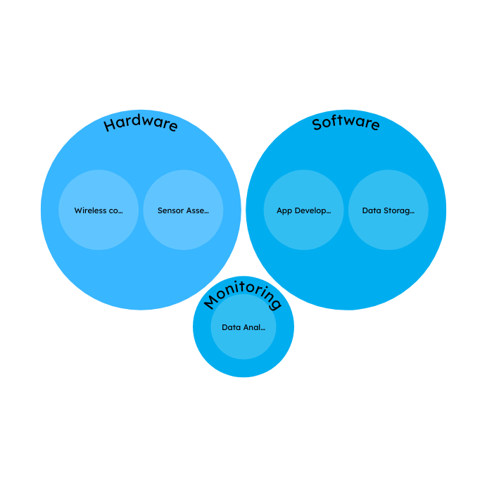
Methodology
Assemblage of multiple sensors in a single system to measure Air Quality Parameters.
Sensor-Based Real time Data Collection
Access of Data with cloud based storage - Firebase Storage
Development of an App for Historical and Real time Data Representation.
Air Quality Parameters Data Processing and Analysis
Fig-3 : Diagram indicating work
involved in project
Interactive Visualisation of data in App developed

Slide 6
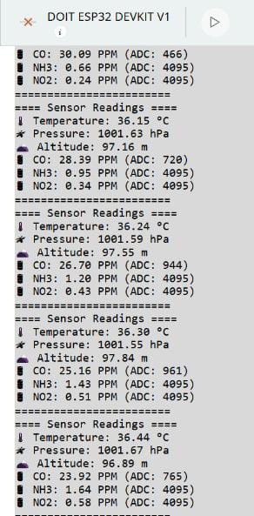
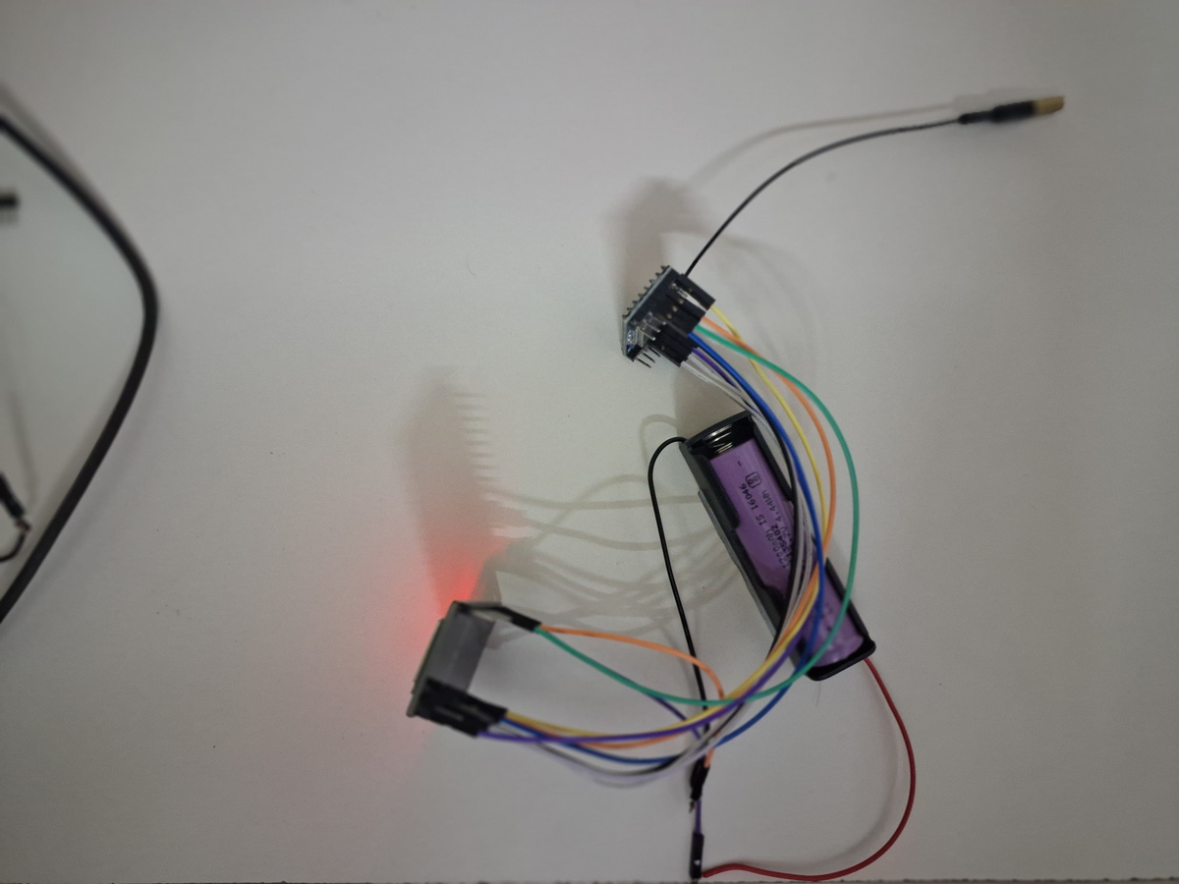
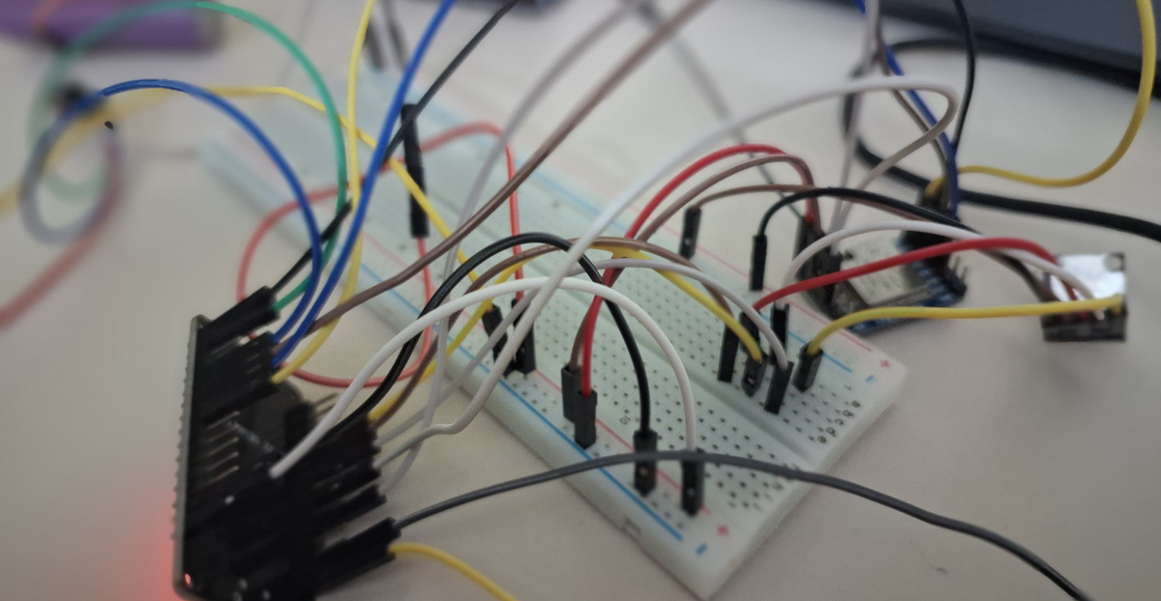
Sensor Assembly and Data Aquisition
Fig-3 : Circuit depicting assembly of Micro-controller ESP-32 with MICS-6814 sensor and BMP180 sensor along with LoRa module for wireless data tranfer
Fig-4 : Data Receiver circuit- Connection of LoRa module with ESP-32 micro-controller
Fig-5 : Data from receiver

Slide 7
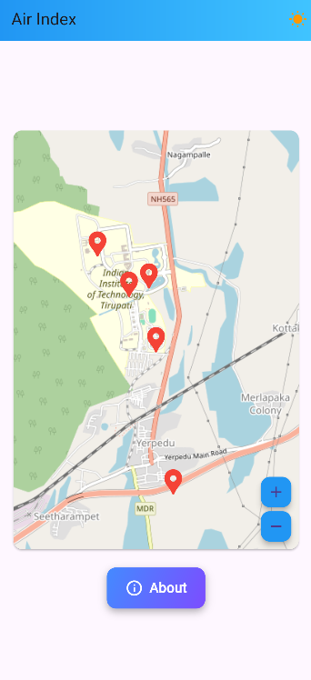
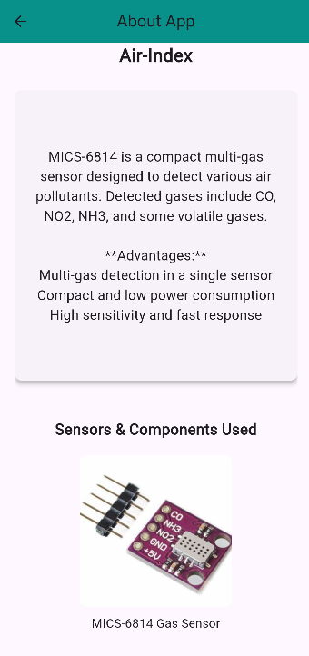

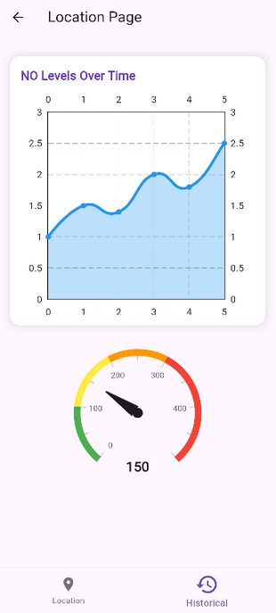


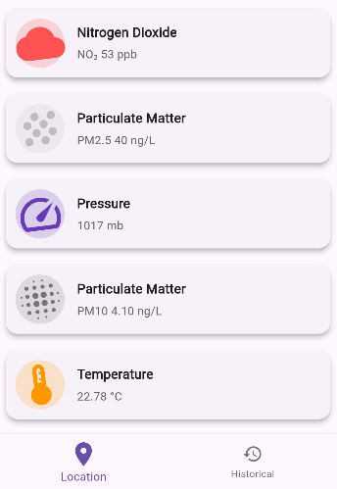





App Structure

Slide 8

Milestones
1
2
3
4
Basic Sensor Assembly
Testing Analog-Digital conversion
App Development
Data-Visualisation
Successfully Assembled
MICS-6814 (Gas Sensor)
,BMP180 (Pressure and Temperature Sensor) and PM2.5 Sensor
Confirmed hardware connectivity and communication with micro-controller
Designed a user-friendly UI with an interactive dashboard for real-time air-quality parameters tracking.
Integrate Map-based visualization for localized monitoring which will display data of all parameters and some graphs associated with it.

Slide 9
Drawbacks
1
2
3
4
Limited Air Quality Parameters Readings
Non-Usage of sensors of high cost
Environmental
Interference
Regular Caliberation and maintenance
Thank you
- Any Suggestions?
Thank you
- Any Suggestions?
As of now, we are measuring only concentrations of CO,NO2,PM2.5 along with NH3 in which only CO,NO2 & PM2.5 are considered for air quality index
Including sensors which can measure SO2,PM10 and O3 will increase burden of cost, so,we didn’t account for those concentrations.
Since we are measuring factors like Temperature, Pressure etc.,they can affect other gas sensors performance
They require regular caliberation and maintenance to ensure accuracy of taken readings.

Slide 10
Thank you

