Slide 1

Seasonal Agriculture Performance Analysis
Sushanth Patel
Malla Reddy Engineering College And Management Sciences (MREM)
STU67d1c78af2dc11741801354

Slide 2

PROBLEM STATEMENT
Agricultural activities are influenced by seasonal variations in environmental conditions, farming practices, resource availability and market conditions. As a result, agricultural performance may differ from one season to another. However, raw agricultural data does not clearly explain how agricultural performance changes across seasons or what patterns can be observed in different seasonal conditions. The problem is to analyze the given agricultural dataset and investigate seasonal differences in agricultural performance by identifying meaningful patterns, trends, relationships and variations within the available data.

Slide 3
Project Description
The Seasonal Agriculture Performance Analysis project focuses on analyzing agricultural data across different seasons, geographical areas, and farming conditions. The dataset contains information on farming practices, environmental conditions, crop production, resource usage, and economic performance.The project involves exploring, cleaning, and analyzing the dataset to identify meaningful seasonal patterns, trends, relationships, and variations in agricultural performance. It examines differences in yield, production, resource usage, environmental conditions, and economic outcomes across seasons, while also comparing relevant agricultural categories. Statistical analysis and data visualization techniques are used to interpret the observed patterns and identify significant or unusual findings. The analysis aims to generate evidence-based insights and recommendations that can support better understanding and planning of seasonal agricultural activities.

Slide 4

WHO ARE THE END USERS?
Farmers
Agricultural Planners
Researchers
Policymakers
Agricultural Organizations

Slide 5
Technology Used
Technology | Purpose
Python | Data analysis and processing
Google Colab | Development and execution
Pandas & NumPy | Data cleaning and manipulation
Matplotlib & Seaborn | Data visualization
SciPy | Statistical analysis
CSV | Agricultural dataset format

Slide 6
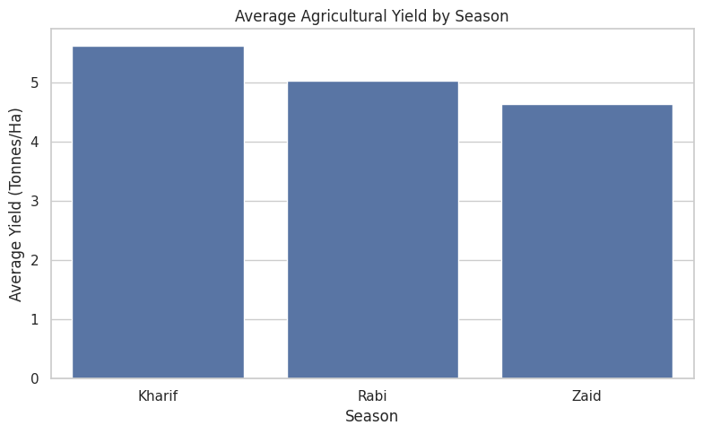
RESULTS
Explanation: Kharif has the highest yield (5.64 tonnes/ha), followed by Rabi (5.08) and Zaid (4.67). This shows that Kharif has the best overall agricultural productivity.

Slide 7
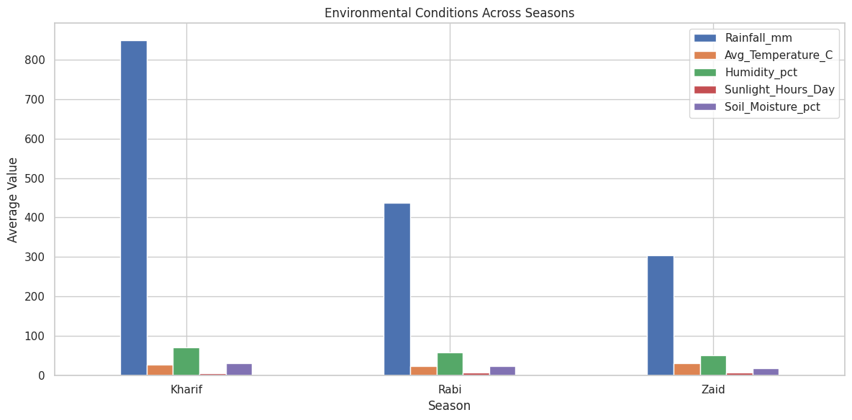
RESULTS
Explanation: Environmental conditions vary by season, with Kharif having the highest rainfall and humidity, while Zaid has the lowest rainfall and soil moisture.

Slide 8
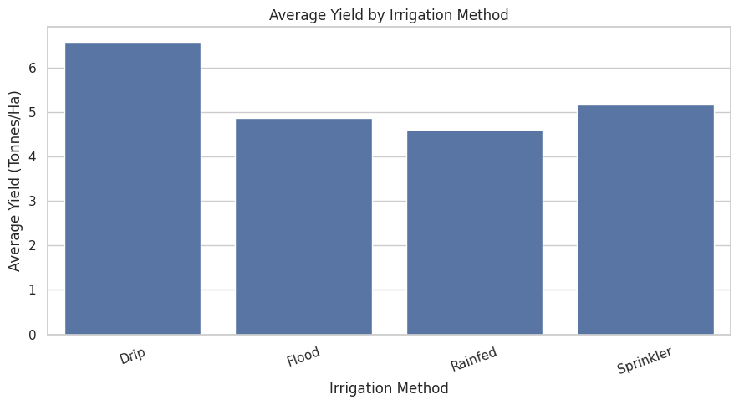
RESULTS
Explanation: Drip irrigation has the highest average yield at 6.62 tonnes/ha, followed by Sprinkler (5.19), Flood (4.85), and Rainfed (4.61). This shows better yield performance with drip irrigation.

Slide 9
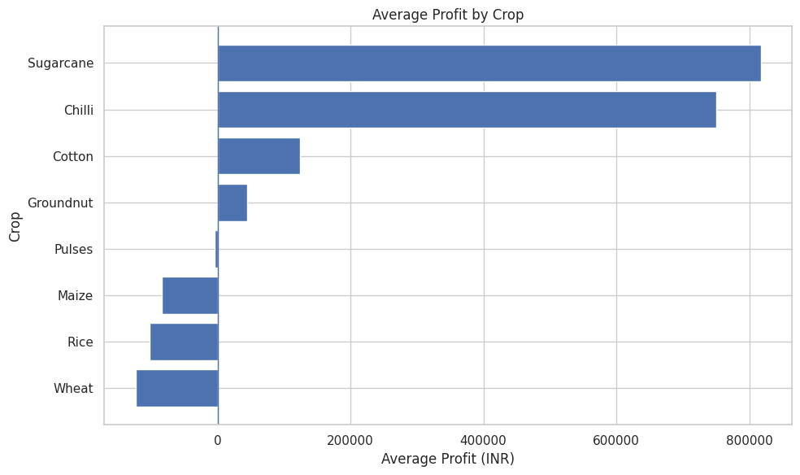
RESULTS
Explanation: Sugarcane has the highest average profit, followed by Chilli and Cotton. Wheat, Rice, and Maize show negative average profits, indicating lower profitability.

Slide 10
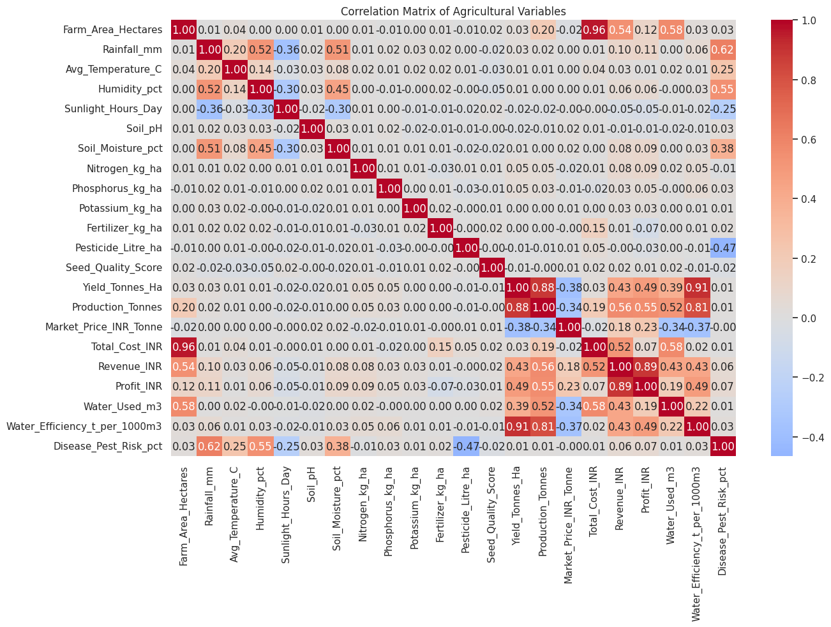
RESULTS
Explanation: The heatmap shows relationships between agricultural variables. Yield has a strong positive correlation with water efficiency (0.91) and production (0.88), while profit is strongly related to revenue (0.89).

Slide 11
Future scope
Develop season-wise predictive models for crop yield and profit.
Integrate real-time weather and market data for dynamic analysis.
Build an interactive dashboard for farmers and agricultural planners.
Extend the analysis using more regions, crops, and multiple years of data.

Slide 12
GitHub Link
https://github.com/Sushanth-Patel/Seasonal-Agriculture-Performance-Analysis

Slide 13

VOIS Course completion certificate - Course name: Data Visualization

Slide 14
Thank you
.
.

